Slide 1

Spatiotemporal urban sprawl and land resource monitoring using remote sensing and cloud computing
Team:
ForestMapper
Vikas Dugesar
Research Scholar
Banaras Hindu University
Varanasi
Komal Kumari
PGD-Geoinformatics
IIRS, Dehradun
Neeraj K Maurya
Research Scholar
Birla Institute of Technology
Ranchi

Slide 2
INTRODUCTION
Why We Chose This Problem?
Limitations of traditional technique: Time consuming and labor intensive, flexibility, data integration, accessibility and collaboration, limited advanced analytics and machine learning capabilities.
Solution of these problems: Cloud Computing
Why Cloud Computing: Big Geodata handled easily, Scalability, Advanced spatial analysis.
Use of Cloud computing: Quick real-time data analysis, efficient urban planning, and sustainable urban development.
Google Earth Engine (GEE)
Cloud computing platform,
Petabytes of open ready-to-use products,
High speed parallel processing.

Slide 3
Objective of Study
To learn about Big Geo-data techniques and apply appropriate tool for analysis of urban growth/sprawl in capital city Ranchi.
To compare and use suitable machine learning approaches for supervised classification of built-up and non-built-up classes for monitoring changes in urban growth.

Slide 4
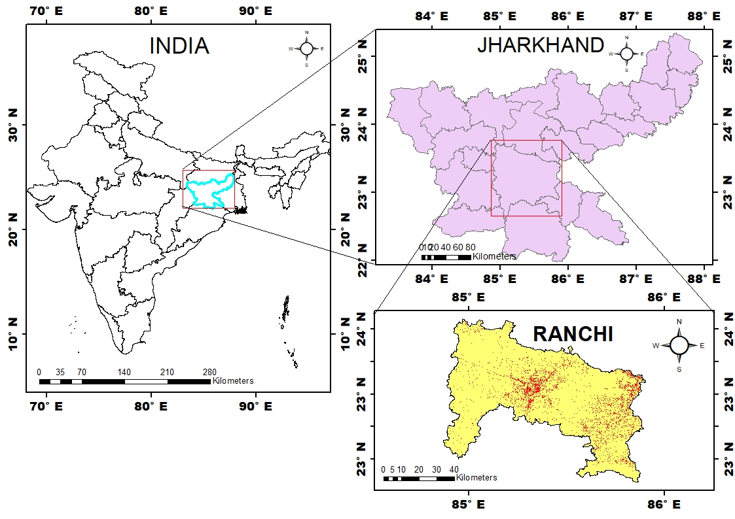
Study Area
Capital City of Jharkhand.
Area~ 5097 km²
Lat: 23°20’39.5340” N; Lon: 85°17’45.6468” E
Altitude: 651 m.
Rich in forest biodiversity.
Close proximity to the mining areas.
Fig.1:Study area map.

Slide 5
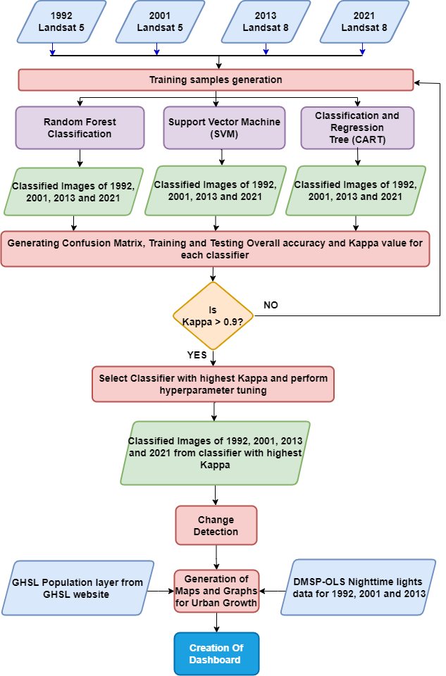
Methodology : Flowchart
Fig.2: Schematic representation of the workflow.

Slide 6
Dataset Used
Dataset Used
Methods applied: Supervised ML (RF, SVM, CART)
Google Earth Engine Datasets:
Landsat 5 TM Collection 1 Tier 1 for 1992
Landsat 5 TM Level 2, Collection 2, Tier 1 for 2001
Landsat 8 TM Collection 1 Tier 1 for 2013
Landsat 8 TM Collection 1 Tier 1 for 2021
Nightlights:
DMSP OLS: Nighttime Lights Time Series Version 4 (Defense Meteorological Program Operational Linescan System)
GHSL Population layer data
GHS-POP R2022A - GHS population grid multitemporal (1975-2030)

Slide 7
Comparison of ML Algorithms used
Year | Training Accuracy |  |  | Training Kappa |  |  | Testing Accuracy |  |  | Testing Kappa
 | RF | SVM | CART | RF | SVM | CART | RF | SVM | CART | RF | SVM | CART
1992 | 0.997 | 0.869 | 0.878 | 0.995 | 0.815 | 0.83 | 0.959 | 0.869 | 0.873 | 0.943 | 0.812 | 0.822
2001 | 0.999 | 0.97 | 0.936 | 0.999 | 0.94 | 0.872 | 0.991 | 0.971 | 0.935 | 0.984 | 0.943 | 0.868
2013 | 0.999 | 0.955 | 0.968 | 0.998 | 0.929 | 0.95 | 0.982 | 0.955 | 0.965 | 0.969 | 0.929 | 0.945
2021 | 0.999 | 0.979 | 0.981 | 0.997 | 0.925 | 0.931 | 0.992 | 0.979 | 0.981 | 0.973 | 0.926 | 0.934
Random Forest Classifier was adopted as its predictive power and accuracy is higher than a single CART model.
RF exhibit lower variance.

Slide 8
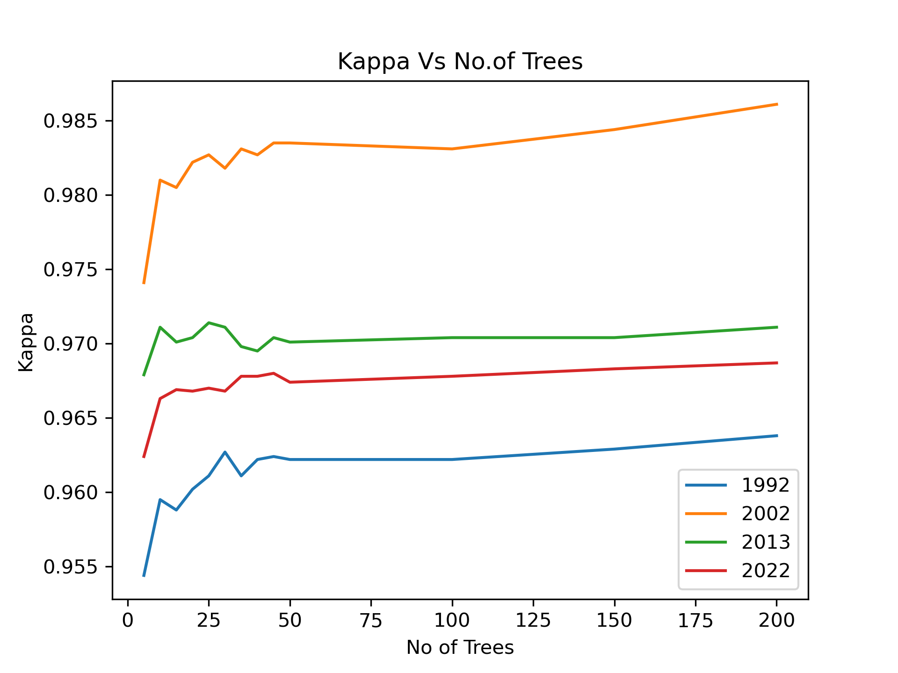
Hyperparameter Tuning
Hyperparameters are the variables that govern the training process itself.
No. of Decision Trees used for Random Forest: 30
Fig.3: Graph showing relation between Kappa coefficient and no. of decision trees.

Slide 9
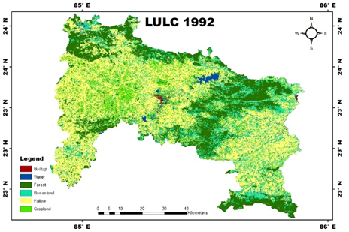
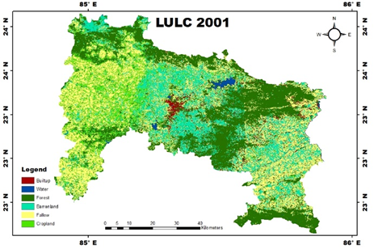
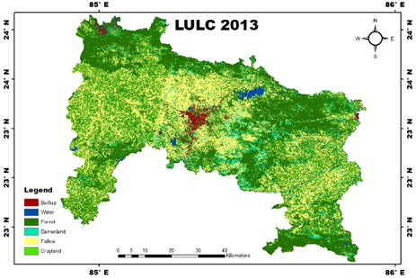
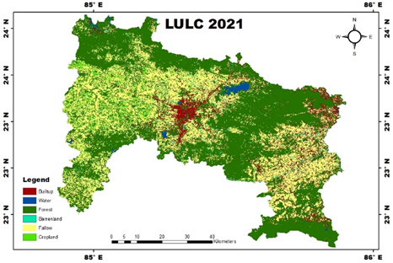
LULC Classified Maps
Fig.4: Year-wise classified LULC.

Slide 10
Validation/Error Matrices
Actual Data (AD) | Predicted Data (PD) for 1992
 | Build-up | Water | Forest | Barren | Fallow | Cropland
Build-up | 162 | 2 | 0 | 7 | 6 | 0
Water | 3 | 1496 | 3 | 3 | 3 | 0
Forest | 0 | 0 | 2439 | 8 | 2 | 11
Barren | 6 | 1 | 29 | 421 | 72 | 6
Fallow | 13 | 2 | 5 | 28 | 1054 | 11
Cropland | 0 | 0 | 9 | 4 | 10 | 158
Actual Data (AD) | Predicted Data (PD) for 2001
 | Build-up | Water | Forest | Barren | Fallow | Cropland
Build-up | 87 | 0 | 0 | 1 | 0 | 0
Water | 3 | 645 | 2 | 0 | 1 | 0
Forest | 0 | 0 | 3007 | 0 | 0 | 3
Barren | 0 | 0 | 1 | 170 | 11 | 0
Fallow | 0 | 0 | 1 | 2 | 397 | 1
Cropland | 0 | 0 | 3 | 4 | 5 | 98
Actual Data (AD) | Predicted Data (PD) for 2013
 | Build-up | Water | Forest | Barren | Fallow | Cropland
Build-up | 173 | 2 | 0 | 5 | 0 | 0
Water | 1 | 987 | 1 | 0 | 0 | 1
Forest | 0 | 1 | 2770 | 0 | 0 | 10
Barren | 4 | 0 | 1 | 216 | 20 | 0
Fallow | 0 | 0 | 0 | 5 | 641 | 21
Cropland | 0 | 0 | 5 | 1 | 20 | 206
Actual Data (AD) | Predicted Data (PD) for 2021
 | Build-up | Water | Forest | Barren | Fallow | Cropland
Build-up | 244 | 1 | 7 | 5 | 3 | 1
Water | 3 | 1824 | 9 | 0 | 1 | 1
Forest | 3 | 1 | 19766 | 0 | 7 | 7
Barren | 14 | 2 | 7 | 193 | 59 | 0
Fallow | 1 | 0 | 5 | 12 | 1218 | 5
Cropland | 0 | 0 | 9 | 0 | 13 | 135

Slide 11
Accuracy Assessment: For Built-up
 | 1992 | 2001 | 2013 | 2021
Producer's Accuracy | 88.04 | 96.66 | 97.19 | 92.07
User's Accuracy | 91.53 | 98.86 | 96.11 | 93.48
Classification result for built-up was seen to be the most accurate for the year 2001 followed by the year 2013, 2021 and then 1992.
Notes:
Producer’s accuracy measures how well the real world built-up class is classified. (Omission)
User’s accuracy measureslikelihood of a classified pixel matching the land cover type of its corresponding real-world location (Comm

Slide 12
LULC Class Area Prediction
Table 1: Classification result for year 1992, 2001, 2013, 2021.
Class | 1992 |  | 2001 |  | 2013 |  | 2021
 | km2 | % | km2 | % | km2 | % | km2 | %
Build-up | 85.464 | 1.714 | 126.26 | 2.53 | 136.90 | 2.74 | 372.95 | 7.48
Water | 51.229 | 1.03 | 54.57 | 1.09 | 86.75 | 1.74 | 92.36 | 1.85
Forest | 1274.123 | 25.55 | 1583.84 | 31.76 | 1446.75 | 29.01 | 2688.51 | 53.92
Barrenland | 765.143 | 15.35 | 963.34 | 19.32 | 307.26 | 6.16 | 104.47 | 2.09
Fallow | 2207.08 | 44.26 | 1649.44 | 33.08 | 1377.72 | 27.63 | 1516.44 | 30.415
Cropland | 602.844 | 12.09 | 608.42 | 12.20 | 1630.51 | 32.70 | 211.15 | 4.24
NOTE: % is of total geographical area.
Notes:
Fallow land decreased over the time

Slide 13
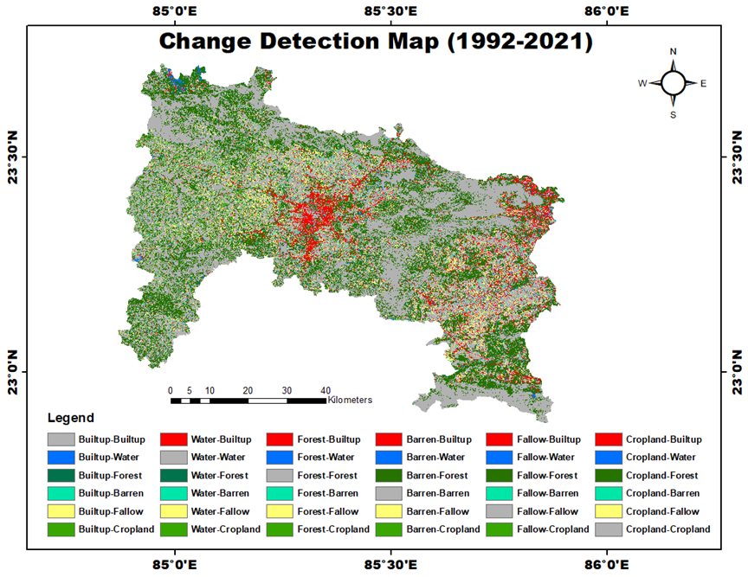
Change Detection Map and Transition Matrix for Built-up
Area changed from other classes to built-up (km²) | Built-up
 | 1992 to 2001 | 2001 to 2013 | 2013 to 2021 | 1992 to 2021
Built-up | 16.75 | 38.10 | 77.42 | 27.11
Water | 4.06 | 3.91 | 8.97 | 3.76
Forest | 4.19 | 26.50 | 17.61 | 13.76
Barren | 46.77 | 25.58 | 38.48 | 99.99
Fallow | 38.35 | 37.01 | 72.74 | 168.07
Cropland | 11.17 | 5.79 | 159.21 | 61.74
Total New Built-up | 104.56 | 98.80 | 297.01 | 347.33
Fig.5: LULC Change Detection map.

Slide 14
Built-up change : Areas changed to Built-up
Animation 1: Change in Built-up area.

Slide 15
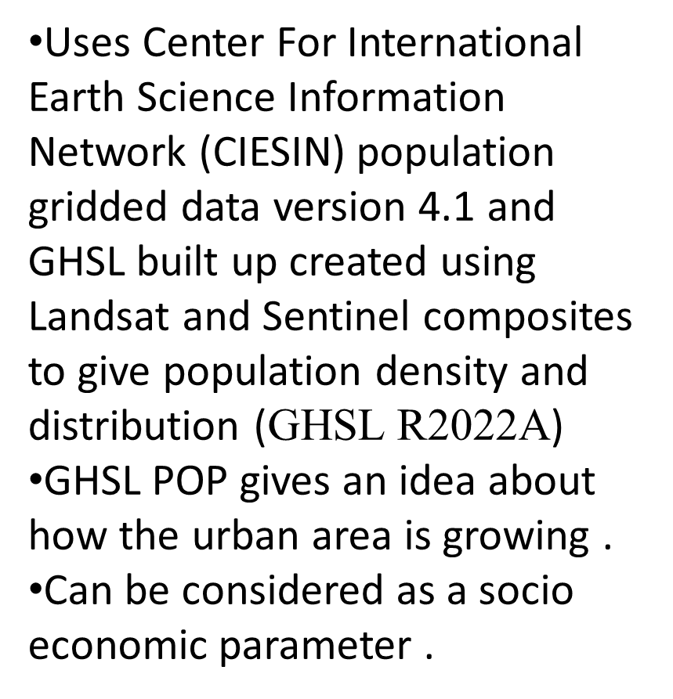
GHSL Population Data Results
Animation 2: Change in population distribution 1990,2000,2010, 2020.

Slide 16
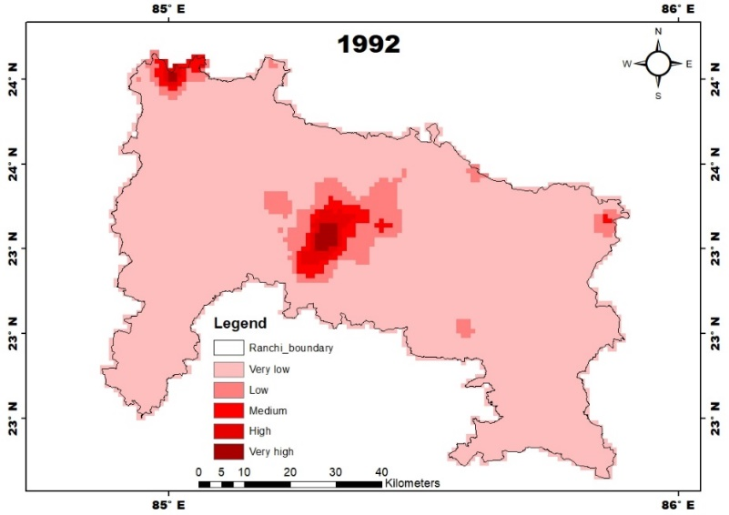

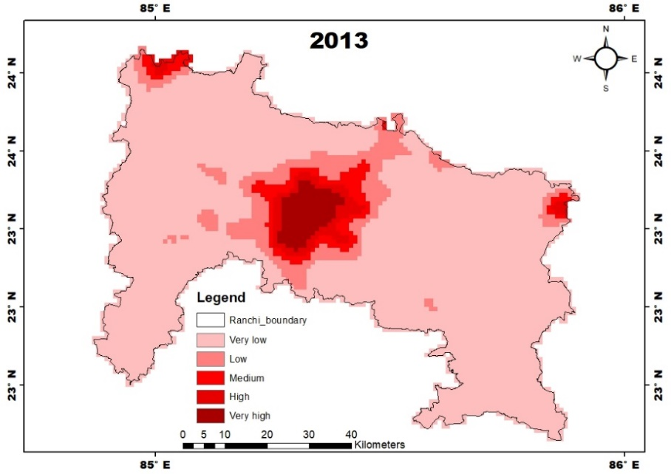
DMSP OLS Nighttime Lights Data Maps
Animation 3: showing increase in Nightlights with time.
Fig.6: Year-wise nightlight variation.

Slide 17
Results and Discussion
GEE is a major platform for geospatial data science application.
Built-up land expanded upto 7.48% which was 1.714% in 1992.
From 1992 to 2021, fallow land (168 km2) undergone maximum conversion into built-up area.
This was followed by barrenland and then cropland.
During 2013, cropland mapped was highest over all time. Over the 3 decade, Barren Land decreased from 15.35 % to 2.09 % due to expansion in forest land.
RF proved to be most efficient classifier due to its ensemble property.
CART also performed better in term of SVM.

Slide 18
Conclusion
Cloud Computing platform (GEE) were taken to identify the most suitable measure/method for urbanization study.
Multiple methodologies were considered and classification method using Random Forest was found to be more reliable and scalable among all, as it gives higher accuracy in classification.
GHSL and Nightlight data can be used to identify and visualize change, these can be used in further studies in urban studies.
Based on the findings of the change detection analysis, urban sprawl is mapped, and data analysis is carried out to comprehend the dynamics and traits of urbanization. Haphazard urban sprawls took place in Ranchi city at the cost of cropland.
This interpretation might help in policy decisions related to managing urban sprawl and sustainable urban development with the idea of a "compact city" or "smart growth“.

Slide 19
References
Belgiu, M., & Drăguţ, L. (2016). Random forest in remote sensing: A review of applications and future directions. ISPRS Journal of Photogrammetry and Remote Sensing, 114, 24–31.
Chettry, V., & Surawar, M. (2021). Assessment of urban sprawl characteristics in Indian cities using remote sensing: case studies of Patna, Ranchi, and Srinagar. Environment, Development and Sustainability, 23(8), 11913–11935.
Goldblatt, R., Stuhlmacher, M. F., Tellman, B., Clinton, N., Hanson, G., Georgescu, M., Wang, C., Serrano-Candela, F., Khandelwal, A. K., Cheng, W. H., & Balling, R. C. (2018). Using Landsat and nighttime lights for supervised pixel-based image classification of urban land cover. Remote Sensing of Environment, 205, 253–275. https://doi.org/10.1016/J.RSE.2017.11.026
He, C., Shi, P., Xie, D., & Zhao, Y. (2010). Improving the normalized difference built-up index to map urban built-up areas using a semiautomatic segmentation approach. Http://Dx.Doi.Org/10.1080/01431161.2010.481681, 1(4), 213–221. https://doi.org/10.1080/01431161.2010.481681
Vivekananda, G. N., Swathi, R., & Sujith, A. (2021). Multi-temporal image analysis for LULC classification and change detection. European Journal of Remote Sensing, 54(sup2), 189–199.

Slide 20
THANK YOU

Slide 21
GEE Repository Link
https://code.earthengine.google.com/?accept_repo=users/dugesarvikas/IEEE_GRSS_GSTD_Hackathon_team_ForestMapper

