Slide 1
Google play store applications
analysis & visualization

Slide 2
About Dataset
1

Slide 3
-Details of the applications on Google Play.
This dataset consists of 13 columns & 10842 rows.
It gives us information about a huge number of applications.
Also it declares the publicity of these applications through different measurements.

Slide 4
Dataset Content :
1) App :- Name of the App
2) Category :- Category under which the App falls.
3) Rating :- Application's rating on playstore
4) Reviews :- Number of reviews of the App.
5) Size :- Size of the App.
6) Install :- Number of Installs of the App
7) Type :- If the App is free/paid
8) Price :- Price of the app (0 if it is Free)
9) Content Rating :- Appropiate Target Audience of the App.
10) Genres:- Genre under which the App falls.
11) Last Updated :- Date when the App was last updated
12) Current Ver :- Current Version of the Application
13) Android Ver :- Minimum Android Version required to run the App

Slide 5
Data Cleaning
2

Slide 6
While preprocessing / cleaning the dataset 1 column and 3,418 rows had been dropped; due to including missing data, numerical string value, and a few wrong
values.
So, we have ended up dealing with a clean dataset of 12 columns & 7424 rows to analyze and visualize.

Slide 7
Data analysis & visualization
3

Slide 8
Which category has more reviews?
4

Slide 9
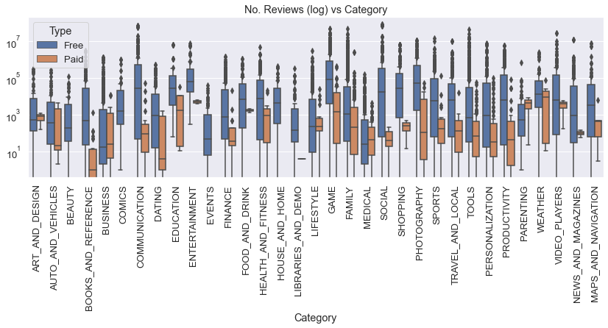

Slide 10
Which category has higher rating?
5

Slide 11
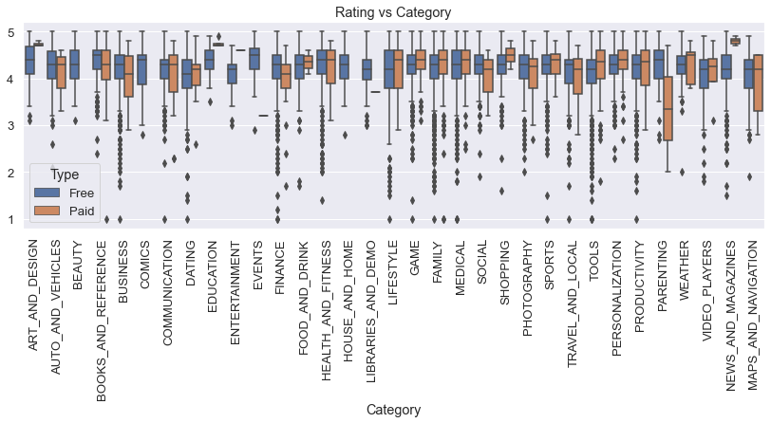

Slide 12
Is there any relationship between the category and app size
6

Slide 13
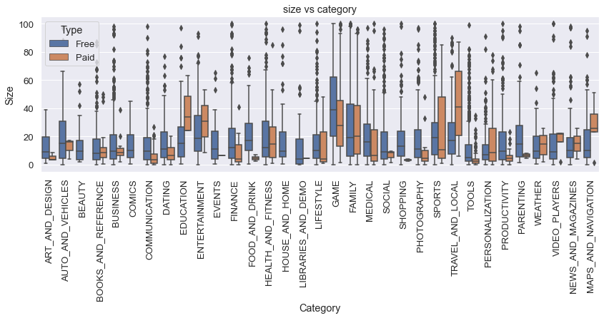
.

Slide 15
Relation between each Category and its count
6

Slide 16
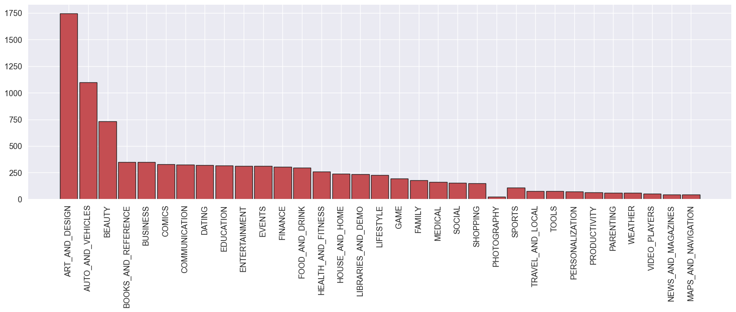

Slide 17
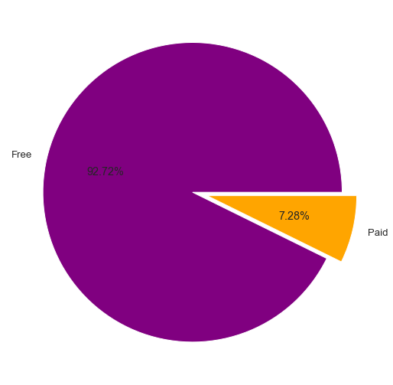
Paid vs free

Slide 18
What is the data correlation rate?
7

Slide 19
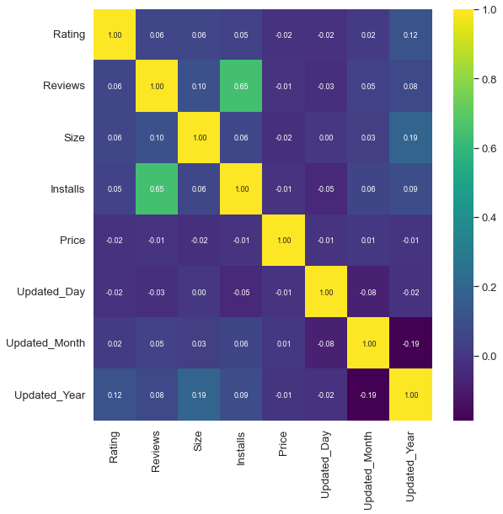

Slide 20
The rate of change in price, size, reviews and ratings every year type of apps

Slide 21
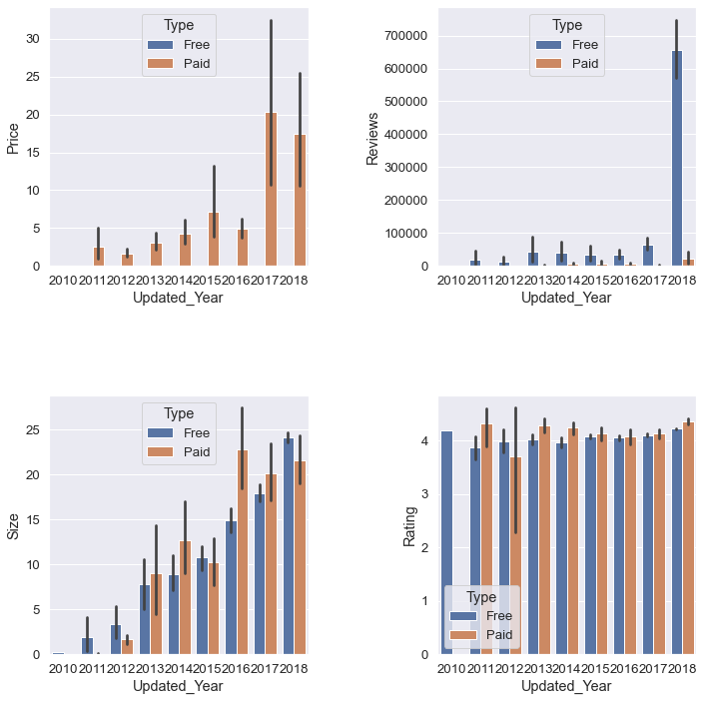

Slide 22
The 10 most common apps that used by Everyone

Slide 23
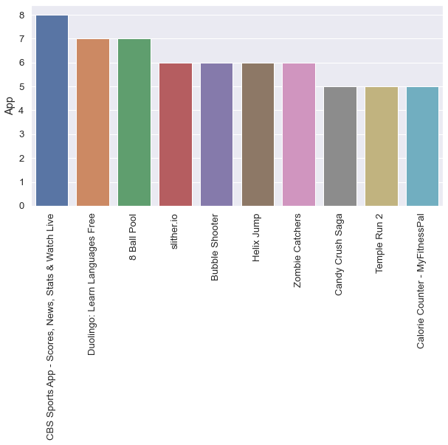

Slide 24
Relation between Number of Downloads &Reviews

Slide 25
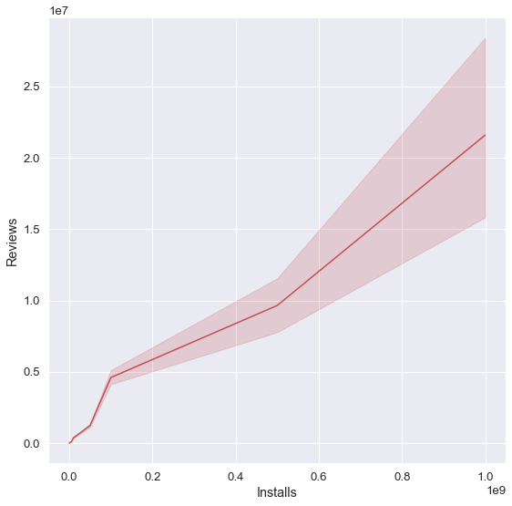

Slide 26
Relation between Rating & Reviews

Slide 27
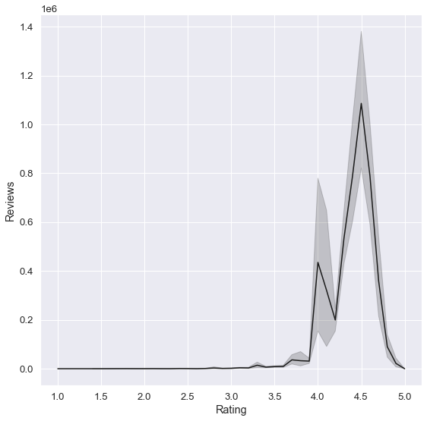

Slide 28




Team Presentation
Farah mohamed
Yasmeen sharaf
Fatma ali
Sara gamil

Slide 29
Thanks!
Any questions?

