Slide 1
Session 1

Slide 2
Agenda
1- Operating system -OS layers
2- About linux -GNU/Linux system -Linux distributions family -what is special about linux system
3-Shell, terminal and command line
4-Linux Filesystem Hierarchy
5-Navigating through the filesystem

Slide 3
Operating system
What is operating system?
most important software that runs on a computer, it manges computer's memory, processes and all of the software and hardware on the computer.

Slide 4
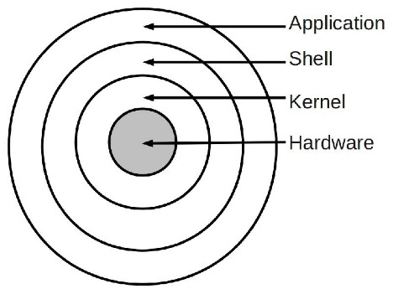
Operating system
What are OS layer?
1-Hardware
2-Kernal
3-shell
4-Application

Slide 5
OS layer
1- hardware
-This layer interacts with the system hardware

Slide 6
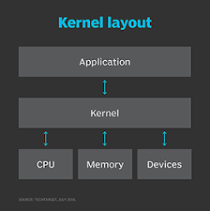
OS layer
2- kernel
-the kernel is the central component of most computer operating.
Kernel functions:
Access Computer resource
Resource Management
Memory Management
Device Management

Slide 7
OS layer
3- Shell
An interface to kernel, hiding complexity of kernel’s functions from users.
Functions:
-The shell manages the interaction between you and the operating system

Slide 8
OS layer
4- Application
This is the highest layer in the layered operating system. This layer deals with the many user programs and applications that run in an operating system such as word, games, browsers etc.

Slide 9
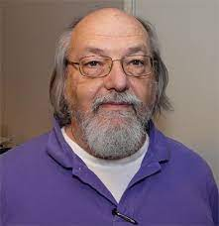

GNU/Linux system
1- (1969) Ken Thompson found himself creating and playing computer games on the company’s expensive, decided to port this games
2- (1980) many versions of unix was released and almost all of software was restricted.
3- (1983) The project to develop the GNU system is called the “GNU Project.”
4- (1990) either found or written all the major components except one—the kernel
5- (1991) Then Linux, a Unix-like kernel, was developed by Linus Torvalds
6- Combining Linux with the almost-complete GNU system resulted in a complete operating system: the GNU/Linux system

Slide 10
Linux Distribution Families
1.Red Hat Family
2.Debian Family
3.Other distributions built for specific use cases

Slide 11
Why linux
1.Open Source Nature
2.Secure
3.Customisability
4. Software Updates
5.Good Development Environment
6.Privacy
7.Hardware

Slide 12
Terminal
A terminal is a program that allows you to run a shell. Is a device with a human-readable display that accepts a stream of characters and displays them
Ctrl+Alt+T to open terminal

Slide 13
Shell
A shell is a program that processes commands and outputs the results. A shell is a layer that sits on top of the kernel
types of a shell
1. The Bourne Shell (sh)
2. The GNU Bourne-Again Shell (bash)
3. The C Shell (csh)
4. The Korn Shell (ksh)
5. The Z Shell (zsh)

Slide 14

The command line
command line is an area to the right of the command prompt on an all-text display mode computer monitor where a user enters commands and data.
The command line prompt syntax:
sphinky: The username of the current logged in user.
@: Defines that you are connected to the machine that has the name after it
ubuntu: The name of the computer running (Name of the host)
~: refers to the directoy that the terminal is working in right now.
$: States that you are logged in as a regular user.

Slide 15
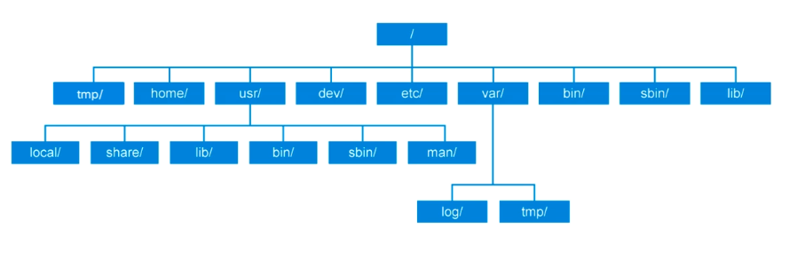
Linux Filesystem Hierarchy

Slide 16
Navigating through the filesystem
cd (“change directory”)
pwd (“print current directory”)
ls (“list”)
The ‘.’ link refers to the directory itself.
The ‘..’ link refers to the directory before it (parent directory)

Slide 17
Any questions?

