Slide 1
Anti-Anti-Masker
IEEE RAS Executive Project

Slide 2
Abstract
Anti-Anti-Masker is a drone that will roam in crowded city areas and search for people who are not wearing masks and breaking covid protocols. This project can have many other applications, such as security and surveillance.
We have used Fusion 360 to design the drone body, rotors and sensor links and then generate its URDF. We have used ROS to design the robot’s physics and simulate the robot. The end plan is to have /cmd_vel topic configured with the robot to pass velocity commands to move_base and use the navigation stack for mapping and motion.
This drone will have a camera that will have a face recognition system to detect faces without a mask.
The model will be built over the MobileNet TensorFlow model. MobileNet is used because this model is easily applicable to devices like Raspberry Pi and Arduino. The model will be trained on some real-time images so that it can detect faces and masks properly. The trained model will be exported to OpenCV where it will be used to classify masks in real-time videos.

Slide 3
The Drone

Slide 4
Robot Model
We chose a quadcopter model for the drone whose dynamics are fully known in 3D space. A quadrotor is an underactuated system whose configuration space is SE(3) but it has only four independent inputs, i.e., the rotor angular velocities.
The custom robot model was designed on Fusion 360. It contains separate parts for the drone body, rotors and sensor links. Afterwards fusion2urdf plugin was used to generate its URDF.
The URDF was then launched in the Gazebo environment where all revolute links were simulated with the proper physics.

Slide 5
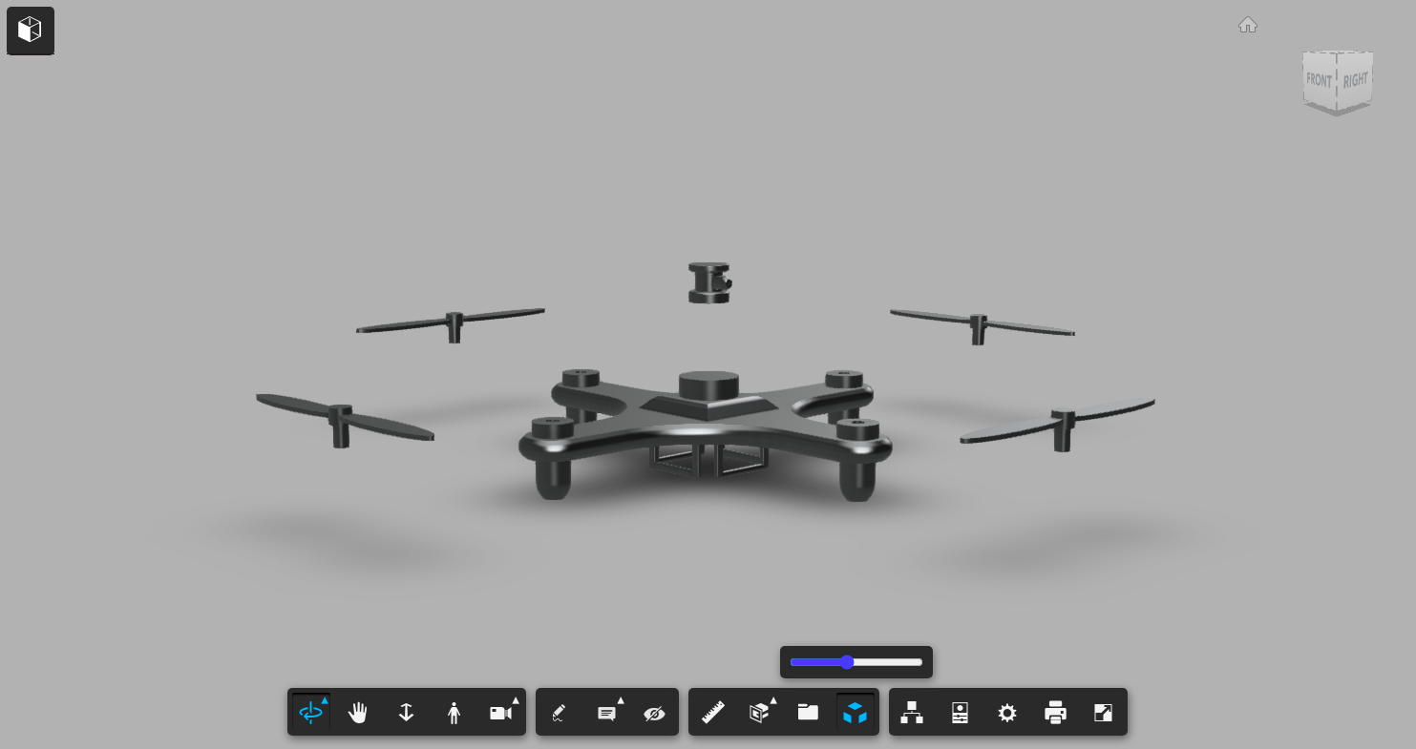
Exploded View in Fusion 360

Slide 6
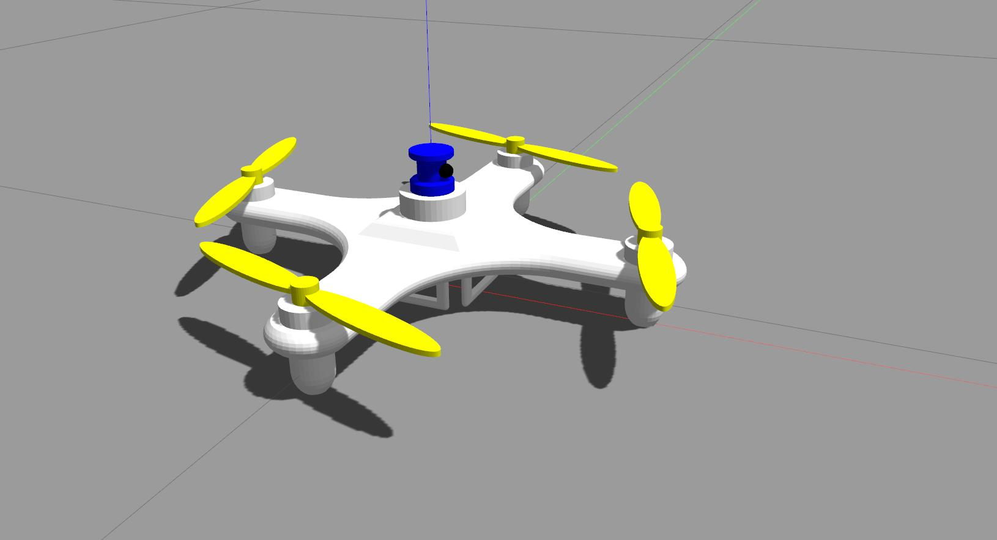
Robot Model in Gazebo Environment

Slide 7
ROS and Sensors
ROS has been used to design the robot’s physics and simulate the robot. We want to use /cmd_vel topic configured with the robot to pass velocity commands to move_base and use the navigation stack for mapping and motion.
This will be done by writing plugins in C++ and using CMake to compile and interface with Gazebo Simulator.
We can also go for a lower level of control, by configuring the motors to have force commands and then design a control system for stability which can also be done similarly using plugins.
Sensors have also been simulated for the robot. As of now, the robot has a front facing camera and a LIDAR sensor. If required for plugin integration, IMU sensor may be added. If front facing camera feed is not enough for viable recognition, a downwards facing camera will be added.

Slide 8
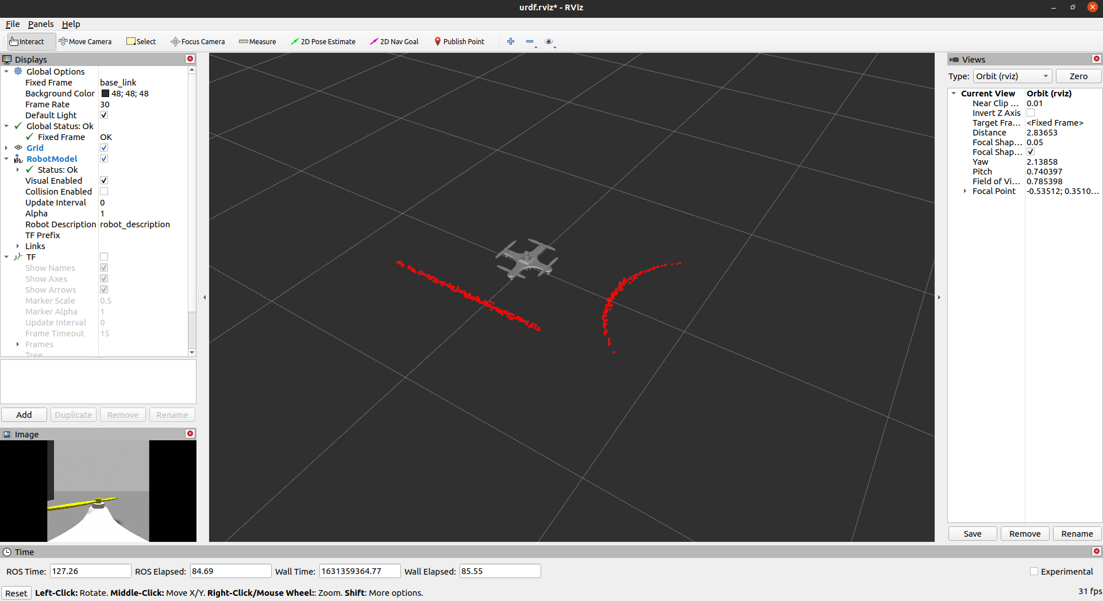
Robot Sensors Feed in RViz Environment

Slide 9
Computer Vision

Slide 10
The Dataset
The Dataset: link
In this dataset, There are two folders. maskdata contains around 900 images and masks2.0 contains a smaller number of images.
The folders are further divided into train and test data , which are further divided in categories- with mask and without mask.
This was the easiest available dataset, but the model can be generalized to recognize anything including traffic violations, construction vulnerabilities, small fires and even for face recognition given a large enough dataset.
Transfer learning can also be used to use general data characteristics for similar problems

Slide 11
Code
We are using google colab for coding the model, link: Google colab
First we setup the directories where the test and train data is kept. As the data is already segmented, we create 2 classes each for test and train data and set the path to the data directories.
Then are using transfer learning to train the model based on the given data. We are using MobileNetV2 as the primary model and we have added some trainable layers at the end.
We are using BinaryCrossEntropy as the cost function and Adam optimizer for optimization
Parameter stats in the model:
Total params: 2,422,210
Trainable params: 164,226
Non-trainable params: 2,257,984

Slide 12
Code
The model code:
input = keras.layers.Input(shape=(224,224,3))
baseModel = MobileNetV2(weights="imagenet", include_top=False, input_shape=(224,224,3), input_tensor= input)
headModel = baseModel.output
headModel = AveragePooling2D(pool_size=(7, 7))(headModel)
headModel = Flatten()(headModel)
headModel = Dense(128, activation="relu")(headModel)
headModel = Dropout(0.5)(headModel)
headModel = Dense(2, activation="softmax")(headModel)
model = Model(inputs=baseModel.input, outputs=headModel)
for layer in baseModel.layers:
layer.trainable = False
The training and optimizer code:
print("[INFO] compiling model...")
opt = Adam(learning_rate=INIT_LR, decay=INIT_LR / EPOCHS)
model.compile(loss="binary_crossentropy", optimizer=opt,
metrics=["accuracy"])
# train the head of the network
print("[INFO] training head...")
H = model.fit(train_generator, batch_size=BS, validation_data=val_generator, epochs=EPOCHS,verbose = 2)

Slide 13
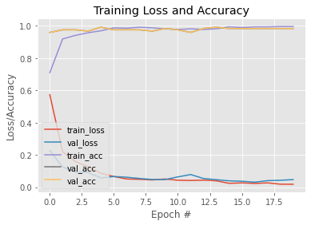
The Accuracy Curve
As seen in the curve the model has a training accuracy of 99.59 % and a validation accuracy of 98.37 %.
The test accuracy is 98.48 %
This suggests that our model has no overfitting or underfitting.
We will try to validate these statistics by increasing the size and augmentation of data.
If time permits we will also compare different models to understand what works best for our goal.

Slide 14
Further Work and End Goal
The plugin still needs to be written, currently we are going through code for similar plugins used in other projects in GitHub and picking out the most desirable features.
To get a more robust control system for navigation and motion planning.
The 3D model can use some improvement. We want to have as much of a generalised detection model as possible which can either be trained from scratch or via transfer learning for smaller datasets.
To compare different models to check which model works best.
To increase and size of augmentation data for fine tuning
To export the model to OpenCV for real time prediction

Slide 15
The End

