Slide 1
BASICS OF COMPUTER ARCHITECTURE

Slide 2
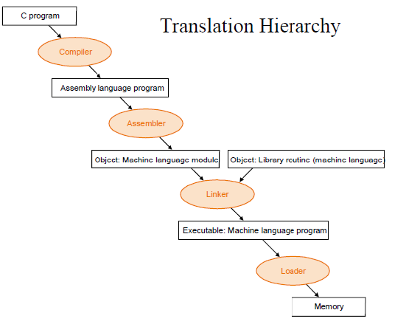
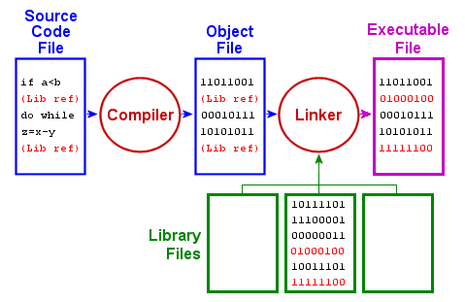
COMPILATION OF A PROGRAM

Slide 3
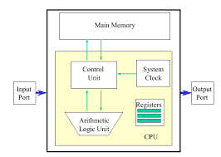
COMPUTER AS A SYSTEM
What is ALU and CU?
What are CPU registers?
What is a register file?
What is the “bitness” of a system?

Slide 4
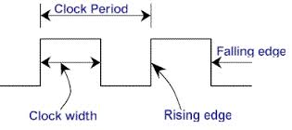
CPU CLOCK CYCLES
Clock generator
Edge triggering of instructions
Clock period and clock rate
Cycles per Instruction(CPI)

Slide 5
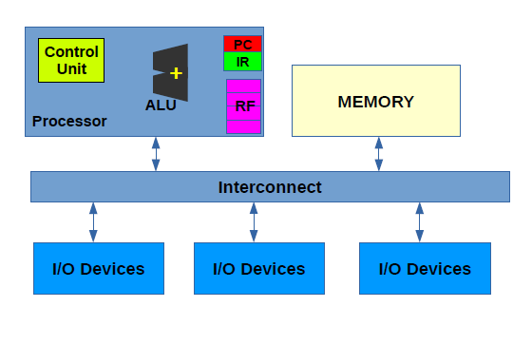
THE NEED FOR CPU REGISTERS
Memory transfer instructions(MTI)
Load and store instructions:
ld R1, a
st R2,b
Arithmetic Instructions:
c=b+a
ld R1,a
ld R2,b
add R3,b,a
st R3, c
Cost of memory transfer instructions and arithmetic instructions
c=b+a
d=c+b
How many load-stores are required?

Slide 6
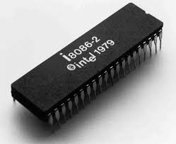
Programming in x86 Assembly
What is an assembly level language?
The x86 family of processors:
Intel 8086-16 bit processor(1978)
Intel 80386 and 80486 (32-bit processors)
3. What is an Instruction Set Architecture (ISA)?

Slide 7
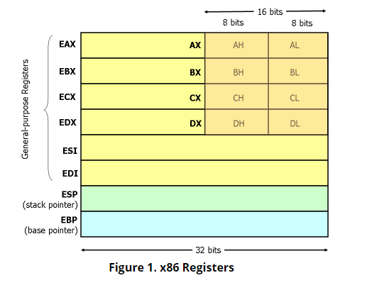
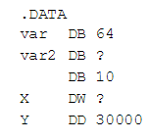
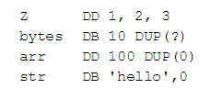
Registers in x86
8 32-bit General Purpose Registers
Nested registers
Declaring variables
Declaring arrays

Slide 8
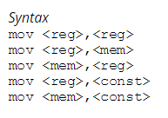
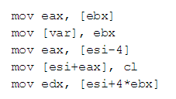

32-bit memory addressing.
Byte-addressable memory
X86 mov instruction syntax
Resolving ambiguity using size directives

Slide 9
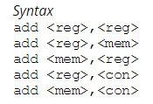
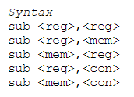
Integer Arithmetic Instructions

Slide 10

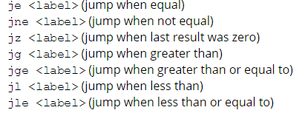

Control Flow Instructions
Jmp instruction:
Conditional jumps:
Machine status word
Cmp instruction

Slide 11
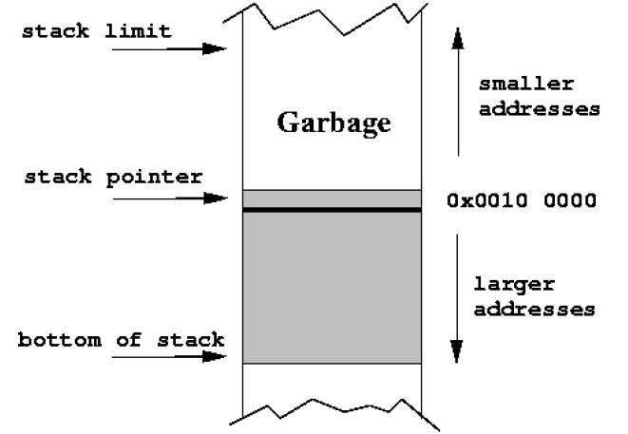


Understanding the Stack
The program stack
ESP as stack pointer
Push and pop in a stack
push instruction:
pop instruction:

Slide 12
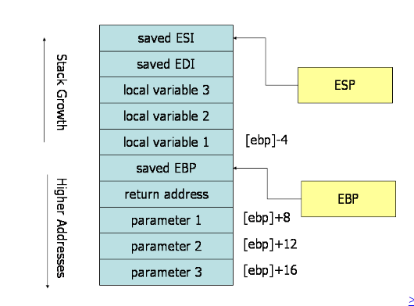

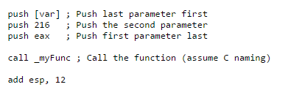
Function calls in x86 Assembly
Call and return instruction:
Difference between the call <label> and jmp
<label>
Passing arguments to functions

Slide 13
Reference:
http://www.cs.virginia.edu/~evans/cs216/guides/x86.html

