Slide 1

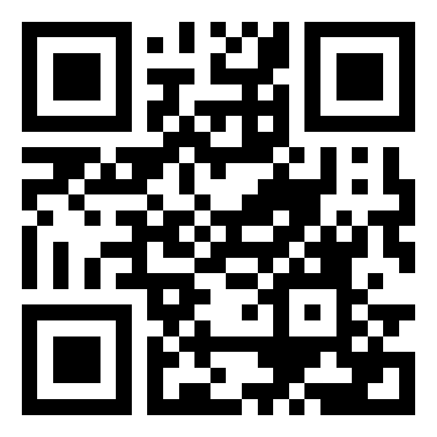
WELCOME TO
IEEE AESS RWANDA
A community for people shaping aerospace and electronic systems in Rwanda.
WHAT YOU GAIN WHEN YOU CONNECT
01
Professional connections
Meet engineers, researchers, students and industry leaders.
02
Practical learning
Take part in technical talks, workshops and industry visits.
03
Career growth
Find mentorship, leadership and professional development opportunities.
04
Research and innovation
Collaborate on ideas and projects with real-world impact.
05
A global community
Connect with the wider IEEE AESS network and its resources.
JOIN THE COMMUNITY
Connect. Learn. Innovate. Lead.
Scan the code or visit the website.
aess.ieeerwanda.org

