Slide 1

MASTERING REACT
Presented By :
Nishida Datkar
Aditya Patil
Yash Wadhwani

Slide 2
What Is React?
1
React is a JavaScript library for building user interfaces (UIs) on the web. React is a declarative, component based library that allows developers to build reusable UI components and It follows the Virtual DOM (Document Object Model) approach, which optimizes rendering performance by minimizing DOM updates. Instead of updating the entire page, React only updates the parts of the UI that change.React is fast and works well with other tools and libraries , React was invented by Facebook developers who found the traditional DOM slow.
Analogy:
Think of React like a chef who replaces only the spoiled part of a dish instead of cooking the entire meal again.
Components, props & states are the building blocks of React.

Slide 3
What is Virtual Dom?
3
What is the difference between actual dom & virtual dom?
DOM:
The DOM (Document Object Model) is the structure of your web page (all HTML elements).
Normally, when something changes on a web page, the entire DOM may get updated, which is slow.
Virtual DOM in React:
Virtual DOM is a lightweight copy of the actual DOM, kept in memory by React.
When a component’s state or props change, React first updates the Virtual DOM.
React then compares (diffing) the Virtual DOM with the real DOM.
Only the parts that have changed are updated in the real DOM.

Slide 4
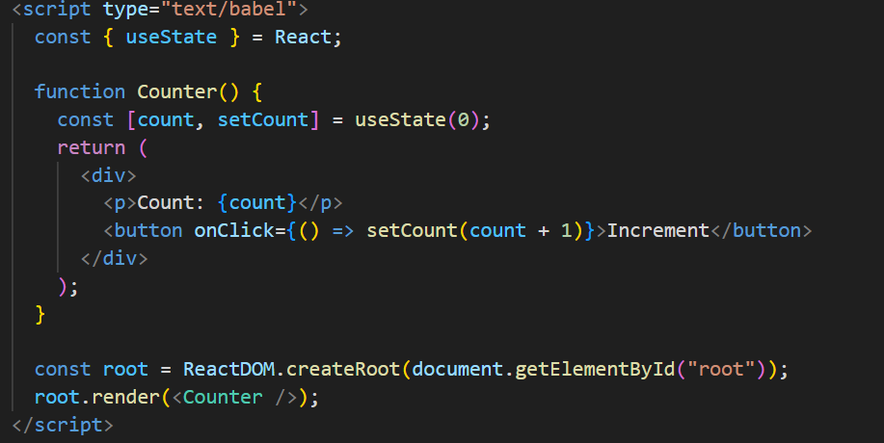
About JSX
3
JSX is a syntax extension for JavaScript that allows writing HTML-like code inside JavaScript.
Why use it?
Easier to write and read UI code.
Looks like HTML but has the power of JavaScript.
React automatically converts JSX into JavaScript.

Slide 5
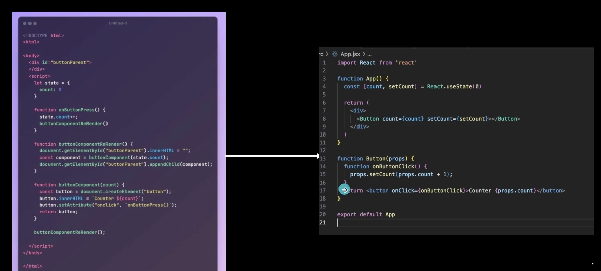

Slide 6
Why React for UI?
4
React breaks the UI into independent, reusable components.
These components can be used multiple times with different data.
React uses a Virtual DOM, which makes UI updates very fast.
Developers can manage large applications more easily by reusing components.
Analogy:
React is like LEGO blocks – small pieces (components) are combined to create a bigger structure (application).

Slide 7
Understanding Component
5
Self-Contained Units
Reusable and Modular
Hierarchical Structure
Components are self-contained building blocks that are small, reusable piece of UI with its own logic and design.
Components can be reused throughout your application, promoting code maintainability and reducing duplication.
Components can be nested within each other, creating a hierarchical structure for your application.

Slide 8


Creating Component
6
1
Define a Function
Start by defining a function component in your JavaScript file.
JSX Syntax
2
Use JSX to write HTML-like syntax within your function to define the component's structure and content.
Render the Component
3
Finally, import and render the component in your main application file to display it on the screen.

Slide 9
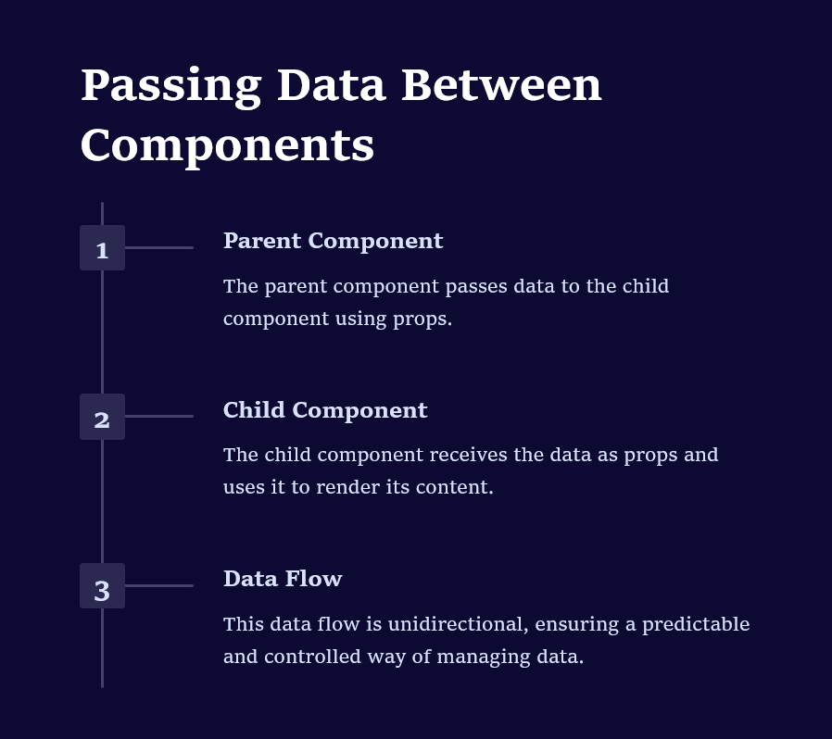

What are Props?
7
Props are inputs to a React component. They allow a parent component to pass data or instructions to a child component.
Key Features:
Props make components reusable – the same component can display different content.
Props are read-only – a child component cannot modify them.
Props can be any type of data: text, numbers, arrays, objects, or even functions.
They are used to customize a component’s behavior or appearance.

Slide 10
What is States?
8
State is data that belongs to a component itself. It determines how a component renders and behaves. Unlike props, state can change over time.
Component-Specific Data
Updating State
Dynamic UI
Dynamic UI
State represents data that is specific to a particular component and can change over time.
You can update a component's state using the "setState" method, which triggers a re-render of the component
State enables you to create dynamic user interfaces that respond to user interactions or other events.

Slide 11
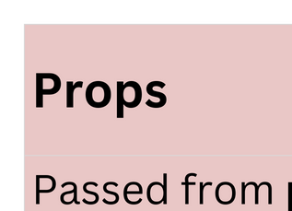
Props VS States
9

Slide 12
Dynamic Rendering & Conditional UI
10
1.Dynamic Rendering
Dynamic rendering means React updates the UI automatically when data (state or props) changes.
Instead of reloading the whole page, React only updates the changed part of the UI.
Analogy: Like a scoreboard in cricket – only the score changes, not the entire board.
2. Conditional UI
Conditional rendering means showing UI only if a condition is true.
Similar to if-else in JavaScript but used inside JSX.
Real life example:
If you are logged in → show Profile Page.
If not logged in → show Login Button.
{isLoggedIn ? <Profile /> : <LoginButton />}

Slide 13
Why Dynamic & Conditional UI Matter
Makes applications interactive and user-friendly.
Saves performance by rendering only required parts.
Common in real apps:
E-commerce: “Out of Stock” message appears dynamically.
Social Media: Like/Unlike button changes instantly.
Banking App: Show “Insufficient Balance” only when condition matches.

Slide 14
What is React hook?
12
A React Hook is like a special tool that gives extra powers to your normal React functions. They let you do things that were earlier possible only in class components
Think of your React function component as a plain phone.
By default, it can make calls (basic UI rendering).
But if you want to save contacts (state), set alarms (side effects), or use GPS (context) — you need to install apps.
Those "apps" you install = Hooks.
What is useState Hook?
useState is a React hook that lets you add state (data that changes over time) to function components.

Slide 15

COMPONENT A :
Imagine two child components. Each has its own private state
has a piece of data.
COMPONENT B :
needs that same piece of data.
PROBLEM
They can't directly share. This leads to "siloed state," where data becomes inconsistent and hard to manage.
When they each maintain their own version of the same data, it's easy for them to get out of sync, leading to bugs and an unpredictable UI.

Slide 16
THE SOLUTION : LIFTING STATE UP
Remove State from Children
The parent also passes down functions that allow the children to update the parent's state.
The child components no longer manage this piece of state themselves
The parent component holds the state
The parent passes the state down to the children via props
Centralize State in Parent
Pass Data Down
Pass Handlers Down

Slide 17
Lifting state up is React's primary method for sharing state. The parent component becomes the owner of the data. It passes the data down to its children as props, which are read-only. To allow a child to modify the state, the parent passes a special function (a callback) as a prop. The child can then call this function to tell the parent to update its state.

Slide 18
Mounting
The component is being created and inserted into the DOM.
Updating
The component re-renders because its state or props have changed.
Unmounting
The component is being removed from the DOM.

Slide 19
useEffect for Side Effects
The useEffect hook is your tool for tapping into the component lifecycle. It's designed for running "side effects"—actions that happen outside the normal rendering flow.
Fetching data from an API.
Setting up timers
Manually changing the DOM.
Setting up subscriptions.

Slide 20
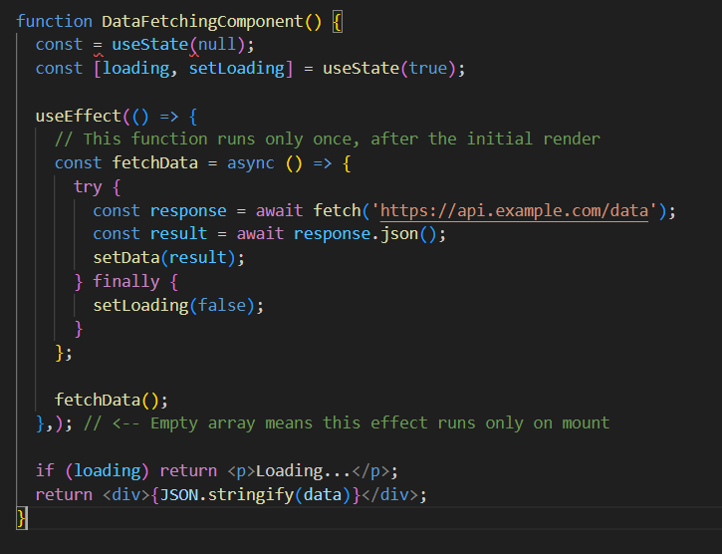
The useEffect hook provides a safe place to run this code, ensuring it happens after React has updated the screen.

Slide 21
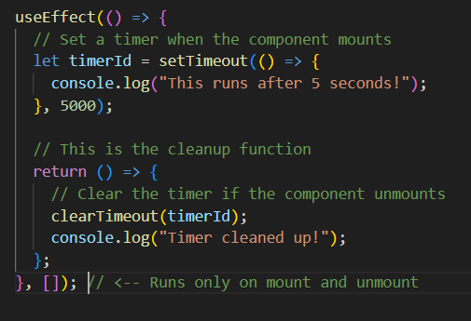
The function you return from useEffect is the cleanup function. React executes this function just before the component unmounts, allowing you to cancel timers, remove event listeners, and prevent memory leaks

Slide 22
React ESLint: "React Hook useEffect has a missing dependency: 'variable'. Either include it or remove the dependency array."
The dependency array controls when your effect re-runs. If you use a variable from your component's state or props inside useEffect, you must include it in the dependency array. Forgetting to do so can cause bugs where your effect uses "stale" data from a previous render.

Slide 23
Lift State Up
All components Mount, Update, and Unmount.
For shared data, move state to the closest common parent.
Component Lifecycle
Use it to handle side effects like data fetching and timers.
useEffect is your tool
Use the dependency array (``) to control when your effect runs.
Return a function from useEffect to prevent memory leaks.
Manage Dependencies
Always Clean Up

Slide 24


CONTROLLED FORMS IN REACT
Building Smarter, Faster, and More Interactive Forms

Slide 25

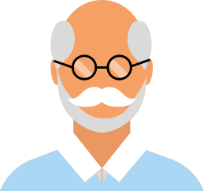
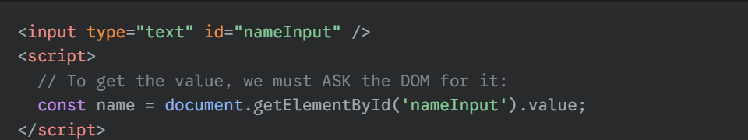
The Old Way: How HTML Forms Work
No Real-Time Sync: Our component is "blind" to what the user is typing. We only find out the value when we manually ask for it.
Delayed Validation: We can only check for errors after the user clicks "Submit", not as they type. This leads to a poor user experience.
Two "Bosses" (Sources of Truth): The value the user sees on the screen (in the DOM) can be different from the value our component thinks it has in its state, leading to bugs.

Slide 26



The React Solution: Controlled Forms
React's solution is simple but powerful: we make our component's state the one and only boss. This is called the "Single Source of Truth" pattern.
We take the memory away from the DOM. The <input> tag is no longer in charge of its own value.
Instead, the <input> becomes a "dumb" element. It only displays whatever value our React state tells it to.
This guarantees that our state and the UI (what the user sees) can never be out of sync.
DOM MEMORY
STATE MEMORY

Slide 27

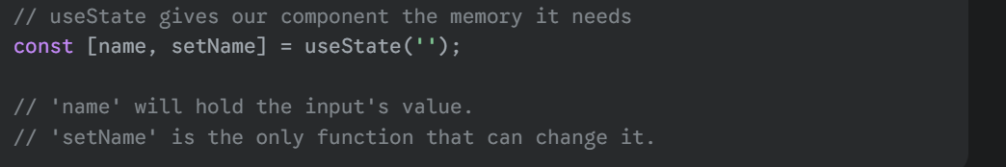
How Do We Give Our Component Control?
To give our component this "brain" or "memory," we need a special tool from the React library.
This tool is the useState hook. We've seen it before, and for controlled forms, it is absolutely essential.
useState gives our component two things:
A state variable to remember the current value.
A setter function to update that value whenever the user types.

Slide 28
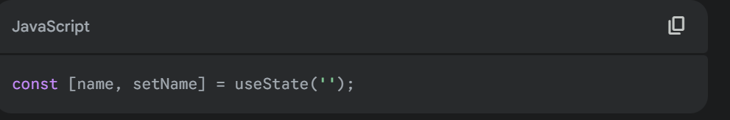
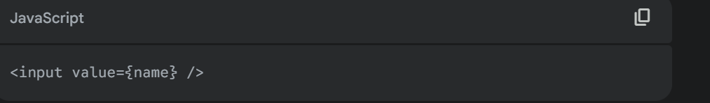
The 3 Pillars of a Controlled Component
To make an input "controlled," you absolutely need these three parts working together. If you miss even one, it will not work.
Pillar 1: The Memory (The State)
Job: To hold the current value of the input inside our component.
Pillar 2: The Display (The value Prop)
Job: To force the input field to only display what is in our state. This is how we make the input "dumb" and take away its memory.

Slide 29
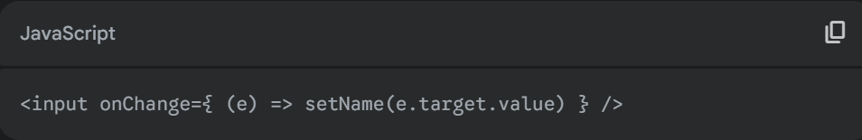
Pillar 3: The Updater (The onChange Handler)
Job: To listen for every keystroke, take the new value from the input (event.target.value), and use our setter function (setName) to update the state.
State ➡️ UI ➡️ Action ➡️ State...
Render: The UI is rendered based on the current state. (<input value={name} />)
User Action: The user types, which triggers an event (onChange).
State Update: The event handler updates the state (setName('Rohan')).
Re-Render: The state change causes the component to re-render, starting the cycle over with the new data.

Slide 30

SUMMARY
1] Components, Props & State
Components are reusable UI pieces, like Lego bricks.
Props are data passed down from a parent to a child (read-only).
State is a component's own private, changeable memory.
2] The useState Hook
useState is the function that adds state (memory) to our components.
It gives us two things: the current value and a function to update it.
Calling the update function is the signal for React to re-render the UI.

Slide 31
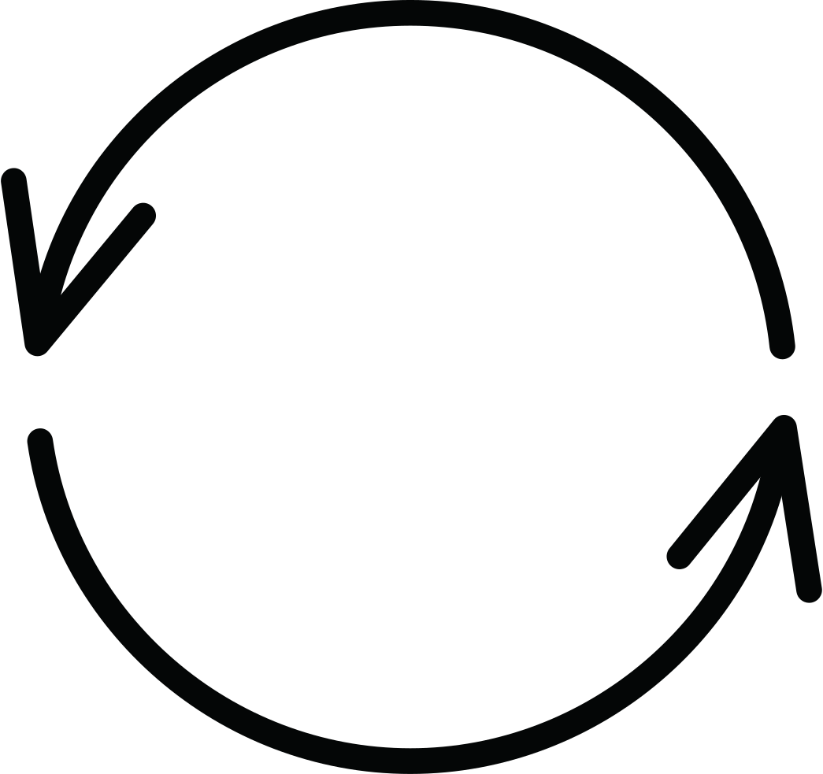
SUMMARY
3] Dynamic Rendering
This is the technique of using our state to decide what to show on the screen.
We use simple JavaScript logic like the ternary operator (? :) to show different UI.
This makes our components interactive and responsive to user actions.
4] Lifting State Up
When two sibling components need to share data, they can't talk directly.
We "lift" the state up to their closest common parent.
The parent becomes the "single source of truth" and passes the state down as props.

Slide 32
SUMMARY
5] The useEffect Hook
useEffect is for handling "side effects" — actions outside of React, like talking to a server.
Its dependency array [] tells React when to run the effect (e.g., only once on mount, or when a state changes).
This is the standard hook for fetching API data when a component first loads
6] Controlled Forms
This is the pattern where our component's state is the single source of truth for an input field.
We connect our state to the input using the value and onChange props.
This gives us complete control to perform instant validation and create a reliable UI.

Slide 33
THANK YOU !

