Slide 1
EE Industrial Advisory Board
First Meeting
Evaluation and Assessment of EE Program
October 4, 2001

Slide 2
ABET EC2000
Accreditation Board for Engineering Technology
Engineering Criteria 2000
Revolutionary change to accrediting engineering programs (mandatory from Sept. 2001). Focus on results of engineering education rather than curriculum.
Setting educational objectives
Outcome assessment for evaluation
Soft (nontechnical) skills should not be neglected
Continuous improvement is necessary

Slide 3
Objectives of IAB
Assessment tool for our EE program
Receive inputs from constituents (industry and alumni)
Visits will serve as trial visits for ABET visit in Fall, 2003

Slide 4
Tasks for IAB
Visit UH EE program at regular intervals.
First meeting (agenda set by EE dept.). Future meetings IAB will have control over agenda.
Form IAB organization and charter.
Evaluate and assess EE program.
Submit written report and fill out survey summarizing findings.

Slide 5
Summary of meetings today
Morning: introductions, overview, IAB organization, what we have done to prepare for ABET, discussions.
Lunch: IAB only
Afternoon: snapshot of EE program, discussion, and filling out report and survey.
Flexibility for some changes and additional meetings.

Slide 6
EE Dept. Overview
One of three departments (CE, EE, ME) in College of Engineering.
Formed in 1959 with 3 professors.
Only EE program in state of Hawaii.
Offers full complement of degrees: B.S., M.S., Ph.D.
Known for quality undergraduate program: many graduates have had very successful careers in Hawaii and on mainland.
Quality research program in targeted areas (e.g. networking and communications (Aloha)).

Slide 7
Current EE Personnel
Faculty: 17 full time, 4 emeritus, several adjunct faculty (down from 24 full time three years ago). Hired two faculty in last year and have verbal commitments for two more faculty to start 1/1/02.
Students: 307 undergraduate students and 65 graduate students (rates slightly higher for UG students and lower for graduate students).
Graduation rates: 40-50 UG students /year, 25 advanced degrees/year
Staff: 3 secretaries, 2 technicians, 1 computer support, 1 admin. asst., student help.

Slide 8
EE Areas
Computer Engineering: hardware and software
Electrophysics: circuits, devices, microwaves, optics
Systems: communications, controls, networking, power, signal processing
Currently have faculty shortages in computer engineering area and circuits

Slide 9
EE Facilities
Computer labs (EE and COE)
EE instructional labs
EE research labs
Instructional facilities: Don Kim lab, new distance learning facility

Slide 10
EE Research
Government funding (NSF, DoD)
Industry funding (Spirent-Adtech, NEC, TRW)
Approximately $1M in last year (down from recent years)
Focus more on group and multidisciplinary research, Hawaii Center for Advanced Communications.
Currently more undergraduate research

Slide 11
EE Awards
5 present and former IEEE Fellows.
9 present and former NSF PYI/NYI/Career Award winners.
At least 9 faculty have been involved with startup companies or new IPOs.
One current faculty received University teaching award.
Former faculty member won Japan prize.
2001 graduate won HKN’s highest student prize.

Slide 12
Summary of packet materials
IAB documents
  IAB organization (membership, charter, EE UG vision)
  ABET EC 2000
    Objectives
    Basic level criteria (8 criteria)
UH EE ABET materials
  ABET program assessment guide
  Instructional program
  Assessment surveys
EE overview
IAB agenda (updated agenda)

Slide 13
ABET EC2000 Objectives
Assure that graduates of an accredited program are adequately prepared to enter and continue the practice of engineering.
Stimulate the improvement of engineering education
Encourage new and innovative approaches to engineering education and its assessment
Identify accredited programs to the public

Slide 14
ABET EC2000 Criteria
Students
Program Educational Objectives
Program Outcomes and Assessment
Professional Component
Faculty
Facilities
Institutional Support & Financial Resources
Program Criteria

Slide 15
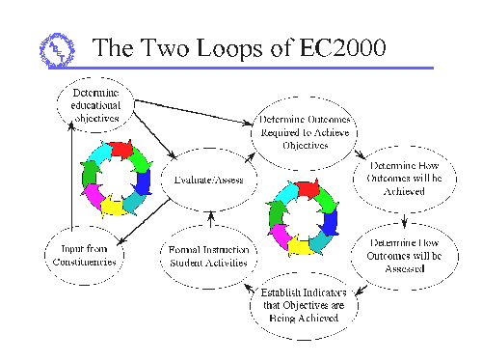
Assessment Cycle
A two-loop process

Slide 16
Programs Outcomes and Assessment
a) An ability to apply knowledge of mathematics, science and engineering appropriate to the discipline
b) An ability to design and conduct experiments, analyze and interpret data
c) An ability to design a system, component or process to meet desired needs
d) An ability to function on multidisciplinary teams
e) An ability to identify, formulate, and solve engineering problems
f) An understanding of professional and ethical responsibility

Slide 17
Program Outcomes and Assessment continued
g) An ability to communicate effectively
h) The broad education necessary to understand the impact of engineering solutions in a societal context
i) A recognition of the need for, and an ability to engage in life-long learning
j) A knowledge of contemporary issues
k) An ability to use the techniques, skills, and modern engineering tools necessary for engineering practice

Slide 18
UH EE ABET Preparation
Overview of mission, objectives, and outcomes
Discussion of assessments methods in place
Evaluation of data and closing the loop

Slide 19
EE Mission Statement
The mission of the Dept. of EE is to provide quality education, research and service to our constituents. Major goals of the dept. are:
Educate a new generation of Electrical Engineers to meet the challenges of the future.
Create, develop, and disseminate new knowledge.
Promote a sense of scholarship, leadership, and service among our graduates.

Slide 20
Program Assessment Guide
Program objectives
Program outcomes
Correlation tables
  Objectives vs. outcomes
  Resources and strategies vs. outcomes
  Assessment methods vs. outcomes

Slide 21
Assessment methods developed
Course syllabus and objectives
Student evaluations
Graduation surveys
IAB
Student Advisory Board

Slide 22
Closing the loops
Objectives and outcomes committee
  ABET committee
  Curriculum committee
  External industry member (from IAB)
  Student member (from SAB)
Goals of committee
  Insure educational objectives are consistent with mission of dept. and UH.
  Continual evaluation and assessment of outcomes to determine where educational objectives are met and can be improved through modifications to curriculum and processes.
  Oversee collection and evaluation of assessment data.
  Coordinate preparation of accreditation visits.

Slide 23
Assessment Cycle where we are

Slide 24
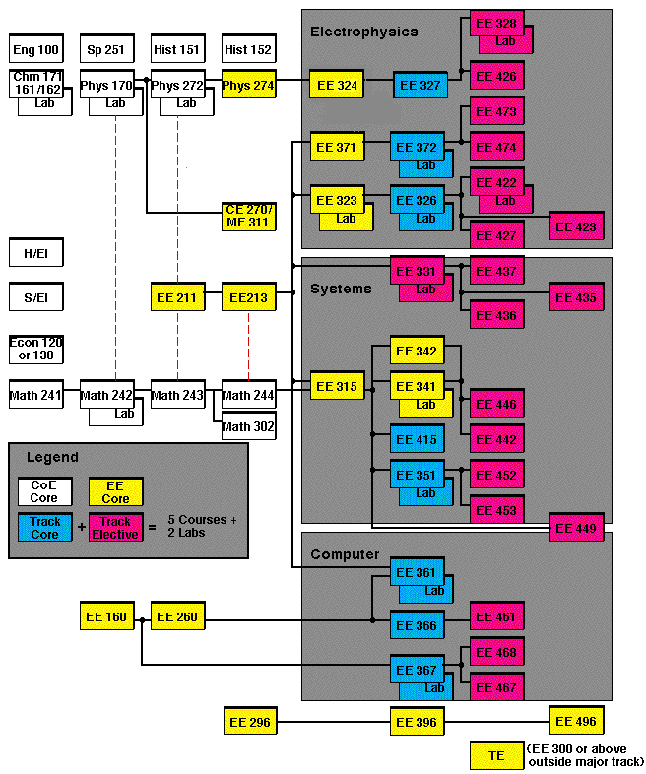
EE
Flowchart

Slide 25
Design Courses
EE196
EE296
EE396
EE496
Provide students with design experience, integrating knowledge from different courses, written and oral communication skills, working in teams, consideration of other nonengineering skills
EE196: optional freshman design course
EE296/396: required sophomore/junior design course
EE496: senior capstone design project

Slide 26
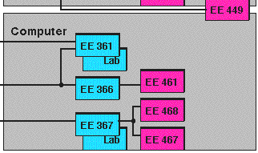
Computer Courses

Slide 27

Electrophysics courses

Slide 28
Systems Courses

Slide 29
Student Design Projects
David Lam: EE 296 – Remote control robot
Mike Hall: EE 396 – Tunable external cavity laser
John Mazotta: EE 496 – Capstone design project
Darren Ghoshi: Group undergraduate wireless transceiver project
Aaron Ohta: Extracurricular project- Micromouse

