Slide 1
SAB Goals
Jodi Enomoto
Michael Tamamoto

Slide 2

Tentative Goals
Finish SAB Charter by April 1st
Announce SAB and compile first real Student Advisory Board end of fall 2002
Gantt Chart

Slide 3

Mission Statement
The Student Advisory Board was created to fairly represent the Electrical Engineering student body and promote an enriching learning environment by,
1) providing the students with a means for voicing their opinions and suggestions to the faculty,
2) advising the University of Hawai'i Electrical Engineering Department regarding Faculty, Facilities, Labs, Coursework, and Student Activities, and
3) taking action where deemed appropriate.

Slide 4
Action Items
Student Concerns
SAB Webpage
  Tell people what we’re about
  Minutes from SAB meetings
  Suggestion/Concern box (can be anonymous)
  Future Goals
Comment Box
Open Forums/Open Meetings?

Slide 5
Action Items
(Charter)
Must finish by April 1st
Some concerns
  Board Composition
    7 members
    Tracks, GPA, Clubs, Class Standing, Grad Students etc.
  Elections – Elected or appointed?

Slide 6
Board Composition
(SAB Committees)
6 committees –
  Faculty
    Involved with hiring process
    Evaluations (mid-semester?)
  Facilities
  Labs
    Address rewriting labs to match courses, TA and professor correspondence,
  Coursework
    Track system, prerequisites

Slide 7
Board Composition
(SAB Committees)
  Elections
    Hold elections, let people know about or get publicity committee to publicize elections
  Publicity
    Web Page, correspond with students

Slide 8
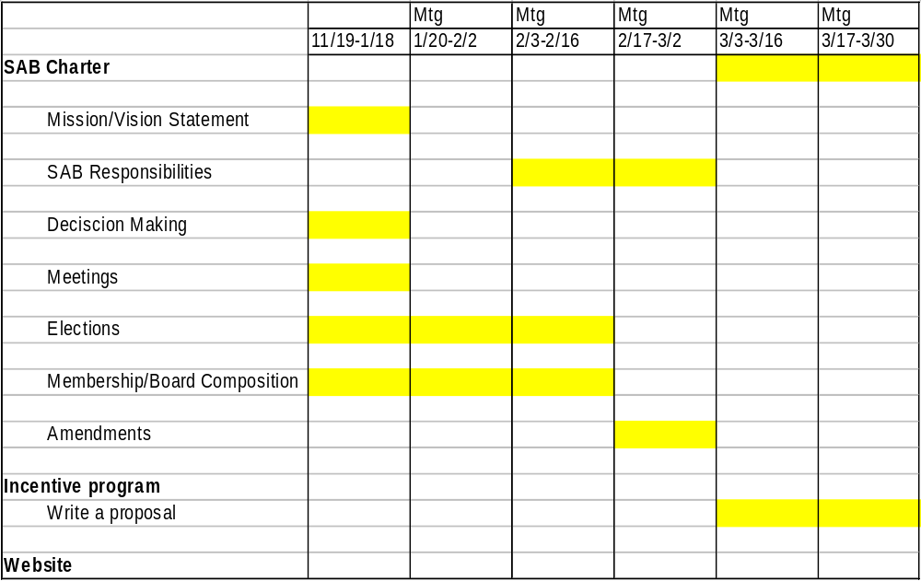
Gantt Chart

