Slide 1

UART Communication
Gantabya Kadel
IEEEngage

Slide 2
UART
Universal Asynchronous Receiver And Transmitter
One of The Serial Communication Protocols for devices.
Few examples of others are : I2C, SPI, USB, ISA
Serial Communication Protocol = Protocol Where Data Is Sent One After Other.
UART is asynchronous => Doesn’t rely on clock
UART May be Used for both Wired & Bluetooth Communication
A Simple Way of communicating.

Slide 3
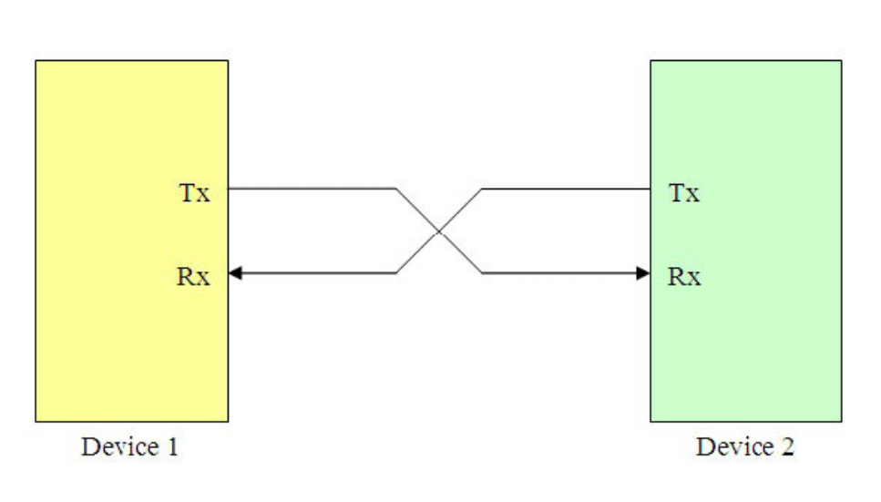
UART – PINS
Require 2 PINS
TX – Transmit Pin
RX – Receiver Pin
As the name suggests, TX Pin is used to transfer from Device 1 to Device 2
And Vice – Versa for RX.
Notes:
Reference: https://microcontrollerslab.com/uart-communication-tm4c123-tiva-c-launchpad/
For picture and info as well.

Slide 4
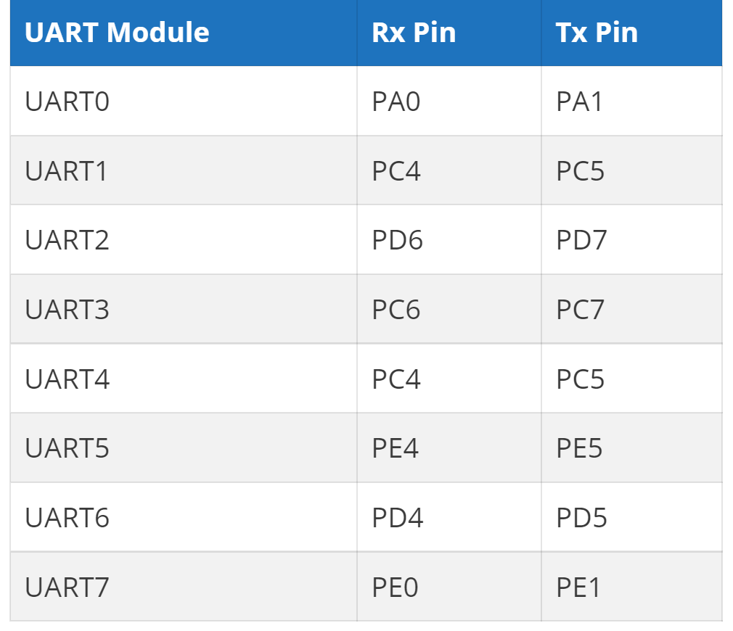
TIVA C - UART
Tiva C Has 8 UART Modules
UART0 – UART7
All of modules can operate independently.
Each UART Module Has Its Own Respective TX & RX GPIO Pins
Some GPIO Pins May Be Used For Multiple UART Modules
UART0 is somewhat special
Utilizes GPIO Pins A0 and A1
Pins Reserved By Tiva … not accessible to use on the board.
WE USE THESE 2 PINS FOR OUR DEMO
Datasheet Should Be Consulted For Detailed GPIO Pin and Port Information
Example Pins/Port Assignments. They are not complete TIVA C pins/port assignments for UART.
Notes:
Reference: https://microcontrollerslab.com/uart-communication-tm4c123-tiva-c-launchpad/
For picture and info as well.

Slide 5
Configuring UART Via TivaWare Library
Configuring UART via TivaWare Peripheral Libraries is relatively simple.
Programmer Doesn’t Necessarily Need To Know About Internal Registers & Configurations.
Hence use of APIs is preffered.
This demo also utilizes the utilites library of Tivaware.
Important “thing” to understand for the demo => Baud rate.
Now because APIs are used … the issue of baud rate generation isn’t important.
Programmer can just simply pass the value they want the baud rate to be.
Baud rate is the only way to synchronize data between 2 UART Devices (since UART is asynchronous)
Baud rate is the # of bits transferred/second
Baud rate must be the same for both devices to avoid the issue of white signals/noise
Typical Baud rate is 9600

Slide 6



LETS PROGRAM

