Slide 1
ML+
Episode 3
Data Pre-processing & Classification

Slide 2
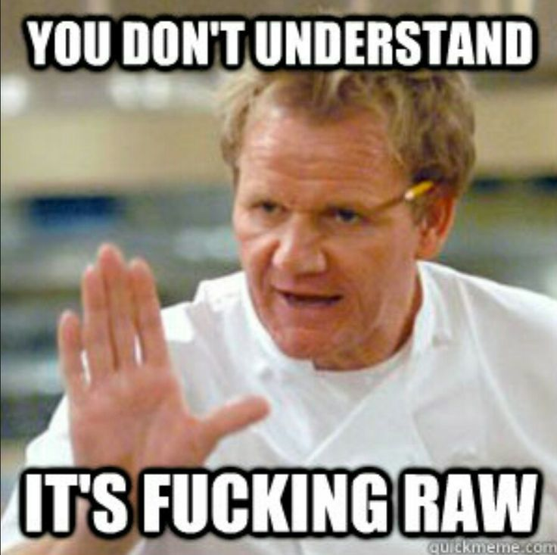
Why?
Data from raw sources usually can’t be used directly
Pre-processing is REQUIRED.

Slide 3
Why is raw data fucked up?
Missing Values
Values are not standardized
Categorical Values

Slide 4
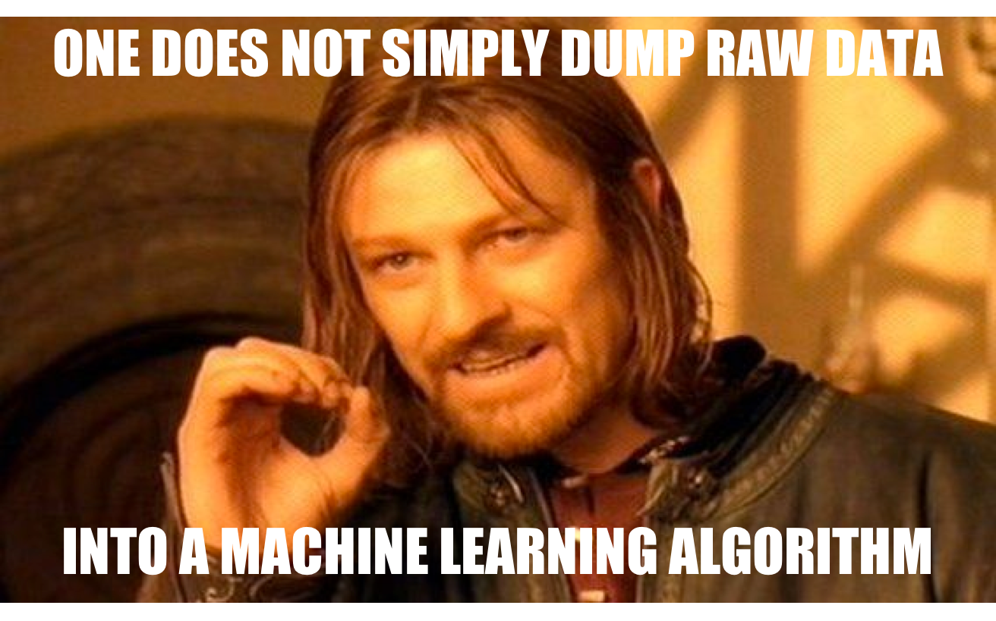

Slide 5
Process
Pre-Processing
Raw Data
Usable Data

Slide 6

Importing data
PANDAS

Slide 7
Pandas basics
Importing:
dataset = pd.read_csv(path)
Indexing:
dataset.iloc
dataset.loc

Slide 8
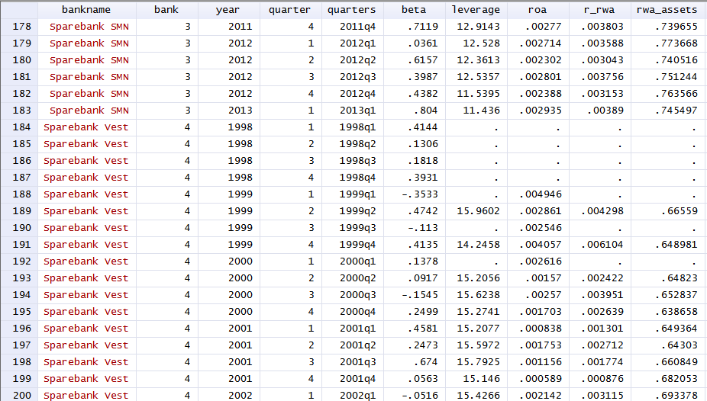
Missing values
Delete or Impute

Slide 9
Sklearn
Making shit simple since 2007

Slide 10


Slide 11
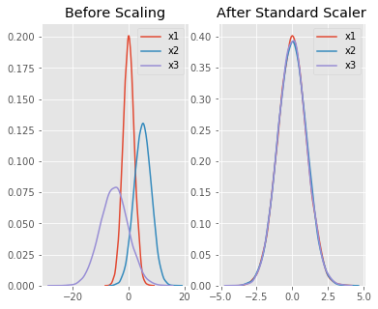
Standardization
Making mean = 0 and variance = 1

Slide 12
Categorical values
Turning non-numerical data into numerical data
City
Hyderabad
Mumbai
Hyderabad
Bangalore
Bangalore
Mumbai
Hyderabad | Mumbai | Bangalore
1 | 0 | 0
0 | 1 | 0
1 | 0 | 0
0 | 0 | 1
0 | 0 | 1
0 | 1 | 0
One-Hot Encoding!

Slide 13


Slide 14
More classification algorithms
SVM
K-NN
Decision Trees

Slide 15
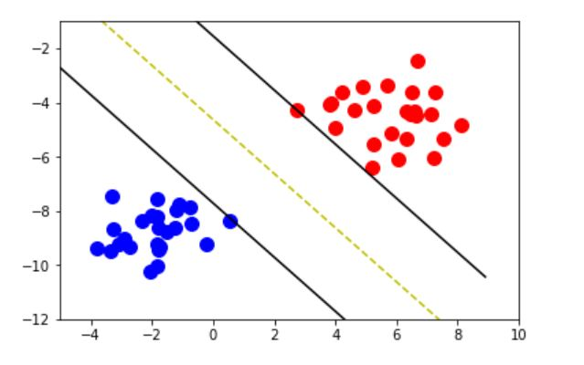
Support vector machines (SVM)
Max – Margin Loss

Slide 16
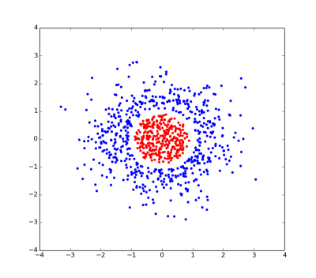
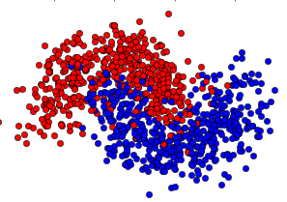
What If shit is linearly inseparable?

Slide 17
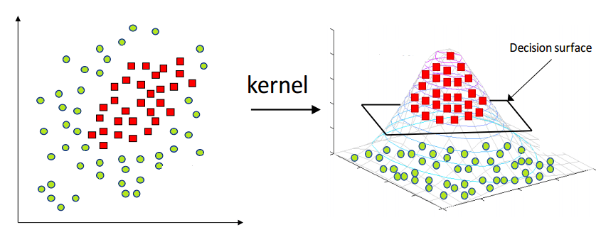
Kernel trick!

Slide 18

Good Guy SVM

Slide 19
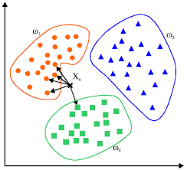
K-Nearest Neighbours (K-NN)

Slide 20
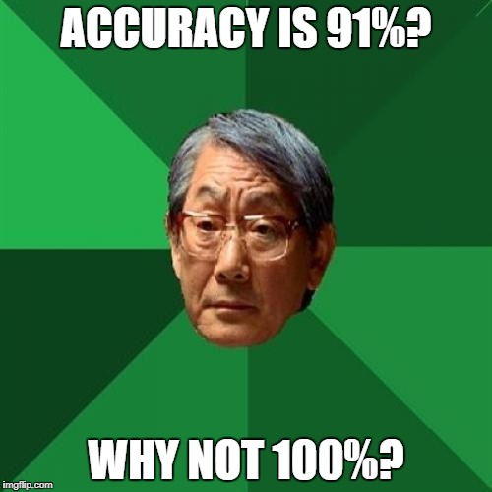
Evaluating your model
Confusion matrix
65 | 3
6 | 26
91%!

Slide 21
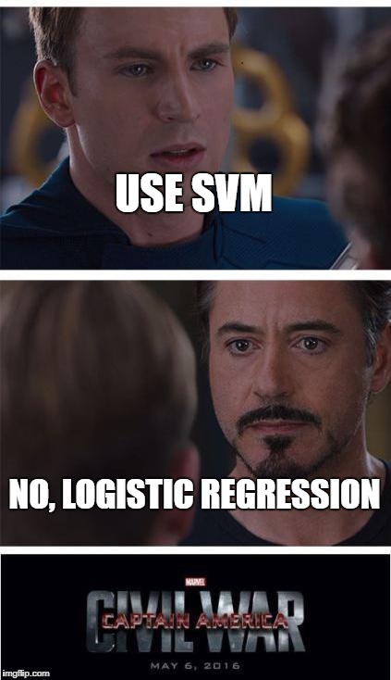
When to use what?

