Slide 1
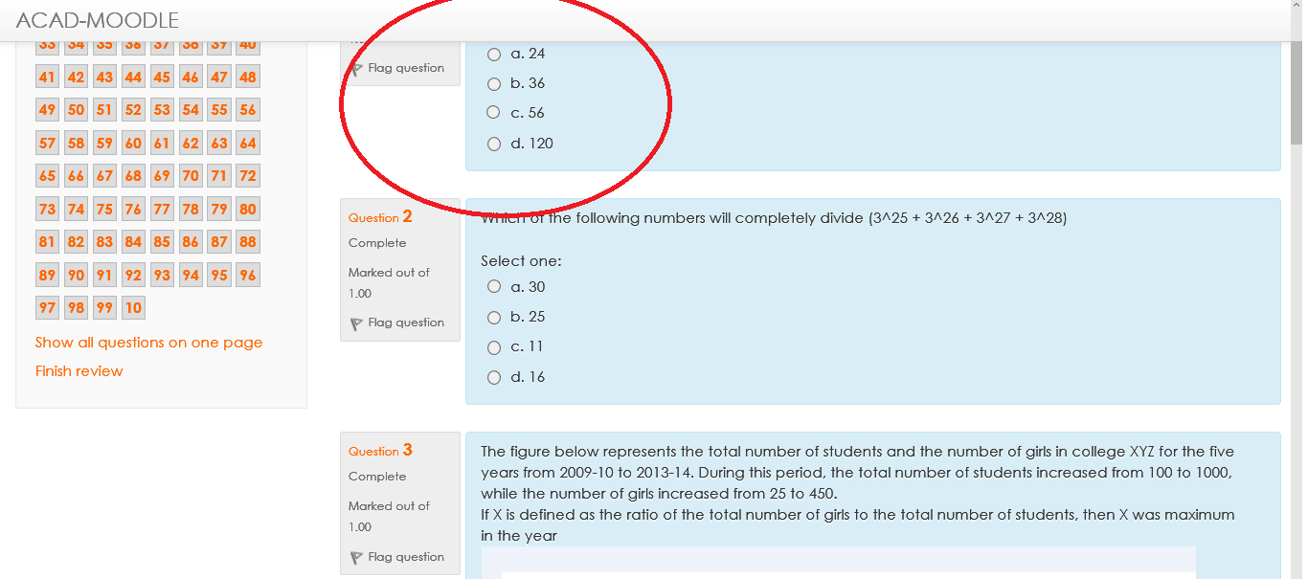
ISSUE If you are not able to view the question properly!

Slide 2
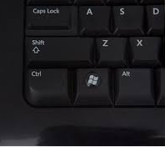

Hold Ctrl Key and Scroll the mouse wheel till you see the question clearly (Zoom-in)

Slide 3
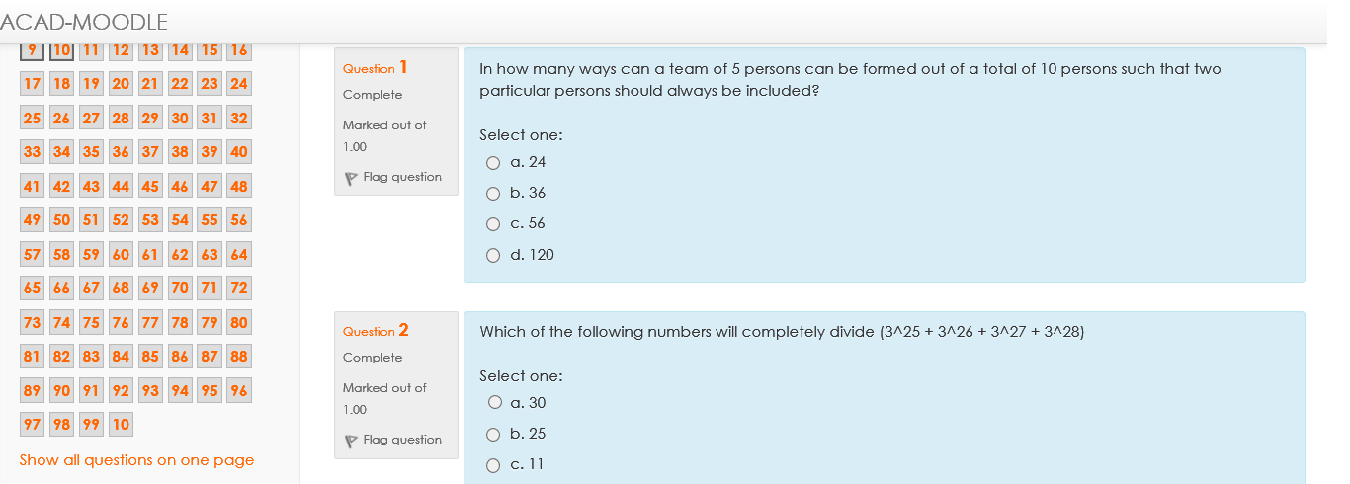
After Zoom-in

