Slide 1

Status of Inland ENCs in Europe
Gert Morlion
Chair CESNI/TI/IECDIS

Slide 2
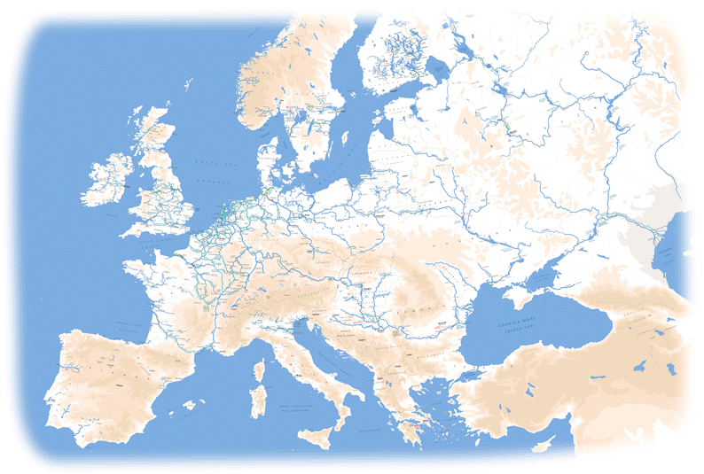

European inland waterways
The network of inland waterways in Europe spreads over 16 countries
4 of these countries are not members of the European Union
There is no organization which is able to publish binding regulations for all countries:
The European Union can adopt binding regulations for 12 countries
The Central Commission for Navigation on the Rhine can adopt binding regulations for 5 countries (4 of them are also members of the European Union)
The Danube Commission can adopt recommendations for 11 Danube countries (7 of them are also members of the European Union)
The Economic Commission for Europe of the United Nations can adopt recommendations for all countries

Slide 3
Inland ENCs and Inland ECDIS in Europe
The standardization of Inland ECDIS in Europe is the subject of the temporary working group CESNI/TI/IECDIS
CESNI (Comité Européen pour l’élaboration de standards dans le domaine de la navigation intérieure)
CESNI/TI (technologies de l’information)
Temporary working group Inland ECDIS
ES-RIS: one standard, four topics (VTT, NtS, ERI, Inland ECDIS) + 2 test standards (VTT, IECDIS)

Slide 4
Inland ENCs and Inland ECDIS in Europe
Permanent working groups
CESNI/PT
Temporary working groups
CESNI/QP
CESNI/TI
ECDIS
NtS
VTT
ERI
Notes:
PT: Préscription technique
QP: qualifications professionelle
TI: technologies de l’information

Slide 5
Inland ENCs and Inland ECDIS in Europe
IEHG is currently only dealing with the standardization of Inland ENCs
The European countries have also developed a common standard for chart viewers
The standard is based on the maritime S-52 standard for Electronic Chart Display and Information Systems (ECDIS)
The European “Inland ECDIS standard” contains the Product Specification for Inland ENCs and the Performance Standard and test procedures for Inland ECDIS applications
And are combined in with the FC, EG, PresLib and VC in the ES-RIS

Slide 6
Legal status of Inland ENCs in Europe
Inland ECDIS Standard Edition 2.4
Inland ECDIS standard edition 2.4 was integrated in ES-RIS 2021/1
Adopted as recommendation for all inland waterways by the Economic Commission for Europe of the United Nations (UNECE) in 2018
Adopted as recommendation for the river Danube by the Danube Commission (recommendation to use the latest version which is published by UNECE)
Published as a binding regulation by the Commission in Europe

Slide 7
Legal status of Inland ENCs in Europe
Inland ECDIS Standard Edition 2.5
Inland ECDIS standard edition 2.5 is integrated in ES-RIS 2023/1
The European Union plans to publish a binding regulation but it’s doubtful. It’s expected that only 2.6 will be amended in the new regulations.
Inland ECDIS Test Standard Edition 2.5
ES-RIS 2023/1 also includes the first test standard for Inland ECDIS

Slide 8
Legal status of Inland ENCs in Europe
Revision of the RIS directive
Currently:
Directive 2005/44 of the European Parliament and of the Council of 7 September 2005 on harmonized river information services on inland waterways in the Community.
Based on 7 corridors
Future:
Referring to ES-RIS
Applicable on T-ENT waterways (not decided yet)

Slide 9
Current status of Inland ENCs in Europe
ES-RIS 2025/1 has been adopted by CESNI/TI:
integration of the requirements for the visualization of AIS AtoN and ASMs
integration of the ‘validation checks’ into ES-RIS 2025:
copied from RVC 2.6
waterway authorities have to ensure that the VC are run before publishing the IENCs
amendement of new ‘IEHG’ and ‘CESNI’ change requests
The TWG has been mandated by CESNI to add new requirements according to the ‘application driven approach’

Slide 10
Current status of Inland ENCs in Europe
ES-RIS 2025/1 (2):
Combination of standards for 4 RIS key services (NtS, ERI, VTT and Inland ECDIS)…
… and 2 test standards
Part I – Electronic Chart Display and Information System for inland navigation
Part V - Inland ECDIS operational and performance requirements, methods of test and required test results (Test Part of Inland ECDIS)

Slide 11
Current status of Inland ENCs in Europe
ES-RIS 2025/1 (3):
Annex 1 – Product Specification for IENCs, edition 2.5
Appendix 1 IENC Feature Catalogue, edition 2.5
Appendix 2 Encoding Guide for IENCs, edition 2.5
Annex 2 - Presentation Library for IENCs, edition 2.5
Annex 3 – Product Specification for bathymetric IENCs, edition 2.5
Annex 4 – IENC validation checks

Slide 12
Current status of Inland ENCs in Europe
ES-RIS 2025/1 (4):
A European standard can only refer to documents/regulations adopted by Europe (in local police regulations or directive).
CEVNI:
Is a recommendation by UNECE, not a regulation.
Consequence: can’t be part of ES-RIS
All standards/documents need to be part of ES-RIS (annexes)
Referring to non-EU papers = almost impossible!

Slide 13
CESNI/TI/IECDIS
Working program 2025-2027 (1)
Revision of the Inland ECDIS parts of ES-RIS, taking into account – if available – the new S401 standard;
Analysis and implementation of the visualization of radar-related information and information from emerging sensors for a higher automation of navigation in an Inland ECDIS;
Definition of minimum requirement applicable to the technical design of the track guidance assistant for inland navigation (TGAIN), to the training of TGAIN users, and to equipment connected to the TGAIN;
Prepare the integration of the tests for visualization of AIS Aids to navigation (AIS AtoN) and AIS application-specific messages (ASM) into the inland ECDIS part of ES-RIS;

Slide 14
CESNI/TI/IECDIS
Working program 2025-2027 (2)
Analyze the requirements for ‘Intention Sharing’ (NL)
Direct impact IECDIS
Develop EU-specific RIS guidelines based on the ‘PIANC Guidelines and Recommendation for RIS’ (B)
Analysis of the different digital aspects of automated / autonomous navigation and remotely operated vessels (B)

Slide 15
Implementation of Inland ENCs in Europe
More than 11000 vessels equipped with Inland ENCs (6000 commercial vessels)
Three certified applications for navigation mode (with radar overlay, > 820 in use)
TGAIN installed on more the 1100 vessels
All IECDIS applications are compatible with edition 2.0, 2.1, 2.3, 2.4, 2.5
Implementation edition 2.4 should have been done until July 2021
CENSI/TI/IECDIS currently recommends the production of IENCs in edition 2.5
More Information at: http://www.cesni.eu

Slide 16
What’s next?
RIS COMEX²
Work package 5 – Task 5.4 - RIS Technical Services Evolution
Objective?
Contribute and support the work of the Temporary Working Groups of CESNI/TI in the development or maintenance of the RIS related standards and services.
What’s in it for us?
Resources for the development of S-401 for all partners in the project!
(see topic S-401)

Slide 17
Do you have questions?

