Slide 1

Teledyne CARIS solutions update for Inland ENC production
Notes:
Hi ,everyone. I am Vivian Zhang, I am from Teledyne CARIS which has forcusd on the marine charting and cartography solution for almost 40 years. I am pleased to share with you about CARIS solution update for the Inland ENC production.

Slide 2
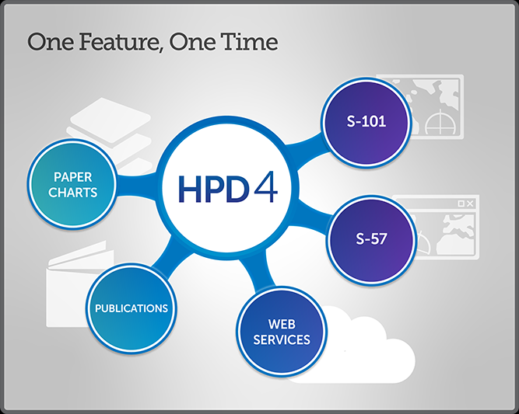
Inland ENC support update
CARIS HPD or Composer support production of Inland ENC
Added support for Inland ENC version 2.5 in HPD and Composer 5.0.1
Added support for Inland ENC S-401 in HPD and Composer 5.0.3
HPD 5
Notes:
Let me start from CARIS application which supports Inland ENC production, it is supported by CARIS Hydrographic Production Database (HPD ) or CARIS Composer.
HPD is a database-based solution and CARIS composer is a file-based solution.
We’ve added support for IENC v 2.5 in HPD and Composer V5.0.1 and S-401 in HPD and Composer 5.0.3

Slide 3
S-100 tools
Enabling S-100 production
HPD needs the S-100 module
S-57 Composer needs the S-100 module per application instance.
Once acquired, S-101 configuration is ready for use, with other specifications easily added to the product folio.
Bathy DataBASE powers S-102 and other raster overlay product creation
HPD 5
Notes:
So for enabling S100 production , S100 module is required for HPD and S57 Composer . Once acquired , S101 configuration is ready for use, with other specifications easily added to the product folio.
And CARIS Bathy database powers S102 and other raster overlay product creation.

Slide 4
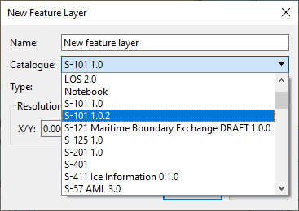
S-100 tools
S-100 module provides functionality to
Edit S-100 vector features
Convert S-57 ENC <-> S-101 ENC
S-100 vector HPD Source database
Export S-101 new editions and updates
Create and edit S-101 exchange sets
BDB & CARIS Cloud provides
S-102 datasets
Bathy Data Service is the distribution pipeline to push raster data to RENCs and other stakeholders
Opening S-100 datasets are supported in all CARIS desktop applications
Notes:
Here is some functionalities of CARIS S100 tools
With S100 module the users can Edit S100 vector features , convert S57 ENC to S101 ENC, vise versa . S100 vector HPD source data , export S101 new editions and updates. Create and edit S101 exchange sets
With BDB provides S102 datasets .
CARIS Cloud – named Bathy Data service is the distribution pipeline to push raster data to RENCs and other stakeholders
The opening S100 datasets are supported in all CARIS desktop applications

Slide 5


S-401 migration and production
Create S-401 from existing data and products
Quick and easy use S-100 Composer or HPD
Good for testing and getting familiar with S-101/S-401
since product specifications are still under development
Migrate source database to S-100/S-401
Convert HPD Source database from S-57
Supporting existing products plus new S-100 products
Maintain history
S-57 features remain as the historic data – with link from new S-100 features
IENC
S-57
IENC
S-401
Notes:
These are 2 approaches or options for S-401 migration and production
The first approach is what the most of Hydrographic office users are using .
Create S-401 from existing data and products by Quick and easy using S100 composer or HPD
This is a good way for testing and get familiar with S101/401 ,especially the product specifications still under development
They second approach is all the users will use in future, migrate the source database to S100/S401
Convert HPD Source database from S57
Supporting existing products plus new S100 products
Maintain history , this is the most concern by the users.
S57 features remain as historic data –with link from new S100 features

Slide 6


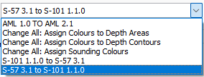

Mapping to/from S-57 and S-401
Setup mapping as part of product definition possible
–
Automatically used when creating and updating products
Mapping available:
During Import
On existing (source and product) data
During product creation and updating
During export
ENC
S-57
Other
(S-57)
HPD Source
S-57+
Paper Charts
S-57
Nautical
Publications
Notes:
This is how “Mapping” works
The “ Mapping” can be from S57 to S401 , also can be from S401 to S57.
Mapping is available during import, on existing data , product creation and updating and export.
The customer will setup mapping as part of product definition possible .
And it will be automatically used when creating and updating products.

Slide 7
1. Producing S-101/S401 from S-57
IENC
S-57
IENC
S-401
Source data may need to be prepared/optimized
ENC
S-57
ENC
S-101
HPD Source
S-57+
Mapping from S-57 to S-401
Other
(S-57)
-
Mapping rules may need to be enhanced
Paper Charts
S-57
Nautical
Publications
Notes:
This is the flowchart of how to produce S100 from S57
The S57 source data may need to be prepared or optimized , the IENC S401 can be produced through mapping from S57 to S401 . The mapping rules may need to be enhanced.

Slide 8
2. More products from S-100 Source
Mapping from S-100 to S-57
S-122
ENC
S-57
Also possible to add own/other products in CARIS
Feature Catalogues are customizable
Product definitions are customizable
S-124
ENC
S-101
HPD Source
S-100+
(S-125)
S-201
Other
(S-57)
IENC S-401
Paper Charts
S-57
Nautical
Publications
Notes:
Besides the S101 ENC and paper charts , CARIS also supports more products from S100 source, such as S122, 124, 125 or 201, IENC S401 ..

Slide 9
Thank you!
Rui.Zhang@Teledye.com
Juan.Carballini@Teledyne.com
Notes:
That’s what I would like to present for today thank you very much for your time and I am sure you may have some questions, unfortunately our expert of production solution was not able to join the conference , however please forward your questions to me and we will reply expeditiously.
Thank you

