Slide 1

15 - 17 October 2024 Beijing, PRC

Slide 2
Welcome, introduction, organization
Many thanks to Waterborne Transport Institute and especially Liu Li for the hosting of the meeting and for the organization!
PRC joined IEHG in 2009
15 years member of IEHG
More than 7400 km of inland waterways with IENCs
IEHG meetings in Chongqing in 2011 and Nanjing 2015

Slide 3
Welcome, introduction, organization
Introductions of participants
Organizational details:
All documents available at https://github.com/IEHG/IEHG-Meeting-2024
please send your presentations to bernd.birklhuber@bmk.gv.at)
All presentations will be published at https://ienc.openecdis.org (please inform, if you object)

Slide 4
Agenda
Welcome, introduction of participants, organizational details
Update on the legal and organizational background and the status of implementation
Presentation of Inland ENC applications by private companies
Core Group, election of chairs, S-100 representatives, amendment of ToR
Updates to the Encoding Guide and Product Specification
Update intervals and processes, decision on next version or edition
Quality standards for Inland ENCs (RVC edition 2.6)
Status of S-99, S-100, S-101 and other S-100 based products
Interoperability and S-98
Development of the Inland ENC Product Specification S-401
S-57 to S-100 converter development
S-201, S-125 and S-402
Annual report to HSSC
Information documents on Inland ENCs
Future operation of ienc website and discussion forum
Any other business
Next meeting
Agenda

Slide 5
Time schedule
Tuesday, 15 October, to Thursday, 17 October
09:00 - 10:30 morning session
10:30 - 11:00 coffee break
11:00 - 12:30 continuation of morning session
12:30 - 14:00 lunch
14:00 - 15:30 afternoon session
15:30 - 16:00 coffee break
16:00 - 17:00 continuation of afternoon session
All times in UTC + 8

Slide 6
Inland ENCs and the Inland ENC Harmonization Group (IEHG)
Update on the legal and organizational background and the status of implementation
Inland ENCs
Brazil
- Planned (names of waterways & no. of km)
- Completed (names of waterways & no. of km)
- Available (e.g., from website)
China
Europe
Russian Federation
USA
Overview

Slide 7
New participants
Presentations by the new participants about their river/inland waterway network, navigation and cartography
India

Slide 8

Open action points
Please provide an email to bernd.birklhuber@bmk.gv.at containing updates to the information on Inland ENC coverage [offline version]
COMEX² to check whether a reporting tool for discrepancies could be implemented by EuRIS or on national level (the US tool is based on Survey 123 of ArcGIS).

Slide 9
Inland ENC applications
Esri
List of IENC applications:
https://ienc.openecdis.org/links [offline version]
IIC Technologies
Periskal
Teledyne
7Cs

Slide 10
Open action points
The IEHG website contains also a list of both National Organizations and Private Companies involved with IENCs [offline version] Please check, whether the information is still up-to-date
If not listed, please provide URL to bernd.birklhuber@bmk.gv.at for inclusion on the website.

Slide 11

The Inland ENC Harmonization Group
Objective: to develop and to maintain a harmonized standard for Inland Electronic Navigational Charts (IENCs) suitable for inland navigation that is based on the standards of IHO for ‘maritime’ ENC
Goal: to agree upon specifications for Inland ENCs that are suitable for all known inland ENC data requirements for safe and efficient navigation in European, North and South American, Russian Federation and Asian inland waterways.
It is further intended that IENC standards meet the basic needs for Inland ENC applications, worldwide
Notes:
Now let me introduce the Inland ENC Harmonization Group (IEHG):
The Objective of IEHG is to develop and to maintain a harmonized standard for Inland Electronic Navigational Charts (IENCs) suitable for inland navigation that is based on the standards of IHO for ‘maritime’ ENC The Goal is to agree upon specifications for Inland ENCs that are suitable for all known inland ENC data requirements for safe and efficient navigation. At the moment all European countries with a connected inland waterway network, the Russian Federation, the United States of America, Brazil, the Peoples Republic of China and the Republic of Korea are actively participating in IEHG.
It is further intended that IENC standards meet the basic needs for Inland ENC applications, worldwide.

Slide 12
IEHG - recognition
As the competent international technical group on Inland ENC technical standards development, implementation and maintenance, IEHG is recognized by:
Europe - European Union, Economic Commission for Europe of the UN and the Central Commission for Navigation on the Rhine
North America – US Army Corps of Engineers
Russian Federation - Russian Ministry of Transport
Brazil, Peru and Venezuela – Hydrography and Navigation Services
Asia – Ministry of Transport of PRC and KHOA of Republic of Korea
International Hydrographic Organization (IHO)
Since there are several countries with Inland Navigation that are not Member States of IHO, IEHG does not intend to become a member of IHO.
Instead, IEHG supports, advises and provides input to IHO regarding Inland ENC matters as a recognized NGIO.
Notes:
IEHG is not an international organization like IHO, but it is recognized by
The European Union, the Central Commission for Navigation on the Rhine (CCNR),
The US Army Corps of Engineers,
The Russian Ministry of Transport,
The Directorates and Services for Hydrography and Navigation of the Brazilian Navy, Peru and Venezuela
The Ministry of Transport of the Peoples Republic of China, the Korean Hydrographic and Oceanographic Administration and
the International Hydrographic Organization (IHO).
Since there are several countries with Inland Navigation that are not Member States of IHO, IEHG does not intend to become a member of IHO.
Instead, IEHG supports, advises and provides input to IHO regarding Inland ENC matters.

Slide 13
IEHG – recognition (2)
In 2009, IEHG has been recognized by IHO as a Non Governmental International Organization (NGIO) with observer status
Current members of IEHG are all European countries with connected inland waterways, the Russian Federation, the United States of America, Brazil, Peoples Republic of China, Republic of Korea, Peru and Venezuela
Notes:
IEHG has been recognized by IHO as a Non Governmental International Organization (NGIO) with observer status in 2009.
Current members of IEHG are the European countries with a connected inland waterway network, the Russian Federation, the United States of America, Brazil, the Peoples Republic of China, the Republic of Korea, Peru and Venezuela. But of course IEHG welcomes every country with inland waterways.

Slide 14
IEHG – composition and organization
Composition - IEHG is a combined government/non-government technical group
Regions – IEHG regions are comprised of countries within a continent (North America, South America, Asia) or a recognized social-economic region (Europe, Russian Federation).
Organization – By simple majority vote, chairpersons, vice-chairs and technical coordinators are elected.
ToR

Slide 15
IEHG – membership
All the members of IEHG should have current expertise in the field of Inland ENCs.
Participants – Anyone who is involved in the production of Inland ENCs or the production of Inland ENC applications and representatives of user groups can participate in IEHG, make proposals and take part in the discussions.
Members - Representatives of competent authorities involved in the provision of Inland ENCs are entitled to become members. If proposed by a competent authority, membership can also include expert contributors.
ToR

Slide 16
IEHG – procedures
Meeting Schedule - The IEHG normally meets once per year. If required, there can be an additional meeting or the meeting can be postponed.
Discussion Forum - The IEHG uses the internet as a discussion platform in the time between the meetings. Every participant of IEHG is entitled to start a new discussion topic and to take part in discussions about Inland ENCs.
Task Groups - The IEHG may decide to form a task group for the drafting of specific proposals.
Proposal Submission and Review: see Terms of Reference
ToR

Slide 17
IEHG – formalization of standards
The IEHG submits Inland ENC standards for formalization to:
Interested international organisations like IHO, the European Commission (EC), the Central Commission for Navigation on the Rhine (CCNR), the Danube Commission (DC), the Economic Commission for Europe of the United Nations (UN/ECE) and the Mekong River Commission
National waterway authorities (e.g., United States Army Corps of Engineers (USACE), Russian Ministry of Transport) and
National Hydrographic Services (e.g. Directorate of Hydrography and Navigation of the Brazilian Navy (DHN))
ToR

Slide 18
What can IEHG do for you?
Europe had developed an Inland ENC standard based on Edition 3.0 of S-57 (with inland specific amendments)
Edition 3.1 of S-57 used the same enumerations for different purposes
The “European Inland ENC standard” became incompatible with the maritime standard, had to be revised, and all existing Inland ENCs had to be corrected
This was an update without backward compatibility!
IEHG and the use of the Product Specification for Inland ENCs guarantees that all inland specific elements are taken into account by IHO for new developments

Slide 19
What can IEHG do for you? (2)
When IEHG has established a portrayal register in the S-100 registry and a S-101 compatible Product Specification: S-100 based ECDIS and ECS on maritime vessels will be able to read and display Inland ENCs correctly
IEHG provides the possibility to participate in the developments of IHO
IEHG provides a forum for chart producers and application builders for exchange of experiences and knowledge

Slide 20
Involving end users
Involvement of end users in the development of S-401, especially regarding portrayal (e.g. which symbols, priority of information, …) would be beneficial
“Representatives of user groups” can become participants of IEHG and can participate in discussions on the forum
Individual boatmasters cannot become participants of IEHG according to the Terms of Reference
But we can invite them to participate in the discussion forum
Please inform some boatmasters who are experienced users of Inland ENCs

Slide 21
Election of the Core Group
By simple majority vote, chairpersons, vice-chairs and technical coordinators are elected.
Chair – Two persons (co-chairs) each from a different region. Only representatives of waterway authorities can become chairpersons.
One vice-chair from each region, which is not already a chair.
Technical Coordinators - One technical coordinator for each region.
Core Group – The two Chairs, the vice-chairs and Technical Coordinators.
The S-100 representatives are also part of the Core Group
ToR

Slide 22
Election of chairs
Chair – Two persons (co-chairs) each from a different region. Only representatives of waterway authorities can become chairpersons.
One vice-chair from each region, which is not already a chair
Current co-chairs: Denise LaDue (USACE, North America) Bernd Birklhuber (BMK of Austria, Europe)
Current vice-chairs: Vitor Pimentel (DHN, South America) Qun Gu (WTI, Asia)
Proposals for the coming period?

Slide 23
Election of technical coordinators
Technical Coordinators - One technical coordinator for each region
Current technical coordinators: Cameron McLeay (CARIS USA, North America) Gaël Billet (Periskal Group, Europe) Vladimir Sekachev (STEOR-NSB LLC, Russia) Nuno Silva (IIC Technologies, South America) Li Liu (WTI, Asia)
Proposals for the coming period?

Slide 24
Election of representatives for S-100
IEHG has to nominate representatives for the registry management of S-100:
representatives as submitting organization (currently Denise LaDue and Gaël Billet)
representatives for the Domain Control Body (currently Denise LaDue and Gert Morlion)
represenatives for the Executive Control Body (currently Denise LaDue and Gaël Billet)
Proposals for the coming period?
ToR, Annex B

Slide 25
Amendment of the ToR
Action points from last meeting:
Bernd Birklhuber to submit a CR for the Terms of Reference to include the S-100 representatives in the Core Group. Status: done, action point closed
Bernd Birklhuber to publish the amended ToR 2023 on the website. Status: done, action point closed
IEHG could check whether the ToR of IEHG need to be updated

Slide 26
Update of the Introduction of the EG
IEHG could check whether the Introduction to the Encoding Guide for Inland ENCs needs to be updated.

Slide 27
List of members and participants
The list is based on the ToR and is containing
Members
Expert contributors
Participants
Some e-mail addresses are no longer active and we can’t contact those persons
Please check if those persons can be deleted or if you know their new addresses
List of members

Slide 28
Adopted documents
Product Specification for Inland ENCs, edition 2.5corr
Inland ENC Encoding Guide, edition 2.5.1
Inland ENC Feature Catalogue, edition 2.5corr1
XML
Product Specification for bathymetric Inland ENCs, edition 2.5
Corrected versions of the symbol libraries for 2.4 and 2.5 and of the XML facility file are available on the website

Slide 29
Action points from last meeting (1)
Comex² to take the change from catach_10 (anchorage for pushing-navigation vessels) in IENC 2.5 to categoryOfAnchorage 16 (anchorage for pushing-navigation vessels) in S-401 into account for the Conversion Guidance.
Buildings over water: The S-100 representatives to inform IHO that IEHG agrees in principle with the proposal, but would need additional enumerations for the category of structure (e.g. the already registered “building above navigable water”) and to clarify whether “bulk” is in this case also covering break bulk. Status: break bulk is also covered
Denise and Gaël to clarify with Jeff the best way forward and to inform Bernd, who will then finalize the CR. Status: Question asked to Jeff - no reply yet
Gaël to contact Jeff and clarify whether we can assign a 17… identifier or IHO is going to assign a code from the S-57 range of numbers and to inform Bernd and Denise. Status: done, action point closed

Slide 30
Action points from last meeting (2)
Patrick or René to send an example how the line should look like to Gert. Gert to register the symbol and the line style. Patrick or René to draw up and submit a CR. Status: done, action point closed
René to update and resubmit the CR 419 (wtwdis) accordingly.
Denise to update the CR 422 (category of sensor) accordingly. Status: done
Gert to amend the Symbol Library and the Lookup Tables.
Bernd to update the CR 423 (refgag) accordingly. Status: done
The domain managers to register the changes in the registry.

Slide 31
Action points from last meeting (3)
Gert to update the CR 425 accordingly. Status: done, action point closed
COMEX² to take the changes regarding CONDTN 3, STATUS 18 and InDispute in CR 426 into account for the Conversion Guidance.
The S-100 representatives to register the changes contained in CR 430, 435 (enumerations 124-127, MARSYS 13, svgs will be provided by Vitor) and 437 (when submitted).
Gert to add the new lines for the Brazilian notice marks (CR 435) to the Lookup Tables. Not necessary, because there is just a reference to a conditional symbology instruction regarding notice marks. AP closed

Slide 32
Action points from last meeting (4)
Bernd to publish the Presentation Library with the Brazilian notice marks on the website.
Bernd to update the CR 433 accordingly. Status: done, action point closed
Michael to update CR 437 accordingly. Status: done, action point closed
Bernd and Gert to discuss the CR regarding CEVNI with the CESNI secretariat and to submit it after finalization and the adding of the concepts. Status: done, action point closed

Slide 33
Action points from last meeting (5)
Bernd Birklhuber to add references to the new documents in the guideline for the drafting of CRs and to publish the documents on the website. Status: done, action point closed

Slide 34
Change Requests
Available documents on https://ienc.openecdis.org and in the discussion forum: Change Request form, Change Request Form for Symbols guideline for the drafting of change requests overview of change requests (has to be consulted to find the number for the next change request)
Change requests since the last edition (that have not already been integrated in the latest published versions)

Slide 35
Update intervals and processes
Time schedule for 2.6 (adopted at last IEHG meeting) Deadline for submission of CRs that affect S-100: 22 March 2024 Deadline for submission of CRs that do not affect S-100: 17 May 2024 Deadline for adoption of CRs for 2.6: 28 June 2024 Distribution of first draft of EG, FC, PS: 12 July 2024 > 6 Aug Deadline for comments on the draft: 23 August 2024 Distribution of the final drafts (forum): 13 Sept. 2024 > 27 Aug Deadline for veto: 31 October 2024 > 8 October Publication of edition 2.6: November 2024

Slide 36
Update intervals and processes Action points from last meeting
Bernd to publish the deadlines on the discussion forum and to inform the European temporary working group for Inland ECDIS. Status: done, action point closed
The S-100 representatives to register requested changes as soon as possible. Status: done, action point closed
Bernd to prepare the draft of the PS 2.6. Status: done, action point closed
Denise to prepare the draft EG and FC 2.6. Status: done, action point closed
Gaël to integrate all adopted changes in the S-401 FC. Status: done, action point closed

Slide 37
Formal adoption of edition 2.6
The IEHG meeting could confirm the adoption of edition 2.6
Product Specification
Product Specification for bathymetric IENCs
Feature Catalogue XML version
Encoding Guide
Facility file
Draft of the European Presentation Library

Slide 38
Quality standards for Inland ENCs
Action points from last meeting:
Bernd to prepare a draft of the VC 2.6 until 12.07.2024. Status: done, action point closed
Gert to check if COMEX² could contribute to the development of test charts. Status: These are under the development if WSV (Claudia Heckert)
China to submit a CR with the necessary amendments of the minimum content for the Chinese inland waterways.

Slide 39
Recommended validation checks 2.6
The deviations of the RVC for Inland ENCs from S-58 are shown as corrections in the tables
This should also allow application developers to adapt validation software that is based on S-58 to the RVC for Inland ENCs
Like S-58 the RVC for IENCs are containing critical checks. IENCs with critical errors might not be loaded by applications
The meeting could discuss how to develop test IENCs for edition 2.6, agree on a timeline and assign tasks.
AP:
RVC 2.6

Slide 40
Minimum content of Inland ENCs
Do we need to develop an update of the minimum content 2.4 for S-401?
Yes: we need to define for each new feature of S-101 that is taken over by S-401 whether it is mandatory (M), conditional (C) or optional (O)
AP:

Slide 41
Status of S-99, S-100, S-101
S-100 has entered into force on 1st January 2010
S-100 edition 5.1.0 has been adopted in October 2023
S-100 Registry 3.1
S-99 edition 2.0.0 has been published in October 2022
S-101 edition 1.2.0 has been published in March 2024
All documents available at https://iho.int/en/standards-and-specifications

Slide 42
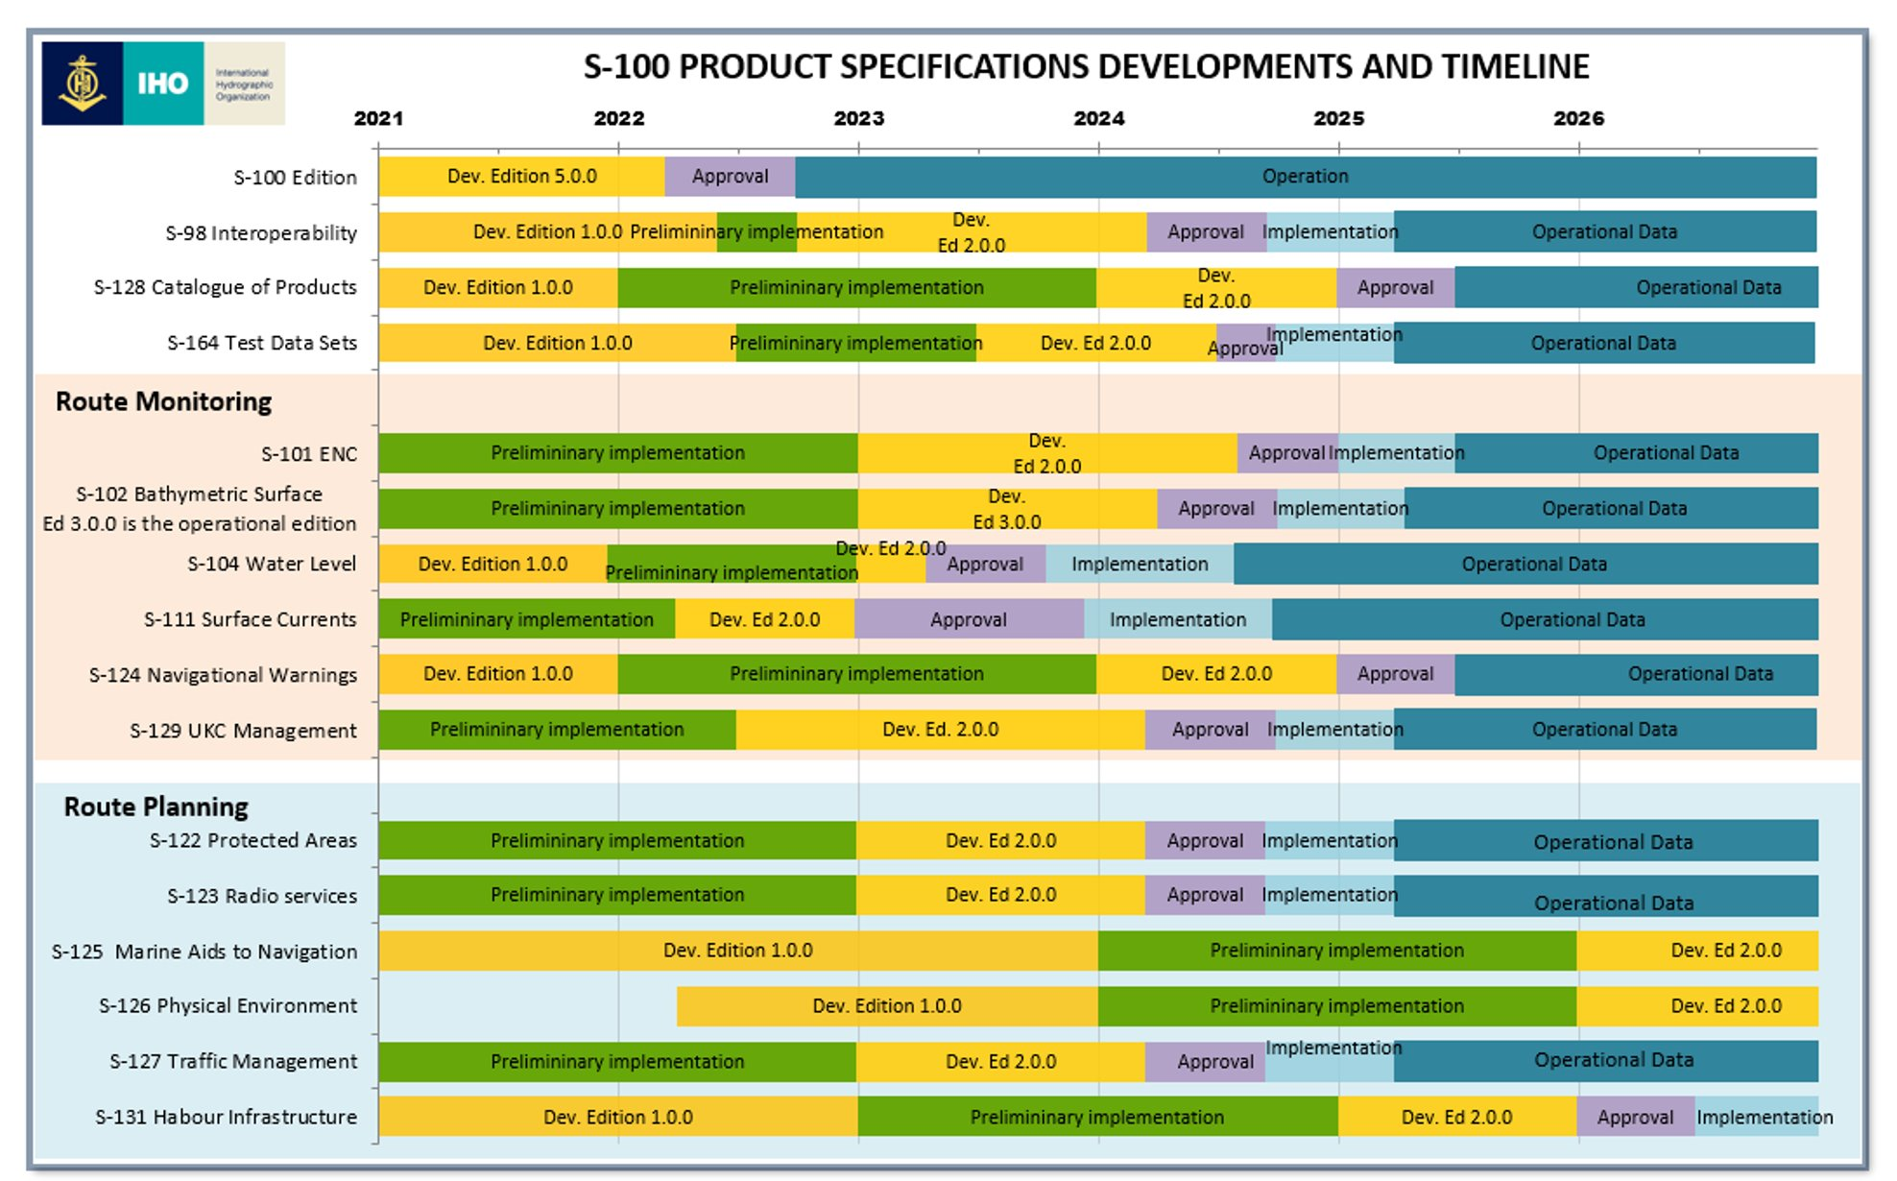
S-100 based ECDIS (IEC standard) in use from 01-01-2026

Slide 43
Status of S-99, S-100, S-101
Action points from last meeting (1):
Bernd to forward the thanks to Mathias Jonas, to forward the apologies that IEHG is not able to participate in all the S-100 related working groups actively due to a lack of personal resources, and to point out, that a DCEG builder that could not only be used once but would allow to update the tables in already established DCEGs whenever a FC is amended would ensure the full integrity of FC and DCEG, while there would always be a growing risk of inconsistencies between FC and DCEG if the two elements are updated manually. If such a dynamic DCEG builder would also be valued by other S-products, it would be very much appreciated if it would be provided as part of the announced S-100 tool kit. It should also be emphasized how important the integration of S-401 in S-98 will be once S-401 has been finalized.
Status: done, action point closed

Slide 44
Status of S-99, S-100, S-101
Action points from last meeting (2):
keep track of S-101 developments and the consequences for IENCs (Cameron, Tom, René, Friedhelm, Gert, Gaël and Patrick.
Denise to reach out to Tom Bovey regarding S-501 developments to determine whether there will be similar challenges faced by S-501 regarding Interoperability with S-101.

Slide 45
Interoperability and S-98
Contradicting messages from various IHO representatives whether S-401 will be included in a future version of S-98
Paper of IEHG and presentation (by Friedhelm) with three different scenarios at the HSSC meeting
Online meeting with IHO WG representatives on 5 September

Slide 46
Interoperability
Main question: is it allowed to use a certified ECDIS with another interoperability standard (and FC, PC)
Answer: YES
Proposal: development of a S-498 interoperability standard for inland navigation based on S-98
AP:

Slide 47
Development of S-501
IEHG could be informed about the development of S-501

Slide 48
Development of S-401
IEHG has to develop
S-401 Product Specification
S-401 Feature Catalogue
S-401 Portrayal Catalogue
S-401 Data Classification and Encoding Guide (DCEG) or Encoding Guide
S-401 Recommended Validation Checks
Conversion Guidance
S-402 Product Specification for bathymetric IENCs (vector): development will start after finalization of draft S-401
Maybe Product Specifications, FCs and PCs for overlay IENCs and basic IENCs for use with overlays
Contribution to S-98 or development of an inland specific interoperability standard including test cells

Slide 49

Introduction (by Gert)
COMEX²:
European study project
13 partners (EU and non-EU)
Studies concerning River Information Services platforms (EuRIS and CEERIS)…
… and other RIS initiatives
all tasks/subtasks receive EU fundings
5 work packages

Slide 50
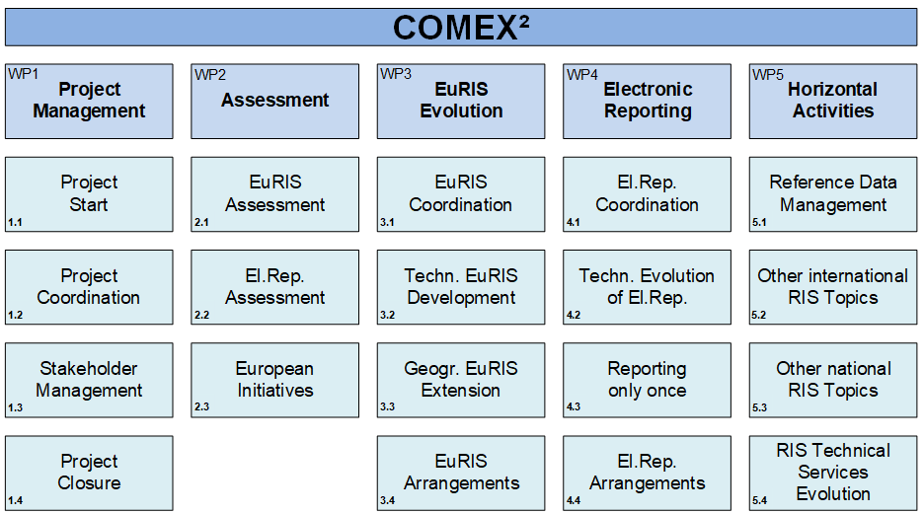
Introduction

Slide 51
Introduction
COMEX²:
Work package 5 – task 4.3 – Development S-401
COMEX² provides the necessary resources for the COMEX² partners (meetings, development, …)
Joint procurement in start up for (ambition = January 2025):
Support manufacturers
Implementation
Creating test charts
Development portrayal elements (scripts, symbols, …)

Slide 52
Introduction
A GitHub repository (https://github.com/iehg) has been created.
The repository is used to share all documents and items which are part of the standard.
Possibility to share issues
Five repositories:
Product Specification
Feature Catalogue
Portrayal Catalogue
DCEG
Conversion Guidance

Slide 53
Product Specification (Gert)
IHO has published edition 1.2.0 of the ENC Product Specification in July 2024 and the next edition is already under review.
The S-401 PS has been compared to the 1.4.1 edition of the S-101 PS in September 2024.
Since edition 1.1.0, the parts describing portrayal were added to the document. Section 9 – Portrayal has been included and is referring to the S-100 Product Specification Part 9A.
Questions:
Copyright: what to do with it?
References to IENC Encoding Guide Ed. 2.2 changing to Ed. 2.6?
References to S-98: valid?
Deleted all contact names and replaced by reference to the ToR on IEHG website.
Document on the GitHub: https://github.com/IEHG/Product-Specification

Slide 54
Action points from last meeting (PS)
All regions to test edition 1.1.0 of S-401 and to submit feedback
The S-401 expert group to try to include overlay cells in the next edition of S-401 and to report to IEHG (would have to be handled by S-98 if separate PS for overlay cells To be discussed whether it is possible and necessary to include them in S-401)
Gert to contact Jeff and to compare the draft with edition 1.2.0 of the S-101 PS

Slide 55
Product Specification – way forward
Draft of S-401 1.2.0 and 2.0.0
Open questions?
Who is able to contribute?
Time line?
Action points:

Slide 56
IHO GI Registry (Gert)
S-99 procedure:
All domain control bodies needs to approve proposals to avoid duplications in the registry
However, some issues were identified:
Inland domain: locationMRN
Location identifier, based on MRN. This can be either a specific identifier for an identified physical location or a type-only identifier for a logical location, such as BERTH.
Hydro domain: interoperability identifier
A common unique identifier for entities which describe a single real-world feature, and which is used to identify instances of the feature in end-user systems where the feature may be included in multiple data product types.
Some notifications are sent for approvals, but they are not listed in the task list.

Slide 57
Feature Catalogue (Gert)
S-401 Feature Catalogue Ed. 1.1.0 finalized based on edition 2.6. XML-version, Word version
FC 1.1.0 will not be used
Edition 1.2.0 is under development
Still to do:
Identification of the feature associations
Encoding of the associations
Open issues on the GitHub:
Issues · IEHG/Feature-Catalogue (github.com)

Slide 58
Action points from last meeting (FC), 1
Gaël to integrate CR426 in the S-401 FC Status: Done in the latest version available on Github, action point closed
COMEX² to finalize the CR for bridges as soon as the S-101 solution is stable. Multiplicity 1,* for category of opening to allow the encoding of bridges that have different opening spans. Attribute category of opening span also for the opening span and Encoding instruction: category only encoded for opening span, if more than one span and more than one categories of those spans
Bernd to inform Mathias Jonas about the importance of a dynamic DCEG builder to keep FC and DCEG in line and to ask whether other products might have the same wish. Status: done, action point closed

Slide 59
Action points from last meeting (FC), 2
Gert and Gaël to identify the necessary associations. Status: see another slide
Gaël to encode them in the draft FC.
Gaël to finalize edition 1.1.0 of the S-401 FC taking also adopted CRs for edition 2.6 into account. This version should then be tested in the viewer of the S-100 test bed and published and registered, together with edition 1.1.0 of the PS. Status: The S-401 FC available on Github is taking them into account. It is based on S-101 Ed1.1.0 (and not yet on 1.2.0 as agreed this summer)
Gaël to submit a CR regarding distanceUnitOfMeasurement. Status: done, action point closed

Slide 60
Action points from last meeting (FC), 3
COMEX² to take that into account for the conversion guidance
Gaël to add PICREP, INFORM, NINFOM to all features in the S-401 FC that have these attributes in Edition 2.5. Status: done, action point closed
Gaël to add all enumerations of 2.5 (and 2.6) to the S-401 FC. Status: done, action point closed
Denise to submit CR to delete the enumerations 7 and 14 and to add the enumeration 15 in edition 2.6.
S-100 representatives to solve the inconsistencies in the registry [10 2e errors in the S 100 registry 2023 10 25.docx]

Slide 61
Open discussions on the forum (yellow buoy line)
During the last IEHG meeting, we decided to develop a new line style to indicate a yellow buoy line in the charts. This buoy line is used to seperate navigable and non-navigable areas in the waterway. The line style has been developed but the question is to which feature this is related? Is a new feature necessary?​
IEHG:

Slide 62
Open discussions on the forum (STATUS)
In the FC Ed2.5 corr1, there is no value mentioned for the attribute STATUS in the following features:
CONVYR (in S-101, status=4,12)
dismar (no status in S-101 for DistanceMark)
FLODOC (in S-101, status=1,4,6,7,8,12 / in Ed2.5, status=5 for flodoc)
PILPNT (in S-101, status=1,4,6,7,8,12,14)
TWRTPT (in S-101, status=1,3,6,9)
Is it interesting to create a CR for Edition 2.6 or is it something that can be solved only in S-401?
Yes, I think it would be interesting to add the allowed values in ed. 2.6 of the FC but also in the EG.
I agree, I think STATUS should be added to those features (both in the FC & CG) for Ed. 2.6. It could be a long time before we're using S-401 officially, so the ability to utilize the attribute in 2.6 is desirable.
IEHG:

Slide 63
Open discussions on the forum (diesel 1)
I have been made aware that we are currently using the terms "diesel oil" and "diesel" in the FC and in the EG and that one or both might not be correct.
The UN Model Regulations for dangerous goods (which are a world wide standard) and the European regulations for the transport of dangerous goods by road (ADR), by rail (RID) and by inland waterway (ADN) are listing three possible names for UN 1202: “GAS OIL or DIESEL FUEL or HEATING OIL, LIGHT".
There is a second entry for UN 1202 in the European standards: “DIESEL FUEL complying with standard EN 590:2013 + A1:2017"
Both entries would mean that we have to use “diesel fuel" instead of “diesel" or “diesel oil".

Slide 64
Open discussions on the forum (diesel 2)
Interestingly the title of the European Standard EN 590 is “Automotive fuels. Diesel. Requirements and test methods".
And the Globally Harmonized System of classification and labelling of chemicals (GHS) is mentioning “Gas oils, diesel and light heating oils".
That brings me to the conclusion that even the official international and worldwide standards are using both "diesel" and "diesel fuel". "Diesel oil" is not mentioned in those standards and could even be misleading because it could be interpreted as a lubrication oil for diesel engines. Should we follow the UN Model Regulations, ADR, RID and ADN or the EN standard and GHS? Personally I would prefer diesel fuel.
If there are no objections against "diesel fuel" I will draft a change request.

Slide 65
Open discussions on the forum (diesel 3)
I have checked in the Registry and 'Fuel Oil' is used in supplyService for 'Fuel Oil Bunkering' (definition: Transfer of fuel oil to the fuel compartments of a ship.). The term 'Lubricants' is also present in supplyService. The associated definition is 'Substances capable of reducing friction, heat, and wear when introduced as a film between solid surfaces)'.
By keeping 'diesel oil', we have the same structure that IHO is using but I have no objection if you want to submit a CR to use 'diesel fuel' to clarify the enumeration. I would maybe suggest to take the opportunity in the CR to replace 'Waste Oil' by 'Waste Lubricants' in 'categoryOfRefuseDump' to make a clear distinction between Fuel/Oil and Lubricants and to be in line with the Hydro Domain.

Slide 66
Open discussions on the forum (diesel 4)
Overview
EG and FC 2.6: diesel and diesel oil
UN Model Regulations: gas oil or diesel fuel or heating oil, light
EN 590: diesel fuel and diesel
GHS: gas oils, diesel and light heating oils
S-100 registry, bunkering: fuel oil (maritime fuel)
IEHG:

Slide 67
Open discussions on the forum (bridges)
In the Netherlands, there is still a lot of discussion about the provision of information regarding the clearance height of bridges.
In the context of RIS-NET and EuRIS, various questions are also asked. Confusion is imminent. The future data model of RIS-NET includes the illustration below in which the terms ABS_HEIGHT and ABS_HEIGHT_OPEN have been introduced.

Slide 68
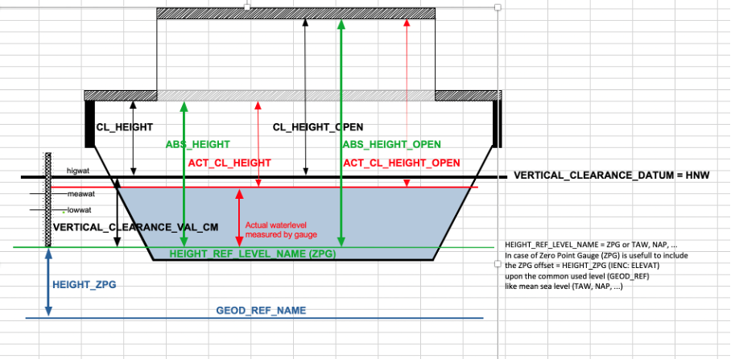
Open discussions on the forum (bridges)

Slide 69
Open discussions on the forum (bridges)
The values of these attributes describe the elevation of the underside of the bridge in relation to reflev, the general reference plane such as NAP, TAW etc.
Because the publications of water level are also published as values relative to revlev (NAP, TAW, etc.) it can be determined more easily, e.g. an up-to-date vertical clearance.
In short, a bridge object according to RIS-NET contains all the ingredients to get a calculated or determined vertical clearance.

Slide 70
Open discussions on the forum (bridges)
The same applies to the bridge in the IENC, but it is a bit more cumbersome to determine the ABS_HEIGHT, for example, while ABS_HEIGHT actually contains the most reliably measured information.
The ABS_HEIGHT is then derivable from the sum of VERCLR + vcrval. vcrval is water level of a fixed reference level (vcrlev = MHWS) expressed in relation to revlev (NAP, TAW etc.)
For the IES 2.5 edition, additional attributes have been added to bridges, namely reflev and elevwl. The elevwl describes the water level in relation to revlev.
Thus, the revlev attribute already exists in the IENC2.5.

Slide 71
Open discussions on the forum (bridges)
In order to clarify the data model of RIS-NET (which will also be a described standard in the long term) and thus also the understanding of this type of information among end users, it seems reasonable to propose to introduce the concepts of ABS_HEIGHT and ABS_HEIGHT_OPEN for the IENC2.6.x as well.
The advantages of adding these two attributes are:
the end user will be able to determine an actual clearance height less complicated,
alignment will be achieved between the data model of RIS-NET, as a future standard, and the IENC standard.
I like to hear your feedback on this concept proposal. Kind Regards René

Slide 72
Open discussions on the forum (bridges)
I understand that it should be clear what is meant by 'vertical clearance' and how this height is measured or calculated. The proposed attributes are indeed added to the RIS.net concept but I'm wondering what the advantage is for the skipper/boatmaster on one hand and the ECDIS-software on the other hand. The skipper only wants to know the available height measured from the water to the bridge. Isn't it going to be a lot more difficult if we add all the other values? BR, Gert

Slide 73
Open discussions on the forum (bridges)
The EG is already containing the following Encoding Instruction: “If the geodetic height of the lower edge of the bridge should be available, e.g., for bridge collision warning systems, and no gauge is available, the encoding of the elevation of the reference water level 'elevwl' and the reference gravitational level 'reflev' allows the calculation of the geodetic height.”
So all the necessary information is already available. It would be possible to add two additional attributes to encode the already available information in a different form, but that would be a duplication of information.
If we replace the existing attributes, all the encoded information in existing IENCs would have to be converted
All Inland ECDIS would have to be able to calculate the geodetic height from the data in old IENCs and to calculate the clearance from the data in the new IENCs.
I am not sure that this would really be an improvement.
Best regards, Bernd
IEHG:

Slide 74
Open discussions: uppercase or lowercase acronyms?
The DCEG is mentioning the six letter acronyms in brackets for existing features and attributes
All S-57 elements are upper case
Inland specific elements have been lower case up to now
Copied S-57 elements with additional inland specific attributes or enumerations have also been lower case up to now
We could easily keep the inland specific elements in small case in the DCEG
What do we do with the copied elements?
Only upper case?
Only lower case?
Both?
IEHG:

Slide 75
Open discussions: tisdge or Service Hours ?
Currently the time schedule of infrastructure (e.g. locks, movable bridges, terminals) is encoded in a standardized external xml-file and the link to this file is encoded in the tisdge feature in the IENC. The tisdge feature allows to describe for which type of vessels the time schedule is applicable and it is even possible to encode several tisdge with references to different xml-files for different types of vessels.
Originally the idea was that an external xml file can not only be edited by the chart producer, but could also be edited by the operator of the infrastructure, because he would only need an xml-editor. As far as I am aware this possibility has never been used and the xml files are always provided and edited by the chart producers themselves.

Slide 76
Open discussions: tisdge or Service Hours ? (2)
S-101 is now introducing new features: Service Hours and Non-Standard Working Days.
The new feature Service Hours allows to encode a start and end time for each day of the week or for a range of days and to define whether these times are normal operation, closure or unmanned operation. The feature does not allow to specify a vessel type for which the schedule is applicable, but we could add such an attribute.
The new feature Non-Standard Working Days allows to encode the date(s) when an event, festival or national holiday occurs each year. Information on special service hours on these days can only be encoded in the information attribute or a referenced external file. It is however possible to encode a Service Hours feature for each of these days.

Slide 77
Open discussions: tisdge or Service Hours ? (3)
We have to decide what we want to use in S-401:
only tisdge and the external xml
only the new Service Hours and Non-Standard Working Days
both options
I don’t think that using both options I one region would be a good solution. The data about time schedules is used by voyage calculation programs and a region should decide to use one of the options in the future.
Using the new S-101 features would ensure that maritime vessels can also use the information.
Sticking to the existing tisdge feature would minimize the necessity of conversions.
IEHG:

Slide 78
Open discussions: external XML or Communication Information ?
S-101 has introduced the complex attribute communication information with the sub attributes:
Call sign
Communication channel
Email address
Fax number
Telephone number
Web address
Currently we are providing detailed contact details in a standardized external XML-file that is referenced in the attribute TXTDSC. The external XML is offering the possibility to provide additionally information e.g. about the company, the the name of the conatct or the postal address.

Slide 79
Open discussions: external XML or Communication Information ? (2)
This leads to different options:
use only the new communication information
use only the existing external XML
allow both and develop a new encoding instruction explaining when to use which option
amend the new communication information with all the additional elements of the XML.
Which option should we use?
IEHG:

Slide 80
Associations
The FC is defining the possible associations between different features
For S-101 features we have to
Delete associations with S-101 features that are not used by S-101
Check, if we need to add associations to inland specific features
For inland specific features we have to define the possible associations
Working document
IEHG:

Slide 81
Feature Catalogue, way forward
To be able to start testing we need an adopted and published version of the S-401 FC
Who is able to contribute?
Timeline?
Action points:

Slide 82
Portrayal Catalogue (Gert)
Symbols were converted according the S100 SVG Tiny profile.
New Brazilian symbols under development
Received an approval of HSSC for the bulk registration = in progress
LUA scripts are under development
Copy/pasted S-101 scripts
Edited S-101 scripts for S-401
Developed inland specific scripts
How to test the individual scripts?

Slide 83
Portrayal Catalogue (Gert)
Still to do:
Conversion of the CS
Solution for features on the same position
Open issues on the GitHub:
Issues · IEHG/Portrayal-Catalogue (github.com)

Slide 84
Action points from last meeting, PC (1)
COMEX² with the support of Mikan to
continue as proposed in the presentation when a stable PCB is available, contribution of all members via the discussion forum
develop test data based on the input from Laszlo and René
amend the Conditional Symbologies on the basis of available CS (OpenCPN) or CS of other manufacturers
consider real world pictures as a solution for the display of multiple notice marks at the same spot
create a tree structure for the PC
create the XML for the PC.

Slide 85
Action points from last meeting, PC (2)
Bernd to describe the rules for the selection of the correct notice mark symbol and to send them to Mikan. Status: done, AP closed
All members that submit proposals with new symbols to provide the symbols in SVG format themselves or to provide them in a different format to Claudia Heckert for conversion to SVG. They have to take the new guideline and the form for symbols into account.
Gert to check the consequences of the decision of IHO when it is available. Status: Done. The new SVG Profile was adopted by IHO and all the inland specific symbols were re-designed according to this profile scheme. The bulk upload is initiated by me and I’m waiting on the feedback of Yong Baek.

Slide 86
Action points from last meeting, PC (3)
Vitor to provide the svg symbols and raster symbols of the Brazilian notice marks and the additional lines for the Lookup Tables. Status: done, action point closed The symbols still need to be converted according to the new SVG profile. WSV was going to do this.
Bernd to publish the amended Presentation Library on the website.

Slide 87
S-401 Portrayal Catalogue
The meeting could discuss how to deal with future updates of the S-101 Portrayal Catalogue. Currently it is hard to detect what is changed in the PC. Is it necessary to take all amendments of the S-101 Portrayal Catalogue into account for S-401 in the future?
IEHG has decided to use the European Presentation Library as a starting point for the Portrayal Catalogue of S-401. On the other hand, IEHG decided to stay as close as possible to S-101. According to S-101 topmarks are just displayed by their shape. According to the European Inland ECDIS Presentation Library they are displayed by shape and colour. From the point of view of the European side it is easier for the boatmaster to match a topmark in the IENC with a real topmark, if they have not only the same shape but also the same colour. IEHG could decide whether topmarks on aids to navigation on inland waterways shall be displayed with or without their colour.

Slide 88
Portrayal Catalogue, way forward
Who is able to contribute?
Who will develop LUA scripts?
Who will provide a testing possibility?
Who will produce the PC?
Timeline?
Action points:

Slide 89
DCEG (Gert)
First draft has been developed based on the S-101 DCEG word document
All differences are marked
Questions are in the comments
S-101 DCEG redline document available!
Document on the GitHub:
https://github.com/IEHG/DCEG

Slide 90
Action points from last meeting DCEG (1)
Comex² and all members of IEHG to continue the development of a DCEG for S-401 taking into account the decisions of IEHG.
Gaël to include Helipad, Dolphin, Bollard and Mooring Area in the S-401 FC when they are finalized for S-101. Status: done, but without the feature associations
All to check whether additional categories are necessary.
COMEX² to take them into account for the conversion guidance.

Slide 91
Action points from last meeting DCEG (2)
Bernd to compare the general section of the DCEG 2.0.0 when it is available with the draft of the S-401 DCEG and to make the necessary changes;
Denise, Gaël and Bernd to start with the development of the inland specific feature related pages of the DCEG on the basis of the S-101 DCEG 1.2.0 and the amendment of the maritime feature related pages when edition 2.0.0 of the S-101 DCEG is available.
Status: draft DCEG available, still a lot of open questions and will have to be updated to align with 2.0.0 of S-101

Slide 92
Use of the DCEG builder
IHO is using the DCEG builder only once and the builder can not be used for updates. Updates are first developed, discussed and implemented in the DCEG and then in the FC
IEHG has decided earlier to use the S-101 DCEG as a base
There were 2 options:
Use the S-401 DCEG produced with the DCEG builder and copy all the text from S-101
Use the S-101 DCEG and add the inland specific elements
The first option would not have shown what is coming from S-101 and what from the EG for IENCs

Slide 93
Use of the DCEG builder (2)
The draft of the S-401 DCEG is therefore based on the S-101 DCEG
The features, attributes and enumerations have been compared with the S-401 FC via the DCEG produced with the DCEG builder
Amendments are marked as track changes
The “inland specific encoding instructions” that have been copied from the EG 2.6 are not marked with track changes, but necessary amendments of those instructions are marked

Slide 94
Recommended attributes
The Object Encoding in the EG 2.6 is not listing all the attributes and enumerations of a feature that are contained in the FC, but only those that are recommended to be used
The DCEG is always listing all attributes and enumerations that are in the FC
Attributes that are currently not recommended are shown in italics in the draft DCEG
Is it necessary to do the same for the enumerations?
IEHG:

Slide 95
Open discussions: new features,
(M), (C) or (O) and SCAMIN
IEHG has already decided earlier to include several features of S-101 in S-401 that have not been part of the IENC FC until now
The EG is currently stating for each feature whether it is part of the minimum content of an IENC (M), part of the minimum content under certain conditions (C), or optional (O)
This information has to be added to the new features.
The EG is also defining the minimum scale for each feature and this has to be done for the new features, too:
Dock Area (DOCARE): (O)? 22000 like dock/wharf?
Mooring Trot (C_AGGR) (C)? (if in navigable water) EUR: 22000; US: 30000?
Tidal Stream Panel Data (TS_PAD) (O)? 22000 like tide stream?
Fairway System (C_AGGR) (O)? 90000 like fairwy?

Slide 96
Open discussions: new features,
(M), (C) or (O) and SCAMIN (2)
Recommended Route Centreline (RCRTCL) (O)? EUR 22000, US 30000 like navigation line?
Two-Way Route (O)? EUR 12000 US 18750 like TWRTPT?
Inshore Traffic Zone (ISTZNE) (C)? (EUR), 260000 like TSEZNE?
Precautionary Area (PRCARE) (C)? (if notmrk?, if EUR?), 260000 like TSEZNE, or EUR 22000, US 60000 like CTNARE?
Traffic Separation Scheme (C)? (EUR), 260000 like TSEZNE?
Radar Range (RADRNG) (O)? EUR 22000 US 60000 like RADSTA?
Seaplane Landing Area (SPLARE) (O)? 45000 like RUNWAY?
Information Area (M_NPUB) (O)? EUR 45000 US 60000 like comare?
Custom Zone (CUSZNE) (O)? EUR 12000 US 22000 like chkpnt? or EUR 45000 US 60000 like comare (customs)?
Fishery Zone (FSHZNE) (O)? 22000 like FSHFAC?
Straight Territorial Sea Baseline (STSLNE) (O)? 90000 like ADMARE?

Slide 97
Open discussions: new features,
(M), (C) or (O) and SCAMIN (3)
Pilotage District (O)? 24000 like PILBOP?
Marine Pollution Regulations Area (O)? 90000 like ADMARE?
Installation Buoy (BOYINB) (M)? EUR 22000 US 45000 like BOYSPP or 60000 like other buoys?
Mooring Buoy (MORFAC) (C) (in navigable water)? like MORFAC? EUR: 22000; US: 30000; for individual bollards: 4000
Radar Reflector (RADRFL) (C) condition to be defined, EUR 22000, US 45000 or 60000?
Physical AIS Aid to Navigation (C) (if not encoded as attribute)? US 60000 like virtual?
Radio Station (RDOSTA) (O)? EUR 22000, US 60000 like RADSTA?
Vessel Traffic Service Area (ADMARE) (O)? 90000 like ADMARE?

Slide 98
Open questions: time
Time may be expressed as Universal Time Coordinated (UTC). Example: 183059Z
Time may be expressed as a Local Time with a given offset to UTC. Example: 183059+0100
Time may be expressed as a Local Time without a specified offset to UTC. Example: 183059
S-101 states that the first option is preferred
Europe would prefer the second option (which ia also used for other information services)
Can we agree on a common preference or do we spcify preferences by region?

Slide 99
S-401 DCEG draft and way forward
Discussion of the draft
Who is able to contribute (general part, Encoding Instructions, creation of complete DCEG)?
Relation to DCEG builder and the possibility for updates?
Timeline?

Slide 100
Development of S-401 test cells
Action point from last meeting:
Denise to ask Caris and Esri whether they can develop test cells. The cells provided by Laszlo and René can be taken into account, but cells with features in a geometric pattern (on the correct background of DEPARE or LNDARE) would make checks easier. [1R7EMS03.000] [1R57GBG5.000] Status: The development of test cells is amended to the task list of the JJPA within COMEX². The tender is not yet finalized (Germany has the lead).

Slide 101
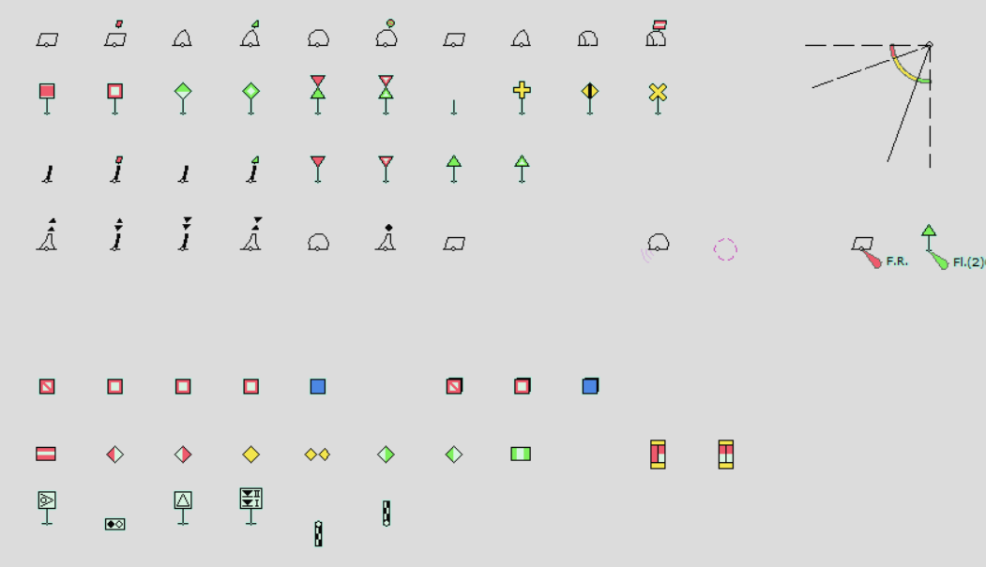
Development of S-401 test cells
S-401 can only be integrated in the interoperability standard S-98, if IEHG provides test cells that can be used to verify the interoperability
Without that S-401 could work in inland areas, but it would not be possible to display S-101 ENCs and S-401 IENCs together in the coastal regions
How can we produce S-401 test cells without a S-401 production software?
“realistic” chart or e.g. all types of notice marks and buoys in a raster?

Slide 102
Development of S-401 test cells
Who is able to contribute?
Timeline?
Action points:

Slide 103
Alert catalogue
The last meeting came to the following conclusions:
Europe: Inland ECDIS standard defines all kind of alarms, there’s no need to focus on an ‘alarm catalogue’.
US and Brazil: no immediate need.
The meeting could discuss whether they are still valid.

Slide 104
S-57 to S-101 converter development
Action points from last meeting (1):
Gert and Gaël to start working on the inland specific features.
Tom and Gert to start working on the copied and amended features (check all existing maritime rules)
Ask Jeff for first draft of S-101 to S-57 conversion guidance.
The S-100 representatives to ask IHO whether a quattro fuel (Inland S-57 / S-401 / Maritime S-57 / S-101) would be taken into account.

Slide 105
S-57 to S-101 converter development
Action points from last meeting (2):
Denise to check the possibilities of APAN.
Gert to check the possibilities of Github, which is especially targeting developers. Status: Done, GitHub is created and available for all. (see presentation status S-401). Action point closed

Slide 106
Conversion guidance
Stable version of the FC and DCEG are needed
Is a conversion guidance S-401 to S-57 necessary?

Slide 107
Update intervals and processes
The meeting could discuss the timeline for S-401
Is it realistic to adopt S-401 in autumn 2026?

Slide 108
S-401 transitional period
It will not be possible to switch from S-57 to S-401 on a specific date (replacement of all existing IENCs and all existing ECS/Inland ECDIS, at least within a region)
We will therefore need a transitional period, in which either
the chart producers will provide S-57 based IENCs and S-401 IENCs or
the manufacturers of ECS/Inland ECDIS will provide dual fuel applications that can read S-57 based IENCs and S-401 IENCs
Which way do we want to go, respectively which way do the different regions want to go?

Slide 109
S-201 and S-125
IALA is working on Product Specifications for Aids to Navigation (AtoN) Information (S-201) and for Navigation Services (S-125). The meeting could be informed about the status of development

Slide 110
The Bathymetric Contour Overlay (S-402)
S-402 has been reserved by IHO for the Bathymetric Contour Overlay for Inland ENC Product Specification as requested by IEHG. The existing Product Specification for bathymetric Inland ENCs and S-401 should be the basis for the development of S-402. IEHG has decided to start with the development of S-402 when the corresponding parts of S-401 have been adopted.

Slide 111
Intention sharing
S-402 has been reserved by IHO for the Bathymetric Contour Overlay for Inland ENC Product Specification as requested by IEHG. The existing Product Specification for bathymetric Inland ENCs and S-401 should be the basis for the development of S-402. IEHG has decided to start with the development of S-402 when the corresponding parts of S-401 have been adopted.
In Europe there are considerations to develop a standard for intention sharing. While the S-421 Product Specification for Route Plans is only dealing with routes that are defined by a few waypoints and is just intended for information exchange between vessel and shore, the idea of intention sharing on inland waterways is to provide a planned track to other vessels in order to improve the planning of passings.

Slide 112
Annual report to HSSC
Action point from last meeting:
Denise LaDue and Bernd Birklhuber to update the report to HSSC in time for the HSSC meeting in Japan. Status: Done, see draft [13 IEHG Report to HSSC 16.pptx], action point closed

Slide 113
Cooperation with IHO
Experience has shown that it is almost impossible to keep track of amendments of S-101 (and other S-100 based Products) that are relevant for IEHG
We do not have the human resources to participate in all IHO WG meetings
We have tried to organize regular online meetings with IHO WG representatives, but they did not solve the problem
In the case of interoperability we received contradicting information from different representatives and it was complicated to find out which one is correct
Ideas for improvements?

Slide 114
Information document on Inland ENCs
IEHG has developed a document that provides information on Inland ENCs and the relation and the differences to maritime ENCs
The document (available on the ienc.openecis.org website) can be used by every member of IEHG for presentations, discussions, explanations
All members of IEHG are invited to submit proposals for amendments of the information document on Inland ENCs
Information (EN)
Información (SP)
Información (PT)
Information (DE)
Informacion (FR)
Informacion (NL)

Slide 115
Information document on Inland ENCs
Action points from last meeting (1):
All members of IEHG are invited to submit proposals for amendments of the information document on Inland ENCs (Inland ENC.ppt on the IEHG website).
The Core Group to update regulatory status, coverage and contact persons.
Bernd to add a link to the S-100 registry and the S-401 PS.

Slide 116
Information document on Inland ENCs
Action points from last meeting (2):
Vitor to update the Spanish version and to produce a Portuguese version. Status: done, action point closed
Gaël to produce a French version. Status: done, action point closed, text could be reviewed by another French speaker
Claudia to produce a German version. Status: done, action point closed
All to take not only the slides themselves but also the notes in the ppt into account.

Slide 117
Operation of Web Services (1)
Future operation of the ienc.openecdis.org website
now hosted by the European Committee for drawing up standards in the field of inland navigation (CESNI)
Proposals for improvements?
https://ienc.openecdis.org

Slide 118
Operation of Web Services (2)
Discussion forum
Due to internal regulations of USACE the discussion forum had to be moved to a new platform
Please register yourself (information available at the ienc.openecdis.org website) to be able to participate in discussions
Notifications are operational
Action point from last meeting: Denise LaDue to investigate whether it would be possible to display the status of the CRs in the overview (pending, adopted, rejected)
APAN - Sign In

Slide 119
Operation of Web Services (3)
IENC domain in the registry of IHO
http://registry.iho.int

Slide 120
Next Meeting
Do we need an IEHG meeting next year?
Do we need a physical meeting or is an online meeting sufficient?
where and when ? Last meetings: 2015 China, 2017 Brazil, 2019 US, 2021 Europe, 2022 online, 2023 US, 2024 China
Changes to the agenda of next meeting?

Slide 121
Any other business
How to encourage other countries to join IEHG? South America / Asia
Any other business?
Departures

Slide 122
Any other business, Next Meeting
Distribution of work
Report

Slide 123
Thank you, Li, for the hosting of the meeting and the hospitality! Thank you all for participating!

