Slide 1
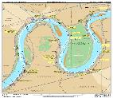
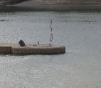
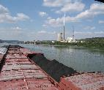
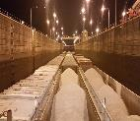
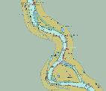


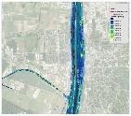
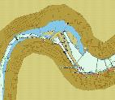
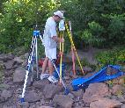
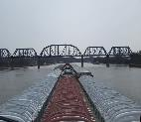

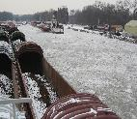

Status of inland encS in the us
Inland ENC Harmonization Group
Denise LaDue
IENC Program Manager
U.S. Army Geospatial Center
15 October 2024

Slide 2
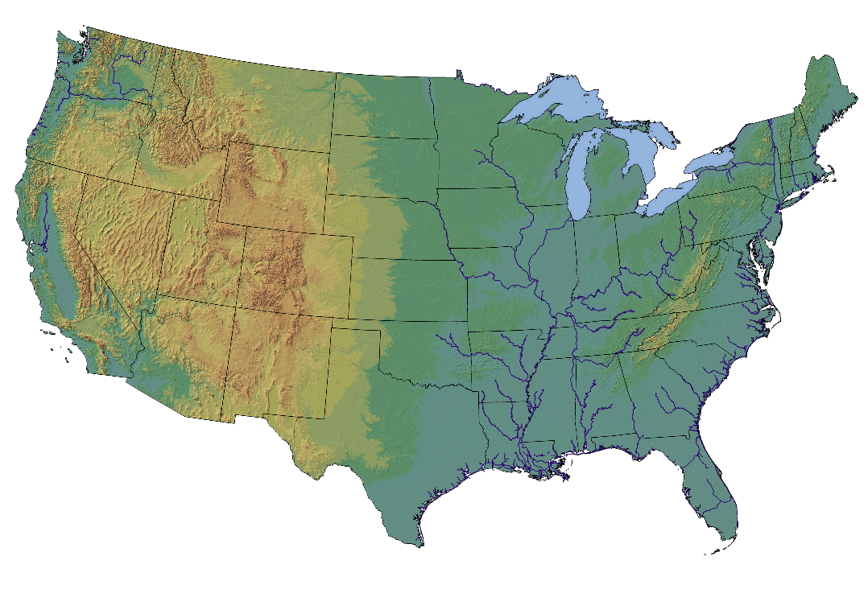

Usace navigation mission
Great Lakes Surveying & Dredging
USACE IENC
Inland Waterways
Coastal Surveying & Dredging
Intracoastal Waterway Surveying & Dredging

Slide 3
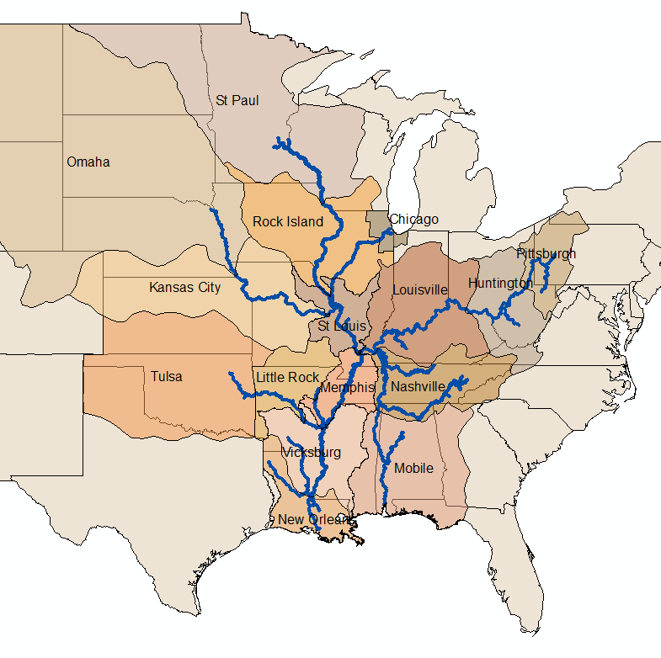
Ienc coverage in the us
Western Rivers System
109 IENC cells covering approximately 12,000 km
22 Rivers
16 USACE Districts
Charts are produced to the IENC 2.4 Standard
All charts are reviewed monthly and updated, as necessary

Slide 4
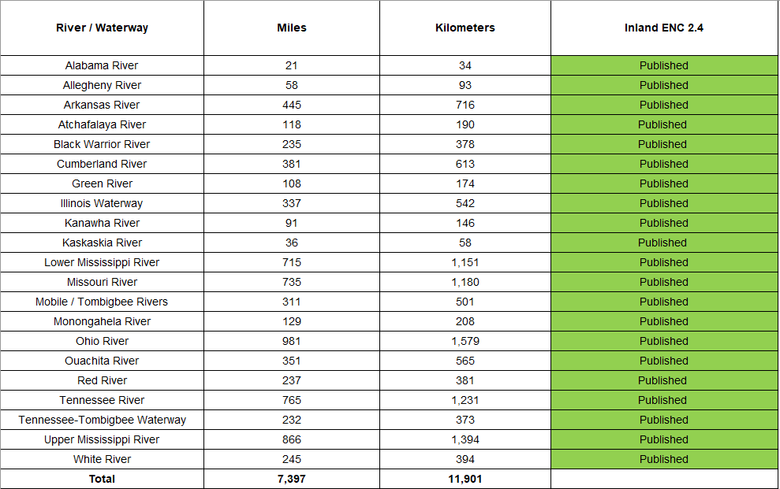
Implementation of IENC in the us

Slide 5

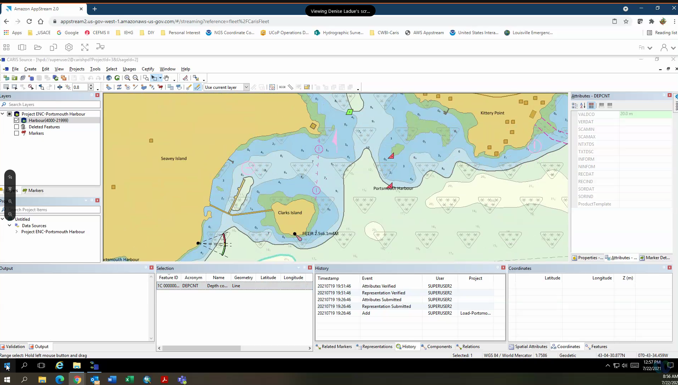
Chart maintenance on the cloud
AppStream
- Amazon Web Services
Caris HPD
All charts (both contracted and in-house) are now hosted in the same database.

Slide 6
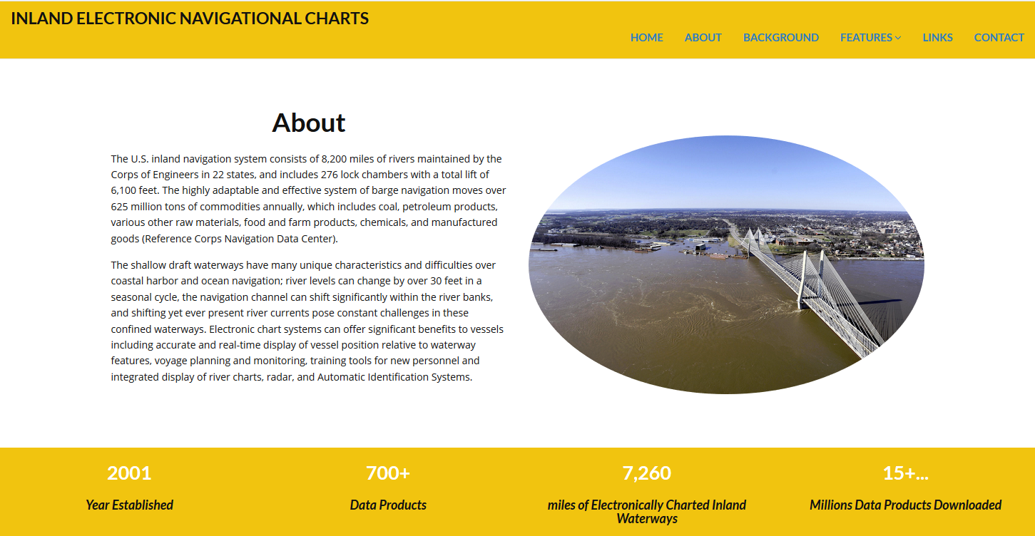
IENC Data Download Services
http://ienccloud.us/
Products
IENC Cells
IENC Overlays
Buoys (updated daily)
Hydro surveys
Data Formats:
IENC 2.4
Shapefile
KML
GeoPDF
Dynamic Web Services
XML Catalogues
*NVIC – Navigation and Vessel Inspection Circular

Slide 7
Inland Waterway Carriage Requirement
Presently there is no mandatory carriage requirement for electronic charts or systems on US inland waterways, however based on the NAVIGATION AND VESSEL INSPECTION CIRCULAR NO. 01-16 (CH-2), published in 2016 and revised in 2020:
US In 2016, the Navigation Safety Advisory Council (NAVSAC) recommended that Coast Guard update its policy on carriage of the Inland Navigation Rules. In 2017, the public requested the same. Recognizing the usability and advantages in cost and space of electronic publications over paper, the Coast Guard is expanding the list of publications allowed to be carried in their equivalent electronic format in lieu of paper to include the Inland Navigation Rules and Vessel Traffic Service Rules.
The Coast Guard is now allowing current electronic editions of the Inland Navigation Rules and Vessel Traffic Service Rules to meet the equivalent carriage requirement to that of current paper copies, provided their respective files are downloaded so as not to require internet connectivity to access them when needed.

Slide 8
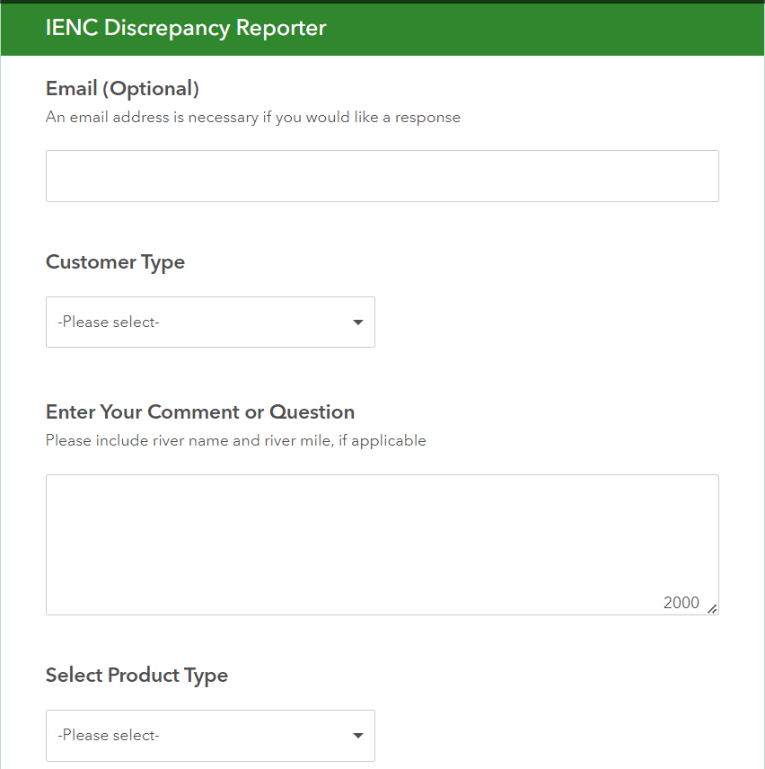
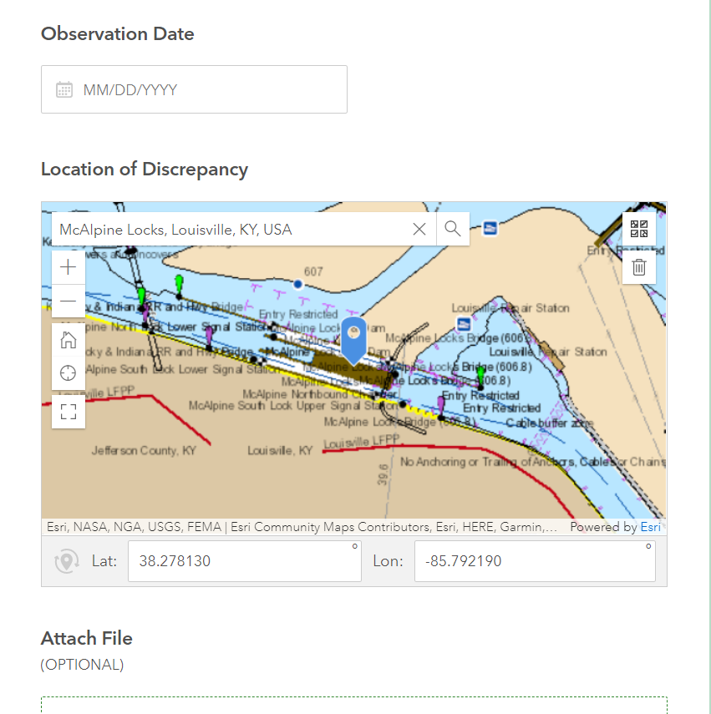

Ienc discrepancy reporter

Slide 9
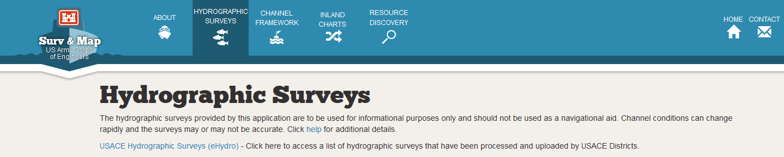
Implementation of IENC in the us
eHydro
An enterprise Hydrographic Survey Processing within a GIS Framework
Mission: To catalog, organize, and disseminate navigation related data efficiently and effectively
Feature Management:
National Channel Framework (coastal)
Hydrographic Surveys (XYZ, Bathymetry raster)
Reports (Channel Condition & Channel Availability)
Provides unrestricted access to all USACE hydrographic survey data
https://navigation.usace.army.mil

Slide 10
Questions?

