Slide 1
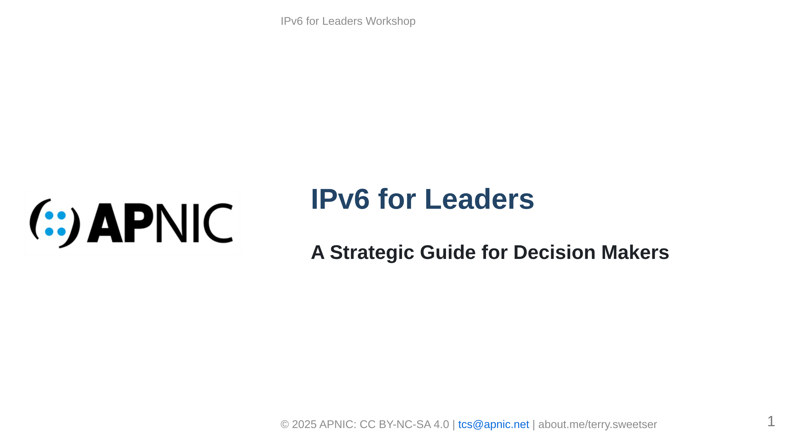
Notes:
MARP Slide Deck for IPv6 for Leaders Workshop Each slide is designed with appropriate content density Image placeholders are included where visuals would enhance the content

Slide 2
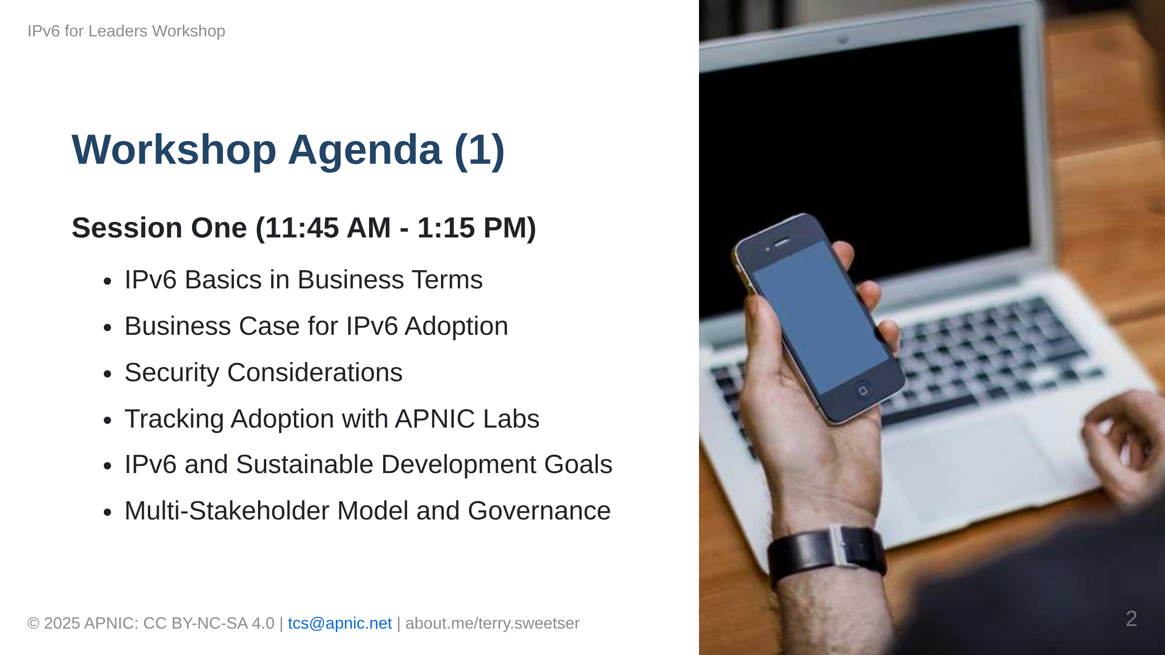

Slide 3


Slide 4


Slide 5
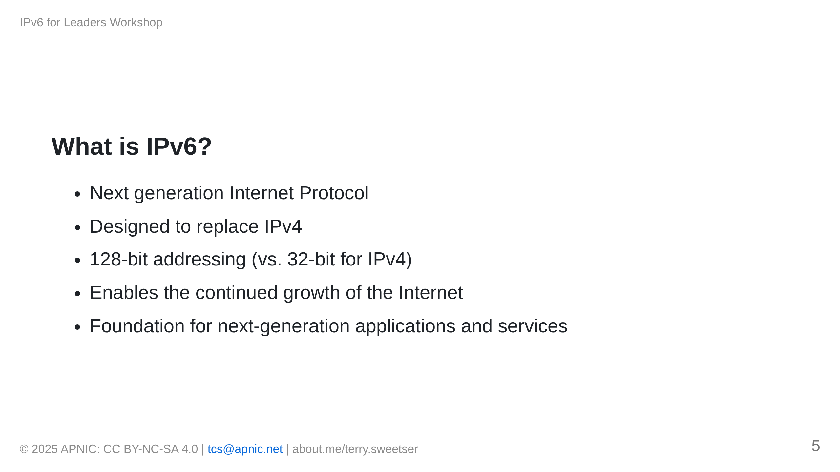

Slide 6
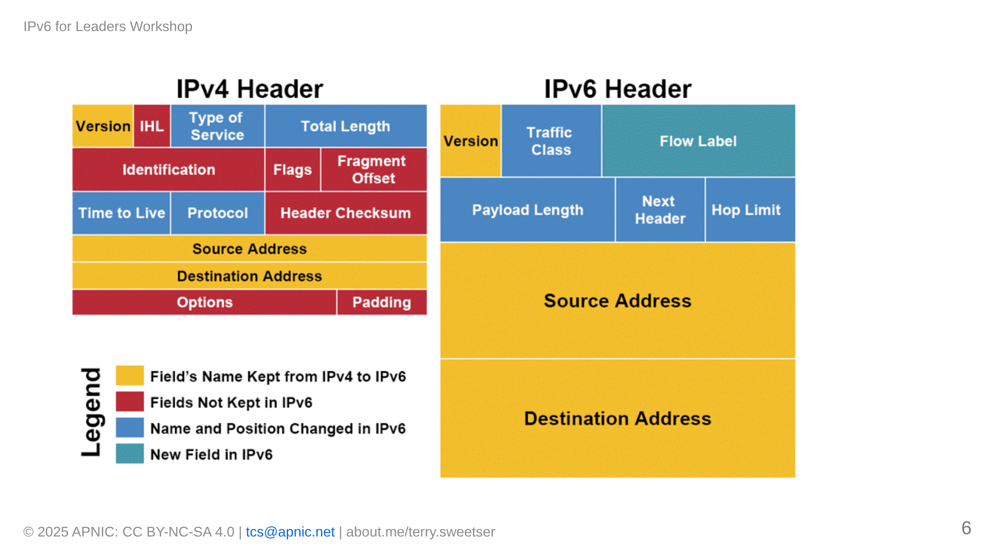

Slide 7
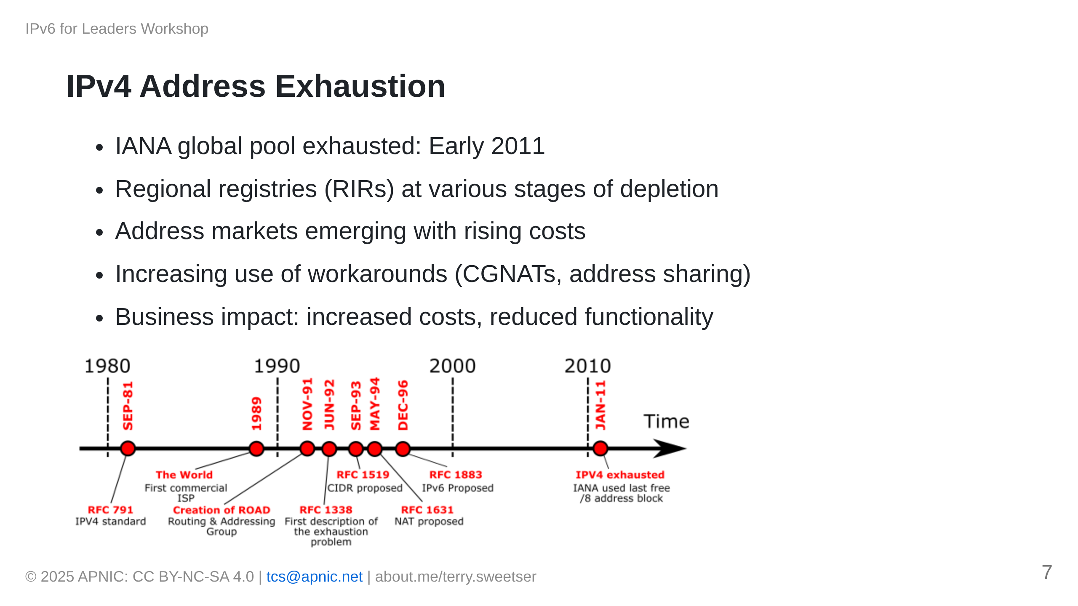

Slide 8
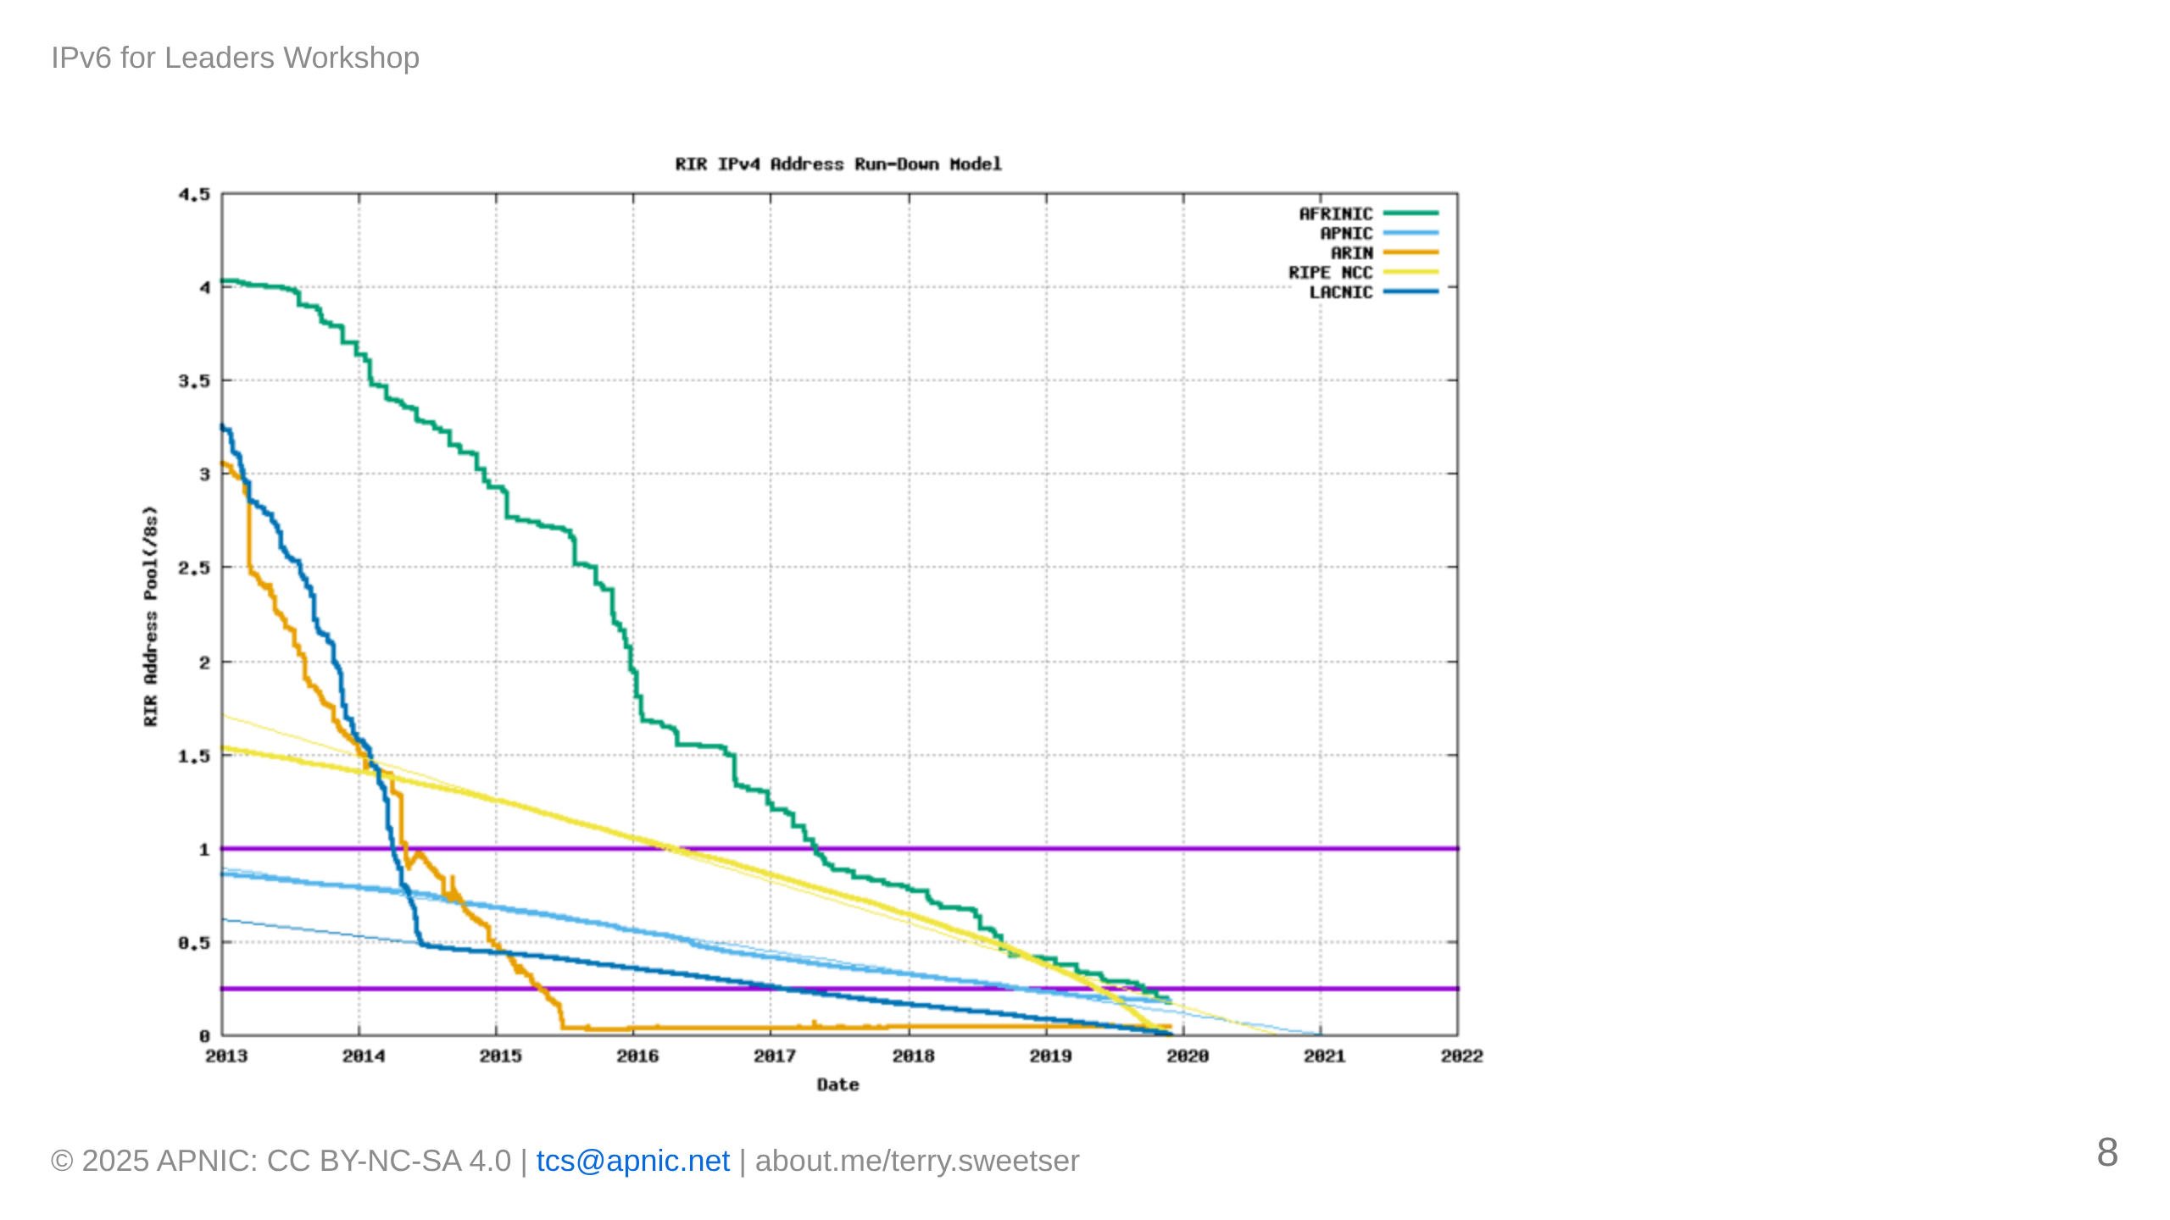

Slide 9
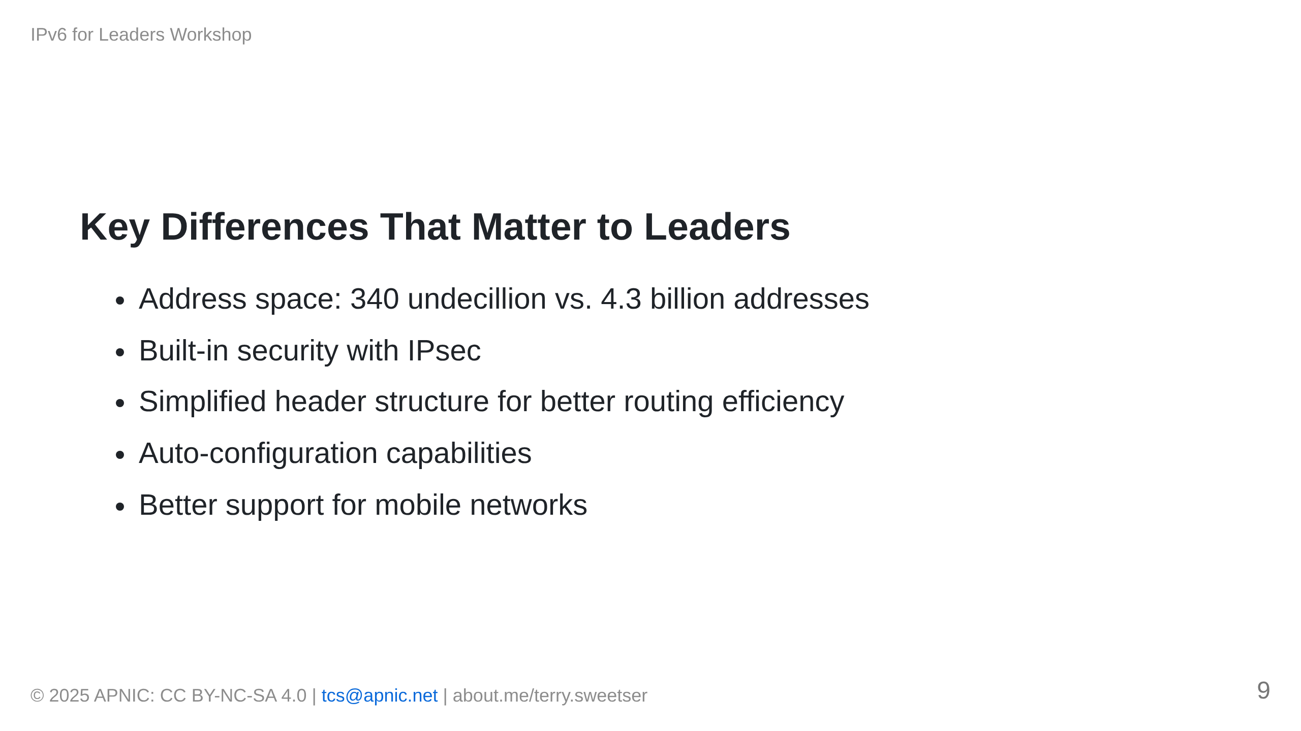

Slide 10
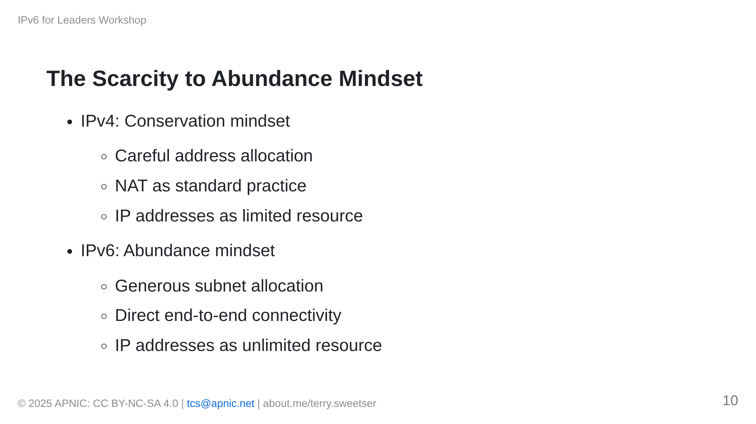
Notes:
[IMAGE PLACEHOLDER: Visual comparing scarcity vs. abundance approaches to network design]

Slide 11
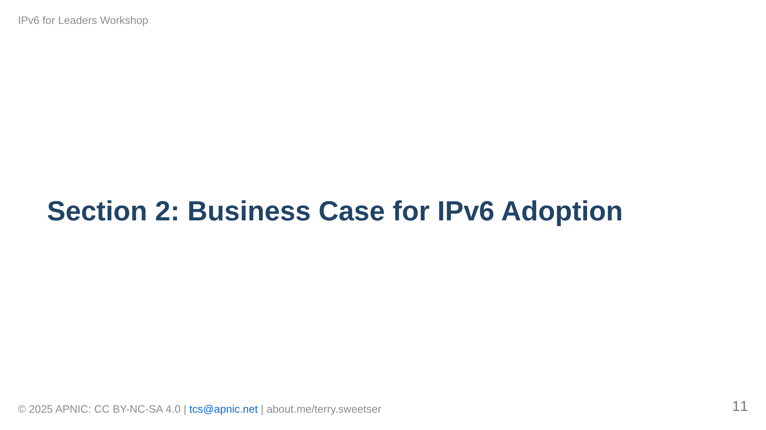

Slide 12
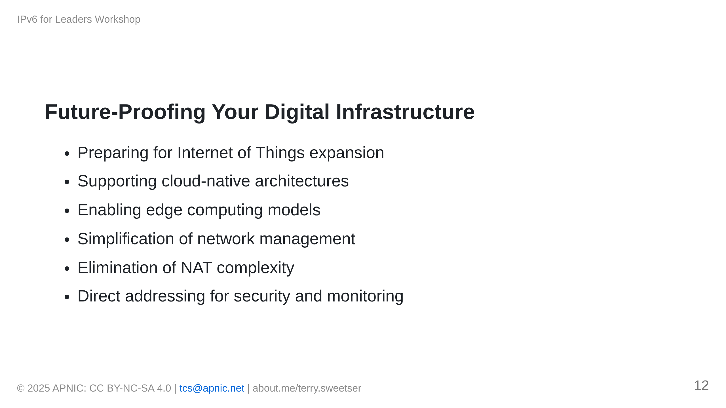
Notes:
[IMAGE PLACEHOLDER: Diagram showing digital transformation elements enabled by IPv6]

Slide 13
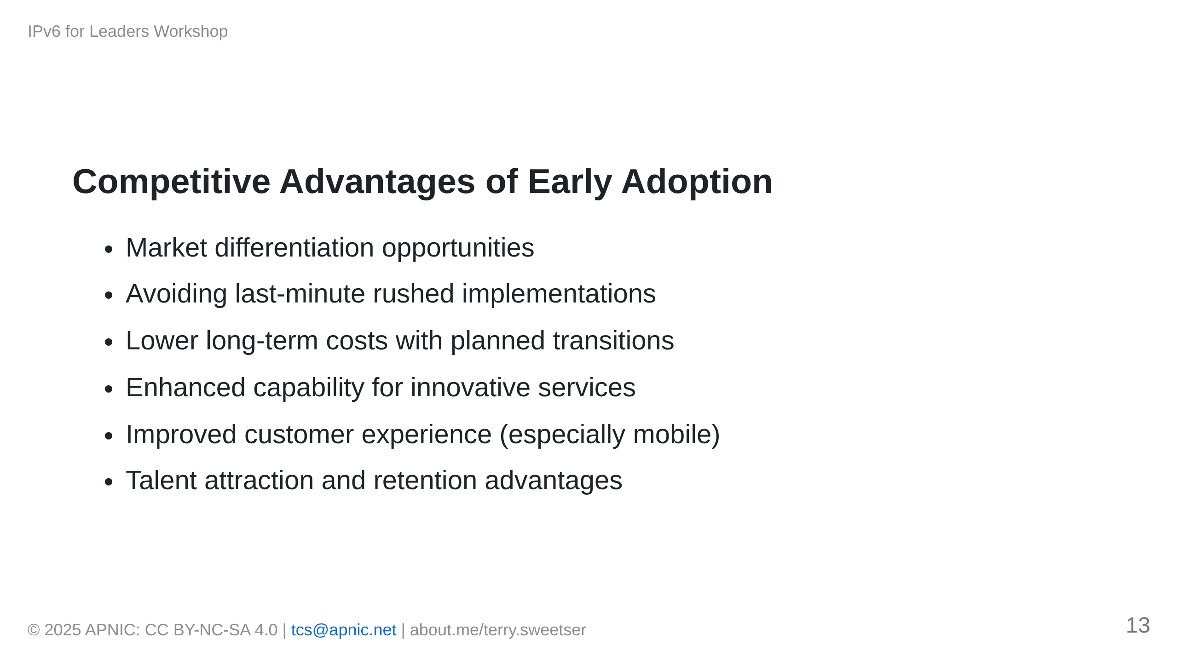

Slide 14
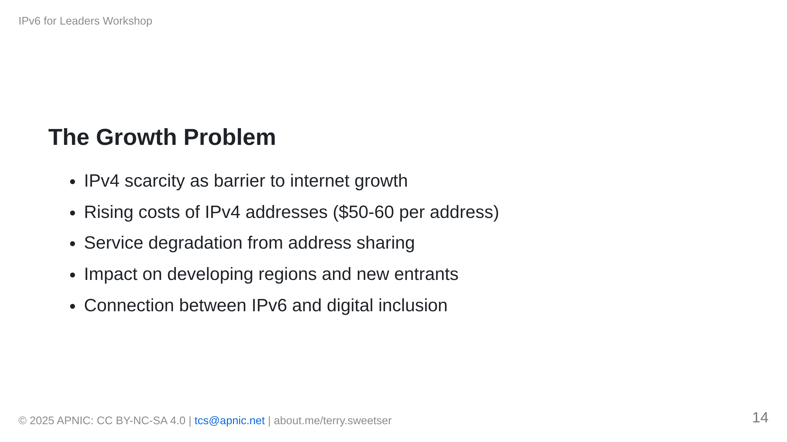

Slide 15
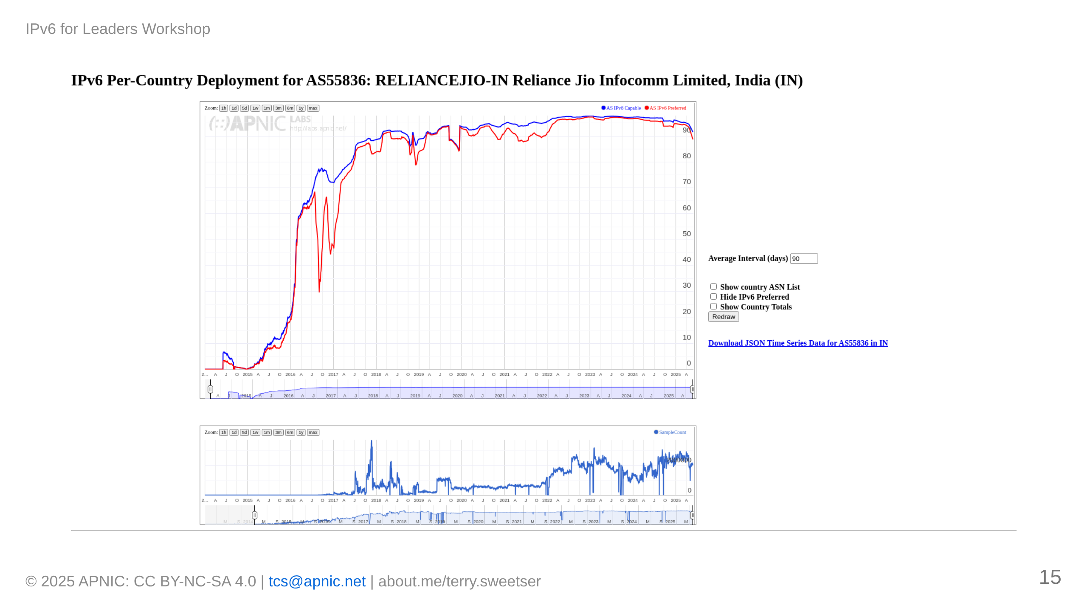

Slide 16
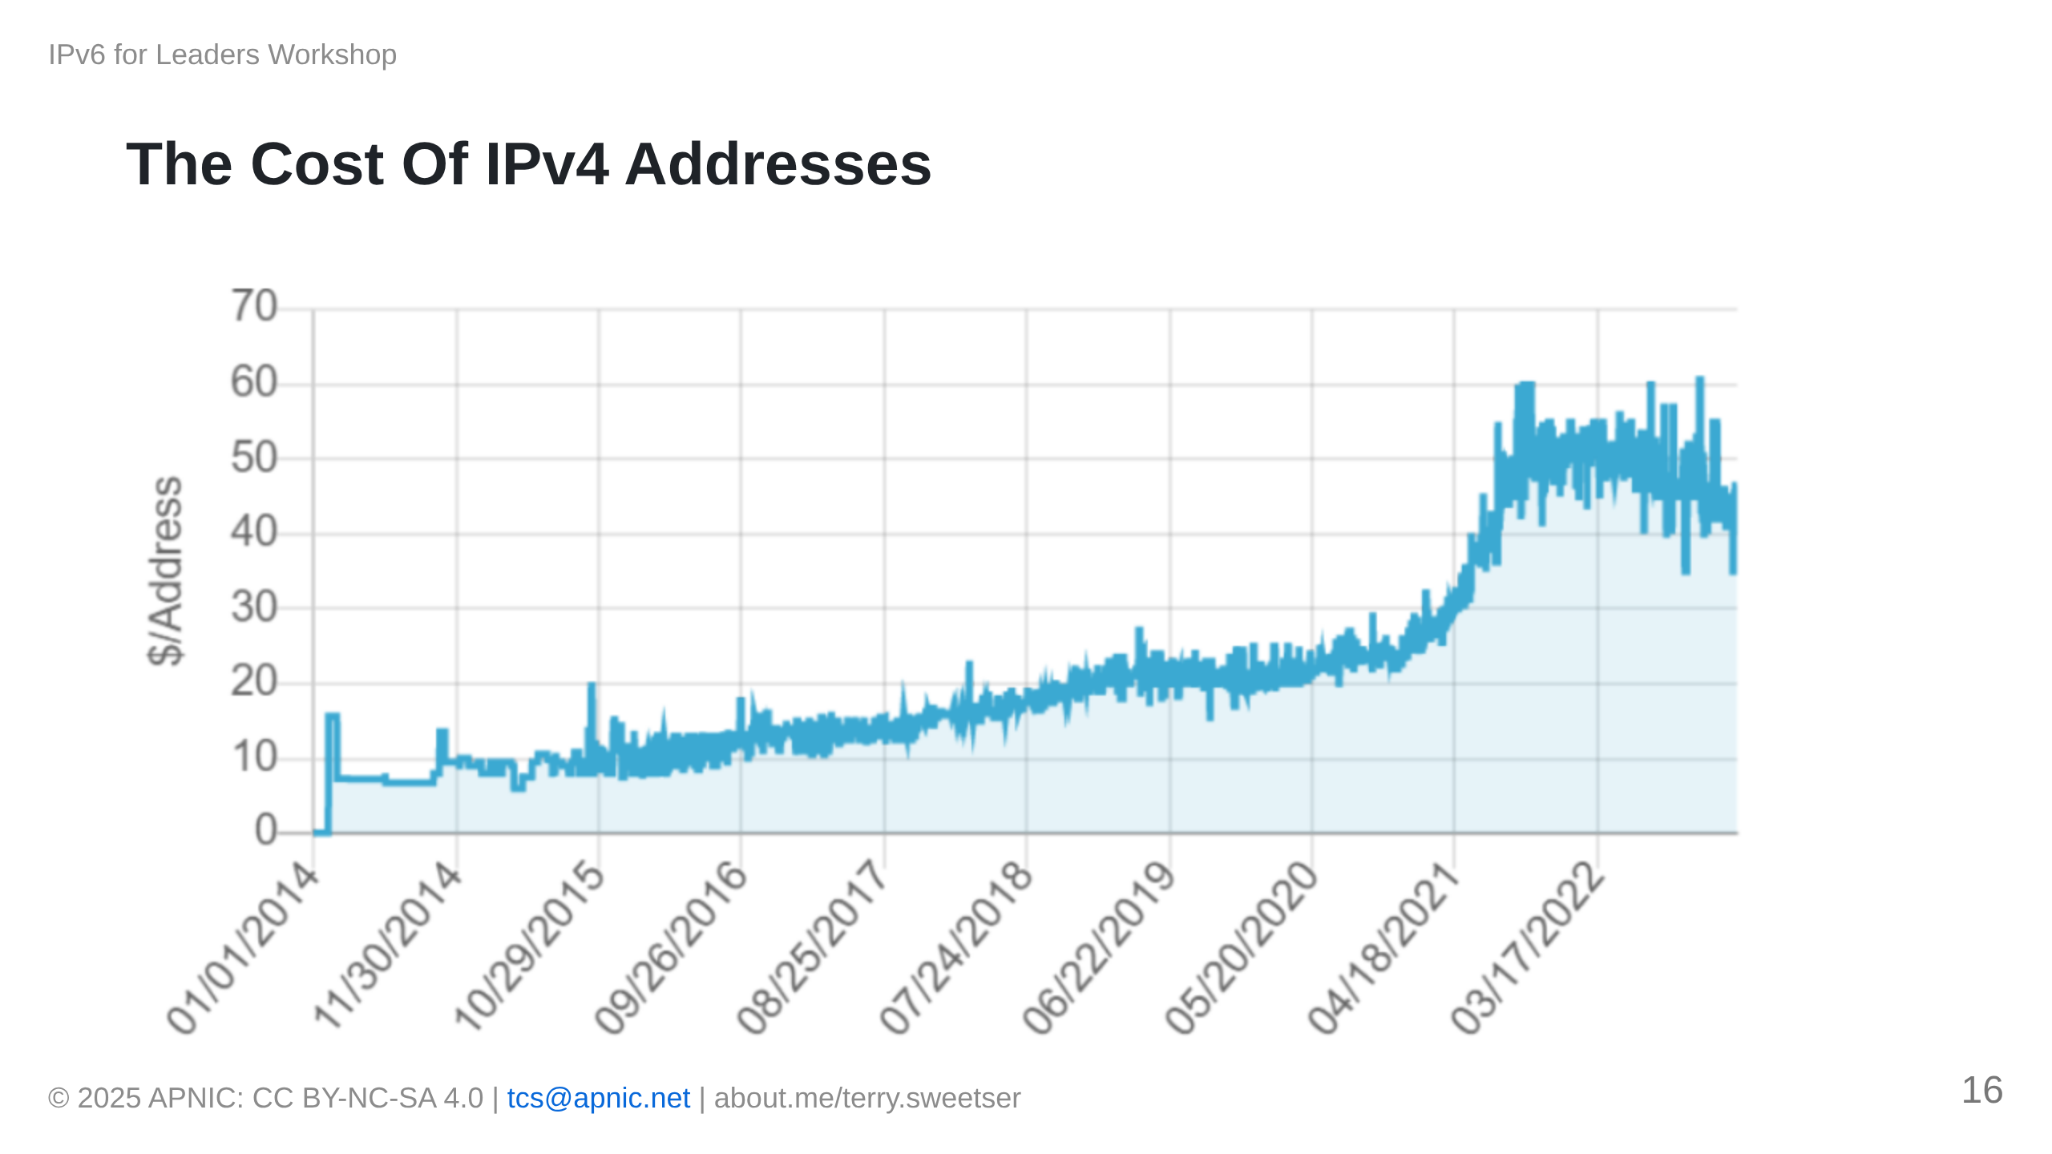

Slide 17
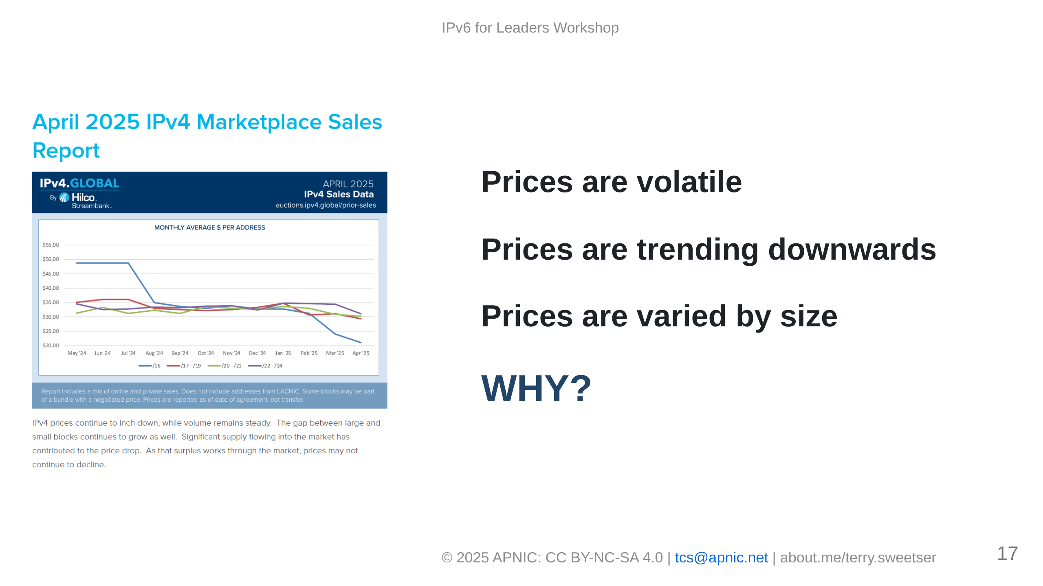

Slide 18
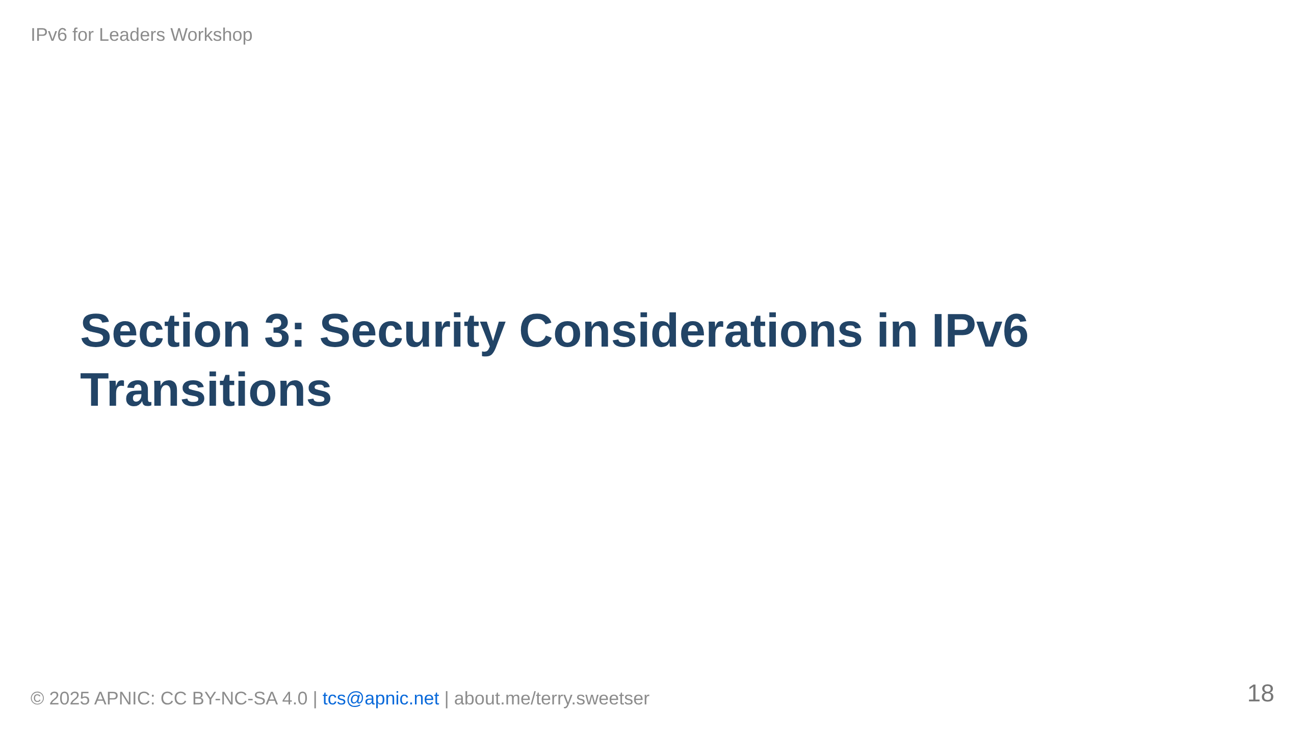

Slide 19
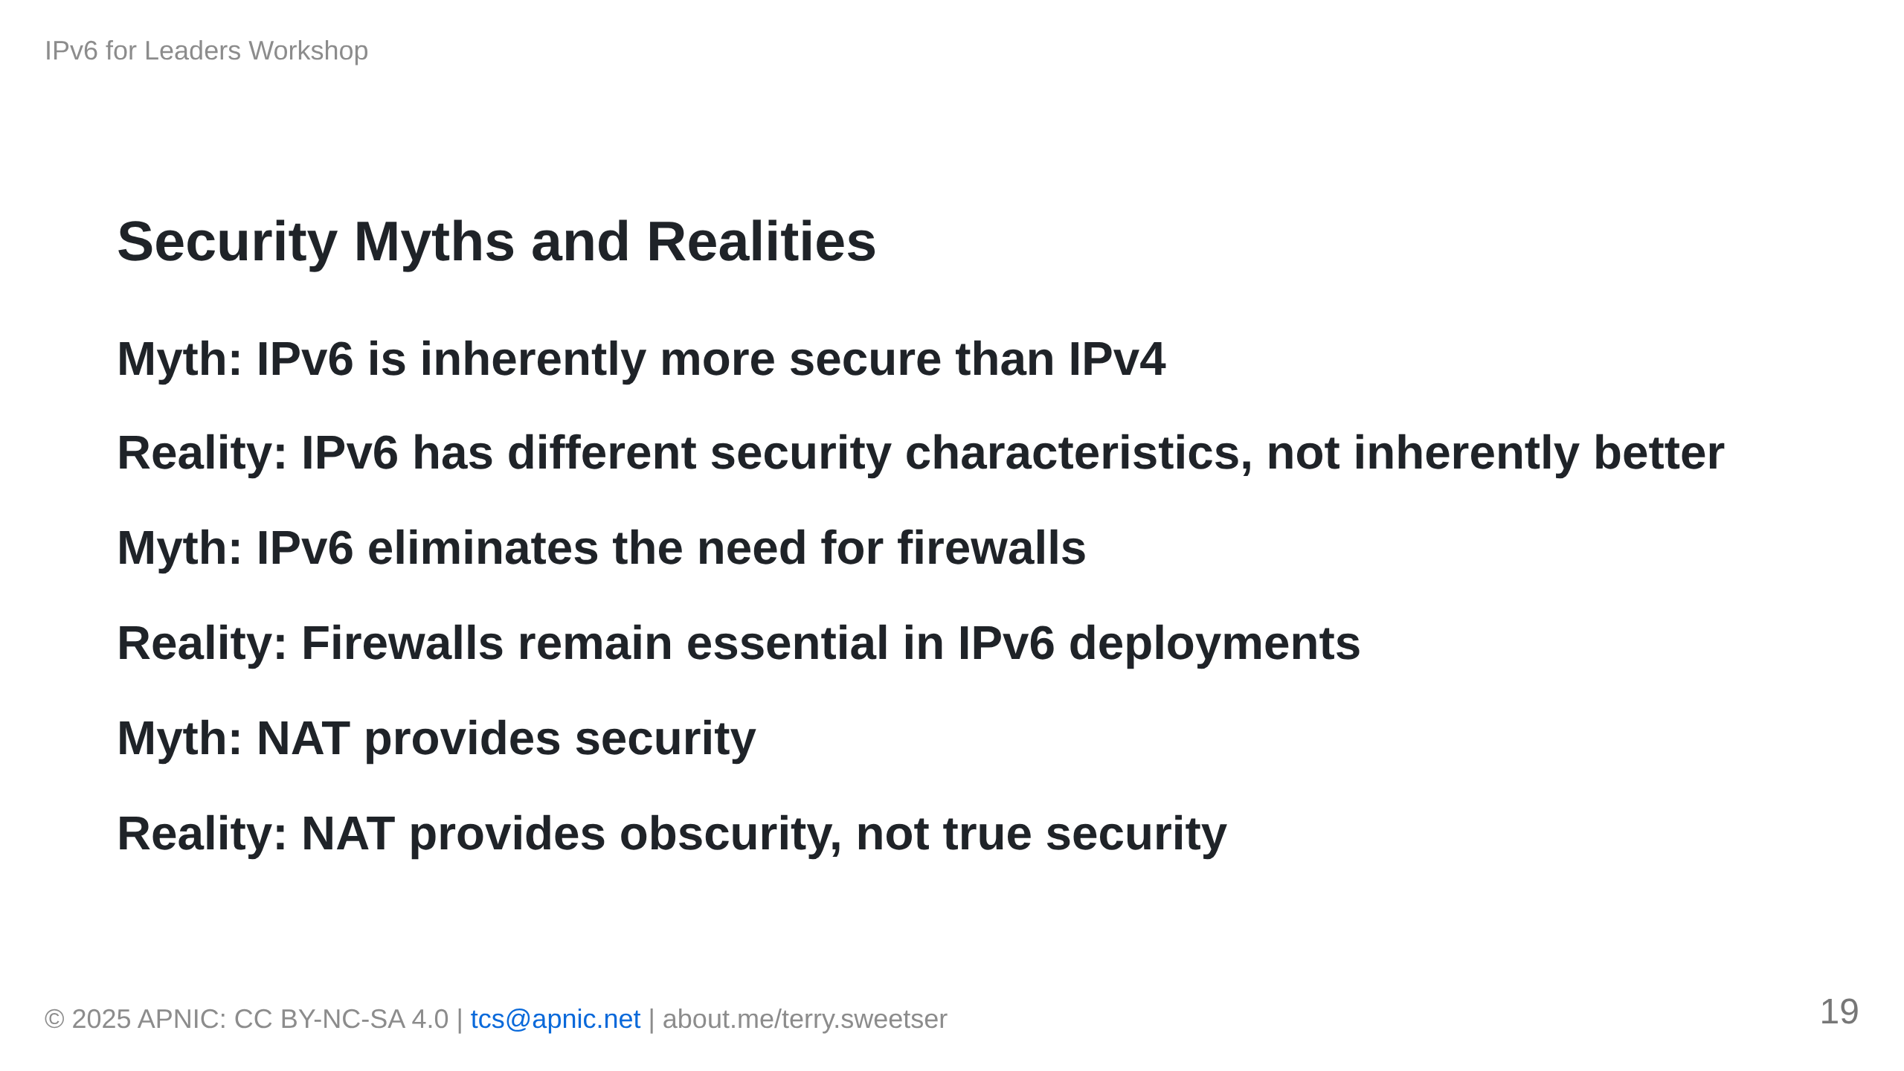

Slide 20
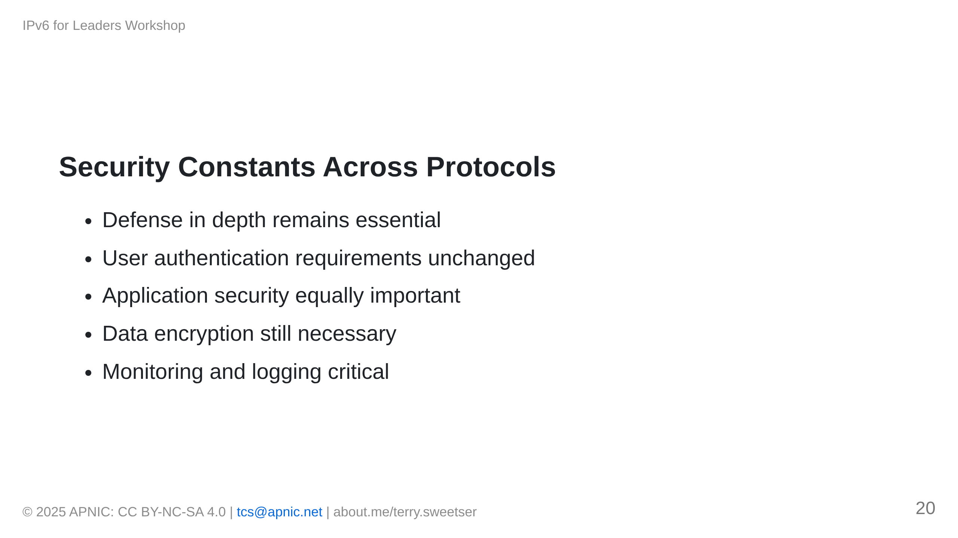
Notes:
[IMAGE PLACEHOLDER: Security layers diagram applicable to both IPv4 and IPv6]

Slide 21
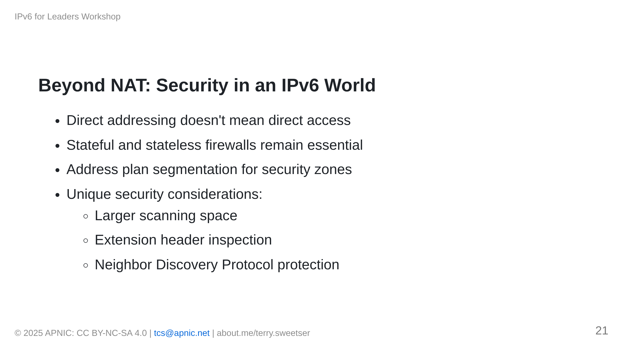
Notes:
[IMAGE PLACEHOLDER: IPv6 security architecture diagram]

Slide 22
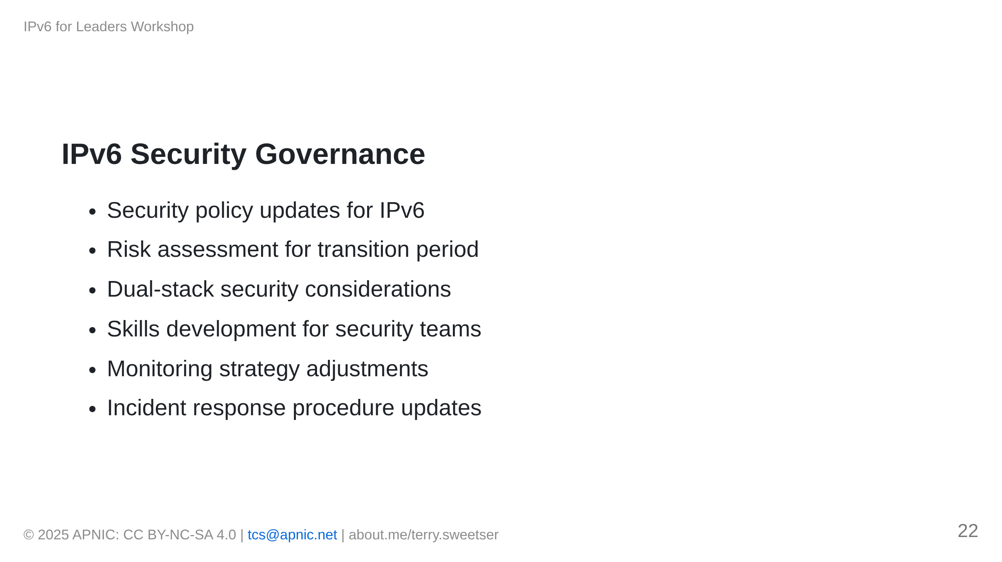

Slide 23
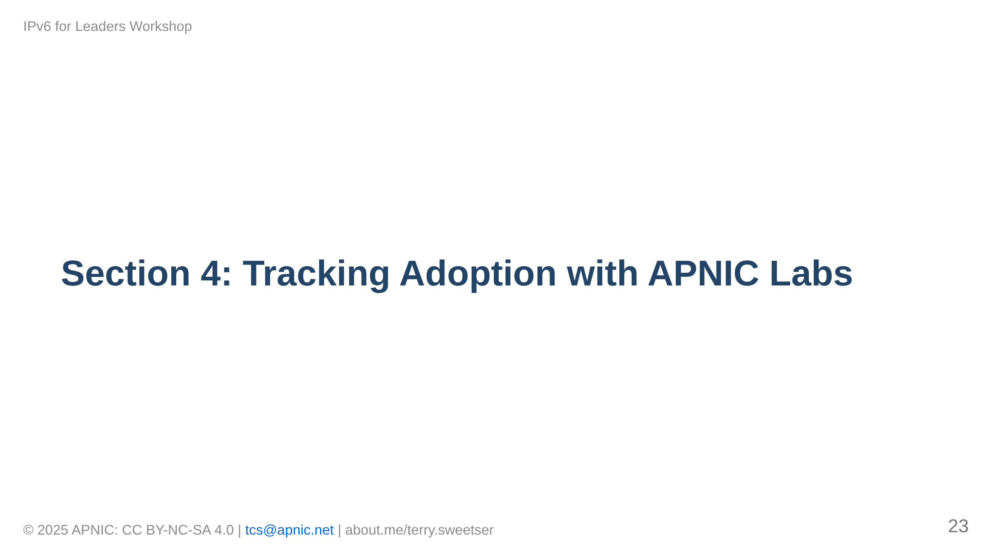

Slide 24
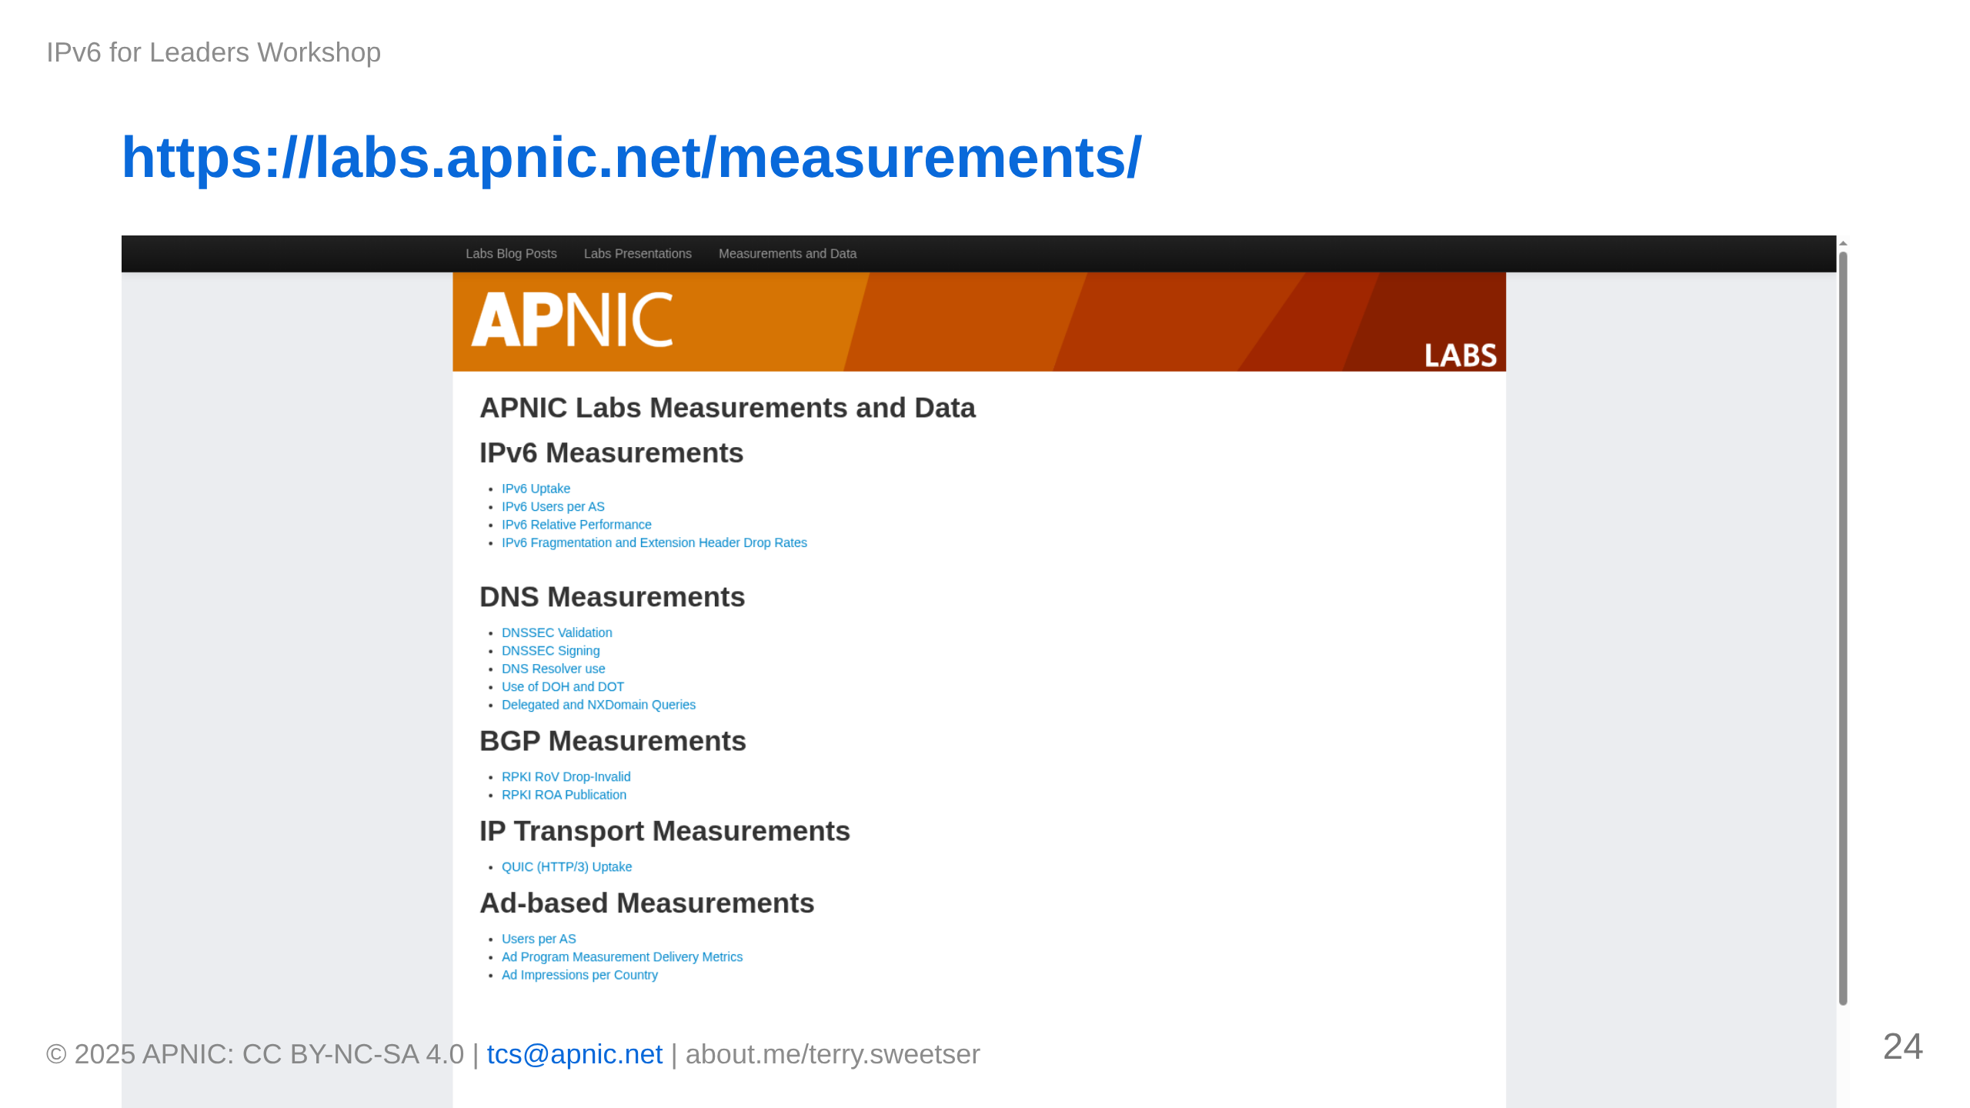

Slide 25
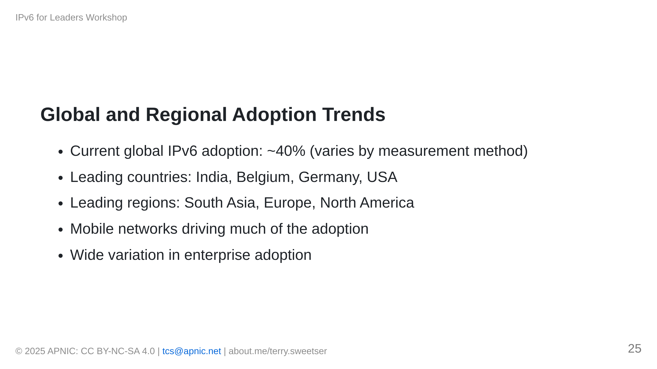

Slide 26
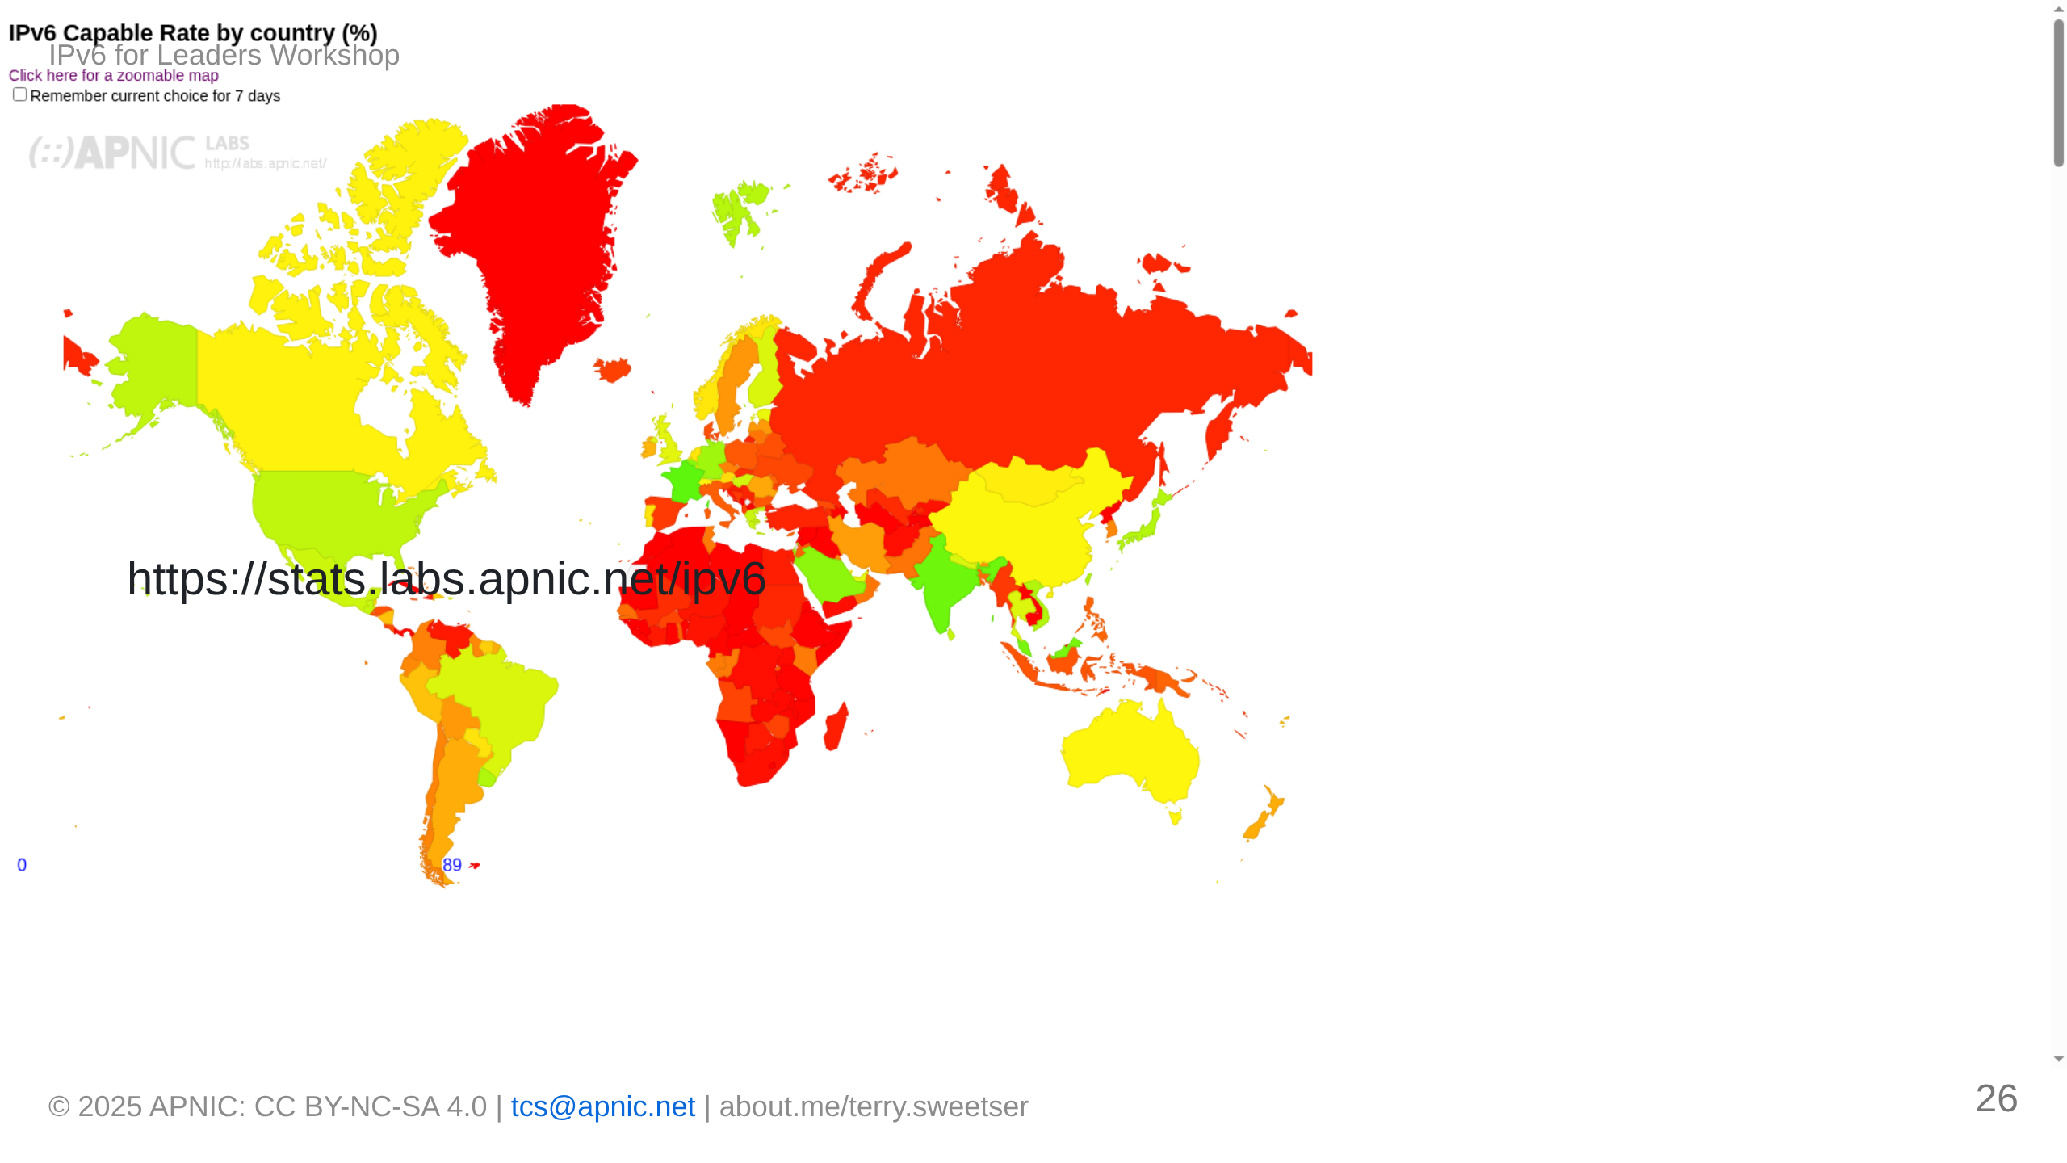

Slide 27
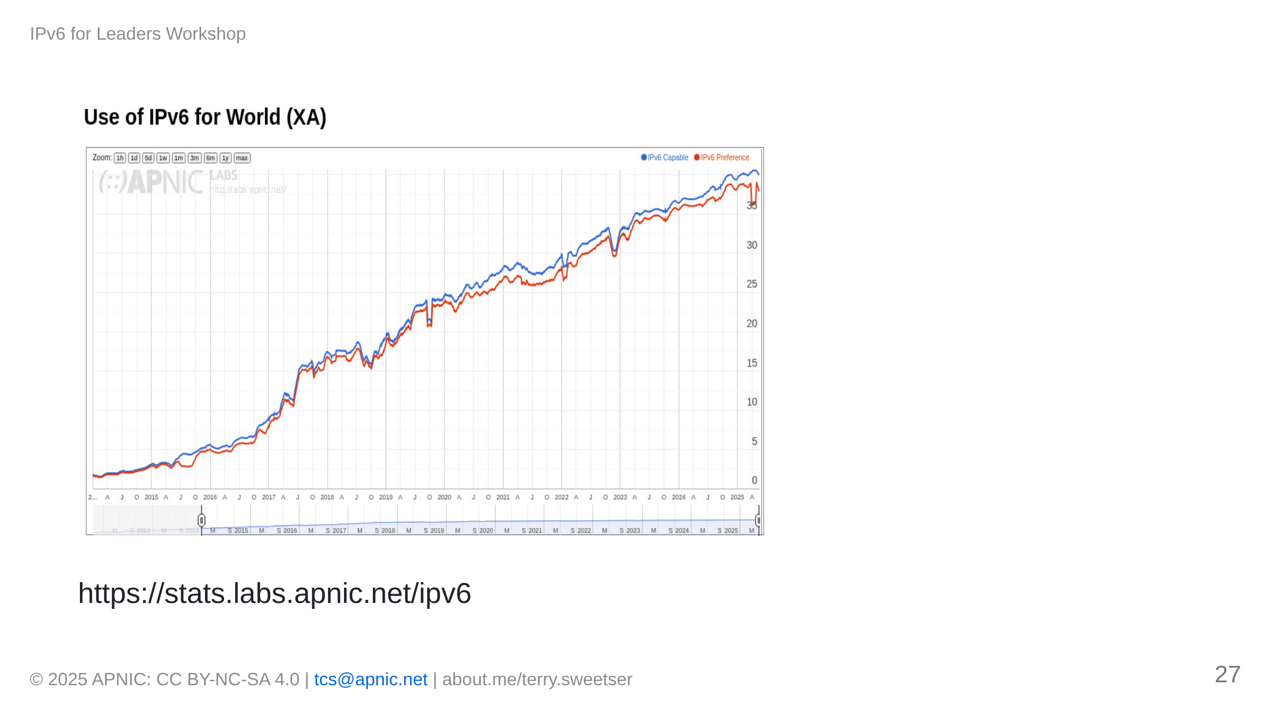

Slide 28
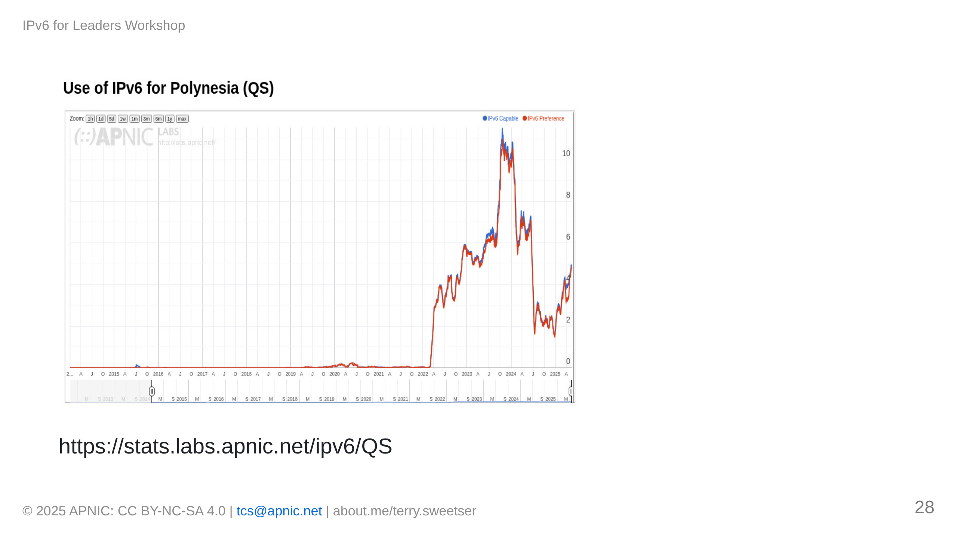

Slide 29
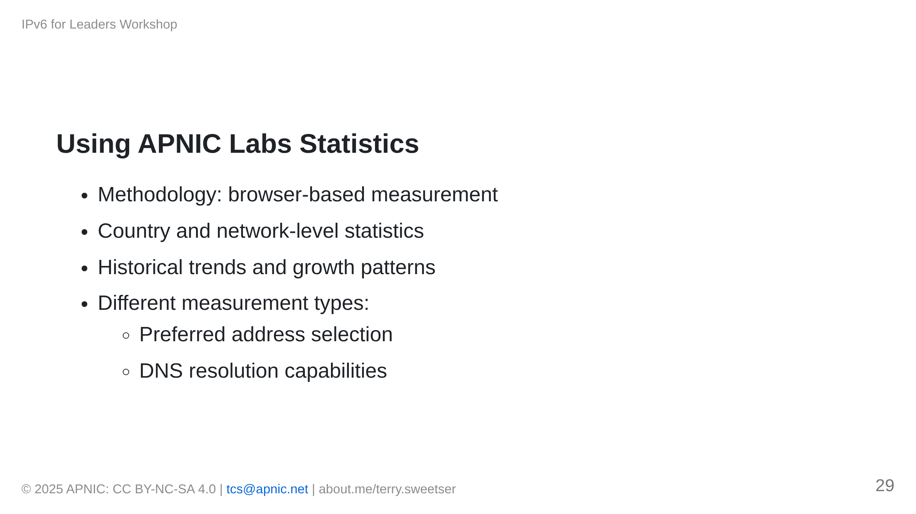

Slide 30
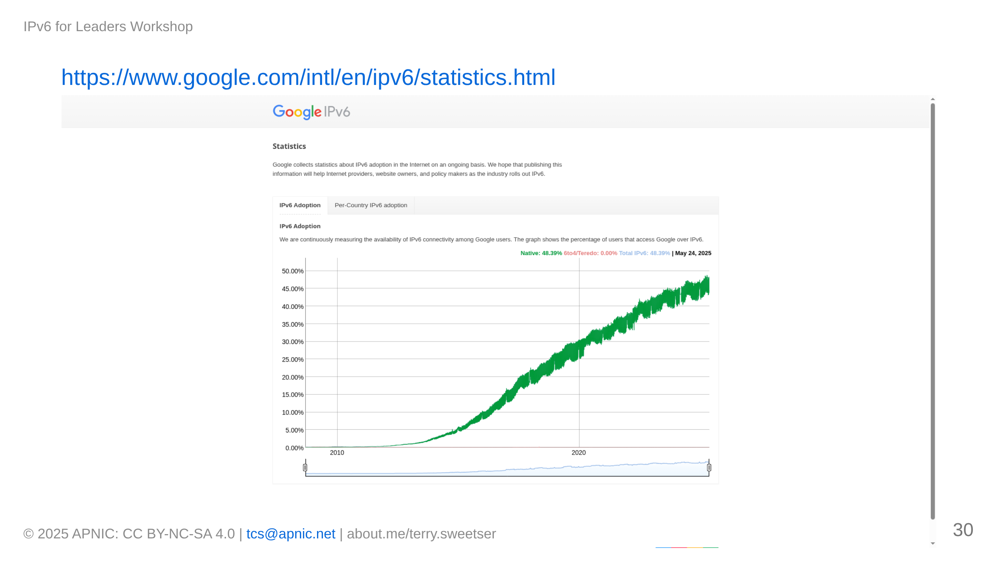

Slide 31
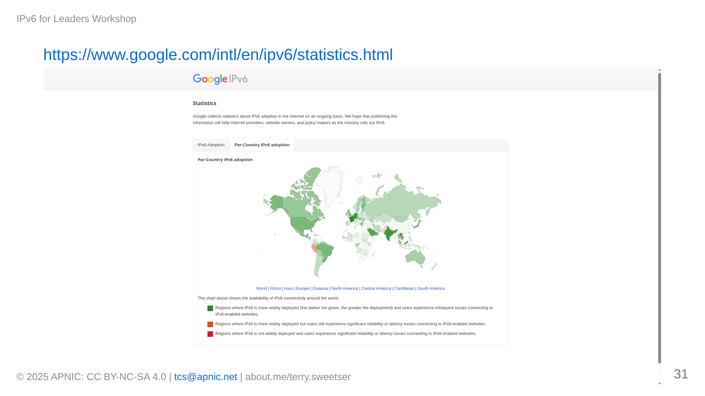

Slide 32
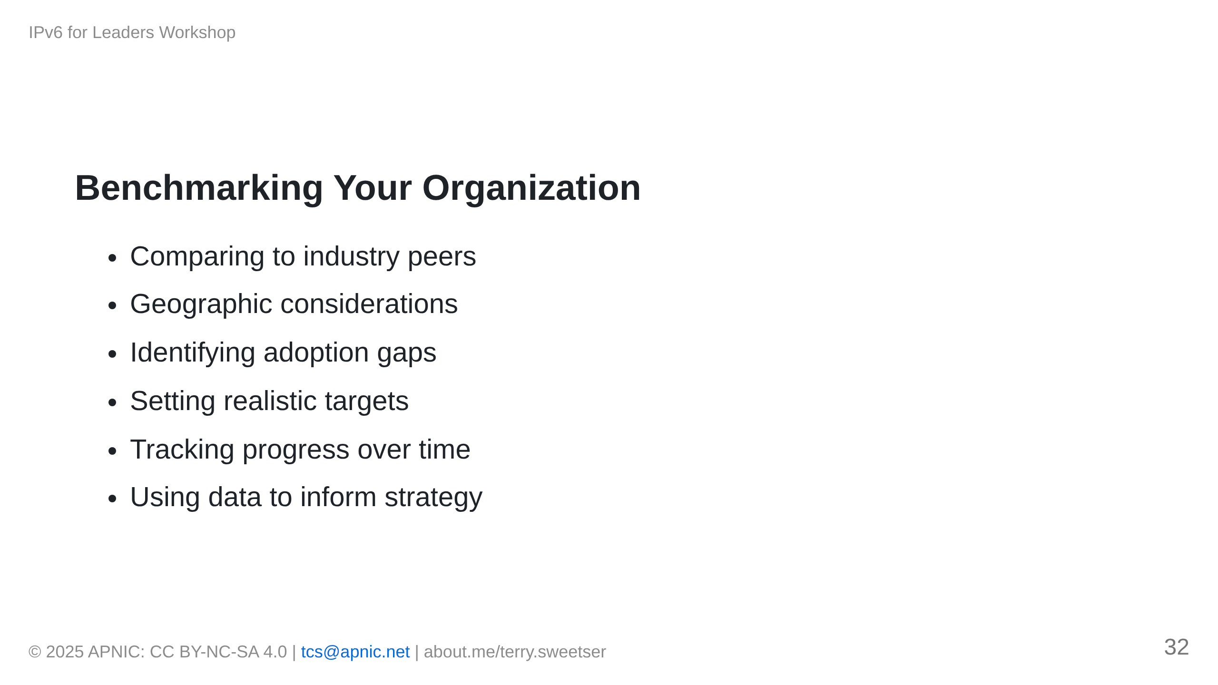
Notes:
[IMAGE PLACEHOLDER: Benchmark matrix template for organization assessment]

Slide 33
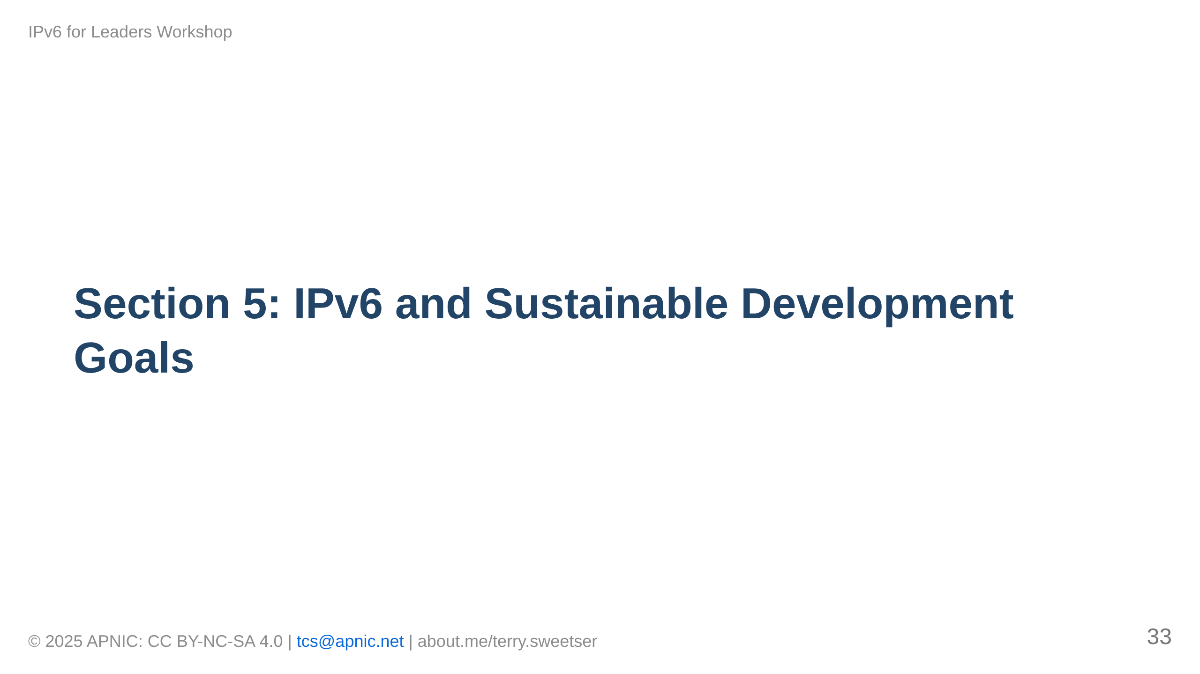

Slide 34
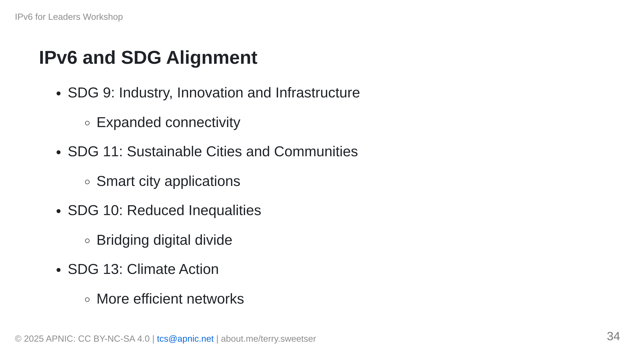
Notes:
[IMAGE PLACEHOLDER: Matrix showing IPv6 contributions to SDGs]

Slide 35
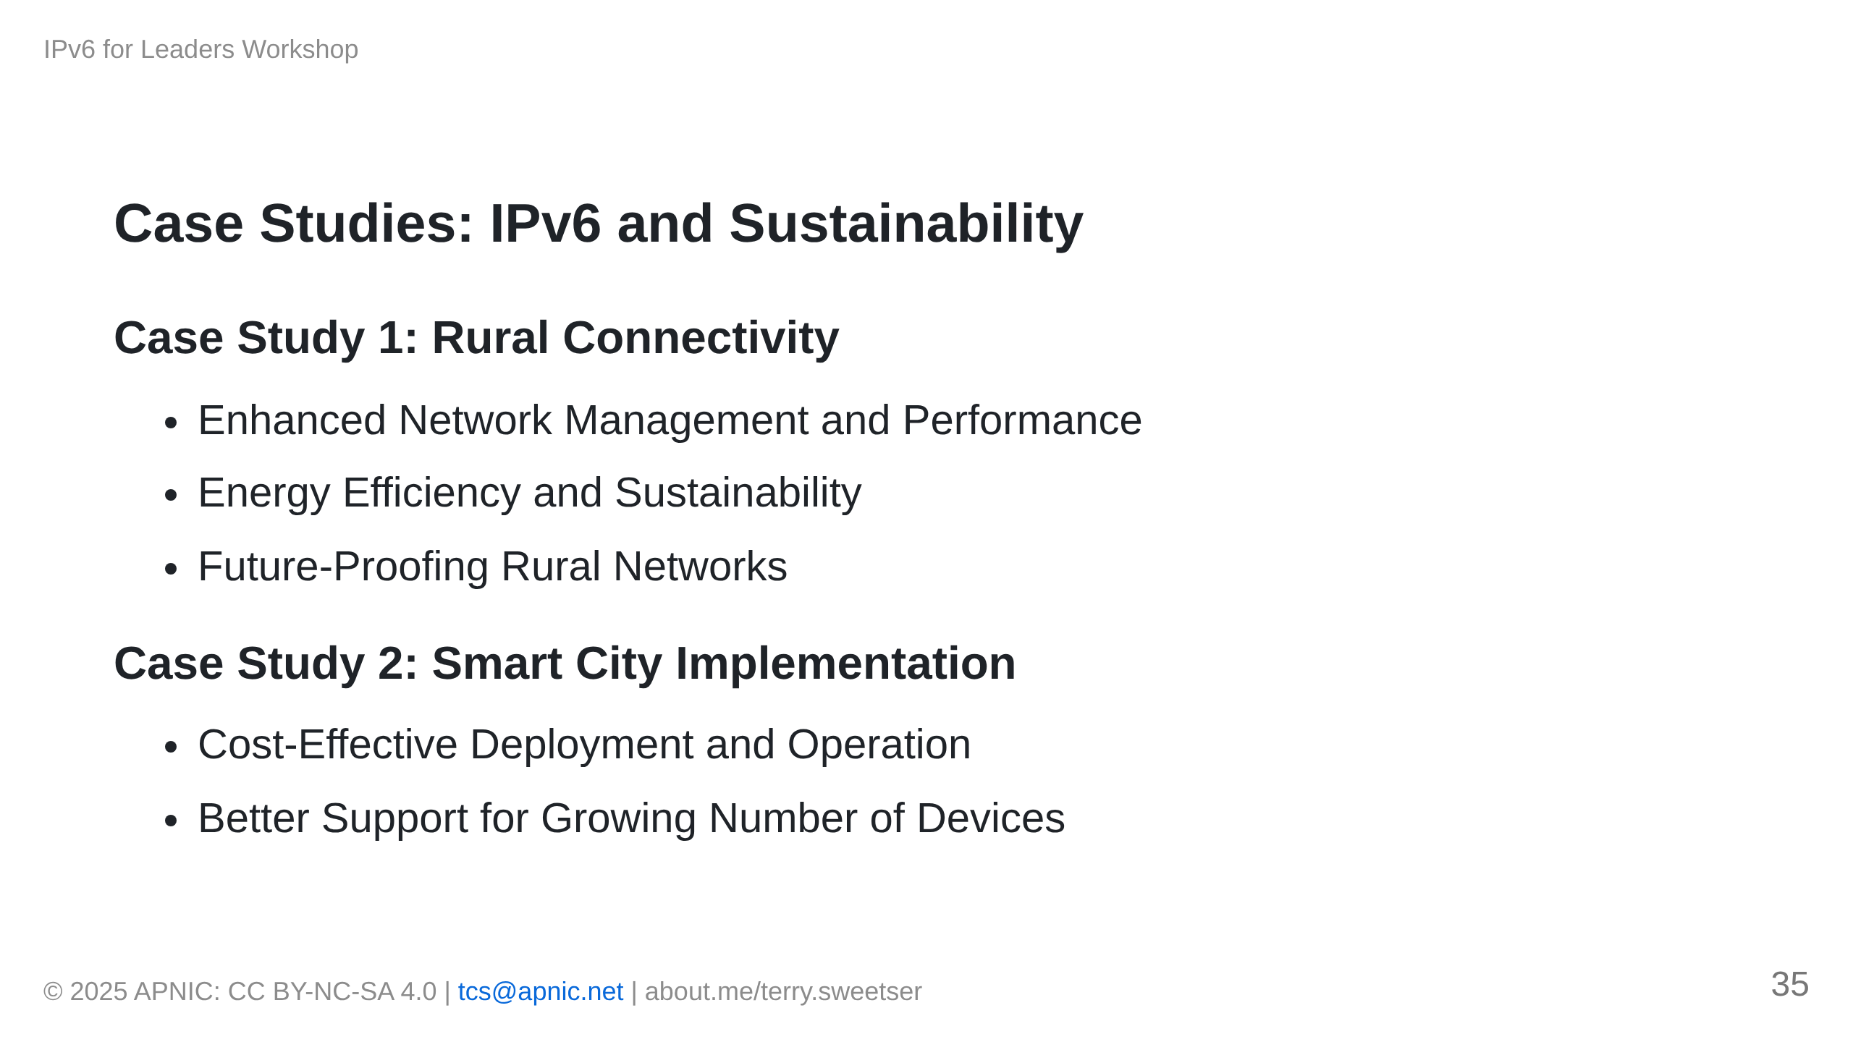

Slide 36
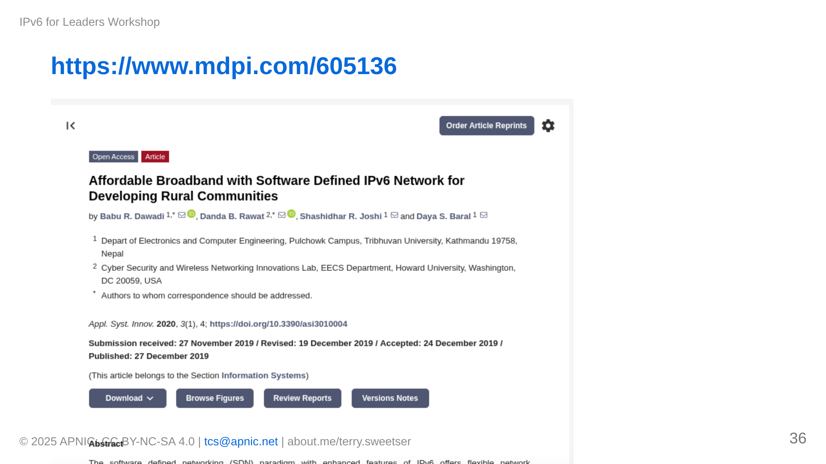

Slide 37
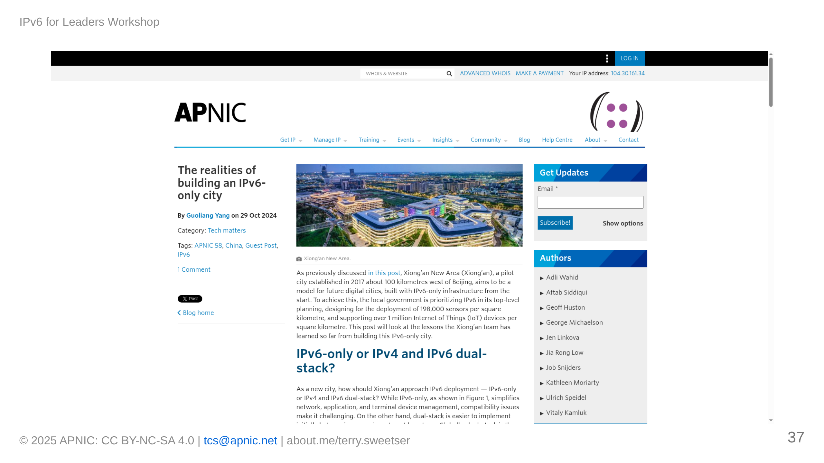
Notes:
[IMAGE PLACEHOLDER: Smart city implementation using IPv6]

Slide 38
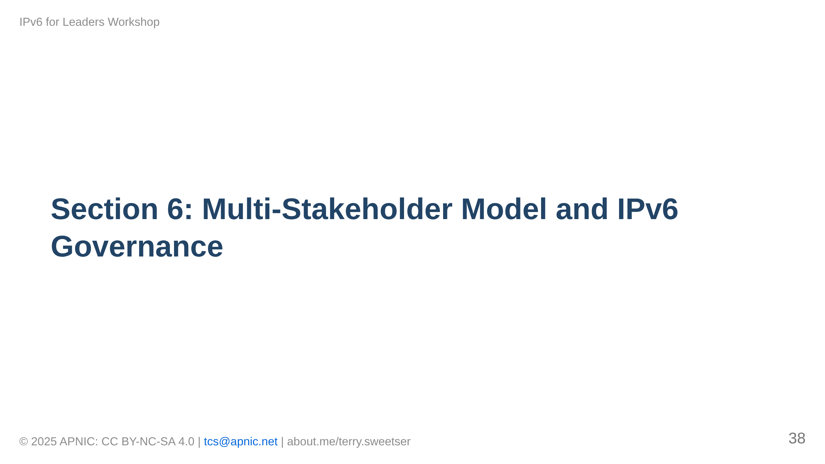

Slide 39
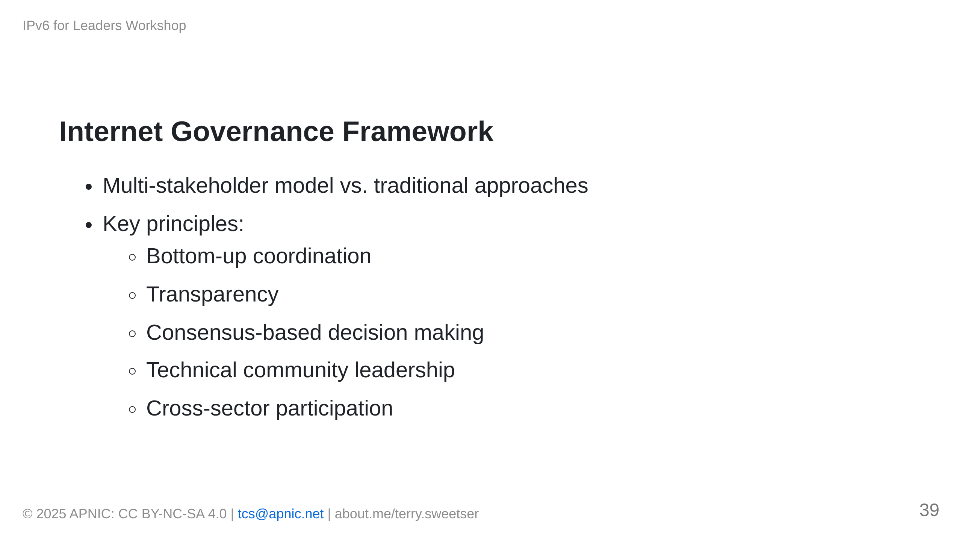
Notes:
[IMAGE PLACEHOLDER: Multi-stakeholder model diagram]

Slide 40
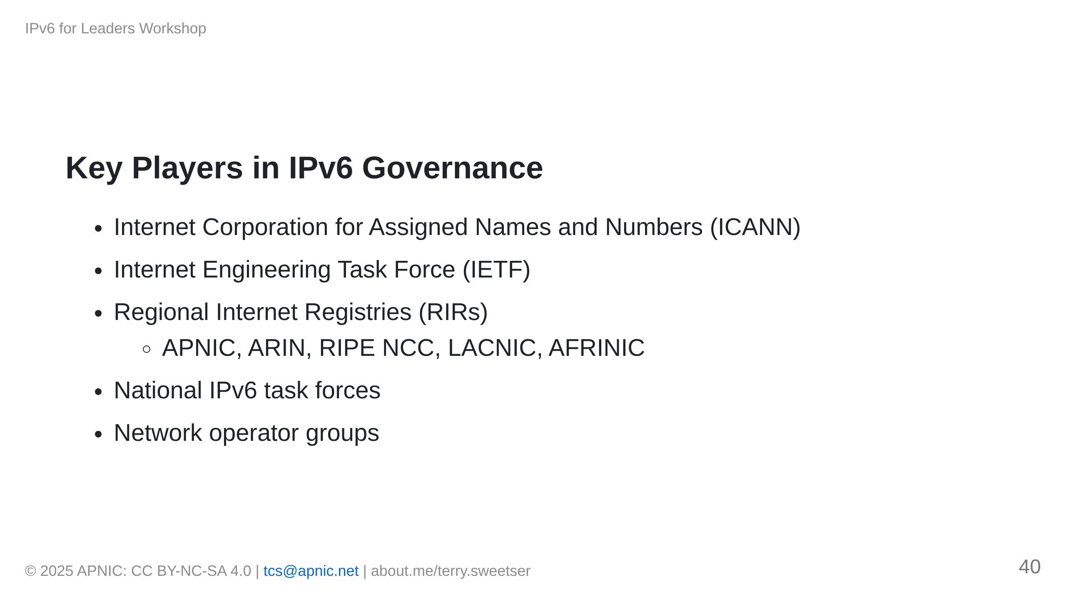
Notes:
[IMAGE PLACEHOLDER: Ecosystem of IPv6 governance organizations]

Slide 41
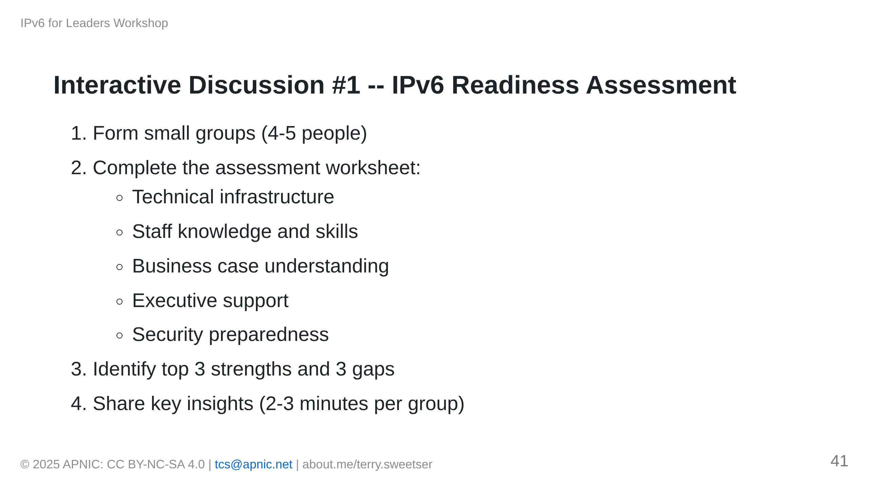

Slide 42
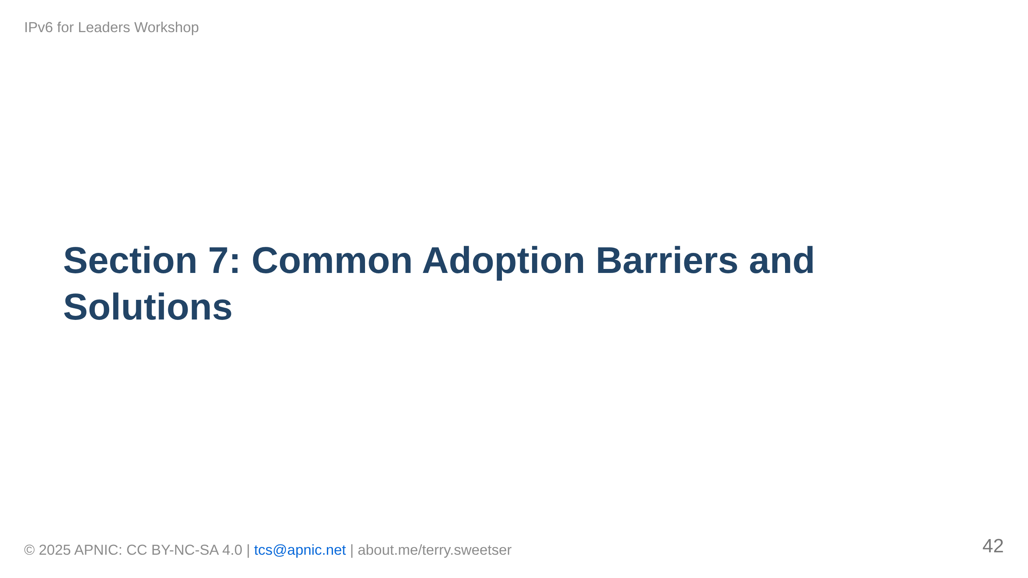

Slide 43
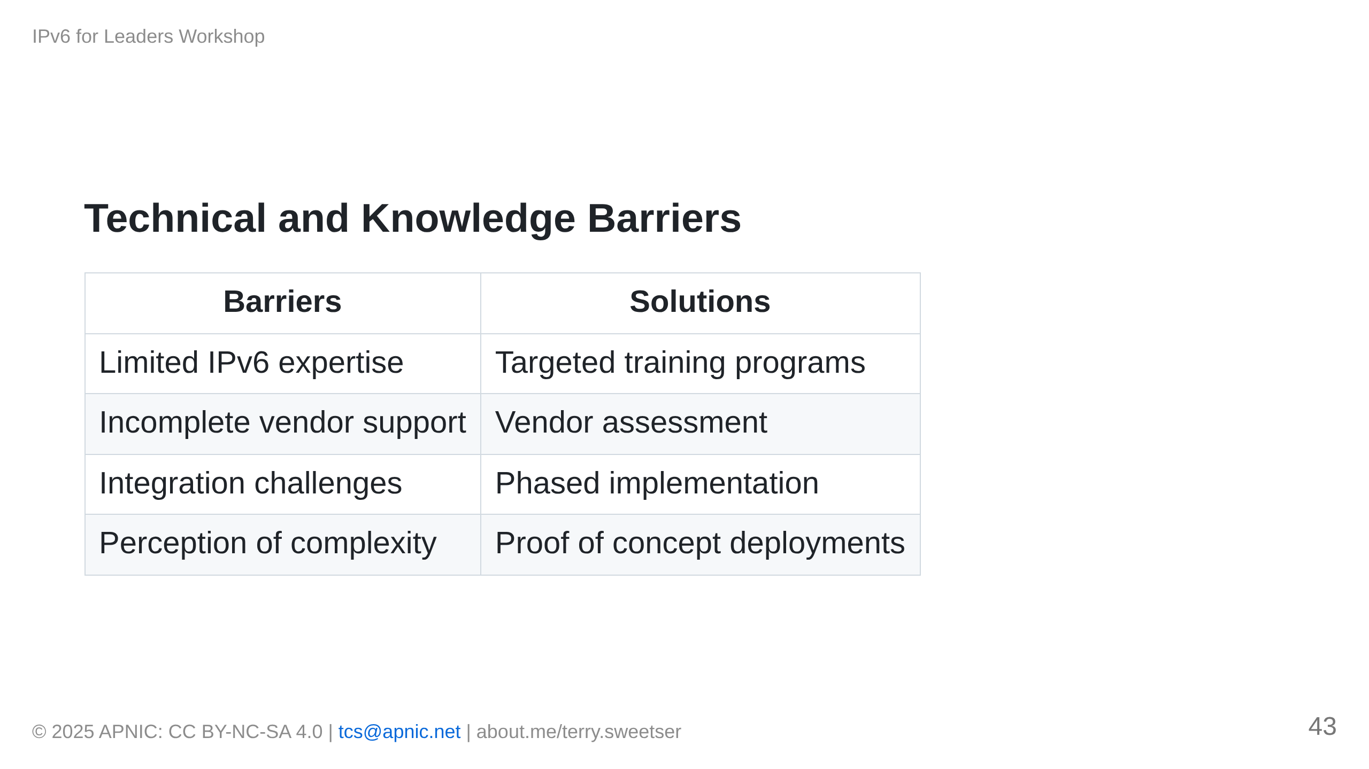

Slide 44
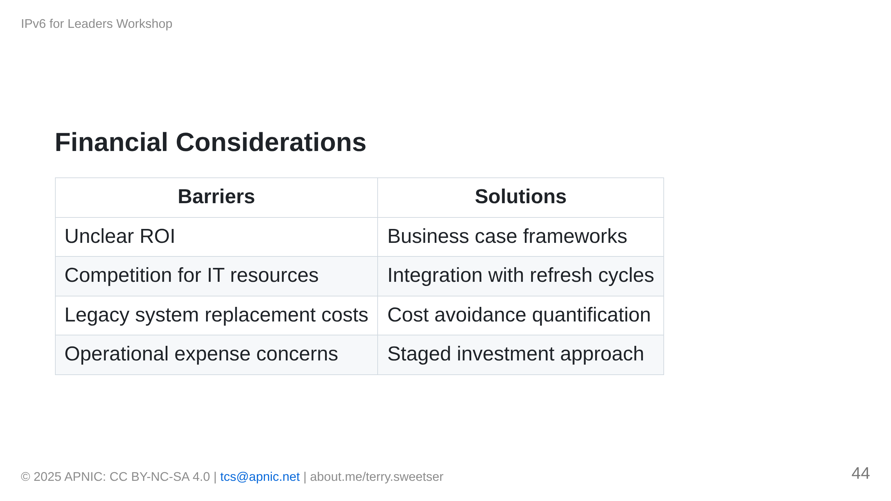
Notes:
[IMAGE PLACEHOLDER: ROI calculation framework diagram]

Slide 45
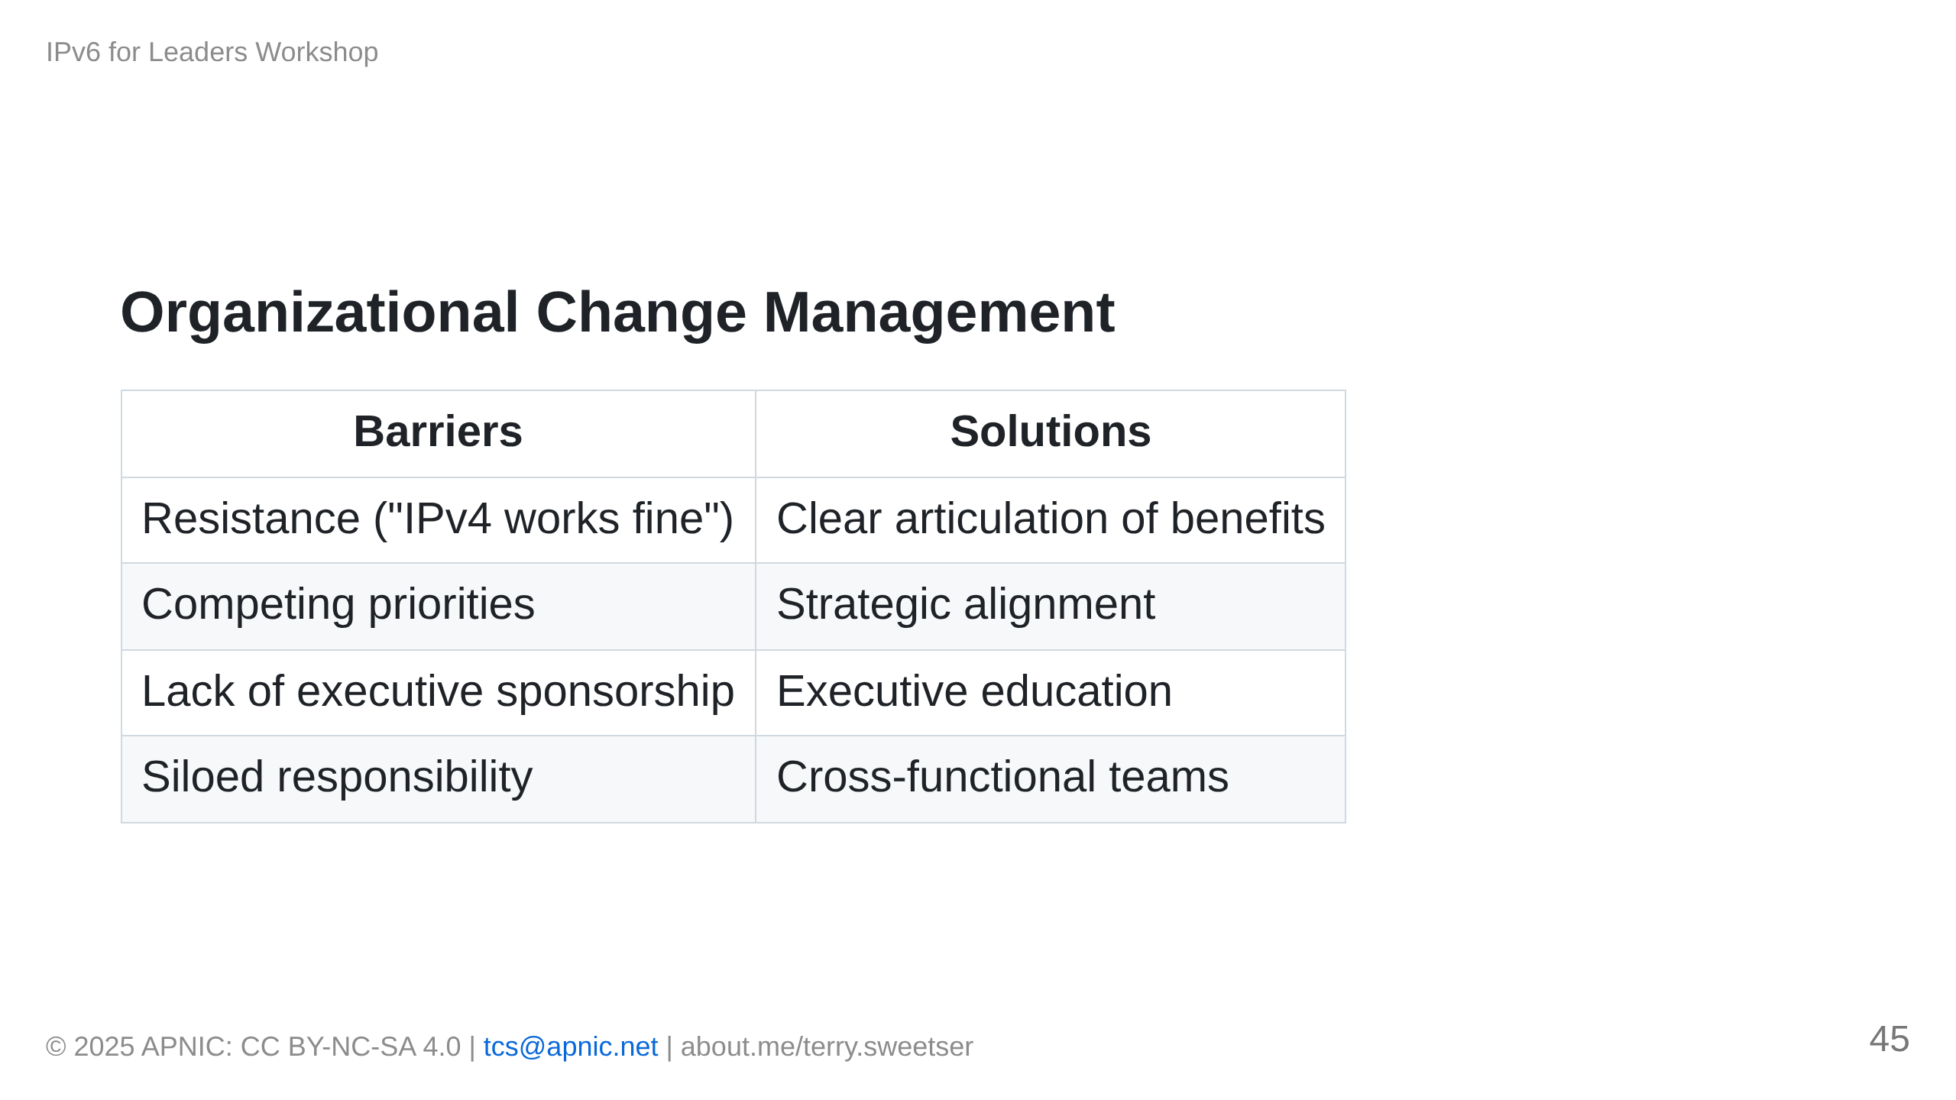

Slide 46
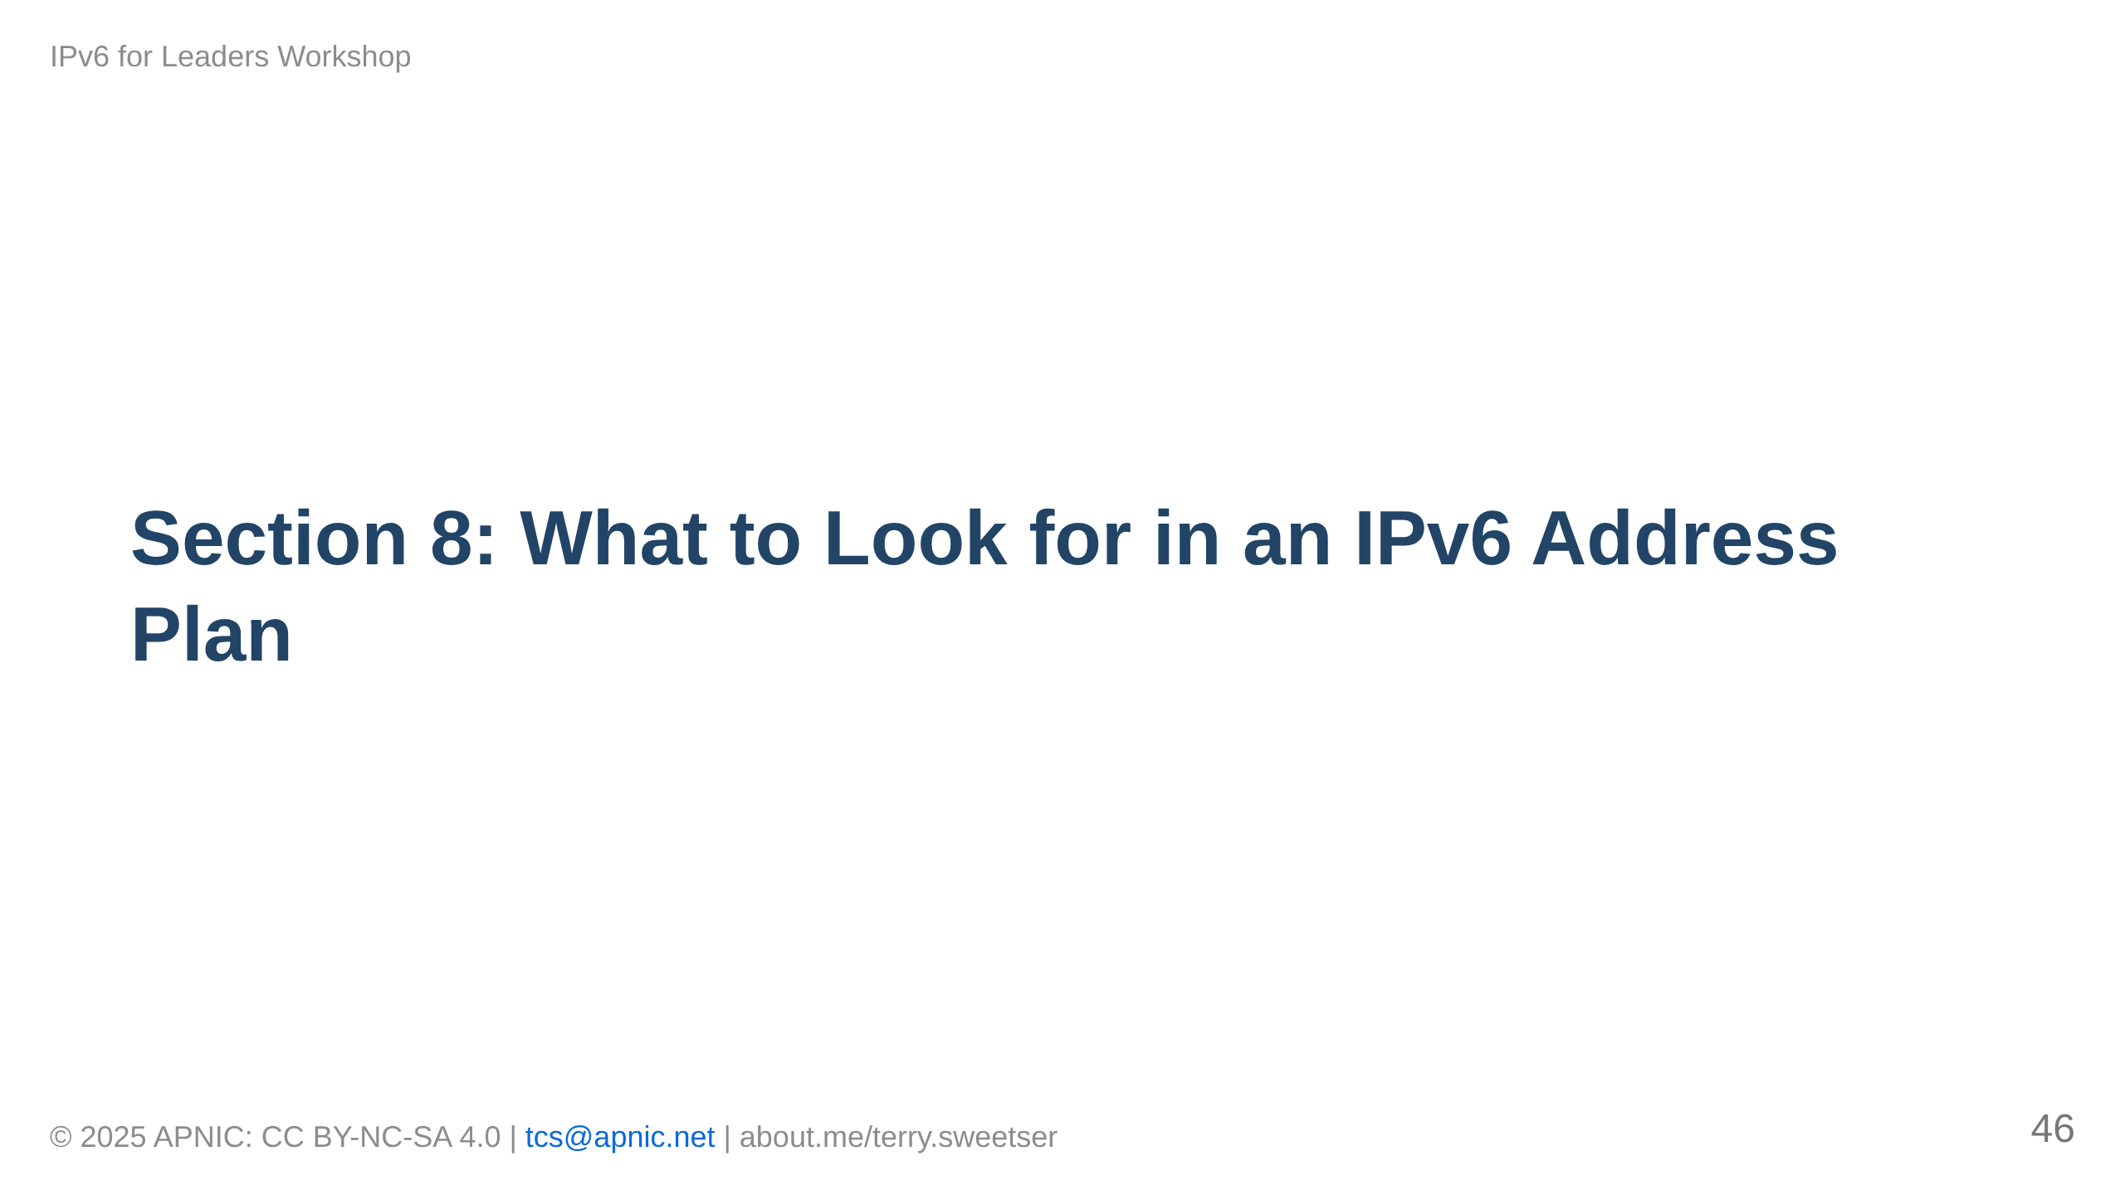

Slide 47
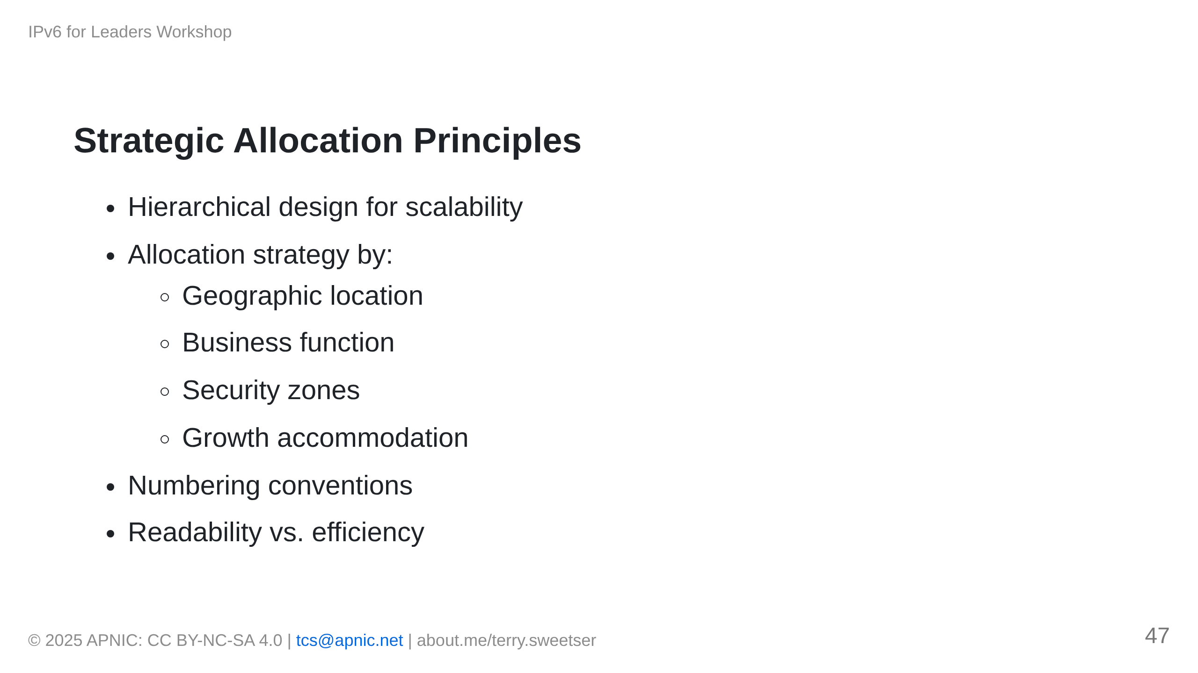
Notes:
[IMAGE PLACEHOLDER: Hierarchical address allocation diagram]

Slide 48
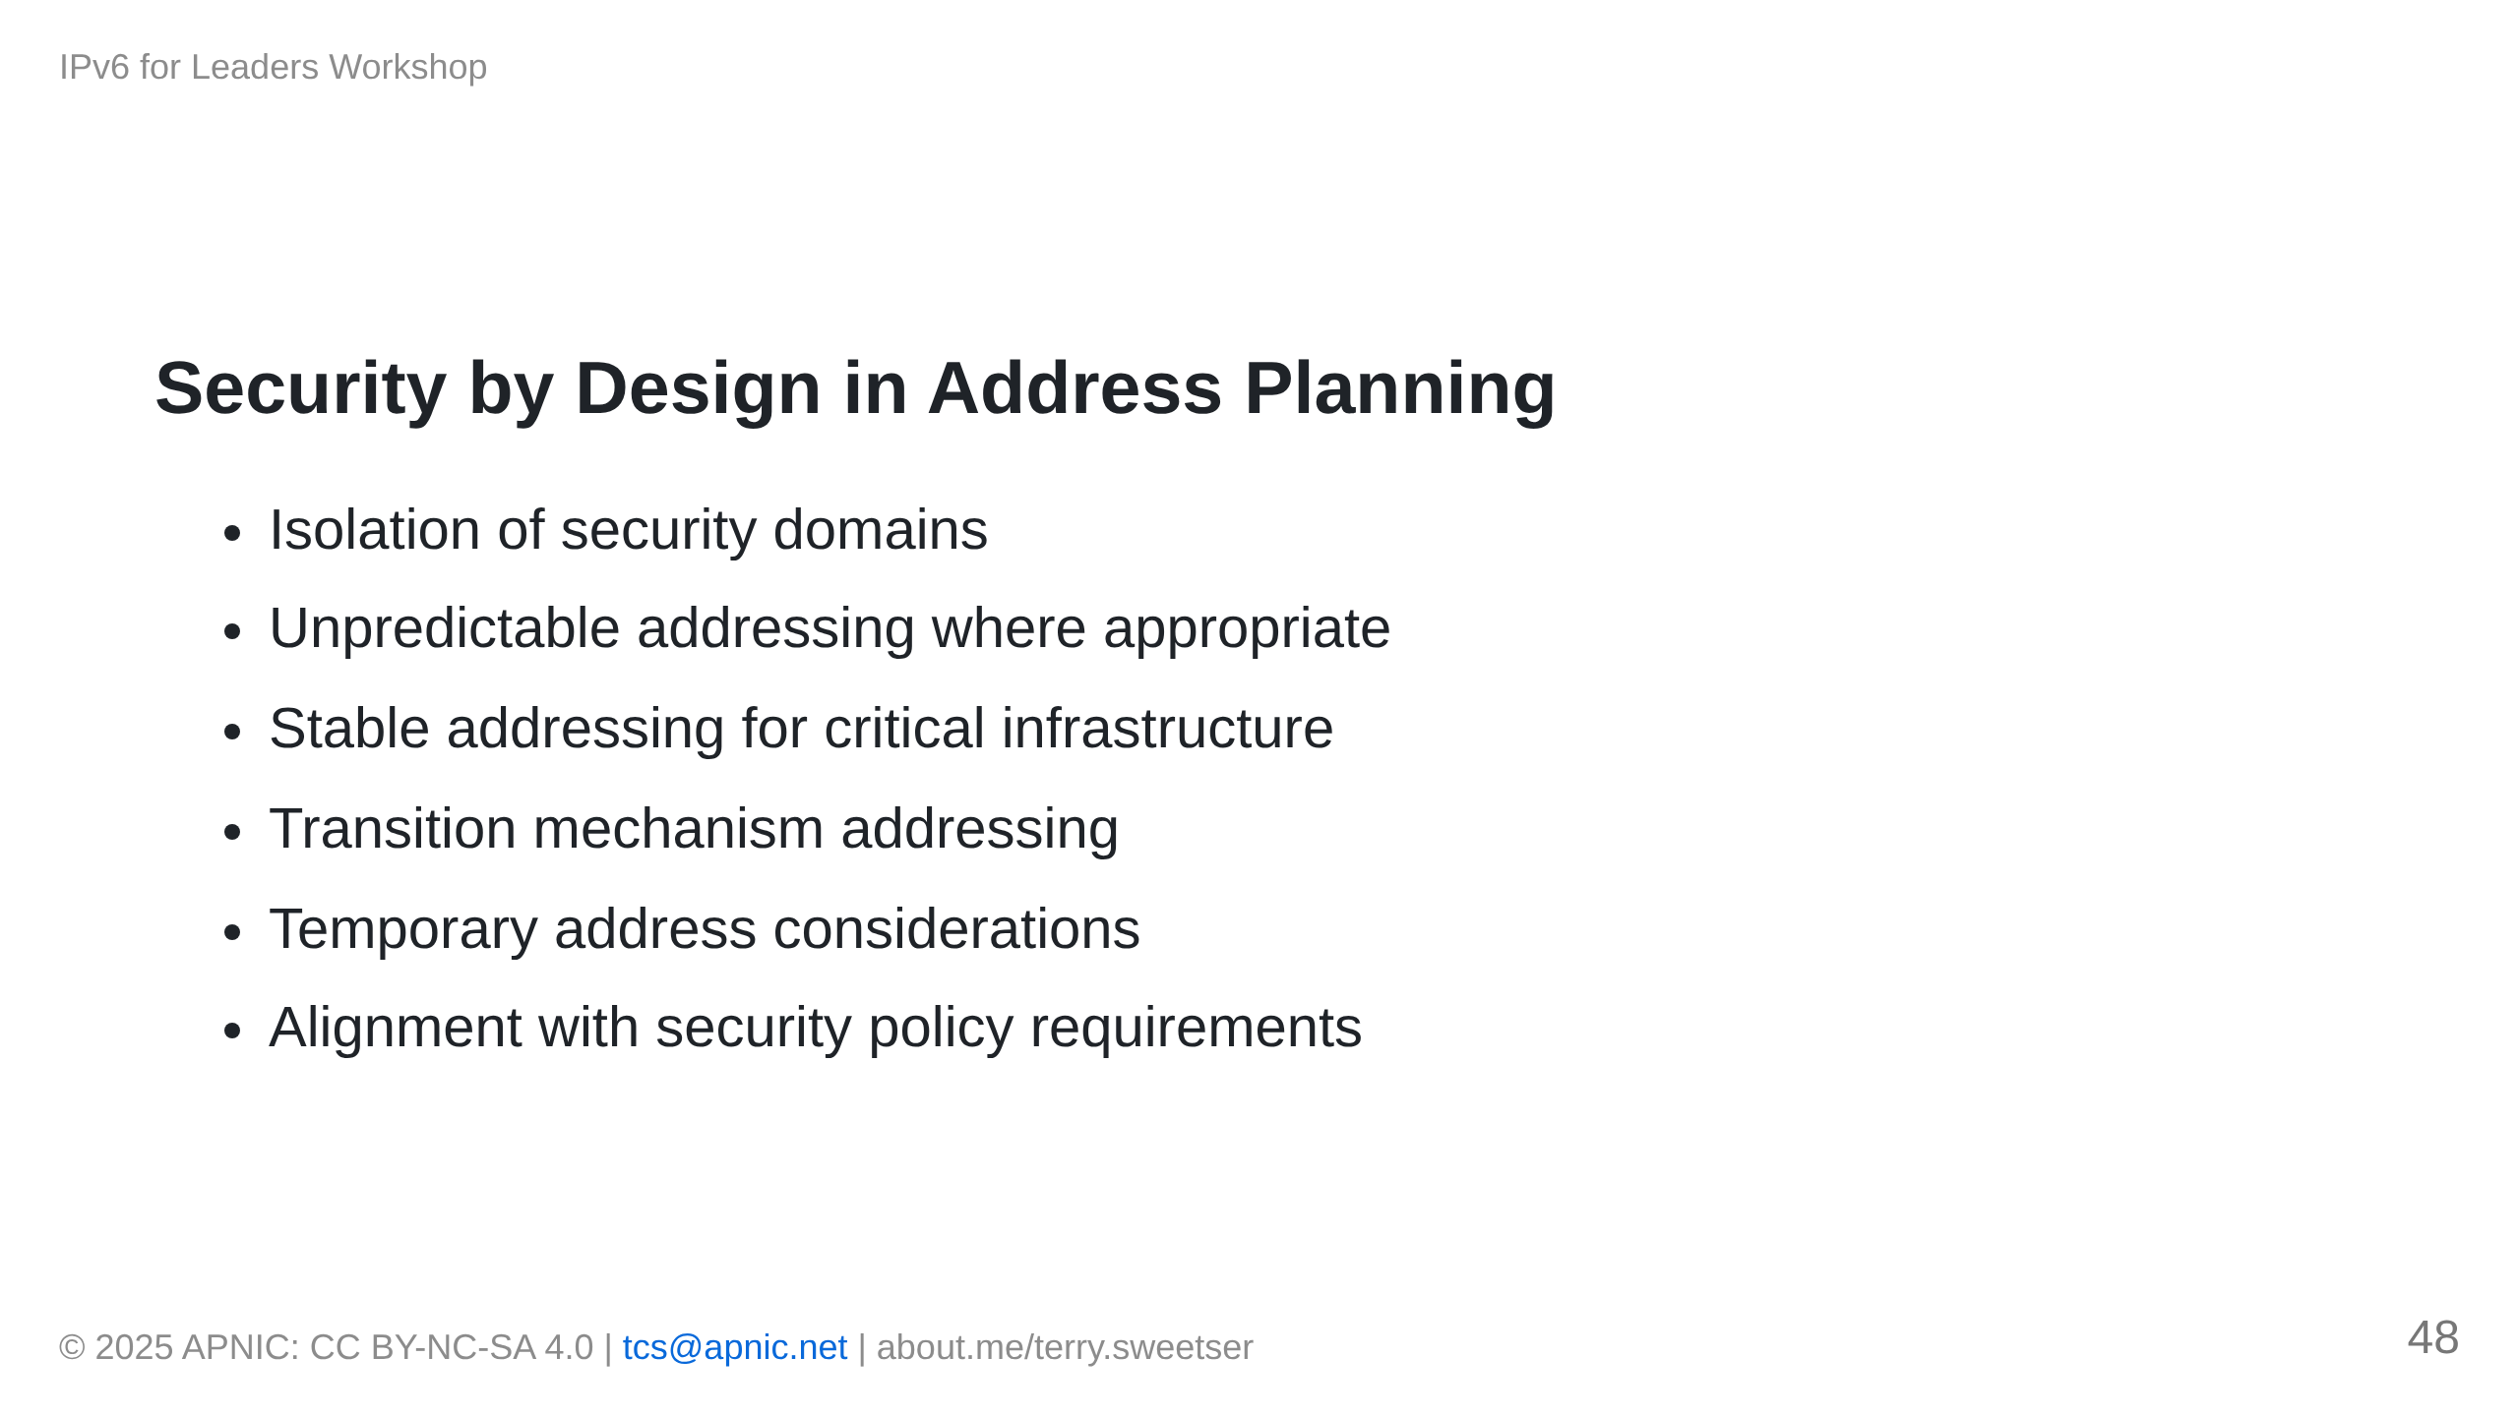

Slide 49
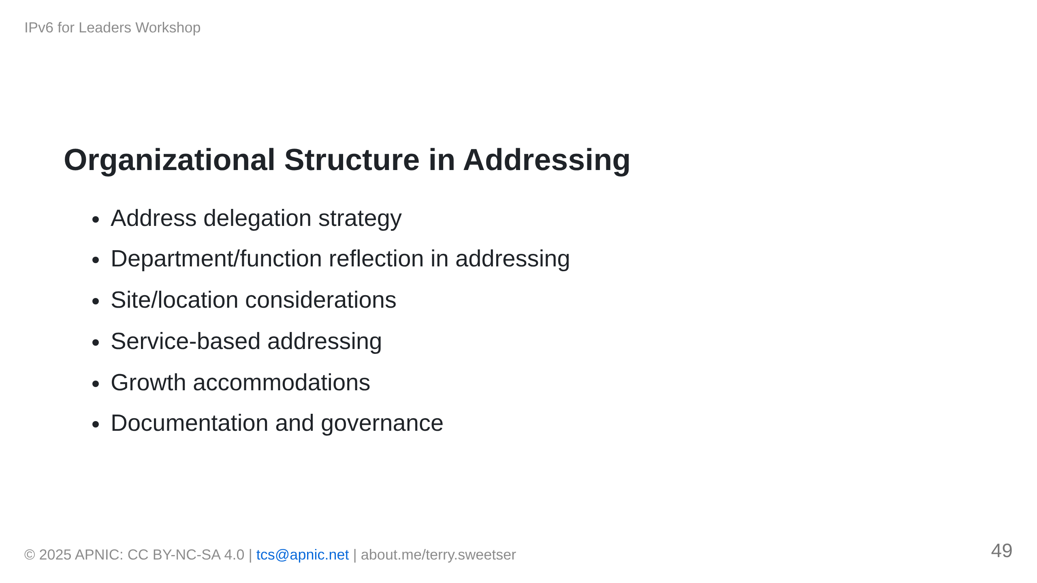
Notes:
[IMAGE PLACEHOLDER: Organization-to-address mapping example]

Slide 50
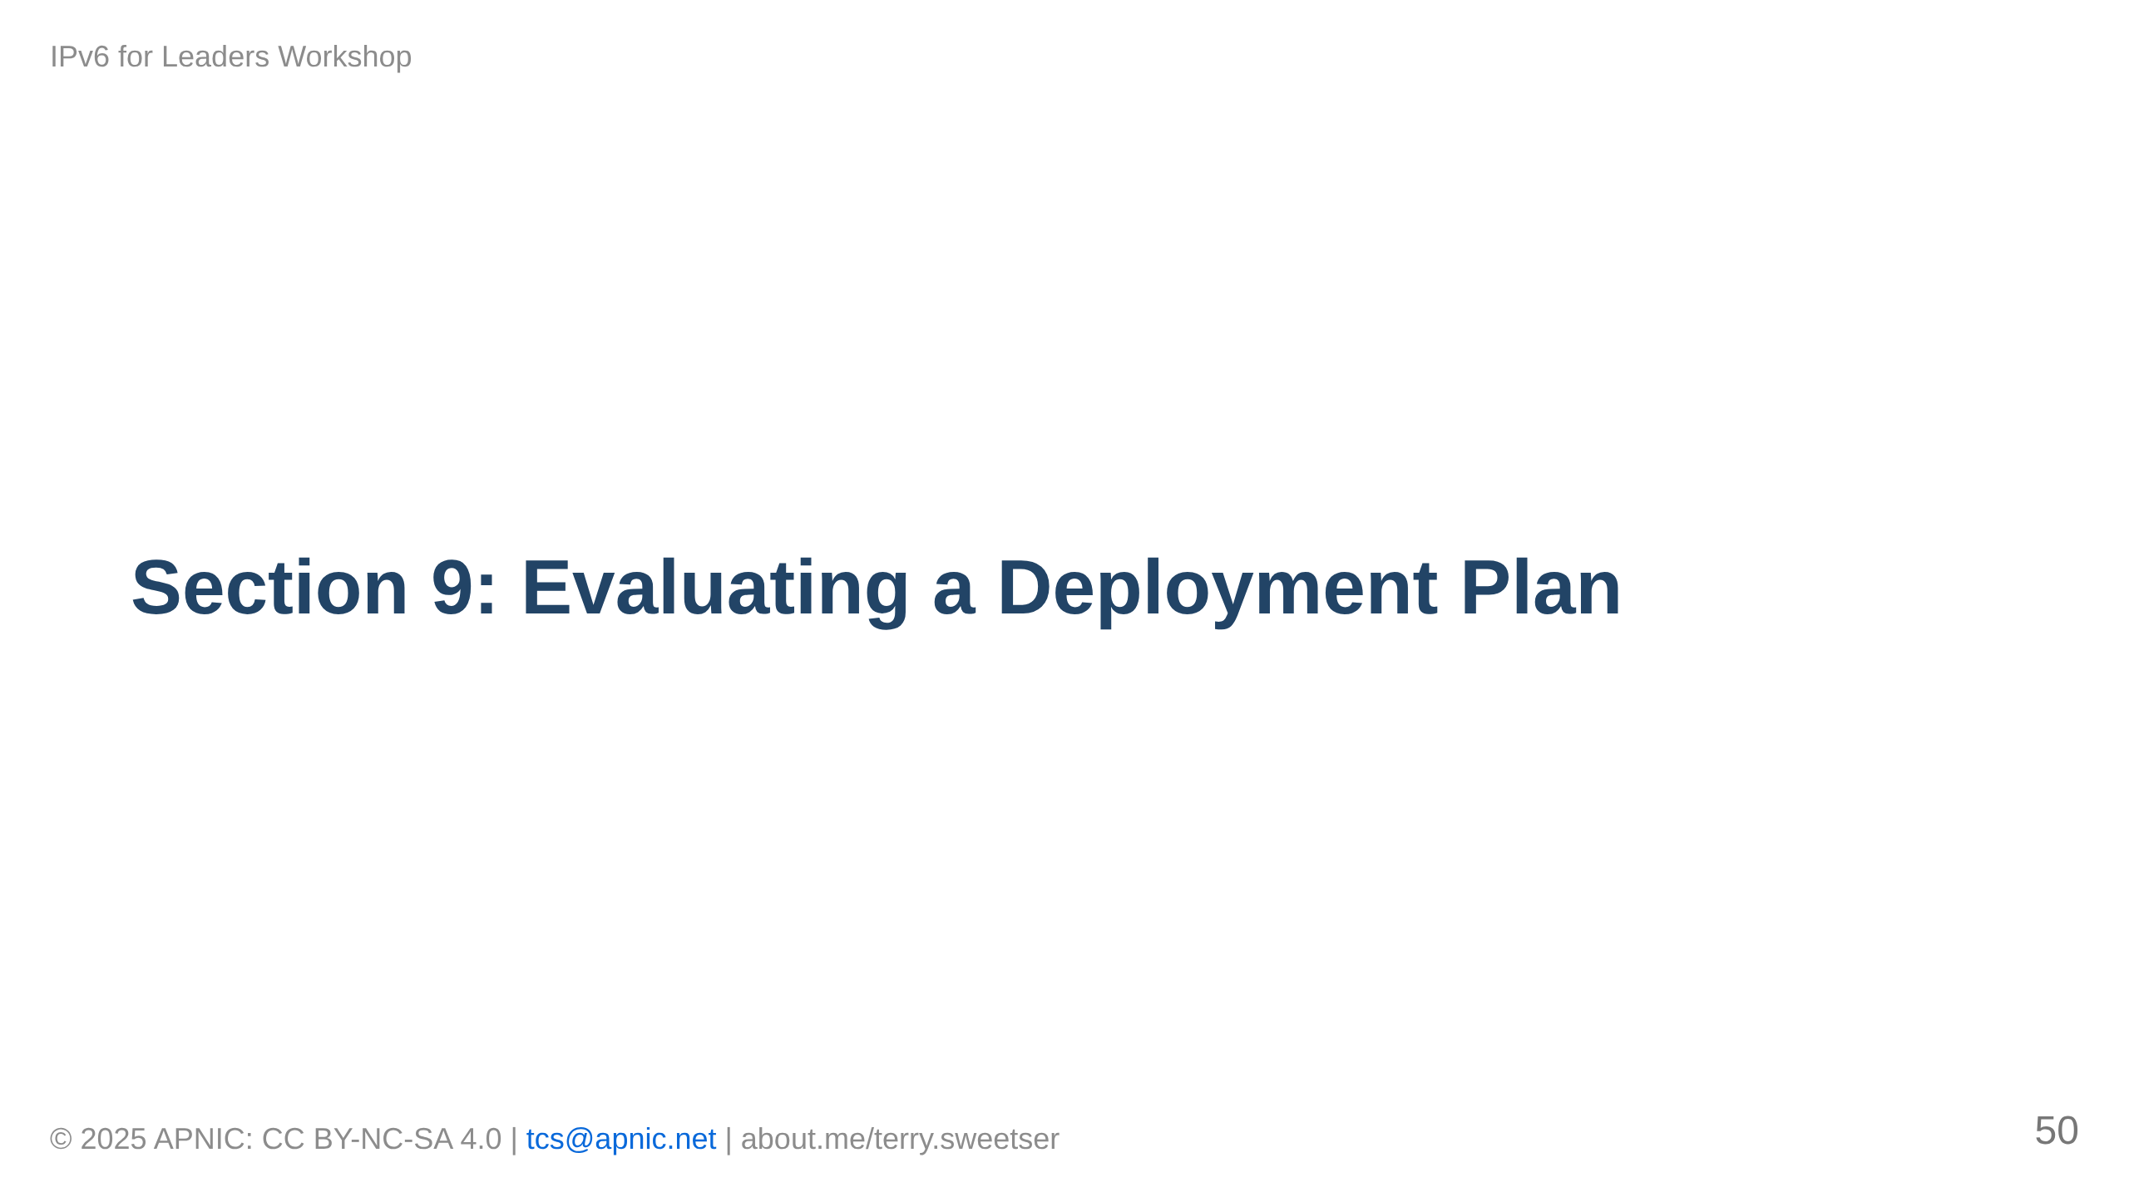

Slide 51
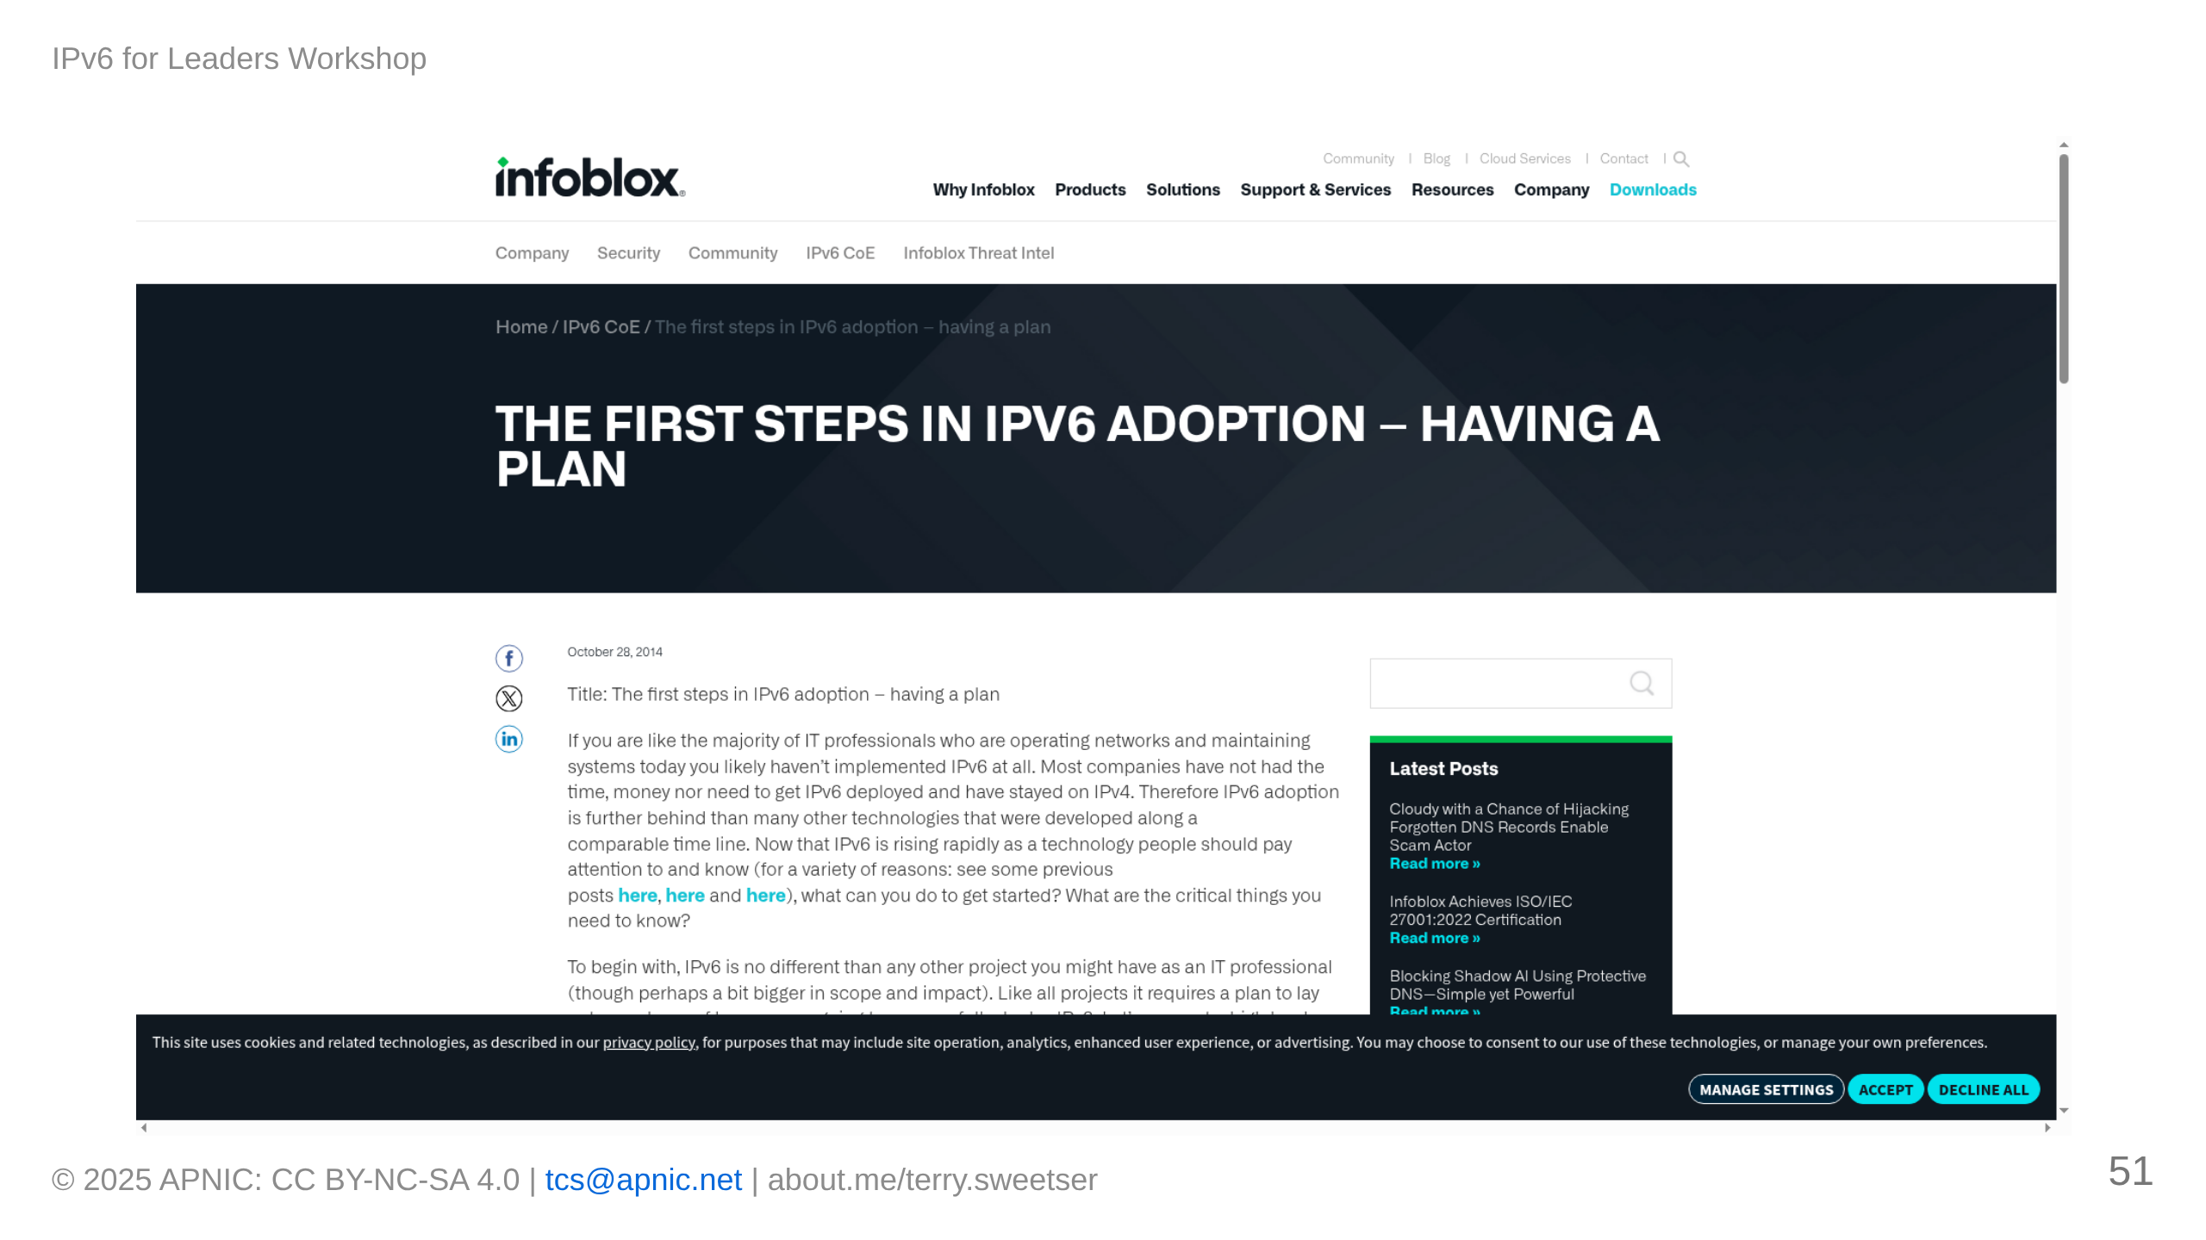

Slide 52
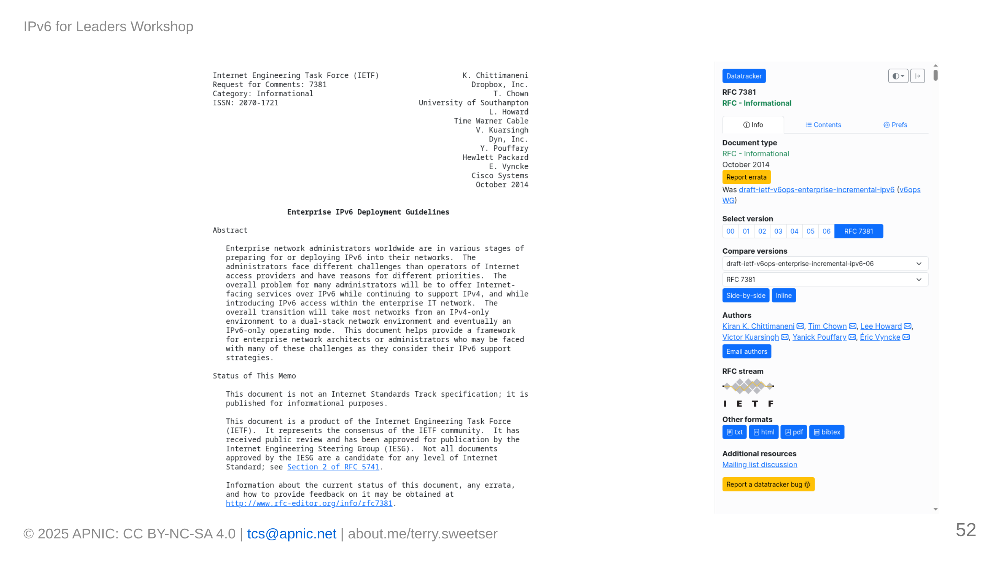

Slide 53

Notes:
[IMAGE PLACEHOLDER: IPv6 deployment timeline with milestones]

Slide 54


Slide 55

Notes:
[IMAGE PLACEHOLDER: Transition mechanisms comparison]

Slide 56


Slide 57


Slide 58

Notes:
[IMAGE PLACEHOLDER: IPv6 implementation KPI dashboard example]

Slide 59


Slide 60


Slide 61

Notes:
[IMAGE PLACEHOLDER: Executive dashboard for IPv6 implementation]

Slide 62


Slide 63

Notes:
[IMAGE PLACEHOLDER: IoT growth projection and addressing]

Slide 64

Notes:
[IMAGE PLACEHOLDER: Edge computing with IPv6]

Slide 65

Notes:
[IMAGE PLACEHOLDER: Connected enterprise vision]

Slide 66


Slide 67

Notes:
[IMAGE PLACEHOLDER: IPv6 competency matrix by role]

Slide 68

Notes:
[IMAGE PLACEHOLDER: APNIC training resources]

Slide 69

Notes:
[IMAGE PLACEHOLDER: Knowledge sharing model]

Slide 70


Slide 71


Slide 72

Notes:
Contact and additional resource information

