Slide 1
Standardisation of
attributes “act” (discrete)
and “tst” (continuous)
Event log
Input of autoencoder
id | case | act | tst
e1 | 1 | A | 5
e2 | 1 | B | 7
e3 | 2 | B | 3
e4 | 1 | C | 10
id | case | C_{A} | C_{B} | C_{c} | C_{tst}
e1 | 1 | 1 | 0 | 0 | -0.42
e2 | 1 | 0 | 1 | 0 | 0.25
e3 | 2 | 0 | 1 | 0 | -1.09
e4 | 1 | 0 | 0 | 1 | 1.26
Case 1
e1
1 | 0 | 0 | -0.42
0 | 1 | 0 | 0.25
0 | 0 | 1 | 1.26
e2
e4
Case 2
0 | 0 | 0 | 0
0 | 0 | 0 | 0
0 | 1 | 0 | -1.09
e3

Slide 2
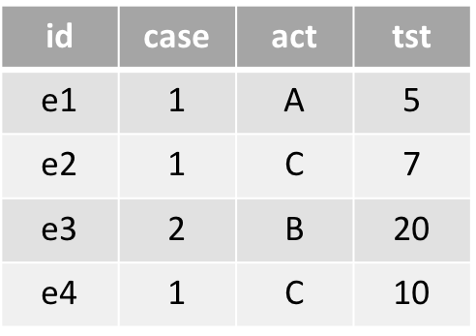



Event log (low quality)
Event log (Anomaly removed)
Input matrices
Trained
Model
(VAE, AE, LSTMAE)
Output matrices
Pre-processing
Model Training
Multivariate
Anomaly
Detection
Anomaly
Detectors

Slide 3
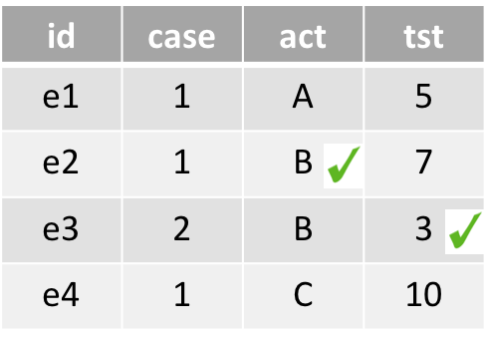
Event log (low quality)
Event log (Reconstructed)
Input matrices
Trained
Model
(VAE, AE, LSTMAE)
Output matrices
Pre-processing
Model Training
Event Log
Reconstruction
Post-
processing

Slide 4
Input
Recon input
A
MAE
(reconstruction error)
Threshold
N
Input
Recon input
Input label
Recon label
Unmatched
A
Matched
N

Slide 5
Input
Recon input
Input label
Recon label
Unmatched
A
Matched
N

