Slide 1
CAR RENTAL
System

Slide 2
Example output 1
===== VEHICLE RENTAL SYSTEM =====
1. Rent Vehicle
2. Exit
Enter choice: 1
Enter customer name: Rahul
Select Vehicle:
1. Car
2. Bike
2
Enter number of days: 2
--- Bike Details ---
Vehicle: Sports Bike
Price per day: 800
Type: Bike
Customer: Rahul
Total Rent: 1600
Example output 2
===== VEHICLE RENTAL SYSTEM =====
1. Rent Vehicle
2. Exit
Enter choice: 1
Enter customer name: Rahul
Select Vehicle:
1. Car
2. Bike
2
Enter number of days: 2
--- Bike Details ---
Vehicle: Sports Bike
Price per day: 800
Type: Bike
Customer: Rahul
Total Rent: 1600

Slide 3
What we did?
﻿Declared some header files like Vehicle.h, car.h, bike.h, rental.h and customer.h and added them
to our main file
﻿Then we used them to our program as per we needed them and as they were declared universally,
we could use them anywhere
lastly, we calculated the expected cost as per the customer's selection of vehicle and
gave them the info they needed
1
2
3

Slide 4
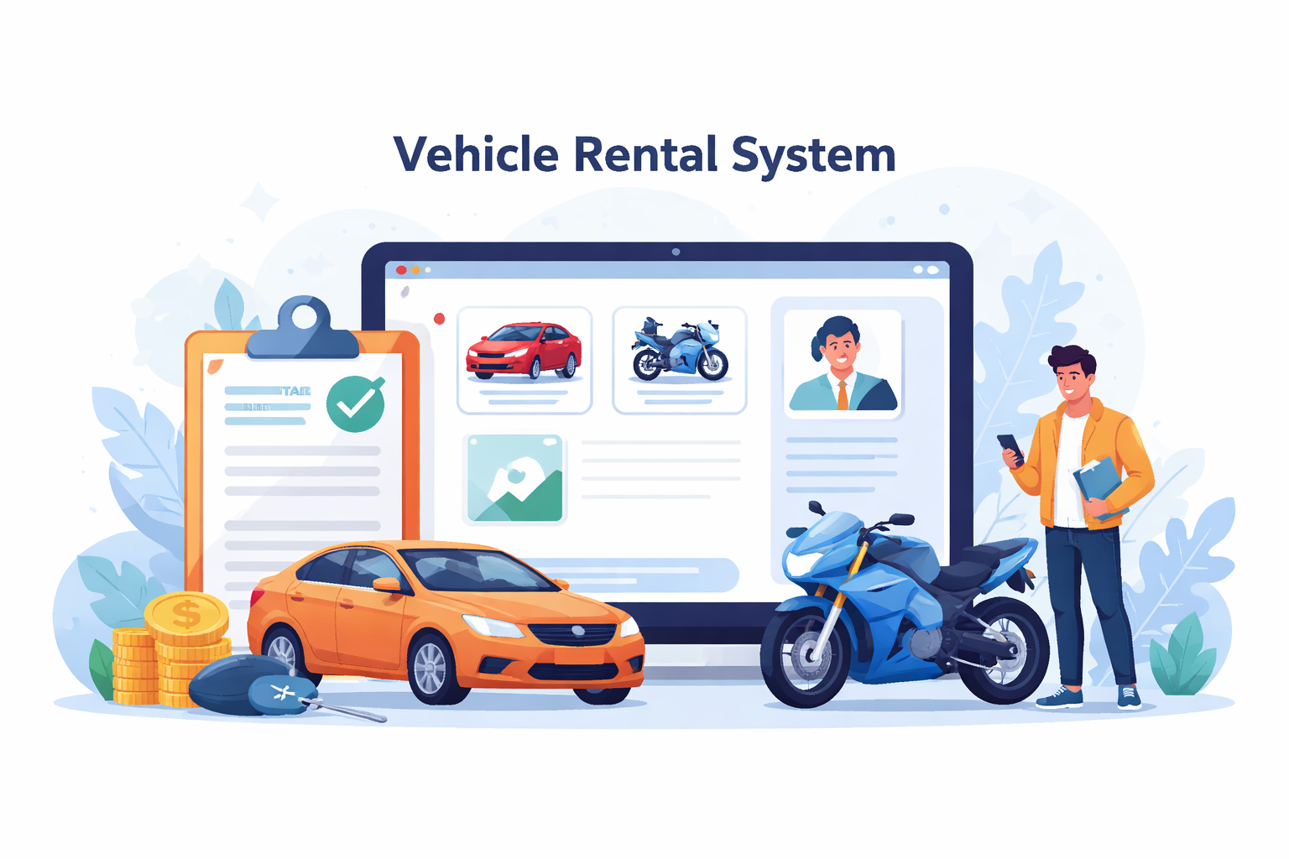
Conclusion
The Vehicle Rental System project demonstrates the practical application of Object-Oriented Programming concepts such as encapsulation, inheritance, polymorphism, and abstraction. It provides an efficient way to manage vehicles, customers, and rental operations through a structured and modular approach. This project not only enhances programming and problem-solving skills but also shows how real-world problems can be solved using well-designed software systems.

