Slide 1
Payroll Management System
Advanced Programming (OOP) Lab
Term-II Project
Name: Dipayan Chatterjee
Course: OOP
Enrollment number- 12024052019024
Roll no - 30

Slide 2
Problem Statement
Many small organizations face difficulties in managing payroll manually, leading to errors in salary calculation, tax deductions, and record maintenance. This system aims to provide a structured and object-oriented solution to manage employee payroll efficiently. It models employees with different salary structures and automates salary computation using modular and reusable components, ensuring accuracy and maintainability.

Slide 3
Objective
• Automate payroll calculation
• Reduce errors
• Demonstrate OOP concepts
• Build modular and scalable system

Slide 4
Core Features
Add employee (Full-time / Part-time)
Remove employee
Display employee details
Calculate salary dynamically
Compute total payroll
Input validation and exception handling
Menu-driven interface

Slide 5
OOP Concepts Used
🔹 Abstraction
An abstract class Employee defines common attributes and behavior.
🔹 Inheritance
FullTimeEmployee and PartTimeEmployee extend the Employee class.
🔹 Polymorphism
The calculateSalary() method is overridden in each subclass, allowing different salary logic.
🔹 Encapsulation
Private data members are accessed using getters and setters with validation.
🔹 Exception Handling
Invalid inputs such as negative salary or hours are handled using exceptions.
🔹 Collections
ArrayList<Employee> is used to store and manage employee objects dynamically.

Slide 6
System Architecture
The system follows a layered object-oriented architecture:
Employee (Abstract Class) Defines common attributes like ID, name, and salary.
FullTimeEmployee / PartTimeEmployee Implement specific salary calculation logic.
PayrollManager Handles employee storage, addition, removal, and payroll calculations.
Main Class Provides a menu-driven interface for user interaction.

Slide 7
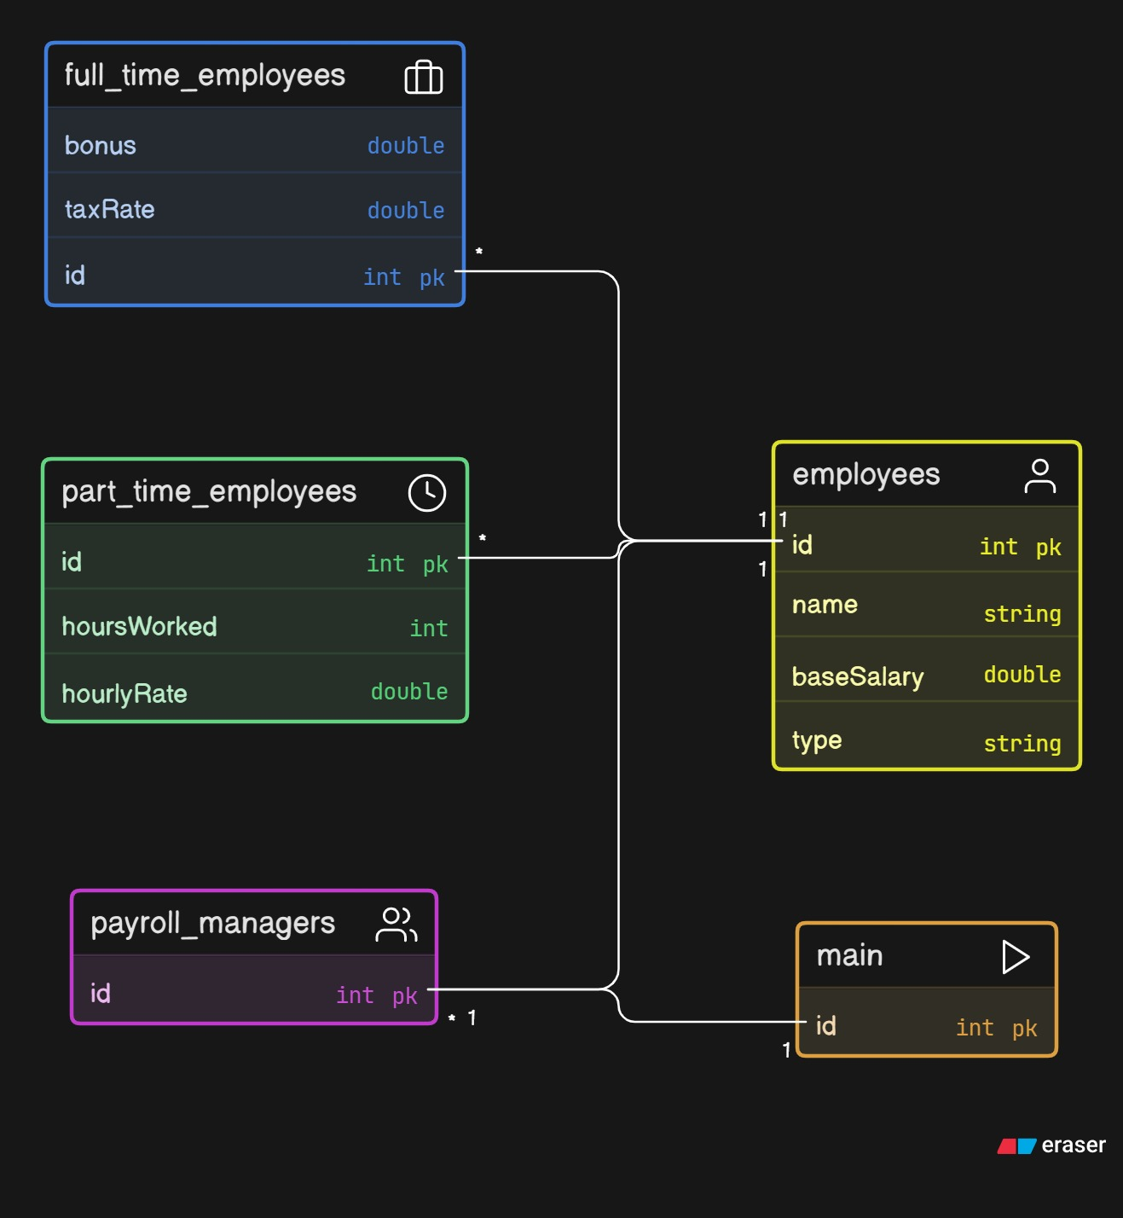
UML Diagram

Slide 8
Conclusion
• Modular design
• Easy to extend
• Demonstrates strong OOP concepts
• Efficient payroll management

Slide 9
Thank You

