Slide 1
Hospital Appointment Booking System
Problem: Manual hospital appointment systems are inefficient and error-prone, Causes delays, poor record management, and booking conflicts
Solution: A simple Java Swing-based GUI system
Target Users: Patients and small clinics
Name: Sampurna Rakshit

Slide 2
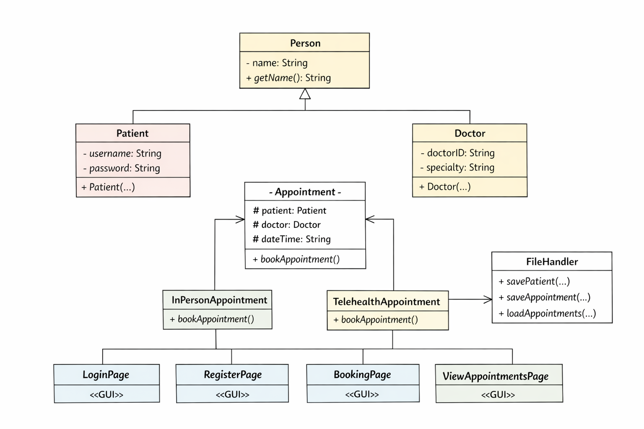
System Design
GUI Layer: Login, Register, Booking, View Pages
Model Layer: Patient, Doctor, Appointment classes
Utility Layer: FileHandler for data storage
Data stored using text files (patients.txt, appointments.txt)
Clear separation of concerns for maintainability

Slide 3
OOP Concepts Used
Abstraction: Appointment abstract class defines common structure
Inheritance: Patient & Doctor extend Person class
Polymorphism: Appointment reference handles multiple types
Encapsulation: Private variables with getters
Collections: ArrayList used for storing multiple records

Slide 4
Technical Highlight
Login validation using file handling and ArrayList
Reads stored users from file and compares credentials
Ensures only valid users can access the system
Chosen for simplicity and no database dependency
Demonstrates real-world authentication logic

Slide 5
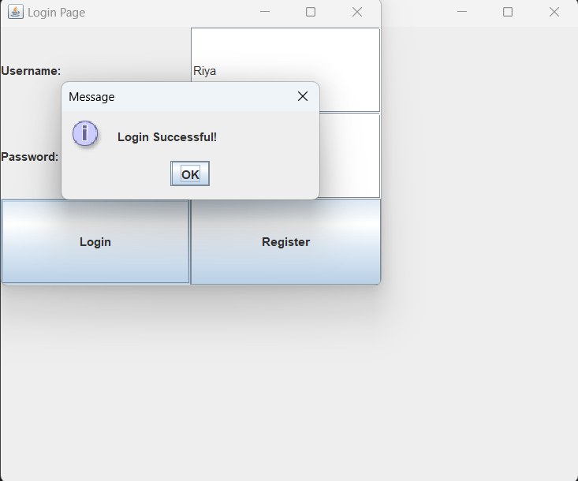
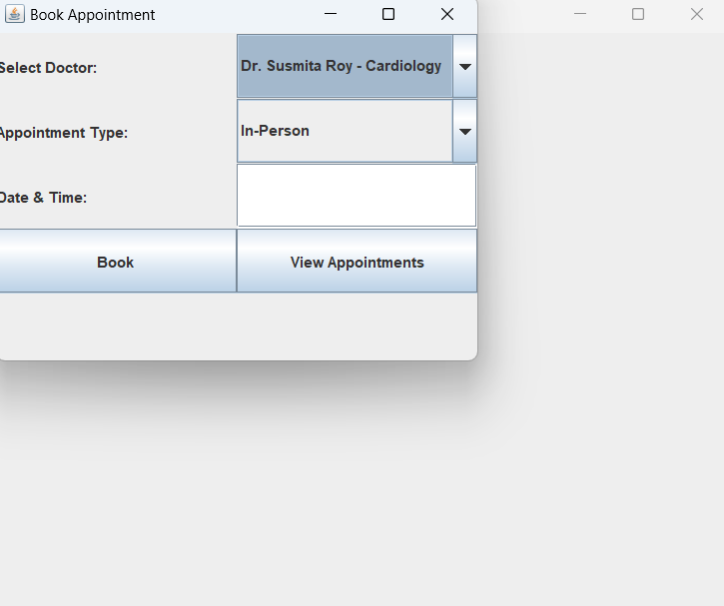
Live Demo & Features
Step 1: Register a new user
Step 2: Login with credentials
Step 3: Book appointment with doctor and date
Step 4: View previously booked appointments
Error Handling: Invalid login & empty input handled

