Slide 1
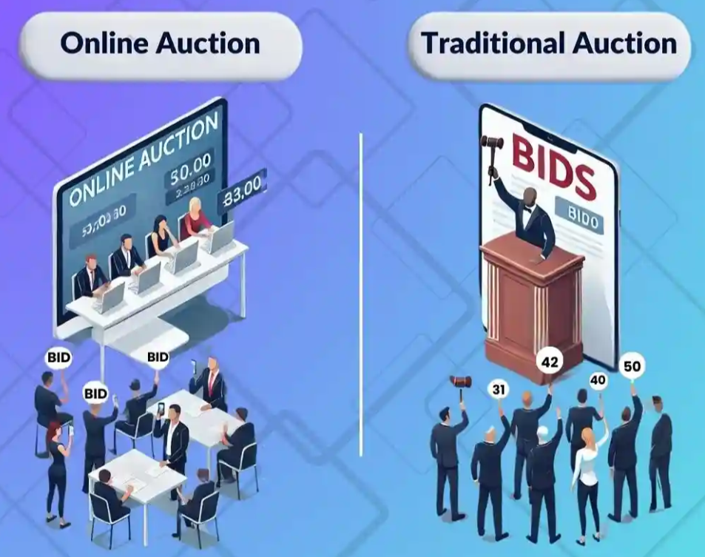
Online Auction System
Java OOP Project
Swing UI
Dynamic Bidding System
Name – Saswata Basak Stream – CSE (IoT) Group – A
Roll No – 17
Enrollment No – 12024052019016
Year – 2nd

Slide 2
Problem Statement
Traditional auction systems require users to be physically present. This Online Auction System allows users to buy and sell items conveniently over the internet. It includes features like user registration, item listing, bidding, tracking bids, and declaring winners. The project demonstrates the use of object-oriented and modular programming concepts using Java.

Slide 3
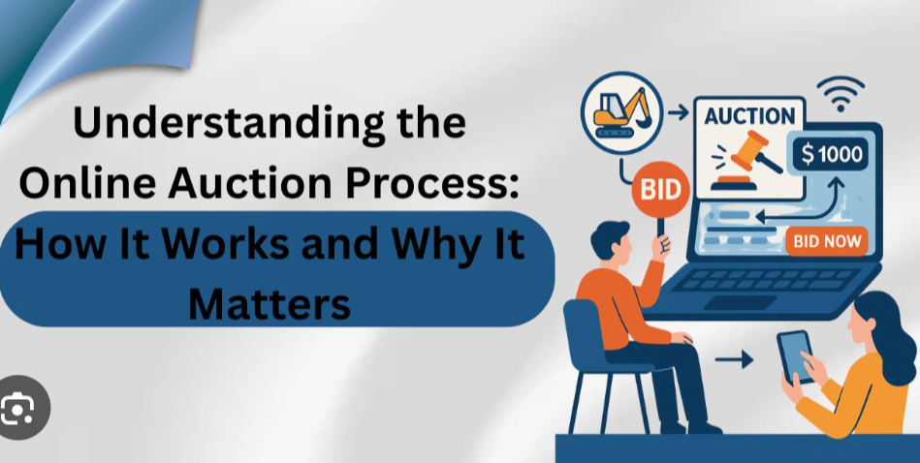
Objectives
• User registration and login
• Real-time bidding
• Auction timer
• Winner determination

Slide 4
Technologies Used
• Java
• Swing (UI)
• OOP Concepts
• Collections Framework
OOP Concepts
• Abstraction (User class)
• Inheritance (Buyer, Seller)
• Encapsulation
• Polymorphism

Slide 5
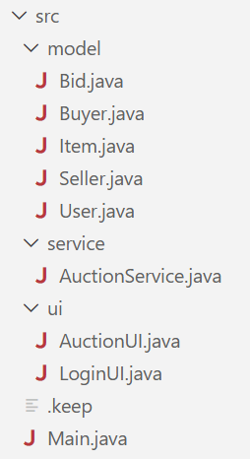
Project Structure
src/ │ ├── Main.java │ ├── model/ │ │ ├── User.java │ │ ├── Buyer.java │ │ ├── Seller.java │ │ ├── Item.java │ │ ├── Bid.java │ │ │ ├── service/ │ │ ├── AuctionService.java │ │ │ ├── ui/ │ ├── LoginUI.java │ ├── AuctionUI.java

Slide 6
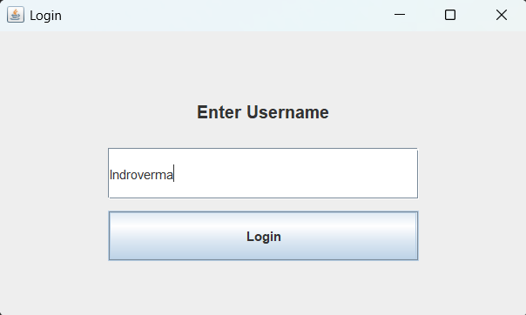
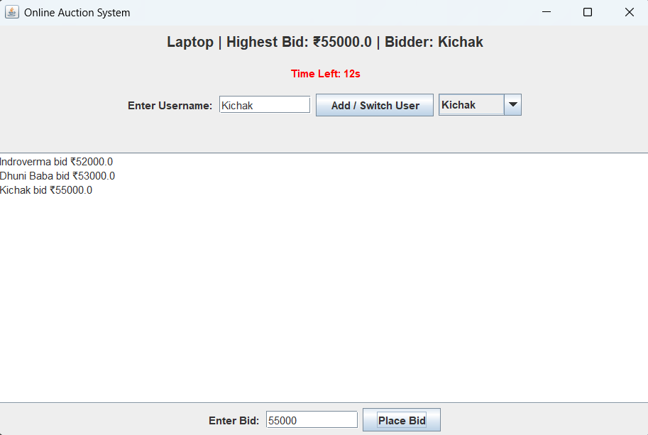
User Interface
• Login Screen
• Auction Panel
Dropdown user selector
Bid input
Bid history display

Slide 7
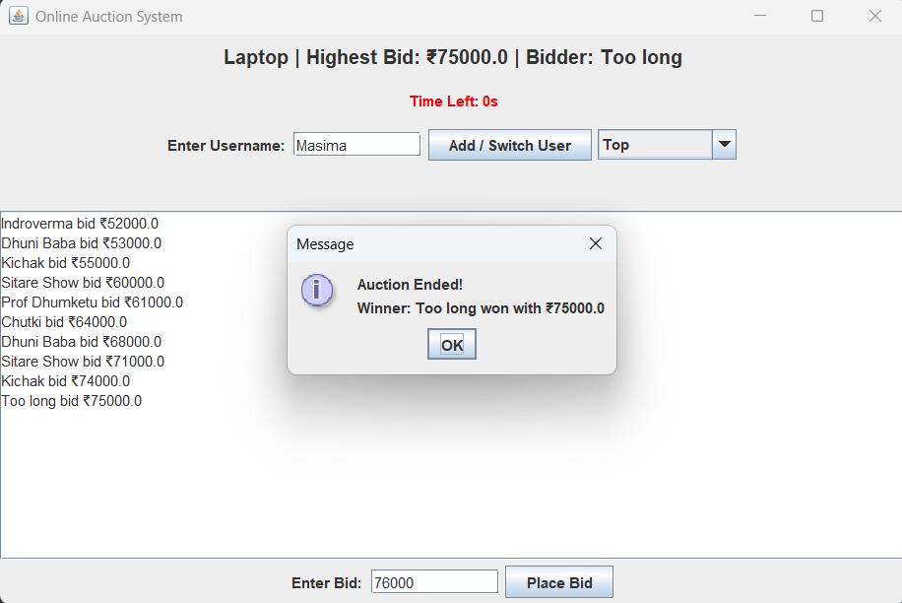
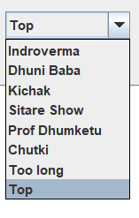
System Features
• Timer-based auction
• Dynamic user addition
• Auto winner declaration

Slide 8
Auction Flow
1. User enters name
2. Selects or adds user
3. Places bid
4. Timer resets
5. Auction ends → Winner declared

Slide 9
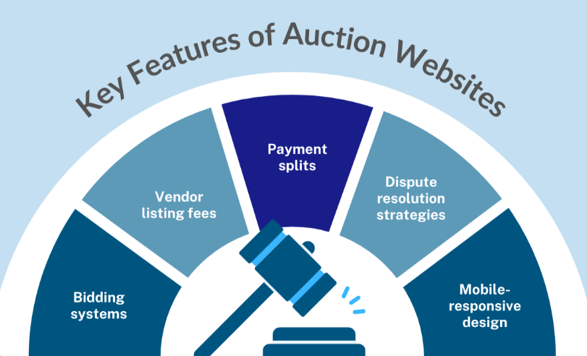
Advantages
• Easy to use
• Real-time interaction
• Scalable design
• Demonstrates OOP clearly

Slide 10
Future Enhancements
• Database integration
• Multiple items
• Admin panel
• Dark theme UI

Slide 11
Conclusion
This project demonstrates a complete OOP-based system
with real-time interaction and user-friendly interface.

Slide 12
Thank You
Saswata Basak
GitHub Link : Click Here to Find the Project

