Slide 1
Simulation of Elevator Control System
using State Pattern
Problem Statement : Elevator systems require handling multiple dynamic states, but traditional approaches rely on complex conditional logic, making the system difficult to maintain and extend.
Target:
Computer Science students learning OOP & Design
Patterns
Beginner developers exploring system design concepts.
Anyone interested in understanding real-world elevator
system simulation

Slide 2
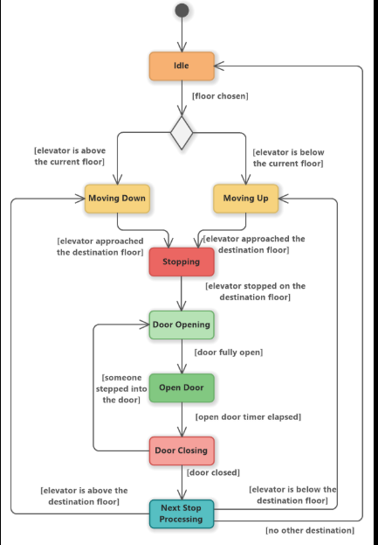
System Design

Slide 3
OOP Concepts Used
Abstraction – Defines common behavior through the State interface without exposing implementation details.
Inheritance – Concrete state classes inherit the structure of the State interface.
Polymorphism – Same method behaves differently based on the current elevator state.
Encapsulation – Elevator data (floor, state, queue) is protected within the class.
Exception Handling – Handles invalid inputs like out-of-range floor requests.
Collections (Queue) – Manages multiple floor requests efficiently in order.

Slide 4
Technical Highlight
The system uses the State Design Pattern to manage elevator behavior dynamically, eliminating the need for complex conditional (if-else logic)
Each elevator state (Idle, Moving Up/Down, Door operations) is implemented as a separate class, ensuring clean and modular design.
The Elevator (context) delegates actions to the current state, allowing smooth and flexible state transitions.
A Queue-based request handling mechanism efficiently manages multiple floor requests in order.
The system includes realistic door state transitions (open, closing, closed) for better simulation accuracy.
The architecture is scalable and extensible, making it easy to add new features like multi-elevator systems or priority scheduling.

Slide 5
Live Demo
Demonstrates the working of the Elevator Control System using the State Pattern in real-time.
User inputs multiple floor requests, and the system processes them using a queue-based approach.
Elevator transitions through different states such as Idle → Moving Up/Down → Door Open → Door Closing → Door Closed.
Shows smooth and dynamic behavior without using complex conditional logic.
Displays current floor, movement direction, and door operations in the console output.
Includes error handling, such as invalid floor inputs, ensuring system robustness.

