Slide 1
Android app development: Design & development of an android-based task Management application using object-oriented programming
Submitted by :
Trinanjan das (12024052004027)
dept. : Information technology (I.t)
college : Institute of engineering & management (iem)
(affiliated to university of engineering & Management (uem))

Slide 2
Problem Statement
Managing daily tasks efficiently is a common challenge for individuals due to lack of proper organization tools. Traditional methods such as writing tasks on paper are inefficient and prone to loss or errors. This project aims to develop a simple and efficient task management application that allows users to digitally store, update, and manage their tasks. The application focuses on usability and structured design using Object-Oriented Programming principles.

Slide 3
Objectives
The primary objective of this project is to design and develop a Task Management Application that enables users to efficiently create, organize, update, and delete daily tasks in a structured digital environment. The project aims to apply core Object-Oriented Programming (OOP) concepts such as encapsulation, inheritance, abstraction, and polymorphism to build a modular and maintainable system. It also focuses on implementing CRUD operations using appropriate data structures like ArrayList to manage tasks dynamically. Additionally, the objective includes developing a user-friendly interface for smooth interaction, ensuring proper exception handling for reliability, and demonstrating how real-world problems can be solved using clean coding practices and logical program design.

Slide 4
🛠️ Technologies Used
Java Core programming language used to implement application logic and OOP concepts
ArrayList Used to store and manage tasks dynamically
Visual Studio Code Code editor used for writing and managing the project
Git Version control system used to track changes and commits
GitHub Platform used to host and share the project online

Slide 5
🧠 OOP Concepts Used
Encapsulation Data and methods are combined inside the Task class using private variables
Abstraction Interface is used to define task operations without implementation details
Inheritance AdvancedTaskManager extends TaskManager to reuse functionality
Polymorphism Methods are designed to perform different behaviors based on usage
Exception Handling Used to handle errors like invalid inputs or operations

Slide 6
🧩 Task Class
The Task class represents the data model of the application and is responsible for storing individual task details such as title and description. It uses encapsulation by keeping variables private and providing public getter methods to access the data. This ensures data security and controlled access, making the code more organized and maintainable.
⚙️ TaskManager Class
The TaskManager class handles the core functionality of the application by managing a collection of tasks using ArrayList. It provides methods to add, update, delete, and retrieve tasks, implementing the main business logic of the system. This separation of logic from the data model ensures modular design and makes the application scalable and easier to manage.

Slide 7
🚀 Features
Add Task Allows users to create new tasks by entering details such as title and description, making it easy to store and organize new activities.
Update Task Enables users to modify the details of an existing task, such as changing the title or description, ensuring flexibility and accuracy.
Delete Task Allows users to remove tasks that are no longer required, helping keep the task list clean and up-to-date.
User-Friendly Interface The application is designed with simple logic and easy interaction, making it convenient for users to navigate and perform operations without complexity.

Slide 8
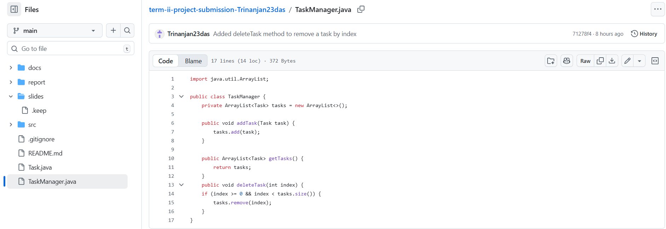
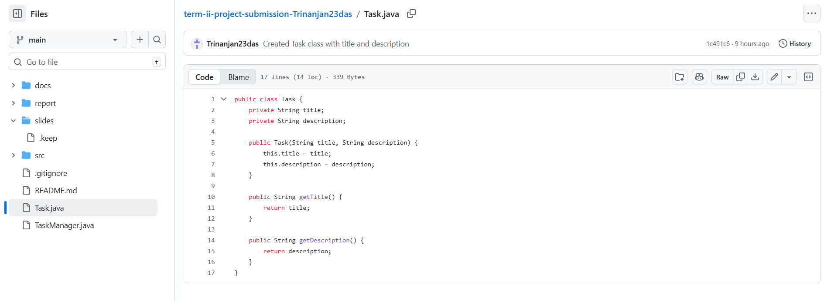
Output / Screenshots

Slide 9
Conclusion
Successfully developed a task management application
Implemented core OOP concepts effectively
Achieved CRUD operations for task handling
Demonstrated structured and modular design
Provides a simple and efficient solution for task management

Slide 10
Future Scope
Develop full Android mobile application
Add user authentication (login/signup)
Implement notifications and reminders
Integrate cloud storage for data backup
Enhance UI/UX for better user experience

