Slide 1
Title: Course Registration System using Composite Pattern
Problem Statement: Students need an efficient system to select, organize, and manage courses, especially when courses are structured into groups like core and advanced modules. Target Users: College and University Students, Academic Administrators

Slide 2
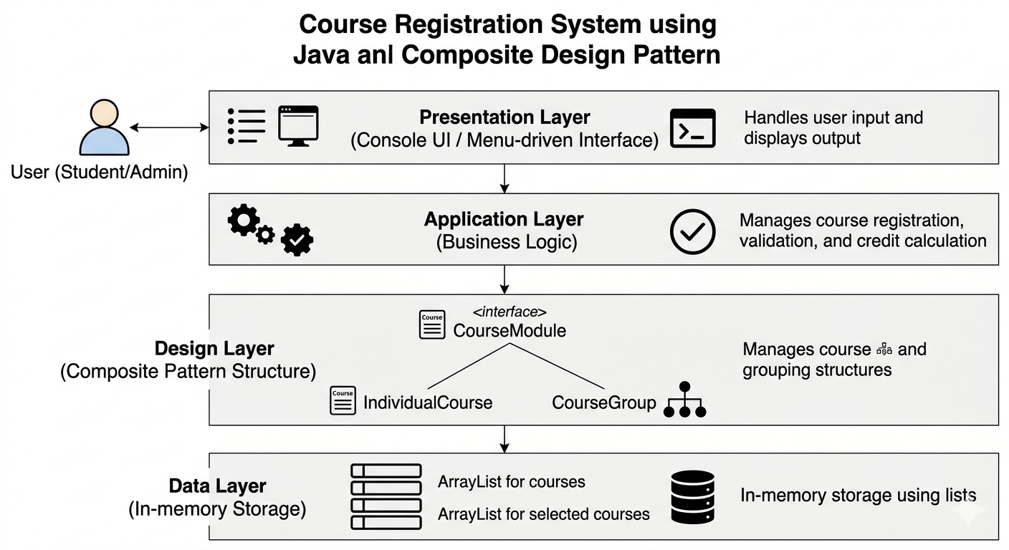
System Design High Level Architecture Diagram:

Slide 3
High-Level Architecture:
User interacts with a menu-driven interface → system processes input → manages course selection using Composite Pattern.
User → Menu System → Course Modules (Composite Structure)
Key Classes & Responsibilities:
CourseModule (Interface): Defines common operations like showDetails() and getCredits()
IndividualCourse (Leaf): Represents a single course with name and credits
CourseGroup (Composite): Groups multiple courses/modules and manages them
Package Structure:
model: Contains CourseModule, IndividualCourse, CourseGroup
main: Contains CourseRegistrationSystem (execution logic)
CourseModule
/ \
IndividualCourse CourseGroup

Slide 4
OOP Concepts Used
Abstraction:
Implemented using the CourseModule interface
Hides implementation details and exposes only essential methods like showDetails() and getCredits()
Inheritance:
IndividualCourse and CourseGroup both implement the CourseModule interface
Ensures a common structure for all course types
Polymorphism:
Same interface (CourseModule) is used to handle both individual courses and course groups
Methods like showDetails() behave differently based on object type
Design Pattern:
Composite Pattern
Allows treating individual courses and groups of courses uniformly
Supports hierarchical (tree-like) course structure

Slide 5
Technical Highlight
Key Design Decision:
Implemented the Composite Pattern to represent both individual courses and grouped course modules
Specific Code Logic:
CourseGroup stores a list of CourseModule objects
Uses a loop to calculate total credits dynamically
Same methods (showDetails(), getCredits()) work for both single courses and groups
Why This Approach:
Simplifies handling of complex course structures
Allows nested grouping (e.g., semester → core + advanced courses)
Makes the system scalable and flexible
Reduces code duplication and improves maintainability

Slide 6
Live Demo:
What I Will Demonstrate:
Menu-driven Course Registration System
Viewing available courses
Registering for courses
Demo Scenario:
Student views all courses
Selects 2–3 courses
System displays selected courses and total credits
Error Handling:
Invalid course selection (wrong number)
Duplicate course registration prevented

