Slide 1


APARAJITA DUTTA
CSE (IOTCSBT)
ROLL-01
Problem Statement:
Traditional quiz systems use rigid, hard-coded logic, making it difficult to add new question types without modifying core code.
PROJECT TITLE:
QuizMaster Pro: A Pattern-Driven Evaluation Engine
Target Users:
Educators, teachers, and corporate trainers who need a flexible and automated assessment system.

Slide 2
Key Classes & Responsibilities
ConsoleUI → Handles user input/output
QuizEngine → Controls quiz flow & scoring
QuestionFactory → Creates question objects dynamically
AbstractQuestion → Base structure for all questions
MCQuestion / BooleanQuestion → Specific implementations
QuestionRepository → Loads questions from file
ResultRepository → Saves results
HIGH-LEVEL ARCHITECTURE :
User
↓
ConsoleUI (UI Layer)
↓
QuizEngine (Service Layer)
↓
QuestionFactory (Factory Layer)
↓
AbstractQuestion → MCQ / Boolean (Model Layer)
↓
Repository (Data Layer)
Package Structure
:
app/
ui/
service/
factory/
model/
repository/
exception/
util/

Slide 3
Abstraction :
Implemented using AbstractQuestion
Defines common methods:
displayQuestion()
checkAnswer()
Design Pattern :
Factory Design Pattern
Implemented using QuestionFactory
Creates objects based on type (MCQ / Boolean)
Polymorphism :
Using:
List<AbstractQuestion> questions;
Runtime method call:
question.checkAnswer(userAnswer);
Inheritance :
MCQuestion and BooleanQuestion
Extend AbstractQuestion

Slide 4
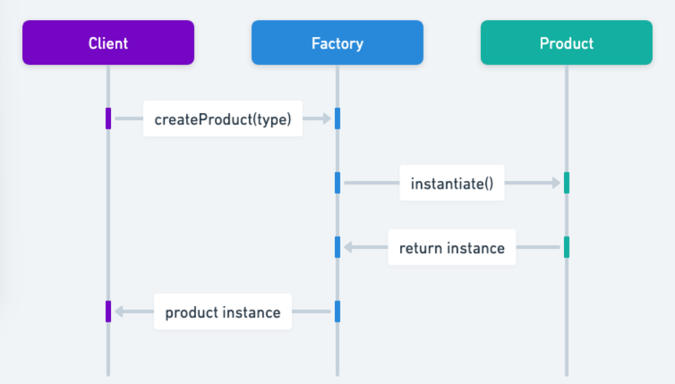
KEY DESIGN DECISION :
Use of Factory Design Pattern for dynamic question creation
AbstractQuestion q = QuestionFactory.createQuestion(type, ...);
01
TECHNICAL HIGHLIGHTS & DESIGN DECISIONS :
TimerService (Multithreading) → countdown + auto submit
File-based persistence → .txt (questions), .csv (results)
Custom Exceptions → robust error handling
02
Why This Approach?
Easy to add new question types
No need to modify existing logic
Improves scalability & maintainability
03

Slide 5

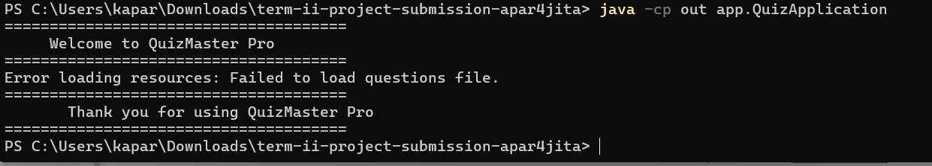
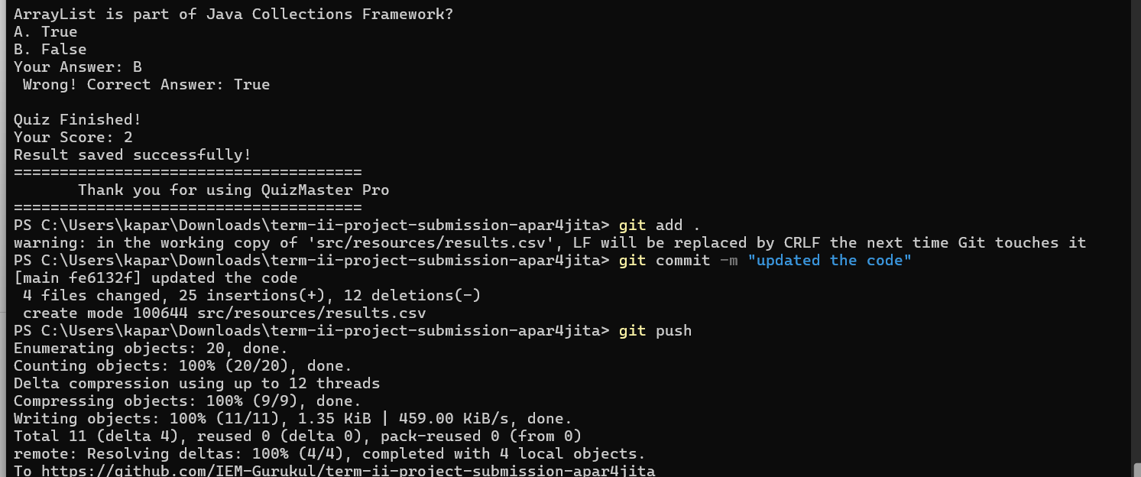
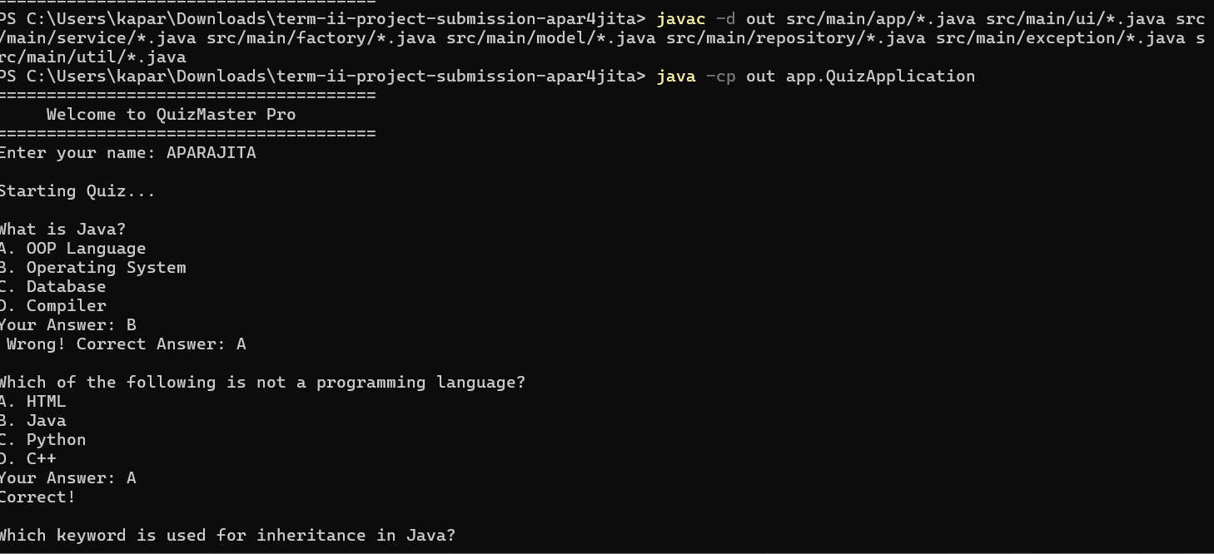
ERROR HANDLING CASES AND DEMONSTRATION :

Slide 6
THANK YOU

