Slide 1

Inventory Management System using DAO Pattern + File Persistence
Problem Statement
This project implements a console-based Inventory Management System in Java to demonstrate the practical application of Object-Oriented Programming principles. The system is structured around the DAO (Data Access Object) design pattern, enforcing a clear separation between the user interface, business logic, and data persistence layers. It serves as a vehicle for applying core OOP concepts including encapsulation, abstraction, inheritance, polymorphism, and exception handling within a cohesive, multi-class Java application backed by file-based persistence.
Target User
Warehouse staff or small business owners managing product inventory from the command line.

Slide 2
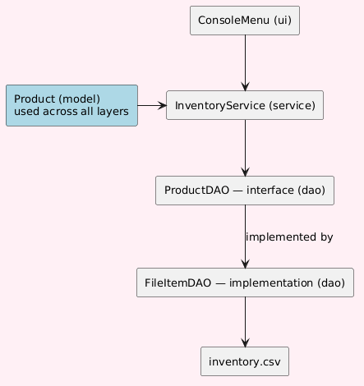
System Design
Architecture diagram
Key classes and responsibilities:
Product:- data model representing an inventory item (SKU, name, price, quantity, description)
ProductDAO:- interface declaring save, find, update, delete operations
FileItemDAO:- reads and writes product data to a CSV file
InventoryService:- enforces business rules, throws exceptions for invalid operations
ConsoleMenu:- presents menu, collects input, displays results
Package structure:
com.inventory.model
com.inventory.dao
com.inventory.service
com.inventory.exception
com.inventory.ui

Slide 3
OOP Concepts Used
Abstraction
ProductDAO is an interface. InventoryService only calls interface methods, it has no knowledge of how data is stored. Swapping FileItemDAO for a database implementation requires zero changes to the service layer.
Inheritance
ItemNotFoundException, InsufficientStockException, and DuplicateSKUException all extend RuntimeException, inheriting exception behaviour while providing meaningful, specific type names.
Polymorphism
InventoryService holds a ProductDAO reference. At runtime, Java routes all calls to FileItemDAO, the correct implementation, without the service layer knowing which concrete class it is talking to.
Design Pattern
DAO Pattern: separates data persistence logic from business logic, making the system extensible and each layer independently testable.

Slide 4
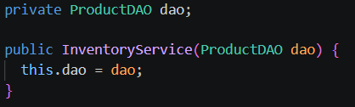

Technical Highlight
InventoryService.java
Specific Design Decision: Constructor Injection and Dependency Inversion
InventoryService does not create its own data access object. Instead, it declares a field of type ProductDAO, the interface, and receives the actual implementation through its constructor. The concrete class FileItemDAO is instantiated only once, in ConsoleMenu, and passed in at that point.
From this point forward, every call inside InventoryService goes through dao, which is of type ProductDAO, not FileItemDAO. Java routes each call to the correct concrete method at runtime without InventoryService knowing which implementation it is talking to.
ConsoleMenu.java
Why this was chosen:
If InventoryService had instead written new FileItemDAO() internally, it would be tightly coupled to file-based storage forever. Changing the storage mechanism would require opening and rewriting the service layer. By depending on the interface and receiving the implementation from outside, InventoryService is completely isolated from that decision.
This means the only line that needs to change to swap storage backends is the instantiation in ConsoleMenu. The service layer, the exception handling, the business rules, none of it changes. That is the practical payoff of the DAO pattern, and it is made possible entirely by this one constructor.

