Slide 1

Car Rental System
Java Console Application
Student: Biswajit Kundu (Roll No. 49, Section A)
Department: Information Technology | Subject Code: PCCCS495

Slide 2



Project Overview
What is it?
Purpose
Relevance
Console-based system managing car rentals, availability tracking, and bookings
Implement OOP principles through practical automation of rental operations
Real-world application demonstrating efficiency gains over manual systems
CAR RENTAL SYSTEM

Slide 3
Project Objectives
01
02
Implement OOP Concepts
Build Modular System
Apply abstraction, encapsulation, and polymorphism in system design
Create organized, maintainable code structure with clear separation of concerns
03
04
Simulate Real Rental System
User-Friendly Design
Model actual car rental operations including booking and return processes
Develop intuitive menu-driven interface for seamless user interaction
CAR RENTAL SYSTEM

Slide 4
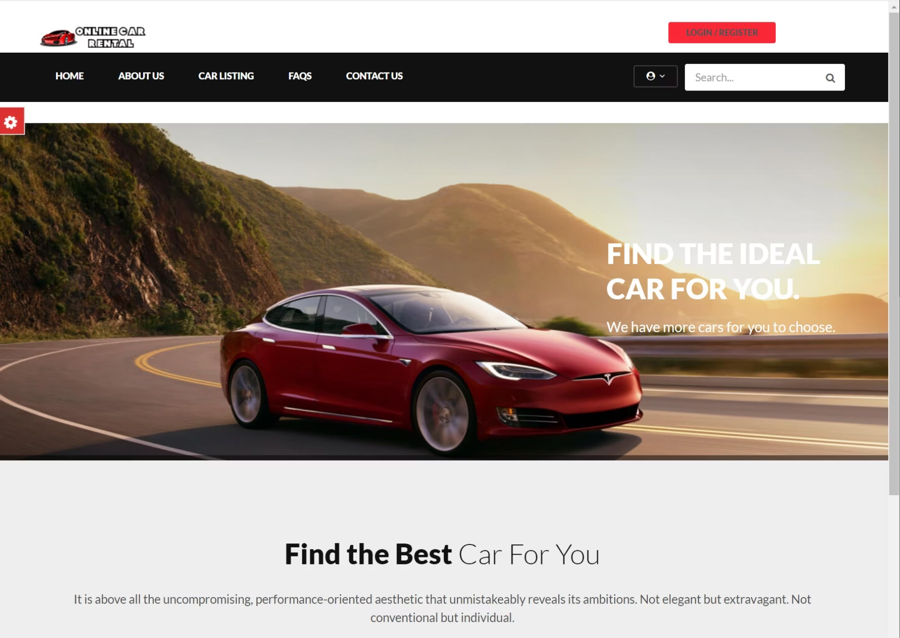
Problem Statement
Challenges with Manual Systems
Time-consuming paperwork and record-keeping
Prone to human errors in availability tracking
Difficult to scale operations efficiently
Limited data accessibility and reporting
Need for Automation
Streamlined processes ensuring accuracy, efficiency, and reliable data management
CAR RENTAL SYSTEM

Slide 5



System Features & Technologies
Core Features
Technology Stack
1
2
Java
Add Cars
Display Cars
Core programming language
Register new vehicles with details
View all available and rented vehicles
3
4
Console
Text-based interface
Rent & Return
Menu Interface
Manage booking and return operations
User-friendly console-based navigation
IDE
VS Code / IntelliJ
CAR RENTAL SYSTEM

Slide 6










System Architecture & UML Design
User
Inputs commands
Main
Entry point
CarRentalSystem
Business logic
Car
Data model
Output
Results displayed
UML Class Diagram
Car
Relationships
CarRentalSystem
Main
CAR RENTAL SYSTEM

Slide 7
Object-Oriented Programming Concepts
Abstraction
Encapsulation
Hide complex implementation details, expose only essential functionality through method interfaces
Private data members with controlled access via public methods ensuring data integrity
Polymorphism
Inheritance
Method overloading for flexible car management operations
Future scope: Extend Car class for different vehicle types
CAR RENTAL SYSTEM

Slide 8
System Working & Implementation
Start Program
1
Initialise system and data structures
2
Display Menu
Show available operations to user
Take Input
3
Read user choice and parameters
4
Execute Operation
Perform selected action
Repeat or Exit
5
Continue loop or terminate
Sample Interaction
Menu Display
Testing & Error Handling
1. Add Car 2. Display All Cars 3. Display Available Cars 4. Rent Car 5. Return Car 6. Exit
Valid inputs: Normal operation
Invalid inputs: Graceful error messages
Edge cases: Empty lists, unavailable cars
Input validation: Data type checking
CAR RENTAL SYSTEM

Slide 9
Advantages, Limitations & Enhancements
Advantages
Limitations
Future Enhancements
Easy to Use
No Database
Database
Intuitive menu-driven interface
Data stored in memory only
Persistent data storage
Reduced Errors
No GUI
GUI
Automated validation and checks
Console-based interface
JavaFX/Swing interface
OOP Practice
Small Scale
Login System
Real-world application of concepts
Single-user application
User authentication
Online Booking
Web-based platform
CAR RENTAL SYSTEM

Slide 10

Conclusion
Project Success
Learning Outcomes
Complete working system implementing all core rental operations with robust error handling
Mastered OOP principles, developed problem-solving skills, gained practical experience in system design
Foundation for Growth
Scalable architecture ready for future enhancements and real-world deployment
Thank You

