Slide 1


PRESENTATION
Writoja Boral

Slide 2
ONLINE QUIZ ENGINE USING FACTORY PATTERN FOR QUESTION TYPES
Problem Statement:
• Many quiz systems lack flexibility in handling different question types
• This project provides a scalable solution using object-oriented design
TARGET USER:
• STUDENTS AND LEARNERS WHO WANT TO PRACTICE QUIZZES INTERACTIVELY
01

Slide 3
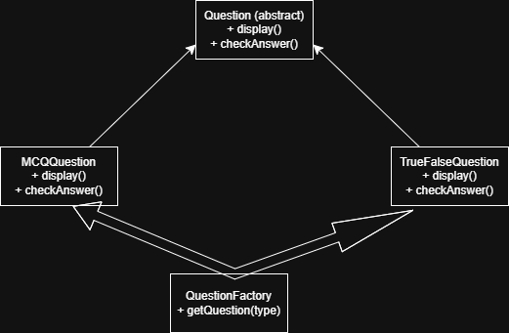
SYSTEM DESIGN
Architecture:
Console-based Java application
Uses Factory Pattern for object creation
Key Classes:
Question (abstract class)
MCQQuestion (Multiple Choice)
TrueFalseQuestion (True/False)
QuestionFactory (creates objects)
Package Structure:
src/ → all Java classes
docs/ → UML diagram
report/ → project report
01

Slide 4
OOP CONCEPTS USED
Abstraction:
Question is abstract
Defines common methods like display() and checkAnswer()
Inheritance:
MCQQuestion and TrueFalseQuestion extend Question
Polymorphism:
Same method (display(), checkAnswer()) behaves differently
Design Pattern:
Factory Pattern used in QuestionFactory
Creates objects without exposing logic
03

Slide 5
TECHNICAL HIGHLIGHT
Feature:
Safe Input Handling + Quiz Flow
What implemented:
Try-catch for invalid input
Range validation
Loop for multiple questions
Score tracking system
WHY CHOSEN:
PREVENTS PROGRAM CRASH
IMPROVES USER EXPERIENCE
MAKES SYSTEM ROBUST AND RELIABLE
EXAMPLE:
IF (Q.CHECKANSWER(ANSWER)) {
SCORE++;
}
04

Slide 6
LIVE DEMO
• Running Quiz Application
• Answering Questions
• Error Handling
• Final Score Display
05

Slide 7
THANK YOU
10

