Slide 1


APARTMENT MANAGEMENT SYSTEM
Manual management of apartment and resident data is inefficient and error-prone
System provides organized digital management
Users: managers, owners, residents
Baivabi Chakraborty
IOTCSBT Roll 17
OOP Project,Spring 26
Notes:
1

Slide 2




HIGH-LEVEL ARCHITECTURE
USER (ADMIN)
MAIN (MENU SYSTEM)
APARTMENT, RESIDENT, OWNER, TENANT
FILE STORAGE (RESIDENTS.TXT)
PACKAGE STRUCTURE
SRC
├── MAIN.JAVA
├── APARTMENT.JAVA
├── RESIDENT.JAVA
├── OWNER.JAVA
├── TENANT.JAVA
├── APARTMENTGUI.JAVA
└── RESIDENTNOTFOUNDEXCEPTION.JAVA
KEY CLASSES & RESPONSIBILITIES
MAIN
APARTMENT
HANDLES FLOW AND INPUT
MANAGES APARTMENT DATA
RESIDENT
TENANT
STORES RESIDENT DETAILS
EXTENDS RESIDENT
OWNER
EXCEPTION
STORES OWNER DATA
HANDLES ERRORS
Notes:
2

Slide 3
OOP CONCEPTS USED
ABSTRACTION
ENCAPSULATION
SEPARATE CLASSES (APARTMENT, RESIDENT, OWNER, TENANT)
PRIVATE DATA WITH METHODS
INHERITANCE
POLYMORPHISM
TENANT EXTENDS RESIDENT
METHODS LIKE TOSTRING()/DISPLAY()
Notes:
3

Slide 4
TECHNICAL HIGHLIGHT
MENU-DRIVEN SYSTEM USING MAIN CLASS
OBJECT-BASED DATA HANDLING
FILE STORAGE (RESIDENTS.TXT)
CUSTOM EXCEPTION HANDLING
CLEAR CLASS-BASED DESIGN
Notes:
4

Slide 5
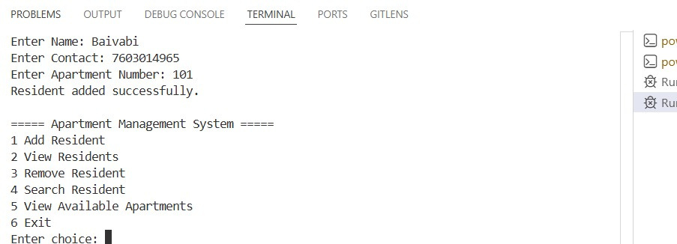
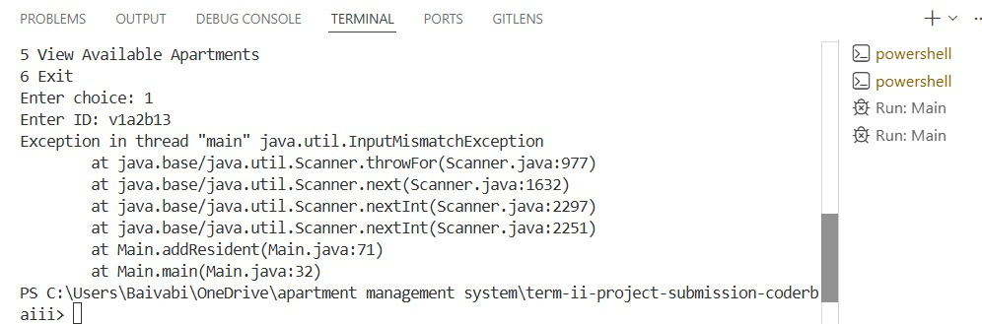
LIVE DEMO
ADD AND VIEW RESIDENT DETAILS
HANDLE INVALID INPUT USING EXCEPTION
Notes:
5

Slide 6
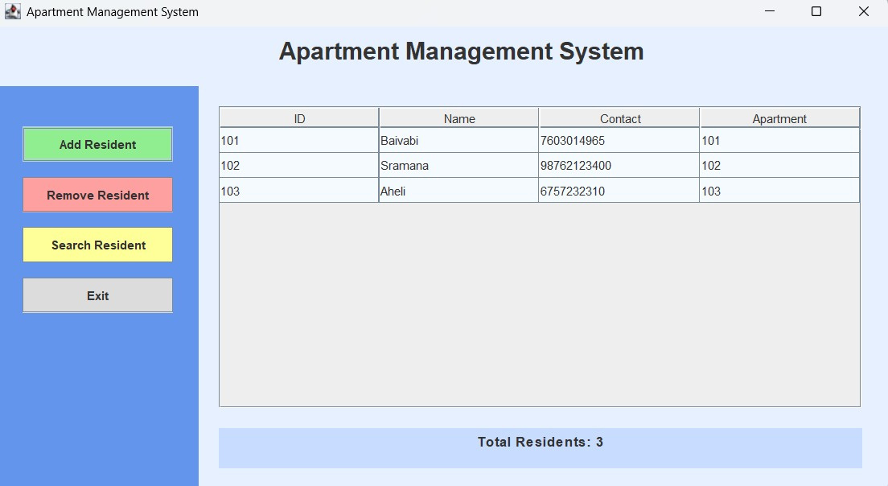
COMPLETE WORKING FLOW

