Slide 1
InvenTrack: Inventory Management System Using DAO Pattern with File Persistence
Course: PCCCS495: Advanced Programming (OOP) Lab
Term II Project
Submitted by: Subhashree Das
Class Roll no.: 64
Enrollment no.: 12024052017066
Department: CSE(IOT CS BT)
Course Instructor: Soumadip Biswas Sir, Susovan Jana Sir, Swagatam Basu Sir.
Semester: 4th (Spring 2026)

Slide 2
PROBLEM STATEMENT
Manual inventory management in small businesses leads to data loss, inefficient tracking, lack of search functionality, and no automated low-stock alerts.
TARGET USERS
Small shop owners & retail stores
Local businesses managing inventory manually
Beginners learning Java OOP & system design

Slide 3
SYSTEM ARCHITECTURE
Model Layer:
Responsibility: Data representation using Product, Category, Supplier classes.
DAO Layer:
Responsibility: Data access and persistence through interfaces and file persistence.
Service Layer:
Responsibility: Contains core business logic and validation rules.
UI Layer:
Responsibility: Presents information and handles user interaction via a Swing-based dashboard.

Slide 4




OOP CONCEPTS DEMONSTRATED
Inheritance
Polymorphism
Design Pattern (DAO)
Abstraction
DAO interfaces declare methods without implementation.
ValidationException extends RuntimeException, UI panels extend JPanel.
Interface references resolved at runtime, method overriding in UI panels.
DAO pattern for data access abstraction.

Slide 5
TECHNICAL HIGHLIGHT
Generic FileManager (Java Generics)
→ Single reusable method for all entities (Product, Category, Supplier)
→ Reduces code duplication and improves maintainability
Service Layer Validation
→ Centralized validation for all inputs
→ Ensures data integrity & prevents invalid operations
→ Enforces referential integrity (valid category & supplier)
Unique ID Generation
→ Auto-generated sequential IDs (PRD001, PRD002…)
→ Prevents duplication even after deletions
→ Ensures consistent product tracking
Low Stock Detection Logic
→ Encapsulated inside Product class
→ Reusable across Dashboard & Low Stock panel
→ Provides real-time inventory alerts

Slide 6
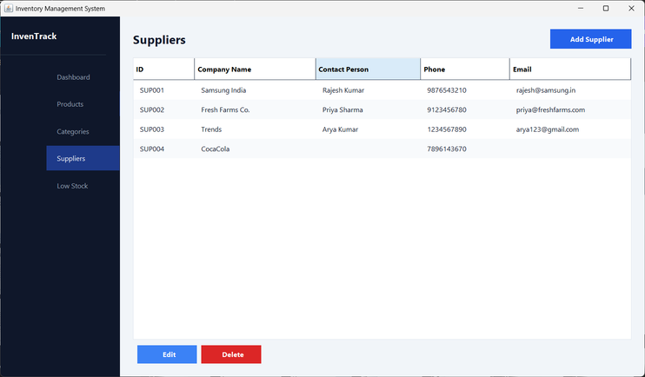
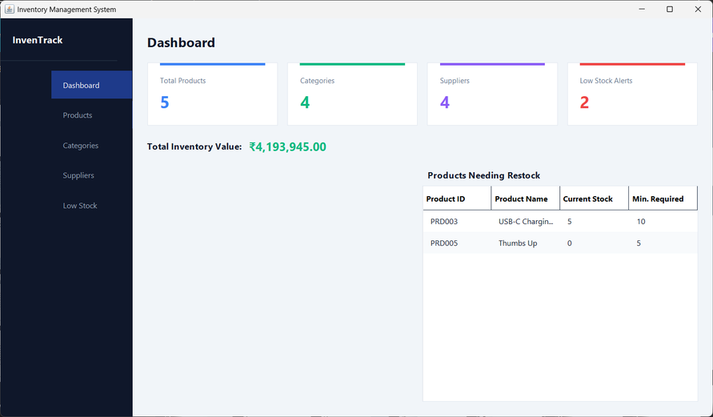
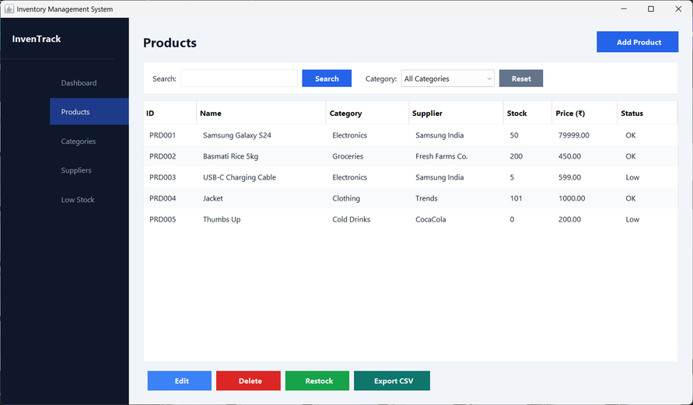
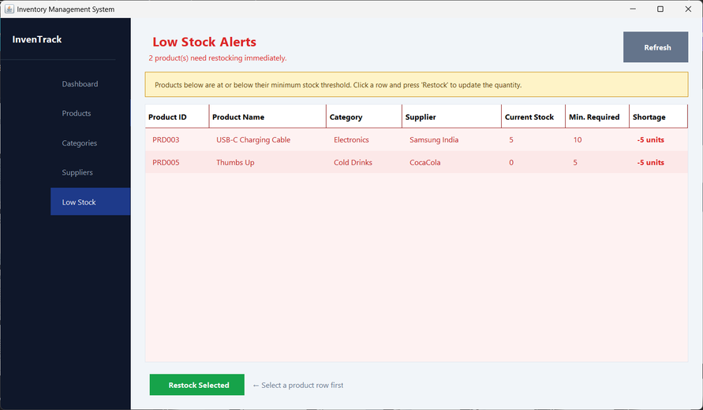
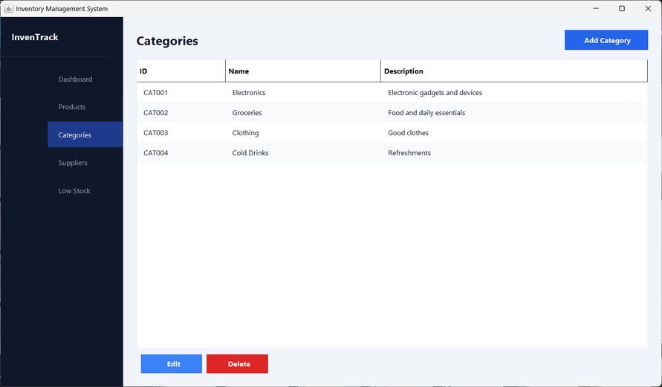
LIVE
DEMO

Slide 7
Thank You

