Slide 1
OOPS LAB · SEMESTER 4
{ }
Online Quiz Engine
Problem: Automate quiz creation, administration & evaluation
with support for multiple question types, real-time timers & persistent storage.
🎯 Target User: Students & Educators
Mohammed Kashif Ansari · Roll No. 45
1 / 5

Slide 2
SYSTEM DESIGN
System Design
HIGH-LEVEL ARCHITECTURE
UI Layer — Main.java (Console Menu)
CORE LAYER
QuizSession Runnable / Timer Thread
ScoreEvaluator Strategy Pattern
Quiz Container Questions + Metadata
MODEL LAYER
MCQQuestion
TrueFalseQuestion
ShortAnswerQuestion
Question (Abstract)
STORAGE & EXCEPTIONS
FileManager storage/
InvalidInputException exceptions/
SessionViolationException exceptions/
📁 Package Structure:
src/ ├── core/ ├── model/ ├── storage/ ├── exceptions/ ├── Main.java └── UnitTest.java
2 / 5

Slide 3
OOP CONCEPTS
OOP Concepts Used
◈
Abstraction
⇣
Inheritance
Question (Abstract Class)
MCQQuestion, TrueFalseQuestion, ShortAnswerQuestion
Defines evaluate(), getScore(), display() as abstract methods — hides implementation from Quiz logic.
All extend Question, inheriting id, text, marks fields and overriding abstract methods.
⬡
Polymorphism
⚙
Design Pattern
QuizSession — question loop
Strategy Pattern — ScoreEvaluator
List<Question> iterates all types uniformly; correct evaluate() / display() dispatched at runtime.
ScoreStrategy interface injected into ScoreEvaluator; swappable scoring (partial credit, weighted) at runtime.
3 / 5

Slide 4
TECHNICAL HIGHLIGHT
Technical Highlight
QuizSession.java · Background Timer
01
@Override
Concurrent Timer Thread
public void run() {
QuizSession implements Runnable — the timer runs in a background thread, counting down without blocking user input.
while (sessionActive && timeRemaining > 0) {
Thread.sleep(1000);
timeRemaining--;
if (timeRemaining % 10 == 0) {
02
System.out.println("[Time: " + timeRemaining + "s]");
Why This Approach?
}
A blocking timer would freeze the console. Using Thread.sleep(1000) in a separate thread keeps I/O responsive while enforcing the time limit.
if (timeRemaining == 0) {
sessionActive = false; // auto-end
}
}
03
}
Strategy Pattern Choice
ScoreEvaluator accepts any ScoreStrategy at runtime — future partial-credit or weighted scoring requires zero changes to core session logic.
4 / 5

Slide 5
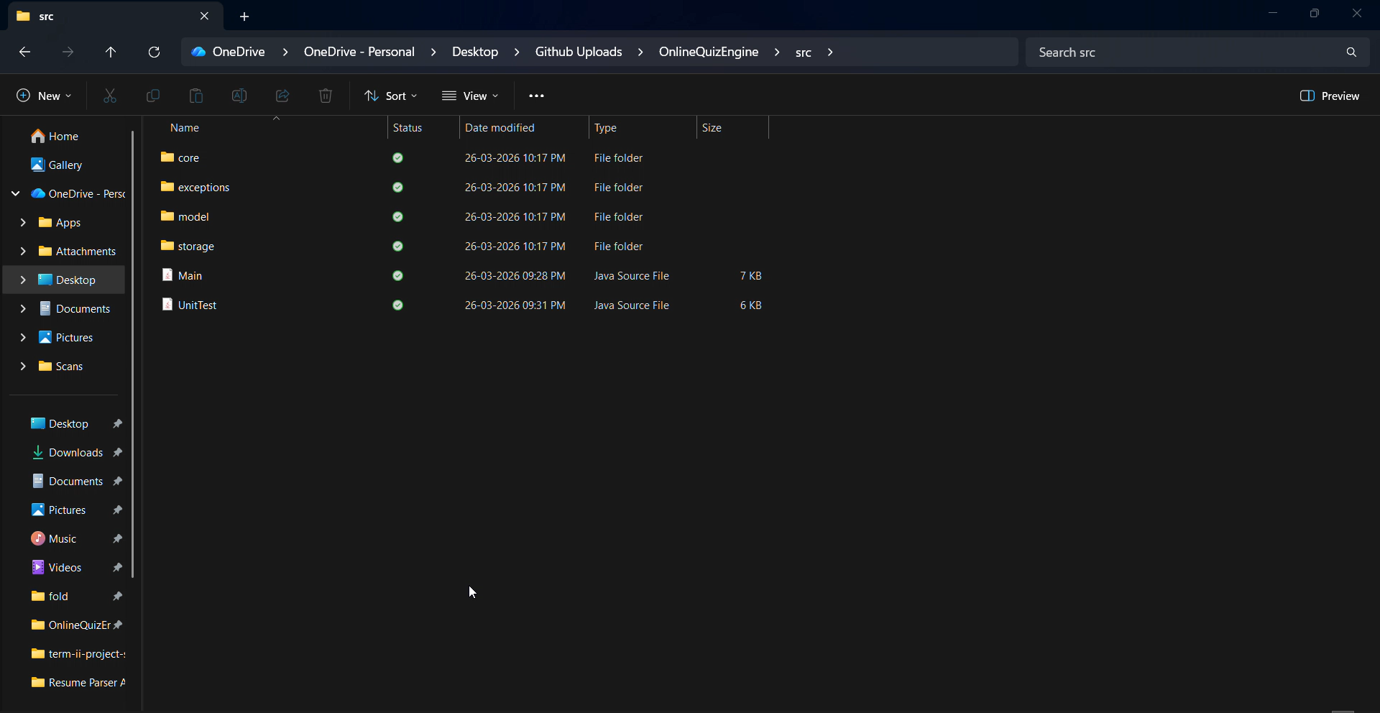
LIVE DEMO
Live Demo
DEMO SCRIPT
1
Working System
Load quiz & start session with countdown timer visible
▶
2
MCQ + T/F + Short Ans
Answer all 3 question types in one session
3
Meaningful Scenario
INSERT VIDEO HERE
Complete a timed quiz — view score & result summary
Drag & drop or Insert → Video to embed your demo recording
4
Error Handling
Submit blank input → InvalidInputException shown; timeout → auto session end
5 / 5

