Slide 1
Hospital Appointment Management System
Problem: Manual systems are inefficient leading to loss of patient /hospital data.
Target Users: Clinics, Reception Staff, Admins

Slide 2
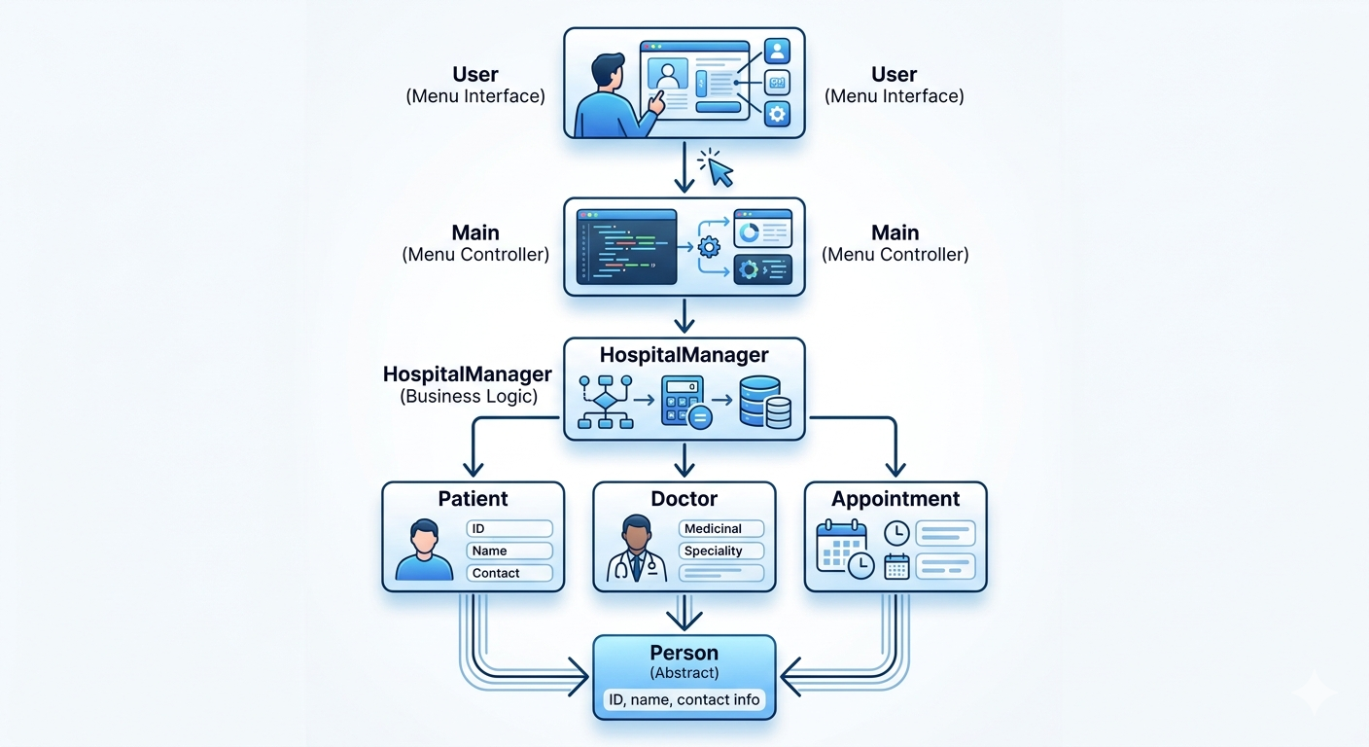
System Design

Slide 3
OOP Concepts Used
Abstraction: Person
Inheritance: Patient, Doctor
Polymorphism: displayInfo()
Encapsulation: private variables
Collections: ArrayList

Slide 4
Technical Highlight
Menu-driven system
Uses ArrayList
Simple, flexible, easy to manage

Slide 5
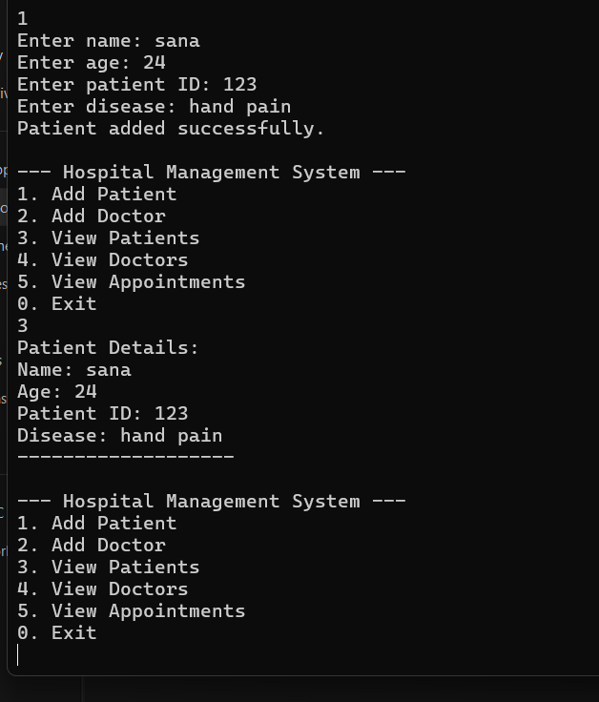
Live Demo

