Slide 1

Inventory Management
System
with DAO Pattern and File Persistence
Java Swing GUI
OOP Design
Offline Ready
Term II Project • Object-Oriented Programming with Java • rish0422

Slide 2
Problem Statement
The Problem
Our Solution
Small businesses lack affordable tools to manage inventory effectively.
Manual tracking leads to:
Stockouts and overstock situations
Lost revenue from poor visibility
No real-time low-stock alerts
Reliance on expensive enterprise ERP
A lightweight offline Java desktop app for complete inventory management.
Built with:
DAO Pattern for clean architecture
Binary file persistence (no DB setup)
Intuitive Java Swing GUI
Works 100% offline

Slide 3






Core Features
Product Management
File Persistence
Search & Filter
Add, edit, delete products with full field validation
Binary products.dat survives restarts — zero DB needed
Real-time search by product name or category
Low Stock Alerts
Stock Operations
Exception Safety
Red row highlighting for products below threshold
Restock and deduct quantities with validation guardrails
All errors shown via dialogs — no silent crashes

Slide 4
OOP Concepts Applied
OOP Concept
File
Description
Abstraction
ProductDAO.java
Interface hides all implementation details from UI/Service layers
Inheritance
ProductDAOImpl.java
Implements DAO interface, inheriting its full contract
Polymorphism
ProductService.java
ProductDAO reference points to ProductDAOImpl at runtime
Encapsulation
Product.java
Private fields, public getters/setters; validation hidden in Service
Exception Handling
All Layers
JOptionPane dialogs surface errors without crashing the app
Collections/Streams
ProductDAOImpl.java
List<Product> + Java Streams API for filter and search

Slide 5

System Architecture
UI Layer (Swing)
MainFrame · ProductTablePanel · ProductFormPanel · SearchPanel
Service Layer
ProductService — business logic, validation, orchestration
DAO Layer
ProductDAO (interface) → ProductDAOImpl (file-based impl.)
Persistence
products.dat — serialised List<Product> binary file
Each layer communicates ONLY with the layer directly below it — strict separation of concerns.

Slide 6
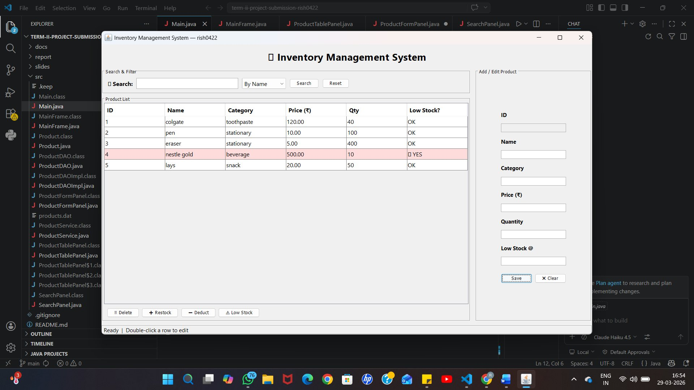
Application Output
Search & Filter Panel
Add / Edit Form
Low Stock Alert (Red)

Slide 7
How to Run
Requirements
Setup & Run
Java Version:
Java 17 or higher
1
Clone the Repository
git clone https://github.com/rish0422/term-ii-project-submission-rish0422.git
GUI:
Java Swing (built-in)
2
Enter Project Directory
Database:
None required
cd term-ii-project-submission-rish0422
3
Compile All Source Files
Network:
Fully offline
javac src/*.java
OS Support:
Windows / macOS / Linux
4
Run the Application
java Main

Slide 8
Thank You!
Inventory Management System
DAO Pattern • Java Swing • File Persistence
github.com/rish0422/term-ii-project-submission-rish0422
Term II • Object-Oriented Programming with Java • rish0422

