Slide 1



Student Attendance Management System
Problem Statement:Manualattendancetrackingisinefficient, error-prone,
andlacks automation.
Target Users: Schools, colleges, and training institutes.

Slide 2

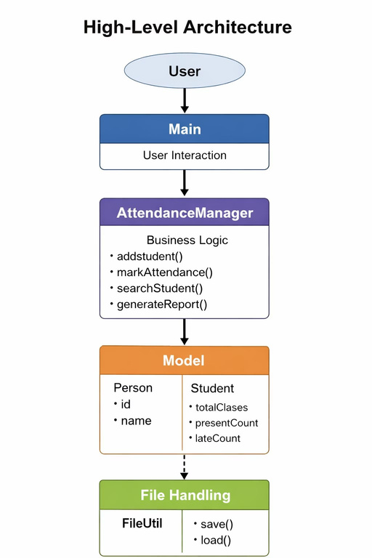
System Design
Key Classes:
Package Structure:
Person → stores ID & name Student → manages
attendance data
AttendanceManager →
controls operations
FileUtil → handles file storage
model service util main

Slide 3

OOP Concepts Used
Abstraction
Main interacts with AttendanceManager
Inheritance
Student extends Person
Polymorphism
Different attendance status (P/A/L)
Encapsulation
Private fields with getters/setters

Slide 4

Technical Highlight
Feature: Attendance Status Handling (P/A/L)
Logic: Single method handles multiple attendance types
Why Chosen:
Flexible input handling Reduces code duplication Improves user experience

Slide 5

Live Demo
Add Student
→
Shows success message
Mark Attendance
→ With date & status
View Reports
→
Displays % and warnings
Error Handling:
Duplicate ID → Error shown Invalid input → "Invalid choice" Student not found → Proper message

Slide 6
