Slide 1
Adaptive Study Strategy Engine
PCCCS495 – Term II Project
Student Name: Shreya Sinha
Roll Number: 26
Instructor Name: Soumadip Biswas, Dr. Susovan Jana
Semester: 4th

Slide 2
PROBLEM STATEMENT
Students struggle to manage multiple subjects
Traditional planners require manual effort
No dynamic prioritization
Weak topics are often ignored
Leads to inefficient study pattern

Slide 3
OBJECTIVES
Automate study planning
Prioritize topics dynamically
Focus on weak areas
Improve time management
Implement OOP concepts

Slide 4
TARGET USERS
College students
School students
Competitive exam aspirants

Slide 5
CORE FEATURES
Add and manage study topics
Record mastery level (0–100)
Dynamic priority calculation
Automatic schedule generation
GUI using Java Swing
Swimlane-based workflow visualization

Slide 6
OOP CONCEPTS
Abstraction → StudyUnit
Inheritance → Topic extends StudyUnit
Polymorphism → calculatePriority()
Encapsulation → Data protection
Collections → PriorityQueue
Swimlane Modeling → Workflow visualization

Slide 7
SYSTEM ARCHITECTURE
Components:
StudyUnit (Abstract class)
Topic (Subclass)
StrategyEngine (Analysis)
ScheduleManager (PriorityQueue)
MainApp (GUI)

Slide 8
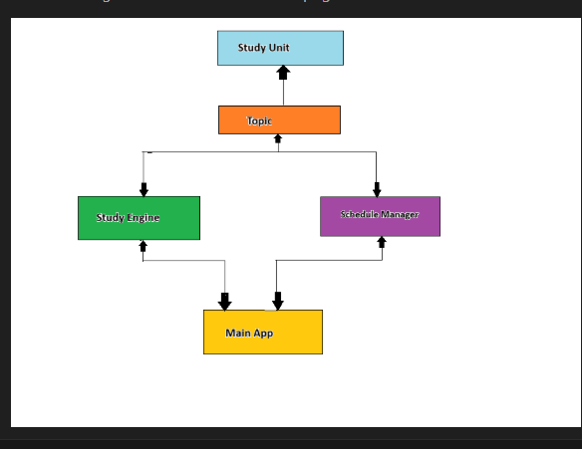
UML DIAGRAM

Slide 9
SWIMLANE FLOW
USER → MAIN APP → STRATEGY ENGINE →
SCHEDULE MANAGER → MAIN APP → USER

Slide 10
IMPLEMENTATION
Language: Java
GUI: Swing
Data Structure: PriorityQueue
Priority Formula:
Priority = 100 − Mastery Level
Lower mastery = higher priority

Slide 11
GIT WORKFLOW
Initial commit → setup
Added classes
Implemented scheduling
GUI development
Final testing

Slide 12
CONCLUSION
Smart and adaptive study planner
Improves learning efficiency
Demonstrates OOP concepts
Scalable and practical system

Slide 13
THANK YOU!

