Slide 1
Smart Task Scheduler with Dynamic Strategy Execution
Problem Statement:
Manual sorting and static priority assignments lead to missed deadlines.
Users face "unproductive workload spikes" when schedules don't adapt to change.
Target Users: College students and early-career professionals needing automated reordering.
Current Limitation: Existing applications rely on manual sorting and static priority assignments, leading to missed deadlines.
System Goal: Address productivity gaps by modeling tasks through a structured object-oriented hierarchy.
Automated Logic: A pluggable scheduling mechanism automatically reorders tasks as conditions evolve.
Core Innovation: Implementation of three interchangeable scheduling strategies that are switchable at runtime.
Conflict Management: Automatic detection and reporting of scheduling conflicts using the Observer design pattern.

Slide 2
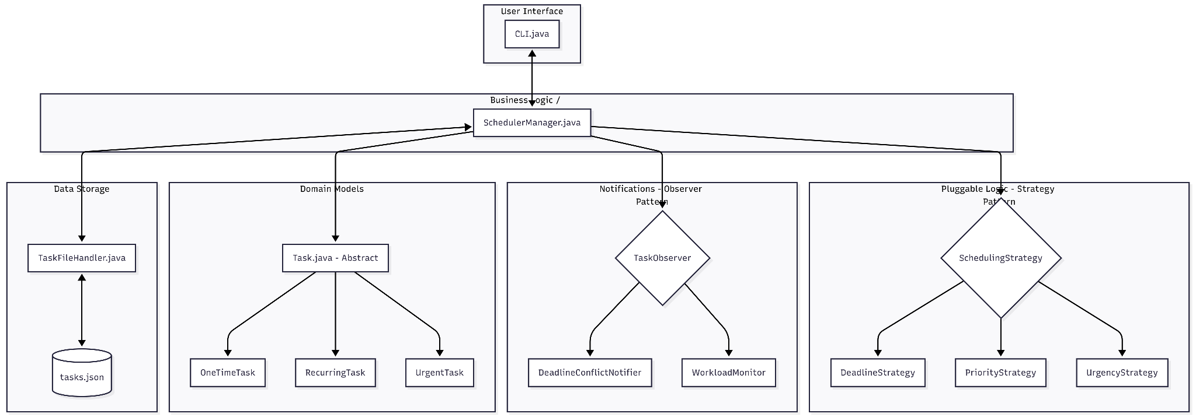
System Design

Slide 3
OOP Concepts Used
Abstraction: The abstract Task class hides complexity and mandates urgency computation for all types.
Inheritance: OneTimeTask, RecurringTask, and UrgentTask reuse base logic for deadlines and validation.
Polymorphism: The UrgencyStrategy calls getUrgencyScore()—the system resolves the specific formula (One-time vs. Urgent) at runtime.
Design Patterns:
Strategy: Algorithms can be switched at runtime without modifying the manager.
Observer: Decouples conflict detection from core logic; observers receive unmodifiable snapshots.
Strategy Pattern: Selects and switches algorithms at runtime without modifying any existing classes.
Observer Pattern: Defines a one-to-many dependency where all registered observers are notified of list mutations
Custom Exceptions: Implements DeadlineConflictException to model distinct failure modes like workload caps.
Collections: Maintains a master list as an ArrayList<Task> to support random-access updates and sorting.

Slide 4
Technical Highlight
The Problem: Initial code used "instanceof" checks inside the SchedulerManager, which was rigid and messy.
The Solution: Moved logic into an abstract method on Task. Now, each task "knows" its own urgency.
Result: Adheres to the Open/Closed Principle—adding a new task type requires zero changes to the scheduling logic.
JSON Persistence: Custom serializer built from scratch to handle subclass-specific fields like.
Type Support: Chose JSON over CSV to naturally support optional, type-specific fields like intervalDays.
Fail-Fast Design: Implemented constructor guard clauses to ensure invalid Task objects cannot be created.
Observer Decoupling: Passed unmodifiable snapshots to observers to prevent accidental mutation of the live list.
Checked Exceptions: Forced callers to handle scheduling conflicts explicitly by extending the Exception class.

Slide 5
Workflow & Error Handling
Workflow:
Creation: Add a RecurringTask (e.g., Weekly Progress Report).
Dynamic Reorder: Switch strategy from "Priority" to "Urgency" and observe the list shift.
Conflict Detection: Attempt to schedule >12 hours on a single day.
Exception Handling: Show DeadlineConflictException providing specific feedback: "Adding this task would schedule 14h on [Date]" instead of a generic error
.Workload Status: Show the monitor classifying health as LIGHT, MODERATE, or OVERLOADED.
Automatic Conflict: Attempt to schedule more than 12 hours on one day to trigger a DeadlineConflictException.
Alert Notifications: Display emoji-coded alerts from the DeadlineConflictNotifier for upcoming or overdue tasks.
Data Persistence: Exit the application and reload to prove tasks are successfully reconstructed from tasks.json.
Recurring Logic: Show how completing a RecurringTask automatically advances the deadline for the next occurrence.

