Slide 1
NivoraStay – Intelligent Hotel Reservation System
Problem: Manual booking systems cause double booking and poor data management. It also lacks real-time validation, leading to errors in room availability and booking management.
Target Users: Hotel staff and Administrators
Student Name: Swastika Das
Roll No: 31
Course Name: Advanced Programming (OOP)

Slide 2
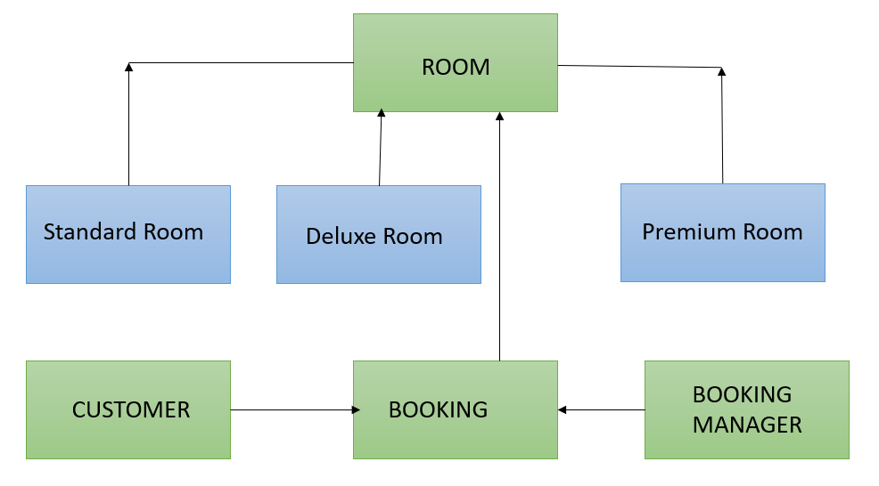
System Design: (High-level architecture diagram)
Architecture: Main → BookingManager → Room / Booking / Customer

Slide 3
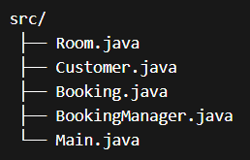
Key Classes & Responsibilities:
• Room – base class for room types • Customer – stores user data • Booking – links room and customer • BookingManager – controls all operations
Package Structure:
model
- Room
- StandardRoom
- DeluxeRoom
- PremiumRoom
- Customer
- Booking
service
- BookingManager
main
- Main
(Project Folder Structure)

Slide 4
OOP Concepts Used
Encapsulation:
Customer data is private
Inheritance:
StandardRoom, DeluxeRoom, PremiumRoom extend Room
Polymorphism:
Room reference used for different room types
Collections:
ArrayList → bookings
HashMap → customers

Slide 5
TECHNICAL HIGHLIGHT
Feature 1: Prevent Double Booking
Logic:
Before confirming a booking, the system checks if the room is available.
if (!isRoomAvailable(roomNumber)) {
→ Display “Room already booked”}
Feature 2: Booking Cancellation • Allows users to cancel booking using ID • Updates room availability automatically
Why this approach?
• Ensures flexibility for users • Maintains accurate booking records • Improves system reliability

Slide 6
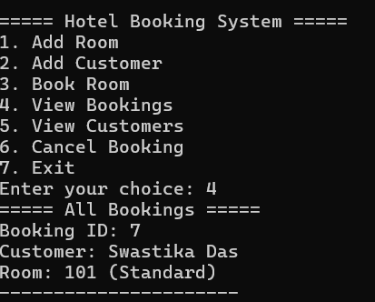
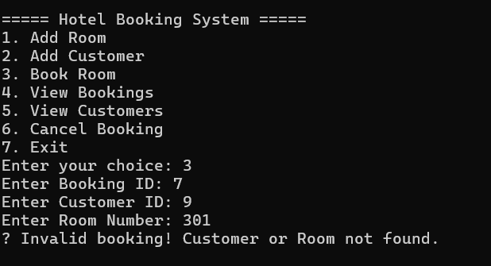
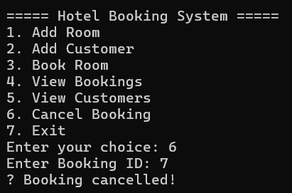
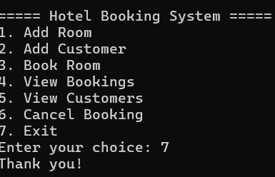
Live Demo:
Steps: 1. Add Customer 2. Book Room 3. View Booking Details 4. Cancel Booking 5. Error Handling
Demonstration: • Successfully booked a room and displayed booking details • Cancelled booking using Booking ID • Verified removal of booking • Handled invalid booking with error message
• Demonstrates validation and system reliability

