Slide 1
PCCCS495 — Advanced Programming (OOP) Lab | Spring 2026
Smart Library
Management System
Saraswata Tarafdar
Department: CSE(IOTCSBT)
Roll no. :62
Term-II Individual Project | Spring 2026
Problem: Manual library management is error-prone — no tracking of borrow records, fines, or availability.
Target: Librarians, members, and administrators

Slide 2
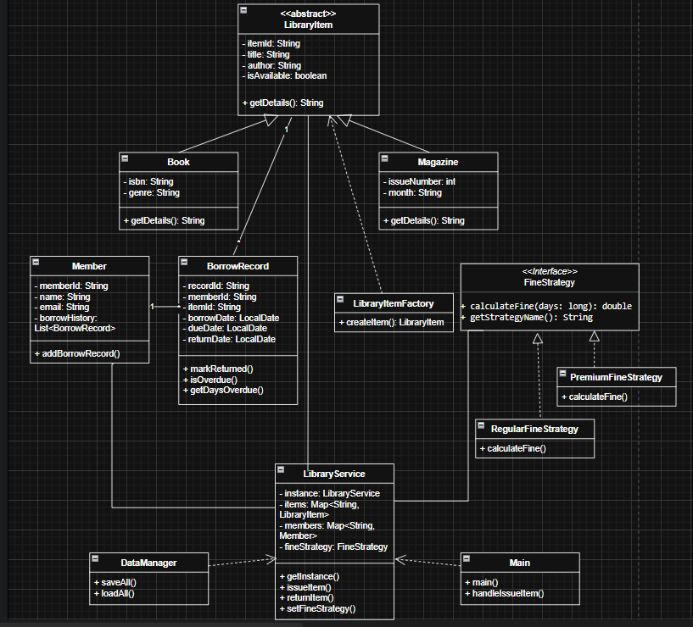
2 System Design
model/
LibraryItem, Book, Magazine, Member, BorrowRecord
factory/
LibraryItemFactory [Factory Pattern]
service/
LibraryService [Singleton] + DataManager
exception/
BookNotFoundException, AlreadyBorrowedException, MemberNotFoundException
strategy/
FineStrategy interface + Regular / Premium impls
Main.java — 12-option console menu
ui/

Slide 3
3 OOP Concepts Demonstrated
A
Abstraction
I
Inheritance
P
Polymorphism
LibraryItem (abstract class)
Book, Magazine extend LibraryItem
getDetails() in Book vs Magazine
abstract getDetails() forces every subclass to define its own output
super() reuses parent fields — no code duplication
Same method name, different output at runtime via @Override
E
Exception Handling
C
Collections
F
File Handling
3 custom exceptions + try-catch
HashMap in LibraryService
DataManager (Serialization)
BookNotFoundException carries the exact bad ID for clear feedback
O(1) lookup by item/member ID — no loop needed
ObjectOutputStream writes full HashMap to .ser binary file

Slide 4
4 Technical Highlight — Strategy Pattern + Fine Calculation
Why Strategy Pattern?
FineStrategy.java + usage in LibraryService
Swap fine algorithm at RUNTIME without changing LibraryService
Regular: Rs. 2.00 per day — no cap
Premium: Rs. 1.00 per day — capped at Rs. 30
Adding a new member type only needs a new class — no existing code changes
Instructor feedback requested an extra design pattern — this was the chosen solution
public interface FineStrategy {
double calculateFine(long daysOverdue);
}
public double calculateFine(long days) {
return days <= 0 ? 0.0 : days * 2.0;
}
public double calculateFine(long days) {
return Math.min(days * 1.0, 30.0);
}
service.setFineStrategy(
new PremiumFineStrategy());

Slide 5
5 Live Demo
01
Working System
02
Meaningful Scenario
03
Error Handling
Program starts → DataManager.loadAll() restores saved data
Add a Book via Factory: createItem('BOOK', 'B01', ...)
Add a Member: addMember('M01', 'Saraswata', ...)
List all items and members — confirm stored in HashMap
Issue book B01 to member M01 → BorrowRecord created
Show: book is now unavailable (isAvailable = false)
Try issuing same book to M02 → AlreadyBorrowedException shown
Return book M01 → fine calculated via FineStrategy
Search for item with invalid ID → BookNotFoundException
Try issuing already-borrowed book → AlreadyBorrowedException
Exit (option 12) → DataManager.saveAll() persists to .ser files
Restart → data reloaded — persistence confirmed

