Slide 1


INDEX
01
INDEX
CONTENTS
Introduction
General Overview
Real Time Analysis
Technical Overview
Tech Stack
Project Highlights
Future Planning
Reference
Team Members
PAGES
2
3
4
5
6
7
8
9
10

Slide 2


INTODUCTION
Motivation behind the Project: -
E-Commerce is now a major topic of discussion in the business industry. The start-up companies gets an advantage from e-commerce app as it promotes growth with the expenditure on the infrastructure. So any kind of e-commerce app with proper features promotes growth to a large extent. A large-scaled business might be self sufficient and can afford any kind of investment to a large scale but any small-scaled business gets a chance from this e-commerce to maximise profits and grow its business quickly. This reason gives an enough motivation for any web or app developer or any other freelancer to work on this kind of projects due to this high demand. The other motivation that any kind of e-commerce need to have virtual personal assistant to generate more sales and better customer experience which will help the start-ups more growth and scalability in a short span of time.
02

Slide 3


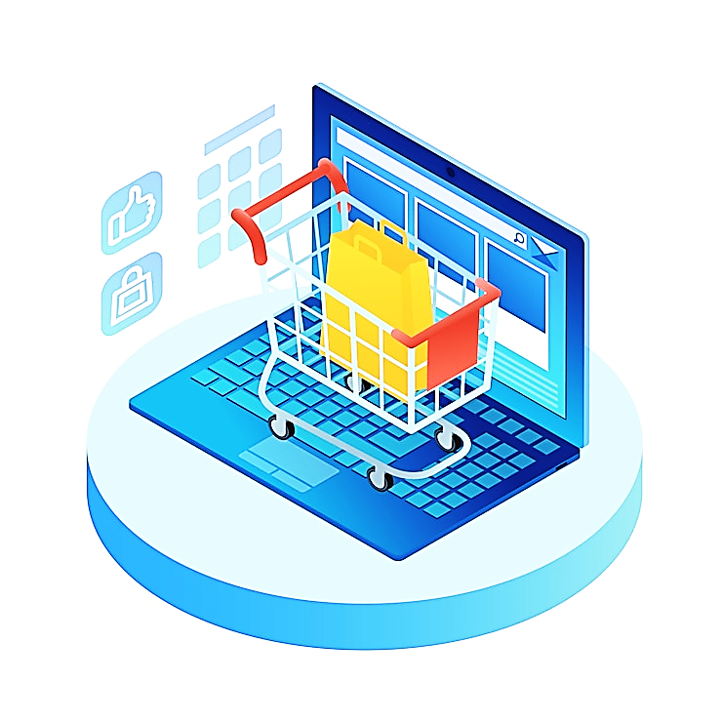

GENERAL OVERVIEW
03
Objectives
The main objective of our project is to make a shopping app with in-built VPA. The motive is to increase the growth of any business industry with a large scalability and flexibility. Over time businessman had faced a lot of problem during the initial stage of business to invest on its infrastructure and sometimes due to less profit the business comes to a shutdown process. This has happened with many handicraft business or small home-made start-ups. Here e-commerce comes to rescue in this situation.
So, this app will save the expenses on infrastructure and manpower. This is so as we will try to introduce a VPA(Virtual Personal Assistant) and it will require less managers to interact with the customers. Even a virtual presentation of goods will be done on app and main office infrastructure or hierarchy will not be required. The only thing that is necessary is a good storage room and manpower for delivery of goods. So this kind of approach also saves time and many customers can be handled at the same time. So, a shopping app is a good approach and with a virtual personal assistant will maximise the profits and the provides a good customer experience. So this is the main objective of this project and real-time scenario will be explained later onwards.
Problems Faced:-
1) Start-Ups have monetary issues to start a new business.
2) Lack of profits always leads to shut down of emerging business.
3)Problems arises with the interaction of customers at the same time.
4) Start-Ups are limited to local customers and are unable to reach on a large numbers.
5) Manpower without e-commerce app goes to a huge number and increase its expenses.
6) Data are mishandled sometimes when done manually but with e-commerce data remains intact and can be properly handled and remains with passage of time.
S
H
O
P
P
I
N
G
A
P
P
WITH IN-BUILT
VIRTUAL PERSONAL ASSISTANT
(VPA)

Slide 4

REAL TIME ANALYSIS
04
Why do we need this project in the first place? This is the first question that arises in everyone’s mind. While explaining this question we need to go for the real time scenario. It has been observed many a times that small scale business or recent start-ups has come to a shutdown process due to lack of profits and no growth situation. This is so as the start-ups who has not taken the approach of e-commerce methods need to spend a lot of money on its infrastructure. Well, by using the term “infrastructure” I meant that the building and the main office where customer/client interaction takes place under the department managers where it has a high chance of not having a proper interaction with the customer as it might be that each and every customer might not be attended with same amount of time and proper attention might not be given to the customer’s problem or the demands for which the profits might decrease to a great extent. So, high manpower is necessary for this kind of situation which cuts off the profit also. A hierarchy in this main office is maintained for which there is a delay to manufacture or purchase this product from any manufacturer and delivering its end product takes a lot of time and so there is less growth and often customer shifts to e-commerce apps. Sometimes due to manual entry of data like order receipts might result in improper allocation of products to the customers. Well due to this reason like no-growth, improper customer interaction, no-profit maximisation with maximum expenditure and improper maintenance of data e-commerce perfectly solves this problem.
Now, another question arises after this analysis of this problem, “How?”. While explaining this answer I need to make some examples related with this project. This project focuses on a specialization product i.e. ‘Book Shopping App’. We are assuming that a team has come up with an idea of having a Book Shop which is relatively a small scale business and the budget is very minimal and have the means to have a proper storage room and manpower for the delivery of the product along with some other extra expenses. So there is no main office or other managers or normal clerks to have a proper interaction with the customer. Moreover even if the team manages a main office in infrastructure list, it would reach to limited customers residing in its locality. Moreover, having a main office means keeping normal clerks and managers to interact with the customers. Now, what if some of the customers did not get a proper attention and does not get sorted out their demands properly, it indicates to one thing – bad customer experience and loss of goodwill too! So there the profit goes down slowly with daily expenses.
So after this real time problem analysis, the team decided to hire some web developer to build an e-commerce app with some modifications on it which is a less expenditure than to have daily expenses on its extra manpower. So the infrastructure is no more required and hence no manager or hierarchy to maintain as its done in the main office. Secondly, customer outreach is done on a large scale rather than limiting the customer’s availability within the locals. The salaries are no more in picture hence profit maximization. The data will automatically be acquired from the website database from the ‘ADMIN PANEL’ and so no mishandling of data. The customer will have its own proper interaction after the introduction of the new concept – VPA(Virtual Personal Assistant) which will increase a good customer experience and rise the firm’s goodwill. So it will increase its scalability to a large scale. The only thing is that the shop need to keep a system for its deliveries by any means of communication as it suits the most for the situation.
Hence, the team will be benefited by having an e-commerce app and it will remove all its disadvantages and will have many benefits just by applying this new approach. This is the real time analysis situation which can be best derived to explain the question that was raised before – ‘Why and How?’

Slide 5
TECHNICAL OVERVIEW
05
Front-End
(ANGULAR / REACT)
Creating and connecting with the Databases with the later mentioned ones (mostly MongoDB) for permanent storage of the data.
SEND
Databases
(H2 as testing database and later on MongoDB or MySQL
FETCH
DATABASE
Having multiple panels for customer and admin and will try to create a delivery panel so data privilege is strictly maintained.
DEPLOYMENT
REQUEST OR RESPONSE
SEND
Issuing REST API Endpoints and creating JWT tokens and security protocols with ROLE Authentication with data specifically mentioned.
Front-End
Cloud Deployment
(NETLIFY)
FETCH
VPA with Python preferably
[ VPA – Virtual Personal Assistant ]
Creating specific service layers with set of protocols and integrating with the frontend part for the users to manipulate specific amount of data.
JYTHON
CONTINUOUS INTEGRATION
& BINDING **
Integrating the whole backend with VPA with Python by using a totally new integration dependency – JYTHON .
INTEGRATION
BACK-END (Using Spring Boot with JAVA + Integration with Python for VPA with Jython)
DEPLOYMENT
BaaS with Heroku/Firebase (Backend as a service will provide the back-end to be hosted on cloud and act as a server).
Database and Back-end together will constitute the Server.
**Data binding must take place in smooth functionality in this project flow.
SERVER

Slide 6
TECH STACK
06
TECH STACK
OBJECTIVE: - SHOPPING APP WITH VIRTUAL PERSONAL ASSISTANT (VPA)
TECHNOLOGY USED: -
SPRING BOOT WITH JAVA. (BACK-END)
ANGULAR / REACT (FRONT-END) → TO GIVE A USER’S VIEW FOR THE BACK-END
HEROKU / FIREBASE → DEPLOYMENT OF BACK-END IN CLOUD SERVER. [ACTING AS A SERVER PART]
NETLIFY → DEPLOYMENT OF THE FRONT-END AS A CLOUD SERVER.
PYTHON → DEVELOPMENT OF THE VIRTUAL PERSONAL ASSISTANT.
JYTHON → INTEGRATING PART BETWEEN PYTHON AND SPRING BOOT WITH JAVA AND SUCCESSFULLY BINDING IT.

Slide 7
PROJECT HIGHLIGHTS
07

