Slide 1
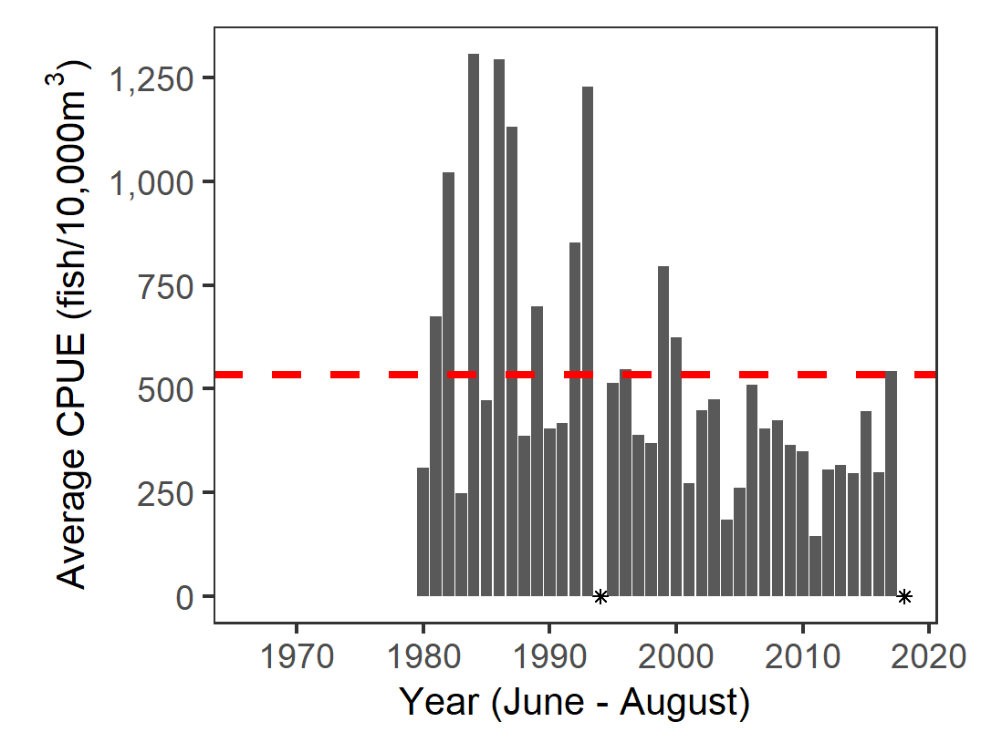
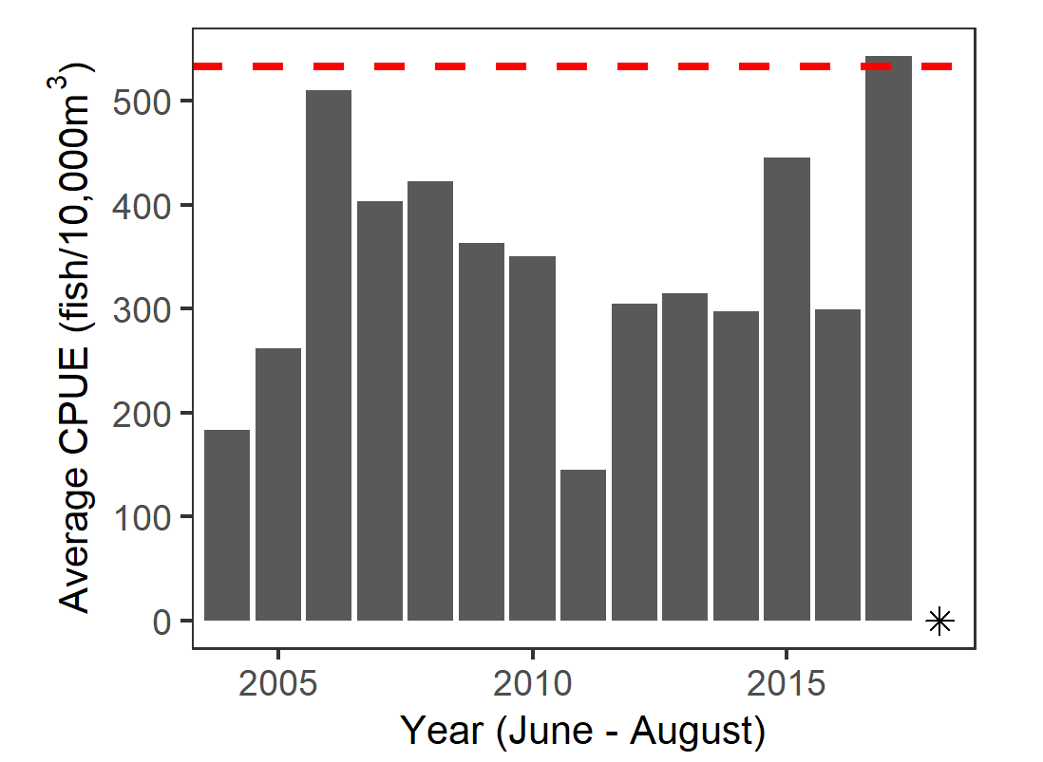
black asterisk (shape = 8):

Slide 2
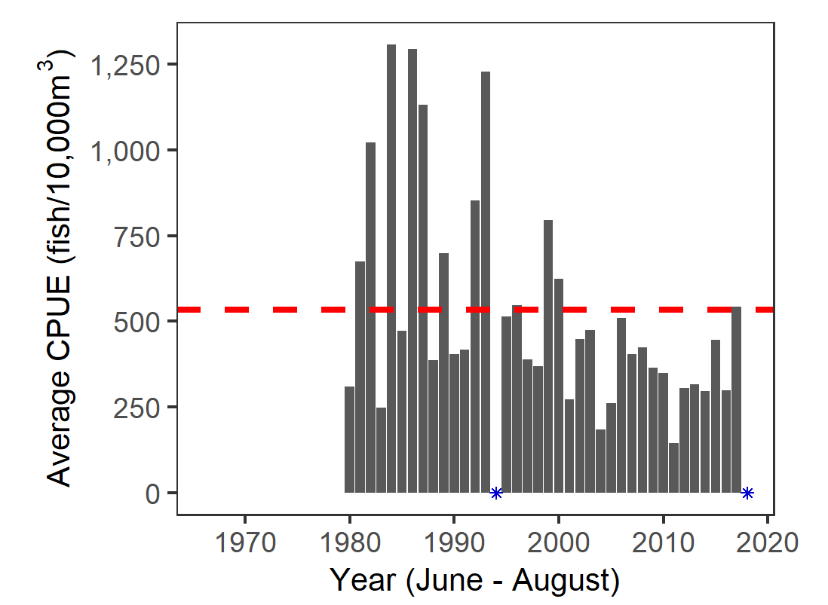
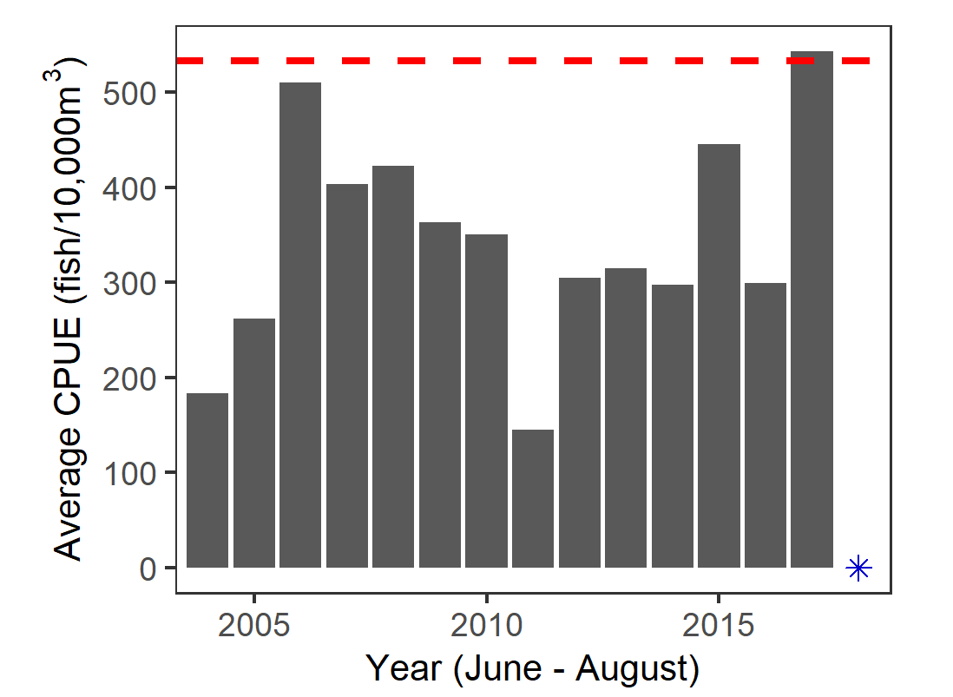
blue3 asterisk (shape = 8):

Slide 3
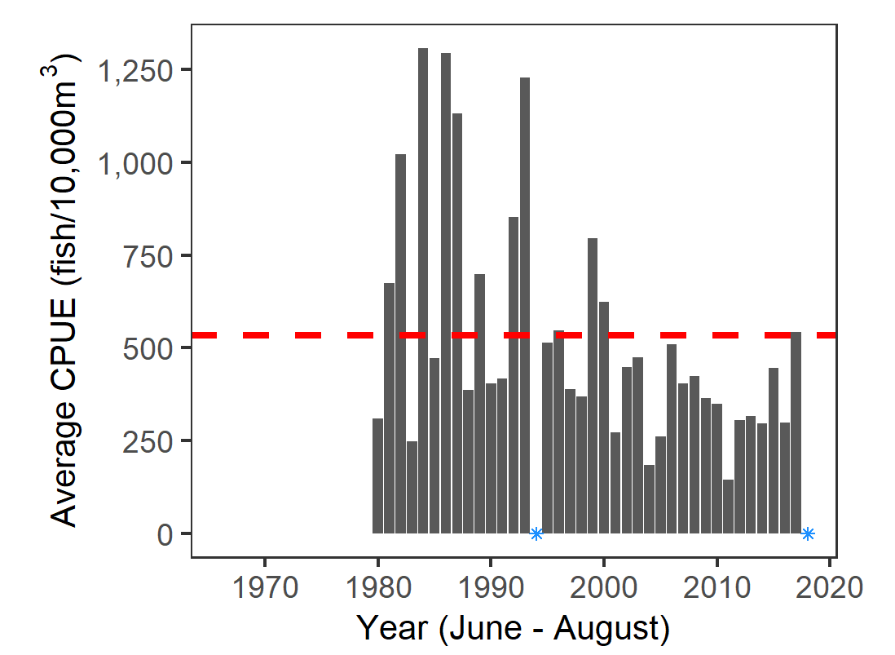

dodgerblue asterisk (shape = 8):

Slide 4

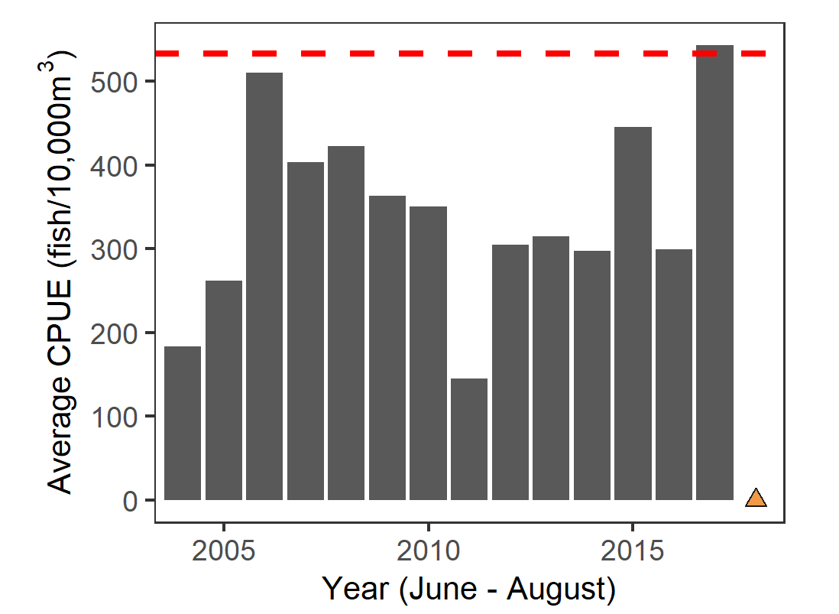
tan2 filled triangle (shape = 24):

Slide 5

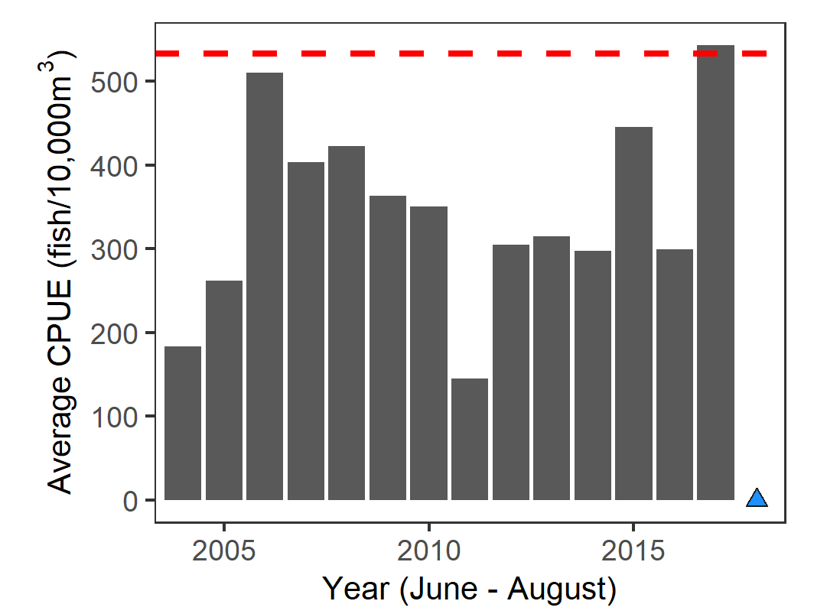
dodgerblue filled triangle (shape = 24):

