Slide 1

Pricing model calibration through Stochastic Optimization
STOCHASTIC OPTIMIZATION TERM PROJECT
By Beatrice Cai, Motahare Mounesan, Kei Nemoto, Ivan Perez

Slide 2
Contents
Preliminaries + Introduction/Background
Black Scholes Merton Model
Methodology
Description of Data
Preliminary Experiments
Heston Model
Experiments and Simulation
Results and Discussion
Conclusion

Slide 3
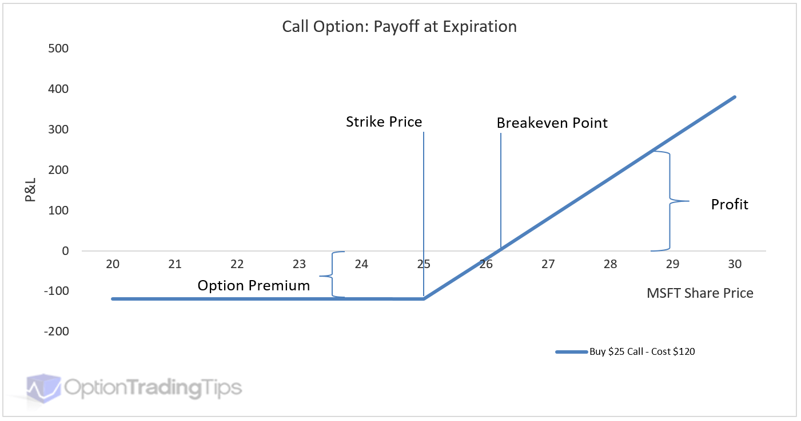
Call option Example¹
Suppose You Speculate that $MSFT will be at or above 28 USD/Share in 1 month:
You could:
1) BUY 100 Shares of $MFST for
25 USD/Share and sell at the
end of the month.
Cost = 100*25USD= 2500 USD
Profit if $MFST > 25 USD
2) BUY a 25 USD Strike Price Call Option for $120/contract
Notational 100Shares/Contract = $1.2 per share of MSFT.
Cost = 120 USD
Profit if $MFST > 26.2 USD
1. https://www.optiontradingtips.com/options101/payoff-diagrams.html

Slide 4
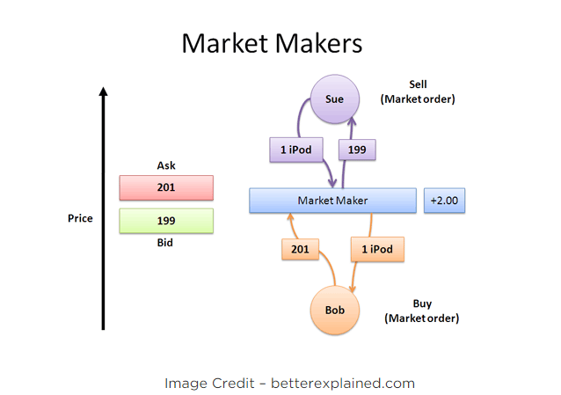
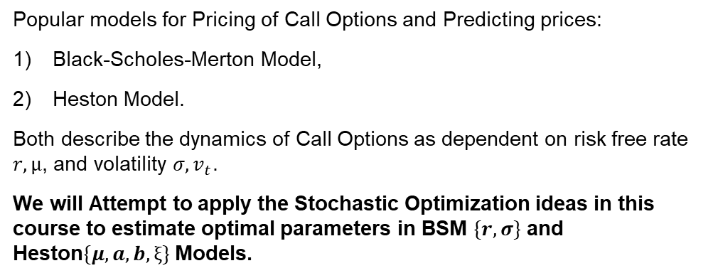
Introduction and Background
Popular models for Pricing of Call Options and Predicting prices:
Black-Scholes-Merton Model,
Heston Model.
Both describe the dynamics of Call Options as dependent on risk free rate $r, μ$, and volatility $σ,v_{t}$.
We will Attempt to apply the Stochastic Optimization ideas in this course to estimate optimal parameters in BSM $\{r,σ\}$ and Heston$\{μ,a,b,ξ\}$ Models.
Market Participants in derivatives markets are the ultimate deciders on the value of an option and its underlying.
Market Making firms (e.g., Jane Street, 2Sigma, Renaissance Trading) create value for their clients by buying and selling large quantities of assets to market participants and using Quantitative Models to Set and Estimate Prices and capture return in excess of risk.
2. https://betterexplained.com/articles/what-you-should-know-about-the-stock-market/

Slide 5
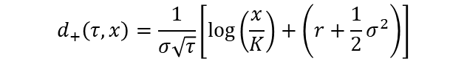
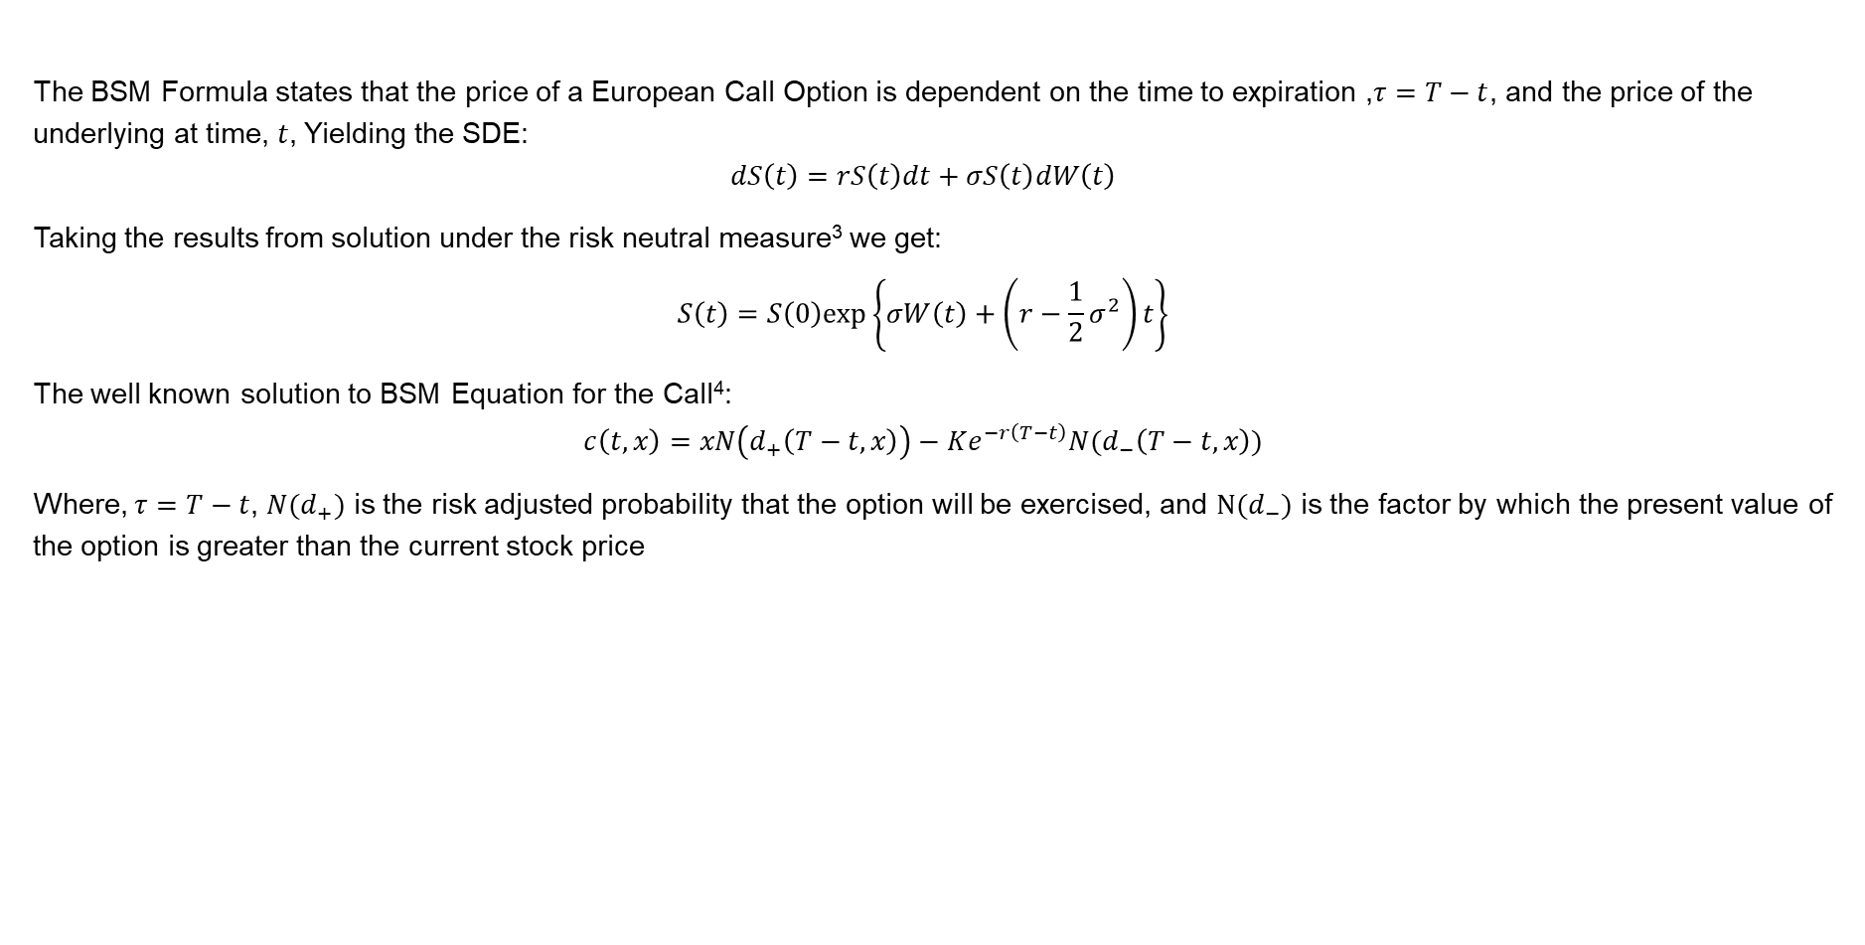

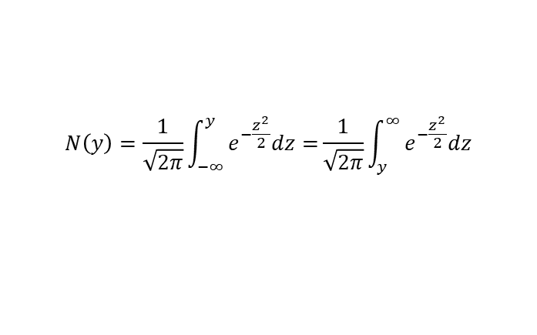

Black-Scholes-Merton Model
The BSM Formula states that the price of a European Call Option is dependent on the time to expiration ,$τ=T−t$, and the price of the underlying at time, $t$, Yielding the SDE:
$$dS\left(t\right)=rS\left(t\right)dt+σS\left(t\right)dW\left(t\right)$$
Taking the results from solution under the risk neutral measure³ we get:
$$S\left(t\right)=S\left(0\right)exp\left\{σW\left(t\right)+\left(r−\frac{1}{2}σ^{2}\right)t\right\}$$
The well known solution to BSM Equation for the Call⁴:
$$c\left(t,x\right)=xN\left(d_{+}\left(T−t,x\right)\right)−Ke^{−r\left(T−t\right)}N(d_{−}\left(T−t,x\right))$$
Where, $τ=T−t$, ${N(d}_{+})$ is the risk adjusted probability that the option will be exercised, and $N(d_{−})$ is the factor by which the present value of the option is greater than the current stock price
$$d_{+}\left(τ,x\right)=\frac{1}{σ\sqrt{τ}}\left[\log\left(\frac{x}{K}\right)+\left(r+\frac{1}{2}σ^{2}\right)\right]$$
$$N\left(y\right)=\frac{1}{\sqrt{2π}}\int_{−∞}^{y}{e^{−\frac{z^{2}}{2}}dz=}\frac{1}{\sqrt{2π}}\int_{y}^{∞}{e^{−\frac{z^{2}}{2}}dz}$$
$$d_{−}\left(τ,x\right)=d_{+}−σ\sqrt{τ}$$
$$N′(y)=\frac{1}{\sqrt{2π}}e^{−\frac{y^{2}}{2}}$$
3. S.E. Shreve, Stochastic Calculus for Finance II: Continuous-Time Models, Springer, New York, 2004, p. 219
4. Ref: S.E. Shreve, Stochastic Calculus for Finance II: Continuous-Time Models, Springer, New York, 2004, p. 158-159

Slide 6




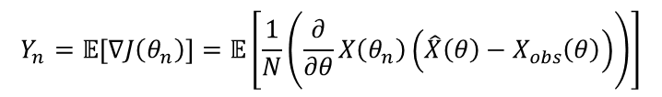


Methodology
1. Observations:
End of Trading day Price data
End of Trading day Call Option data
2. Cost Function: The Expectation of the Squared Difference between Estimates and Observations.
3. Iterative Scheme:
4. Adaptation of Models for gradient estimation:
$$X_{n}\left(t\right)=\left[\begin{matrix}S_{n} \\ C_{n,K_{1}} \\ \begin{matrix}⋮ \\ C_{n,K_{2}}\end{matrix}\end{matrix}\right](t)$$
$$\min_{{θε{(ℝ}^{n})}^{n}}{J\left(θ\right)=𝔼[{\left(X_{n}−{\hat{X}}_{n}\right)}^{2}]}$$
$θ_{n+1}= θ_{n}+εY_{n}$
$$Y_{n}=𝔼\left[∇J\left(θ_{n}\right)\right]=𝔼\left[\frac{1}{N}\left(\frac{∂}{∂θ}X\left(θ_{n}\right)\left(\hat{X}\left(θ\right)−X_{obs}\left(θ\right)\right)\right)\right]$$
$\frac{∂\hat{S}(t)}{∂σ}={(W\left(t\right)−σt)S}_{0}exp\left\{σW\left(t\right)+\left(r−\frac{1}{2}σ^{2}\right)t \right\}$
$$\frac{∂\hat{C}}{∂r}=S_{0}N^{′}\left(d_{+}\right)\frac{∂d_{+}}{∂r}−τ\left(Ke^{−2rτ}N\left(d_{−}\right)\right)+Ke^{−rτ}N′(d_{−})\frac{∂d_{−}}{∂r}$$
$\frac{∂\hat{S}(t)}{∂r}={tS}_{0}exp\left\{σW\left(t\right)+\left(r−\frac{1}{2}σ^{2}\right)t \right\}$
$$\frac{∂\hat{C}}{∂σ}=S_{0}N^{′}\left(d_{+}\right)\frac{∂d_{+}}{∂σ}−Ke^{−rτ}N′(d_{−})\frac{∂d_{−}}{∂σ}$$

Slide 7
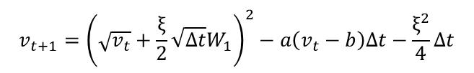
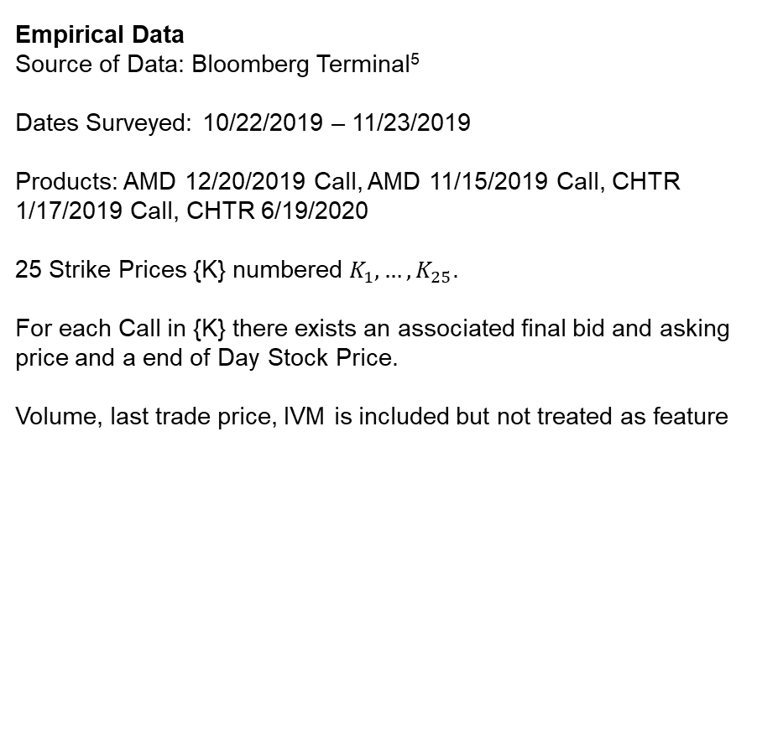




Data Description
Empirical Data
Source of Data: Bloomberg Terminal⁵
Dates Surveyed: 10/22/2019 – 11/23/2019
Products: AMD 12/20/2019 Call, AMD 11/15/2019 Call, CHTR
1/17/2019 Call, CHTR 6/19/2020
25 Strike Prices {K} numbered $K_{1},…, K_{25}$.
For each Call in {K} there exists an associated final bid and asking price and a end of Day Stock Price.
Volume, last trade price, IVM is included but not treated as feature
Simulated Data
Purpose: verify convergence of BSM and Heston Model IPA:
Given a set of initial parameters , $r,σ,μ,a,b,ξ$ , we generate $S(t), C(S\left(t\right),K)$ and $v_{t}$ from Heston SDE.
BSM:
Heston⁶:
$$S_{t+∆t}=S_{t}exp\left\{σW\left(t\right)+\left(r−\frac{1}{2}σ^{2}\right)∆t\right\}$$
$$c\left(τ,S_{t}\right)=S_{t}N\left(d_{+}\left(τ,S_{t}\right)\right)−Ke^{−rτ}N(d_{−}\left(τ,S_{t}\right))$$
$$S_{t+∆t}=S_{t}exp\left\{\sqrt{v_{t}}W_{2}+\left(μ−\frac{1}{2}v_{t}\right)∆t\right\}$$
$$v_{t+1}={\left(\sqrt{v_{t}}+\frac{ξ}{2}\sqrt{∆t}W_{1}\right)}^{2}−a\left(v_{t}−b\right)∆t−\frac{ξ^{2}}{4}∆t$$
$$W_{1}=Z_{1}; W_{2}= ρZ_{1}+\sqrt{1−ρ^{2}}Z_{2}$$
Date | Strike | Ticker | Bid | Ask | Last | IVM | Volm | AMD_Close
10/22/2019 | 25.5 | AMD 11/15/19 C25.5 | 6.20 | 6.30 | 0 | 62.47 | 0 | 31.51
10/22/2019 | 26 | AMD 11/15/19 C26 | 5.75 | 5.85 | 6 | 61.84 | 50 | 31.51
10/22/2019 | 26.5 | AMD 11/15/19 C26.5 | 5.35 | 5.40 | 0 | 62.17 | 0 | 31.51
10/22/2019 | 27 | AMD 11/15/19 C27 | 4.90 | 5 | 5.20 | 61.63 | 13 | 31.51
S0 | 35 |  | t | W1 | W2 | vt | St | C(K=35)
a | 0.5 |  | 0 | 0 | 0 | 0.5 | 35 | 0
b | 0.06 |  | 1 | 1.037879 | 1.037879 | 0.324103 | 62.62969 | 27.62969
xi | 0.06 |  | 2 | -0.07639 | -0.07639 | 0.188547 | 56.24388 | 21.24388
v0 | 0.06 |  | 3 | -0.65967 | -0.65967 | 0.106579 | 42.39291 | 7.392914
mu | 0.098 |  | 4 | 0.099043 | 0.099043 | 0.084338 | 45.78818 | 10.78818
dt | 1 |  | 5 | 0.118983 | 0.118983 | 0.073355 | 50.11953 | 15.11953
rho | 1 |  | 6 | -0.73378 | -0.73378 | 0.054338 | 43.68456 | 8.684557
5. Bloomberg L.P., “Options Chain of AMD, CHTR. 10/22/2019 to 11/23/2019," Bloomberg 2019.
6. https://www.quantconnect.com/tutorials/introduction-to-options/local-volatility-and-stochastic-volatility

Slide 8
Call Strike vs Call Price and Implied Volatility

Slide 9
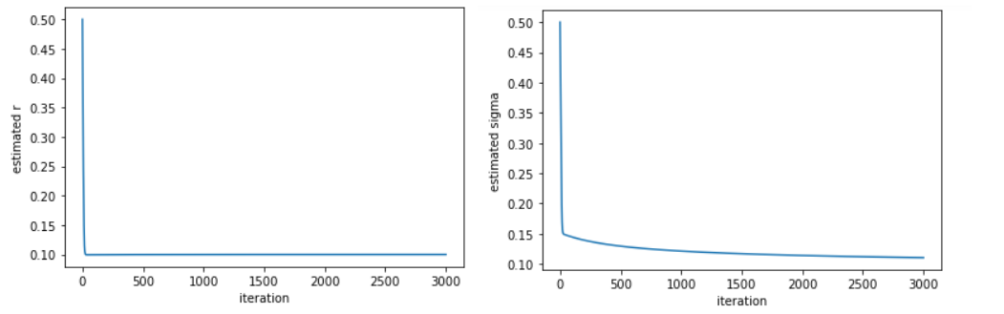
Black-Scholes-Merton – Preliminary Experiments

Slide 10

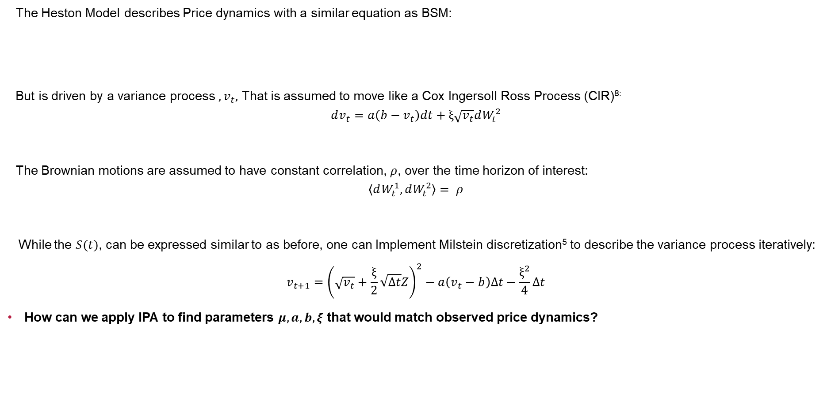
Heston Model⁷
The Heston Model describes Price dynamics with a similar equation as BSM:
But is driven by a variance process $,v_{t},$ That is assumed to move like a Cox Ingersoll Ross Process (CIR)^{8:}
$$dv_{t}=a\left(b−v_{t}\right)dt+ξ\sqrt{v_{t}}dW_{t}^{2}$$
The Brownian motions are assumed to have constant correlation, $ρ$, over the time horizon of interest:
$$\left\langle dW_{t}^{1},dW_{t}^{2}\right\rangle = ρ$$
While the $S(t)$, can be expressed similar to as before, one can Implement Milstein discretization⁵ to describe the variance process iteratively:
$$v_{t+1}={\left(\sqrt{v_{t}}+\frac{ξ}{2}\sqrt{∆t}Z\right)}^{2}−a\left(v_{t}−b\right)∆t−\frac{ξ^{2}}{4}∆t$$
How can we apply IPA to find parameters $μ,a,b,ξ$ that would match observed price dynamics?
$$dS_{t}=μS_{t}dt+\sqrt{v_{t}}S_{t}dW_{t}^{1}$$
7. J. Gatheral , The Volatility Surface: A Practicioner’s Guide, Wiley, New Jerset, 2006, p. 15-24
8. S.E. Shreve, Stochastic Calculus for Finance II: Continuous-Time Models, Springer, New York, 2004, p. 266

Slide 11

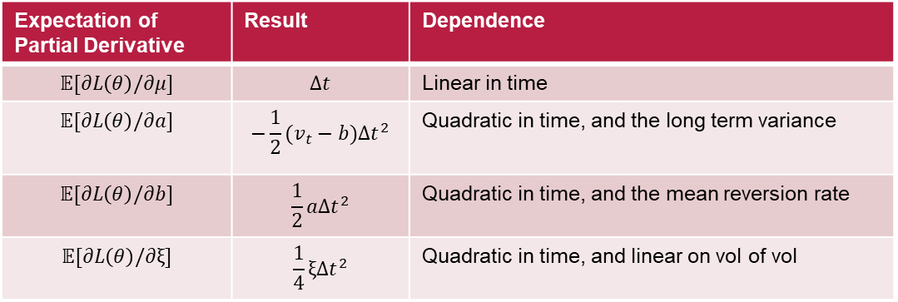


Methodology
We can try to estimate the gradient of $\text{𝔼}\left[Y_{n}\right|ℱ_{n−1}]$ using the IPA derivative:
And we can argue the exchange of derivative and expectation, by the 3 assumptions in Theorem 8.1:
Theorem 8.1: Let $Θ⊂ℝ$ be an open and connected set, such that $X(θ)$ is a measurable mapping on a common underlying probability space $\left(Ω,ℱ,ℙ\right) Let θ_{0}∈Θ If:$
i) The sample path (or stochastic derivative) of $dX(θ)/dθ$ exists w.p.1 at $θ_{0}$.
ii) The mapping $h :S→ℝ$ is differentiable
iii) The mapping $h\left(X\left(θ\right)\right)$ is Lipschitz continuous on $Θ$ w.p.1. then,
We can simplify the math, by taking the IPA derivative of the log of incremental returns $L=\log{\frac{S_{t+∆t}}{S_{t}}}$.
𝔼$\left[Y_{n}\right|ℱ_{n−1}]=\frac{d}{dθ}𝔼\left[h\left(X\left(θ\right)\right)\right]$
$$\frac{d}{dθ}𝔼\left[h\left(X\left(θ\right)\right)\right]=𝔼\left[\frac{∂X\left(θ\right)}{∂θ}\frac{dh\left(X\left(θ\right)\right)}{dX\left(θ\right)}\right]$$
Expectation of Partial Derivative | Result | Dependence
$$𝔼[∂L\left(θ\right)/∂μ]$$ | $$∆t$$ | Linear in time
$$𝔼[∂L\left(θ\right)/∂a]$$ | $${−\frac{1}{2}(v}_{t}−b){∆t}^{2}$$ | Quadratic in time, and the long term variance
$$𝔼[∂L\left(θ\right)/∂b]$$ | $$\frac{1}{2}a{∆t}^{2}$$ | Quadratic in time, and the mean reversion rate
$$𝔼[∂L\left(θ\right)/∂ξ]$$ | $$\frac{1}{4}ξ{∆t}^{2}$$ | Quadratic in time, and linear on vol of vol
$$𝔼\left[\frac{d}{dθ}\log{\frac{S_{t+∆t}}{S_{t}}} | S_{t}\right]=\frac{d}{dθ}\left(\sqrt{v_{t}}W_{t}^{2}+∆tμ−∆t\frac{1}{2}v_{t}\right)=𝔼\left[\begin{matrix}\frac{∂L}{∂μ} \\ \frac{∂L}{∂a} \\ \begin{matrix}\frac{∂L}{∂b} \\ \frac{∂L}{∂ξ}\end{matrix}\end{matrix} \right]=$$
s
Notes:
Estimating Gradient of incremental return process
We should think would getting the IPA of the return process, instead of the direct price process
Should we try to recover the price process IPA?

Slide 12
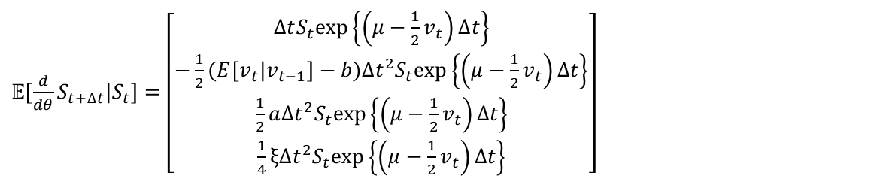
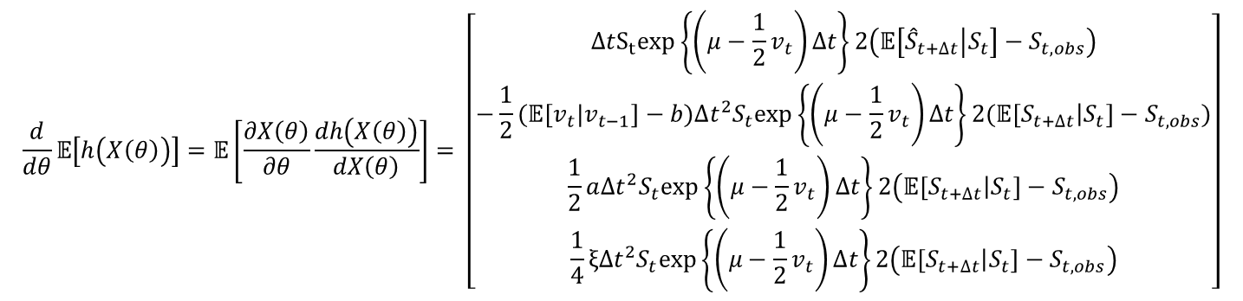
Sensitivity Analysis of HESton Model
We can say that the derivative of the price process is:
Which affords the final IPA of
$𝔼[\frac{d}{dθ}S_{t+∆t}|S_{t}]=\left[\begin{matrix}∆tS_{t}exp\left\{\left(μ−\frac{1}{2}v_{t}\right)∆t\right\} \\ {−\frac{1}{2}(E[v}_{t}|v_{t−1}]−b){∆t}^{2}S_{t}exp\left\{\left(μ−\frac{1}{2}v_{t}\right)∆t\right\} \\ \begin{matrix}\frac{1}{2}a{∆t}^{2}S_{t}exp\left\{\left(μ−\frac{1}{2}v_{t}\right)∆t\right\} \\ \frac{1}{4}ξ{∆t}^{2}S_{t}exp\left\{\left(μ−\frac{1}{2}v_{t}\right)∆t\right\}\end{matrix}\end{matrix}\right]$
$$\frac{d}{dθ}𝔼\left[h\left(X\left(θ\right)\right)\right]=𝔼\left[\frac{∂X\left(θ\right)}{∂θ}\frac{dh\left(X\left(θ\right)\right)}{dX\left(θ\right)}\right]= \left[\begin{matrix}∆tS_{t}exp\left\{\left(μ−\frac{1}{2}v_{t}\right)∆t\right\}2\left(𝔼\left[{\hat{S}}_{t+∆t} | S_{t}\right]−S_{t,obs}\right) \\ {−\frac{1}{2}(𝔼[v}_{t}|v_{t−1}]−b){∆t}^{2}S_{t}exp\left\{\left(μ−\frac{1}{2}v_{t}\right)∆t\right\}2(𝔼\left[S_{t+∆t} | S_{t}\right]−S_{t,obs}) \\ \begin{matrix}\frac{1}{2}a{∆t}^{2}S_{t}exp\left\{\left(μ−\frac{1}{2}v_{t}\right)∆t\right\}2\left(𝔼\left[S_{t+∆t} | S_{t}\right]−S_{t,obs}\right) \\ \frac{1}{4}ξ{∆t}^{2}S_{t}exp\left\{\left(μ−\frac{1}{2}v_{t}\right)∆t\right\}2\left(𝔼\left[S_{t+∆t} | S_{t}\right]−S_{t,obs}\right)\end{matrix}\end{matrix}\right]$$

Slide 13
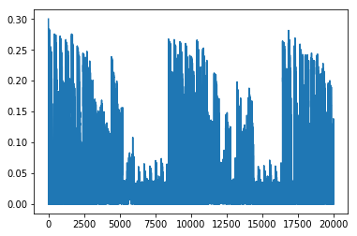
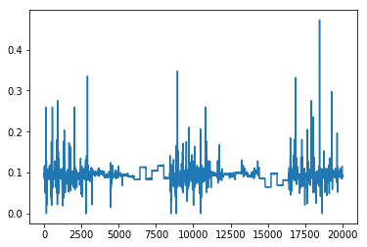
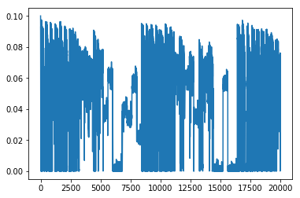
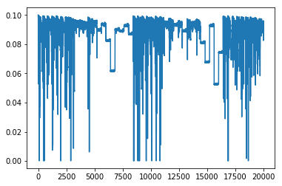
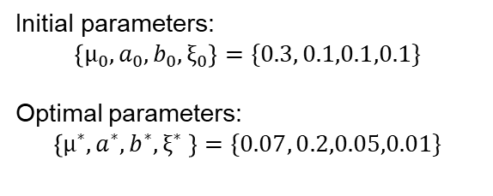
Experiments
Initial parameters:
$$\left\{μ_{0},a_{0},b_{0},ξ_{0}\right\}=\{0.3, 0.1,0.1,0.1\}$$
Optimal parameters:
$$\left\{μ^{∗},a^{∗},b^{∗},ξ^{∗} \right\}=\{0.07, 0.2,0.05,0.01\}$$

Slide 14
4. Conclusion
The IPA Estimator for the Black Scholes Merton formula was found to converge
The IPA Estimator for the Heston Model, can be derived recursively.
Experimental data is inconclusive for Heston Model Calibration.

