Slide 1


Supporting PCS Adoption: A Database of Cooling and Heating Effects for Designers and Practitioners
2026/06/16 Indoor Air 2026 conference presentation (ID: XXX)
Akihisa Nomoto (Takenaka Corporation, Japan),
Maíra André, Thomas Parkinson (IEQ Lab, The University of Sydney, Australia)
Notes:
Hello everyone. My name is Aki Nomoto, and I am a researcher at Takenaka Corporation in Japan.
Today, I would like to present our work titled “Supporting PCS Adoption: A Database of Cooling and Heating Effects for Designers and Practitioners”
I was working on this project when I was in Australia, and the co-authors of this project are Maira Andre and Thomas Parkinson from the University of Sydney.

Slide 2
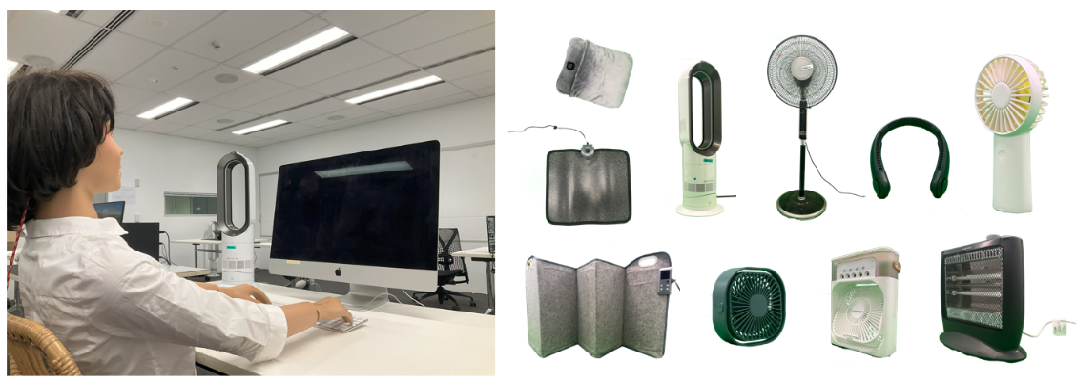

Abstract
We developed an open-access database quantifying the cooling and heating effects of commercially available Personal Comfort Systems (PCS).
The database is publicly available on GitHub at: https://github.com/IEQLab/pcs_database.
To GitHub repo
Notes:
So, in this study, we developed an open-access database that quantifies the cooling and heating effects of commercially available Personal Comfort Systems.
The database is publicly available on GitHub and you can use the data for both research purpose and practical application.

Slide 3
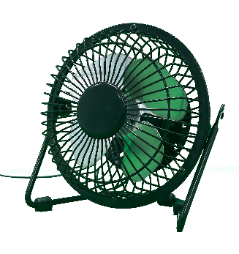
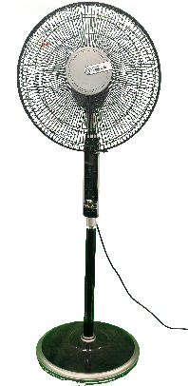
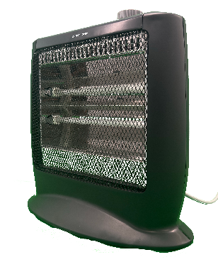
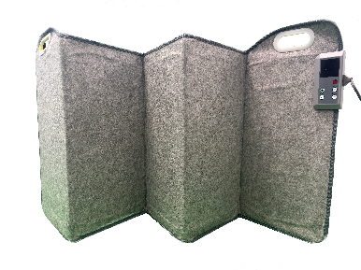
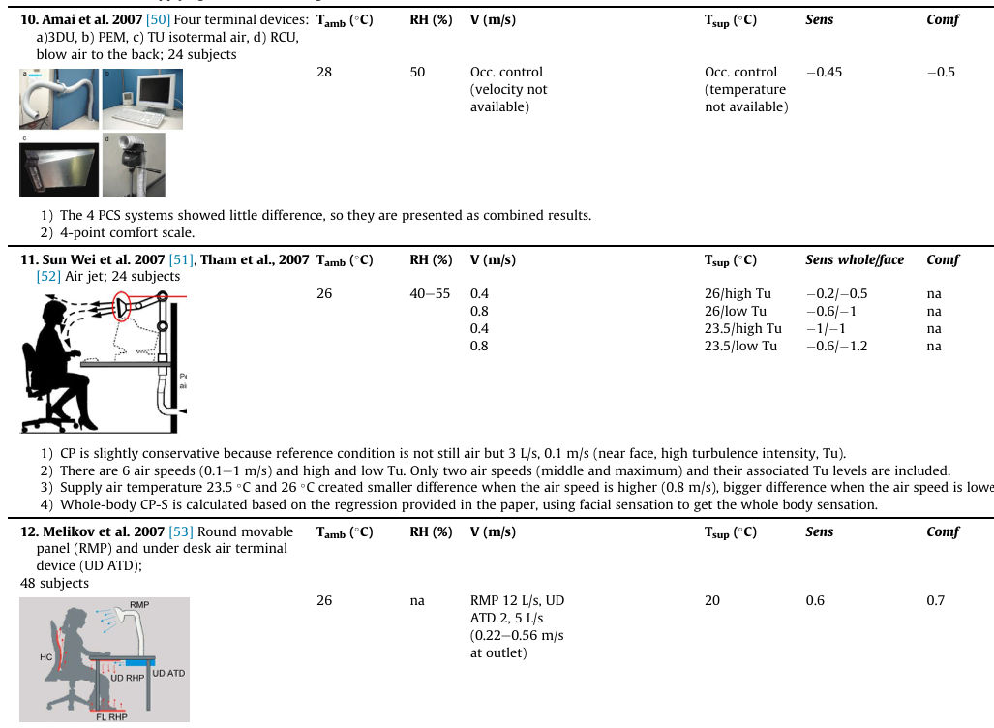
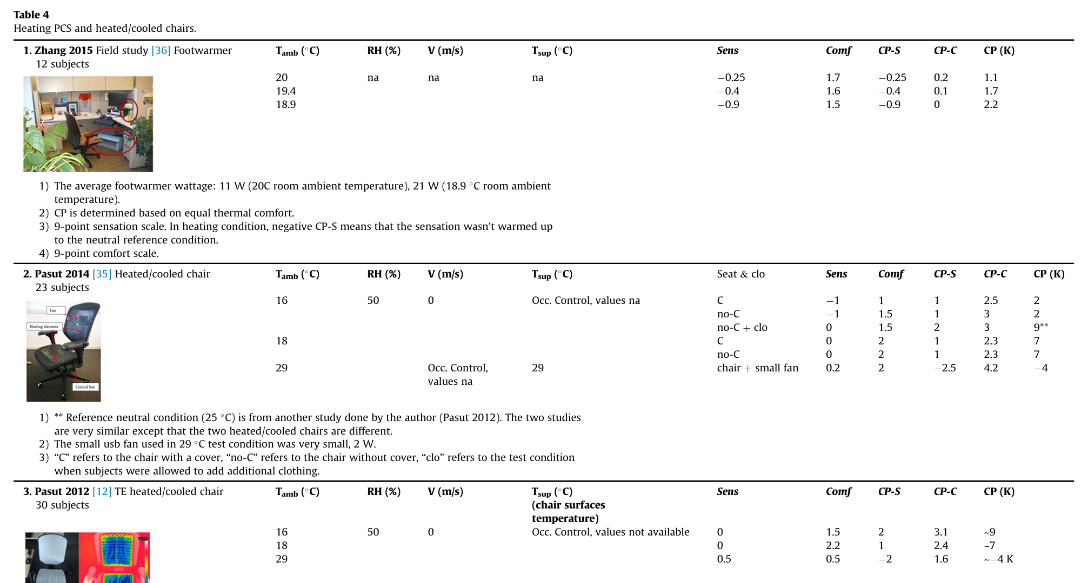
Introduction
Personal Comfort Systems (PCS)
Devices that directly heat or cool occupants
What we know
Improve people’s thermal comfort
Reduce HVAC energy consumption in buildings
Research gap
Prototype products with limited test conditions
No commercially available products
Results are difficult to apply in real building projects
Examples of PCS
Objective
To develop an open-access database for a range of commercially available PCS products for designers and practitioners.
Summary table of PCS studies (Zhang et al., link)
Notes:
First, let me briefly introduce the background and motivation of this study.
So first of all, what is PCS?
PCS are devices that directly heat or cool occupants.
Some common examples are desk fans, standing fans, and foot warmers.
■What we know from the previous studies is that PCS have both comfort and energy benefit.
For comfort perspective, because they are adjustable, you can adjust the level of heating or cooling intensity whatever they want.
In terms of energy perspective, as PCS directly heat or cool occupants, they are much more energy-efficient compared to an air-conditioning system cool/warm the entire space, not people.
However, there is an issue/research gap, which is, most previous studies focus on prototype products with limited conditions.
And there is a few study focusing on commercially available products.
So, it is difficult for us to apply these findings in real building projects because we cannot use prototype products.
■So, the objective of this study is to develop an open-access database for a range of commercially available PCS products.
We purchased a lot of PCS products on Amazon and we did a performance evaluation.

Slide 4
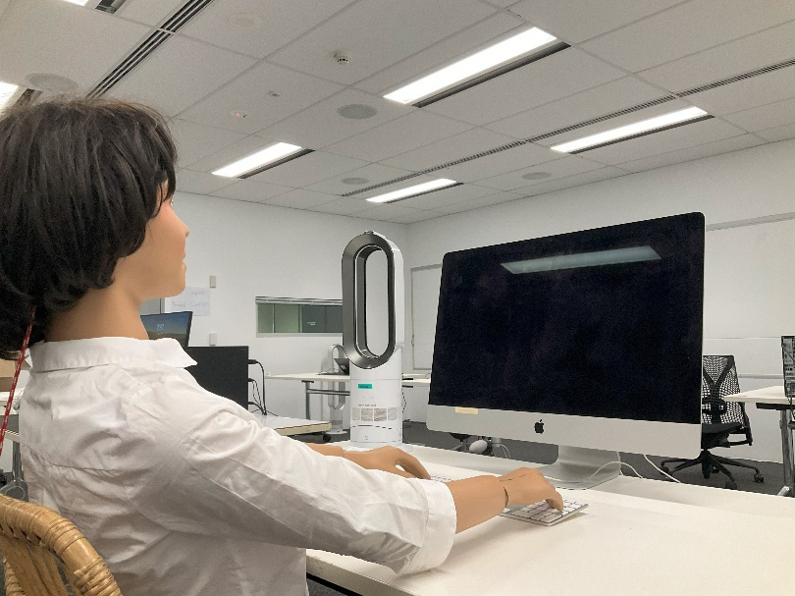
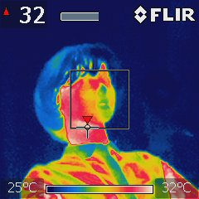
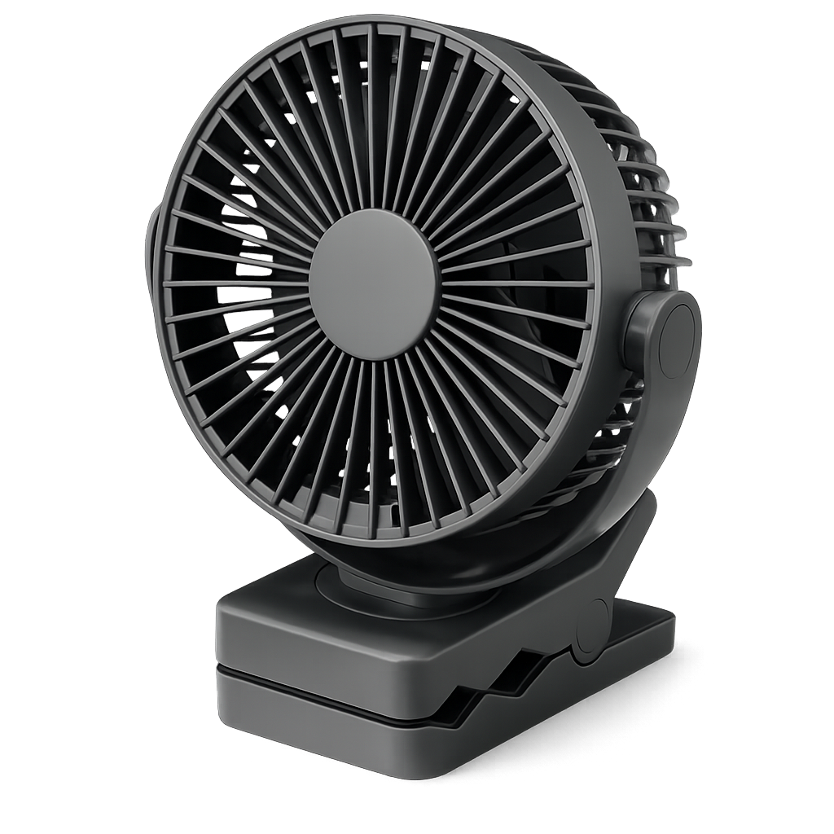

Methods: thermal manikin experiment quantifying performance of 17 PCS devices
PCS performance evaluation:
Skin temperature = 34ºC
Supplied power
PCS effect (W):
Desk fan
$Q_{pcs}=$ $Q_{without pcs} −Q_{with pcs}$
With PCS (50W)
Skin
Thermal manikin
Without PCS (30W)
PCS effect
(20W)
An example of test setup
Tested 17 PCS devices
Test conditions (simulated office conditions)
Operative temp. | 22 / 25 / 28ºC
Relative humidity | 40-60%
Air velocity | No air movement
Clothing | Summer clothing (0.4 clo) Winter clothing (0.8 clo)
Posture | Sitting
Notes:
To do that, we conducted thermal manikin experiments quantifying the performance of 17 PCS devices in a climate-controlled chamber at The University of Sydney.
A thermal manikin is a manikin that is like a real human and we can control surface temperature for different body parts.
The images here shows an example of the test setup.
As you can see, the facial area is cooled by a desk fan.
■For PCS performance evaluation, we maintained the manikin’s skin temperature at 34°C and we measured the supplied power to keep this surface temperature.
We performed two tests: WITH and WITHOUT PCS operation, and the difference in the supplied power between the two conditions was defined as PCS effect.
For example, when a desk fan is used, 50 W is needed to maintain the facial skin temperature at 34°C, but without desk fan only 30 W is required.
In this case, this 20 W difference is defined as the cooling effect of the desk fan.
■In total, we evaluated 17 PCS devices, including 10 cooling devices and 7 heating devices
We did the tests with three temperature conditions: 22, 25, 28oC for each PCS product.

Slide 5
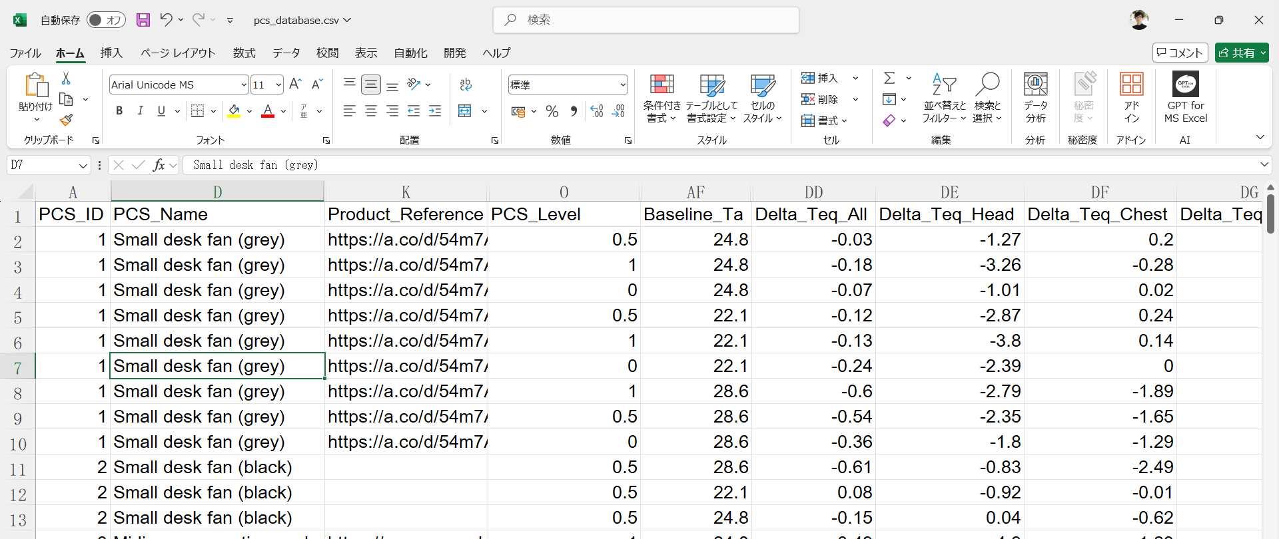
Results: the database includes (1) device info, (2) test conditions, (3) measurement results
Notes:
This is how the database looks like.
It is just a simple CSV file.
The database includes the device info, test conditions, and the measured performance.

Slide 6

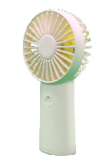

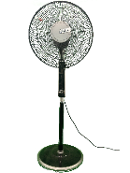
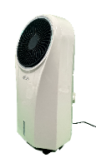
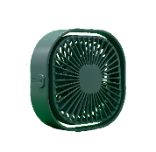
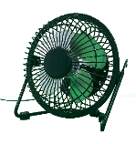
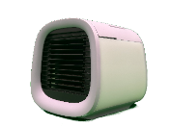
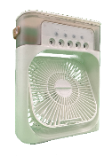
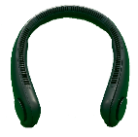
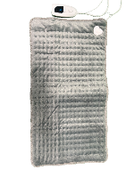
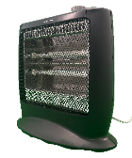
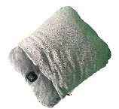
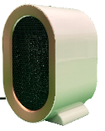

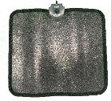

Results: representative results for 17 PCS devices (mid-settings, Ta=25ºC)
Change in equivalent temperature (ΔTeq) for the whole body
Hypothetical temperature that represents the combined effects of air temperature, radiation, and air movement on the human body.
Indicates how much the room temperature setpoint can be relaxed when a selected PCS device is used.
ID | 1 | 2 | 3 | 4 | 5 | 6 | 7 | 8 | 9 | 10
Image
ΔTeq | -0.1 | -0.2 | -0.6 | -0.1 | -0.4 | -0.1 | -0.3 | -3.0 | -2.8 | -1.8
ID | 11 | 12 | 13 | 14 | 15 | 16 | 17
Image
ΔTeq | +3.0 | +0.5 | +1.5 | +2.2 | +1.5 | +1.4 | +1.3
Notes:
This table shows the representative results for 17 PCS devices at their middle-level settings when ambient temperature was 25 °C.
I would like to emphasize this test conditions because the test conditions affect the results a lot.
Here, I am summarizing the results as the change in equivalent temperature for the whole body by each PCS.
■Here, you can see that small fans had limited cooling effects of less than 1°C.■
■In contrast, standing fans and an evaporative cooler produced moderate cooling effects ranging from 1.8 to 3.0 °C. ■
■The heating effects of PCS ranged from approximately 0.5 to 3.0 °C.
The heating pad (ID 11) applied to the back had the strongest impact.

Slide 7
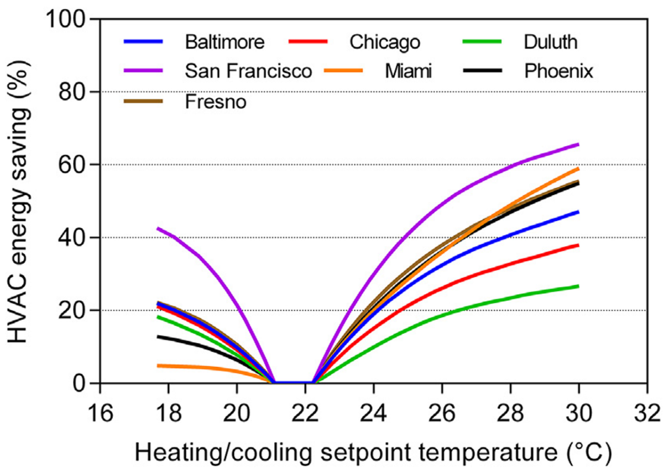
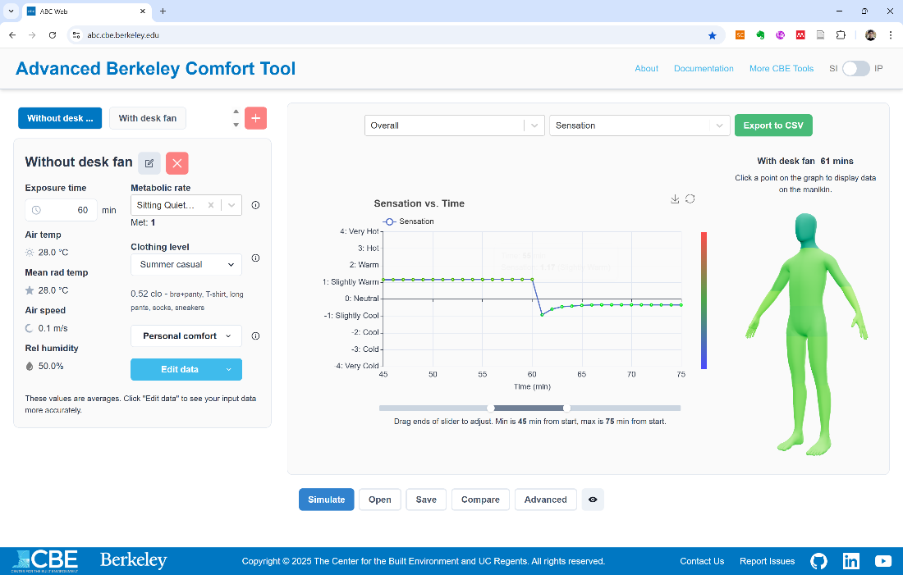
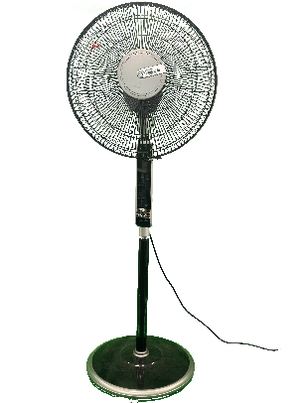
Discussions: potential applications of the database
For PCS-integrated HVAC design (for designer)
How much setpoint temperatures can be relaxed with a selected PCS
Thermal comfort simulation (for researcher)
Advanced Berkely Comfort (ABC) model
JOS-3 model
ΔTeq = －2.8ºC
A web interface of ABC model:
https://abc.cbe.berkeley.edu/
Percent of total HVAC energy saved in different climates
by widened air temperature setpoints (Hoyt et al., link)
Notes:
Now, let me show you how this database can actually be used.
In my opinion, there are two main use cases.
First, for HVAC designers.
They can estimate how much the indoor setpoint temperature can be relaxed when a selected PCS is used, and how that actually contributes to the energy savings in the buildings.
This figure shows the percentage of HVAC energy savings by relaxing the setpoint temperature in different climate zones.
As an example, let’s looks at Miami data because I think Miami has similar climate here in Singapore.
In the U.S., a typical cooling setpoint is around 22°C, which I think a little too cold.
This standing fan, for example, can relax the setpoint to about 3°C. ■
■This corresponds to approximately 25% HVAC energy savings.
The second use case is for researchers.
If you look at the actual database, you can see that there is data for not only the whole-body data, but also for each body segment.
You can use these detailed data for thermal comfort simulation to predict human thermal perception when a PCS is used.

Slide 8
To GitHub repo
Notes:
That concludes my presentation.
If you are interested, there is a QR code below and we welcome your contributions.
Thank you very much for your kind attention. Now, I would be happy to take any questions.

Slide 9
Discussions: limitation of the results
We only measured dry heat loss, and there is no latent heat loss
Fans should have stronger cooling effect under sweating conditions
Present results < Actual
We only showed changes in whole-body equivalent temperature (ΔTeq).
Although the desk fans had small whole-body cooling effects less than 1oC, they provided stronger localized cooling around the head and upper body .
Convective heat loss by PCS depends on the surrounding air temperature
convective heat loss = hc * (Tsk - Ta)
Strong impact
ID | 1 | 2 | 3 | 4
Image
ΔTeq | -0.1 | -0.2 | -0.6 | -0.1
Notes:
Lastly, I would like to point out the limitation of the results.
First, we only measured dry heat loss, and there is no latent heat loss.
So fans should have stronger cooling effect under sweating conditions.
and the present results would be underestimated to the actual results.
Second, we only showed changes in whole-body equivalent temperature (ΔTeq).
We showed that the desk fans had small whole-body cooling effects less than 1oC, they provided stronger localized cooling around the head and upper body like the image below.
This is kind of important because human thermal perception is complex and cooling to one body segment makes people comfortable.
Lastly, convective heat loss by PCS depends on the surrounding air temperature.
Results depends on different ambient temperature conditions, so we encourage you to access the database for additional results.

