Slide 1
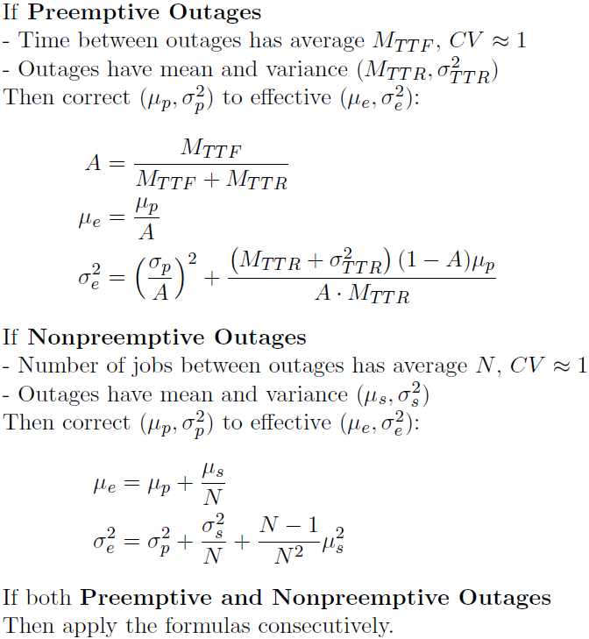
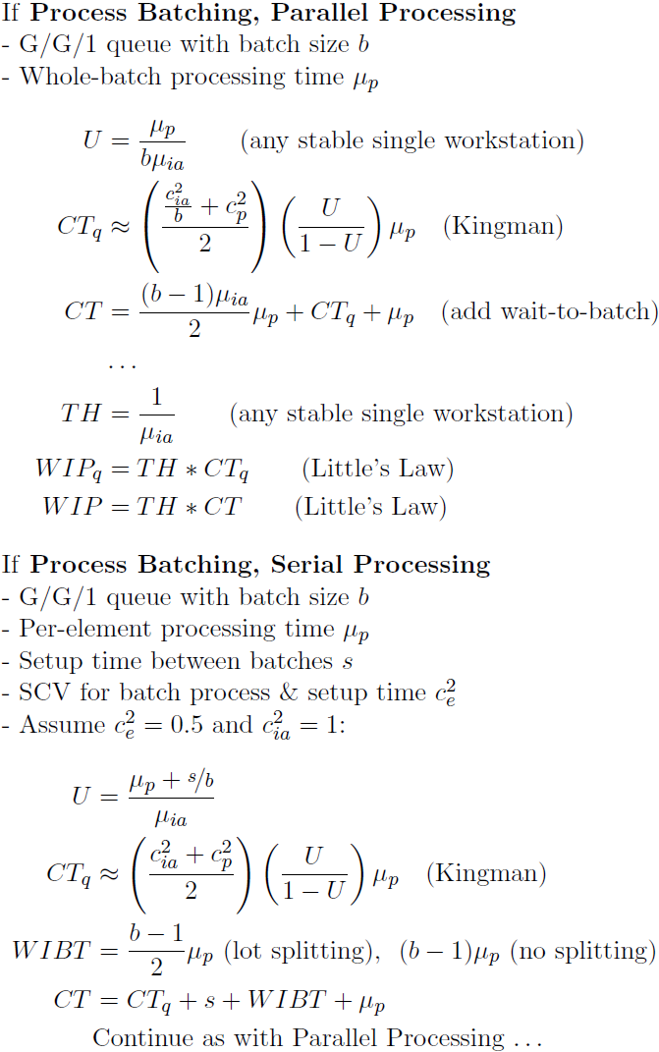
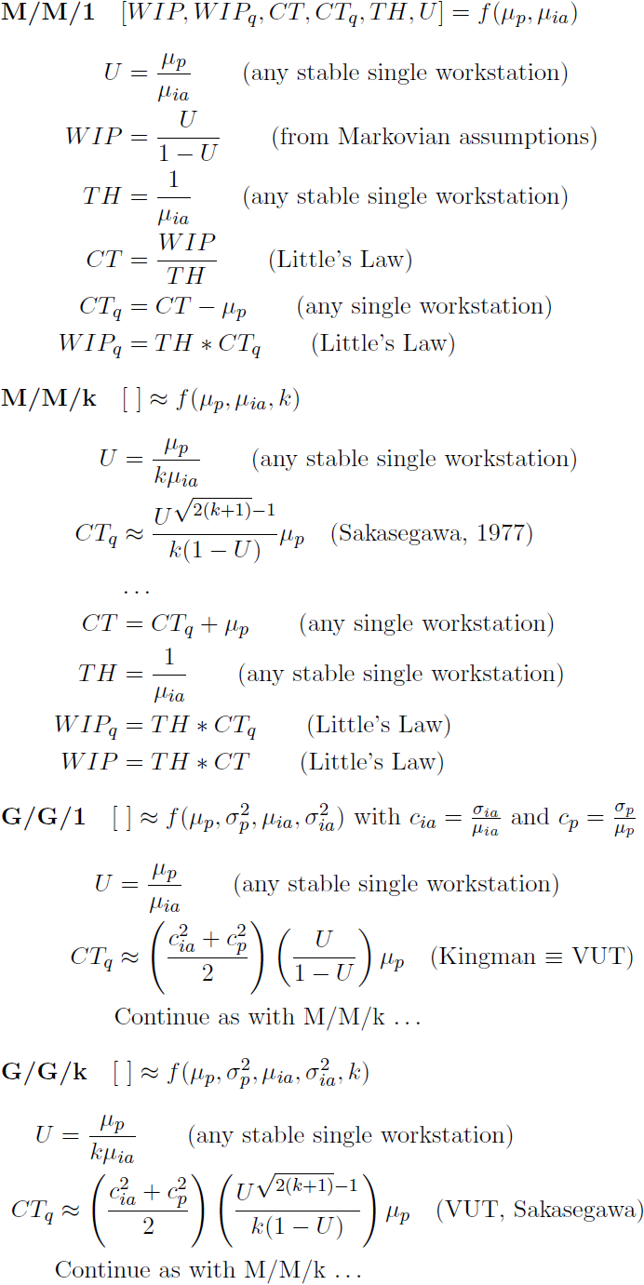
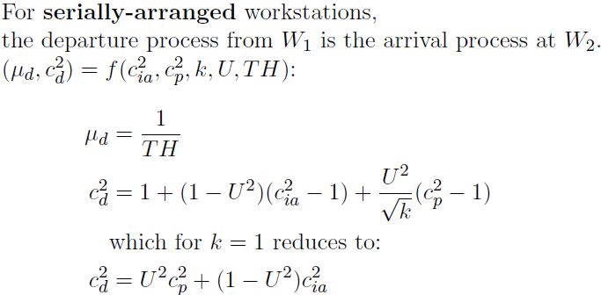
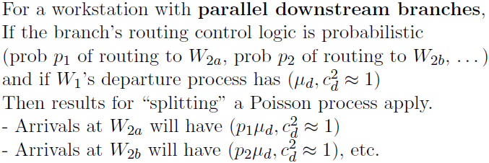
1
Queueing Theory for Single Workstations
(Source: Hopp & Spearman, Factory Physics, ed. 2)
(Copyright © 2016, Georgia Institute of Technology)
2
k
W₁
W₂
W_{2a}
W₁
W_{2b}

