Slide 1
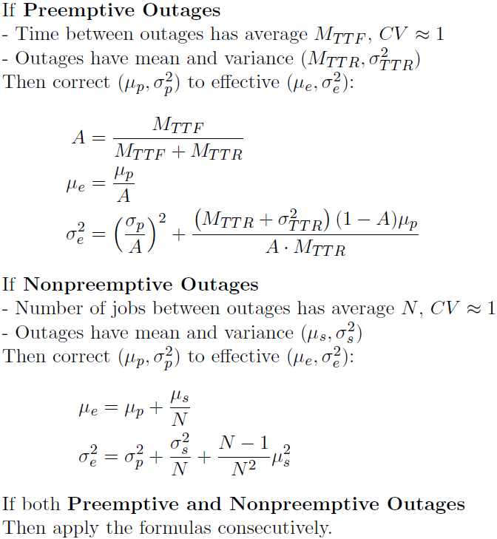
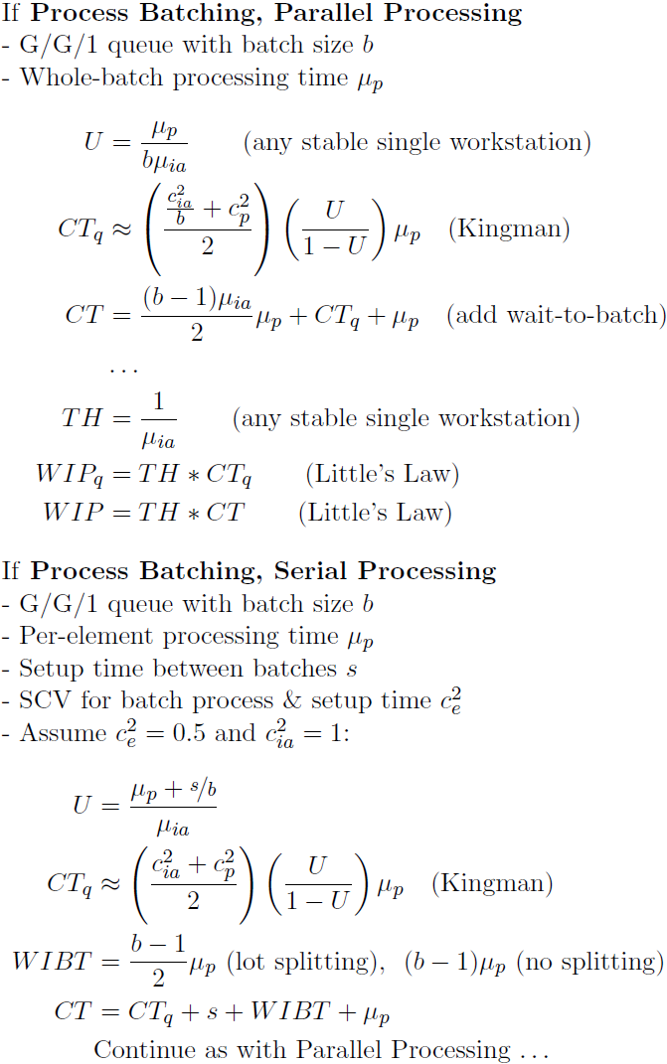
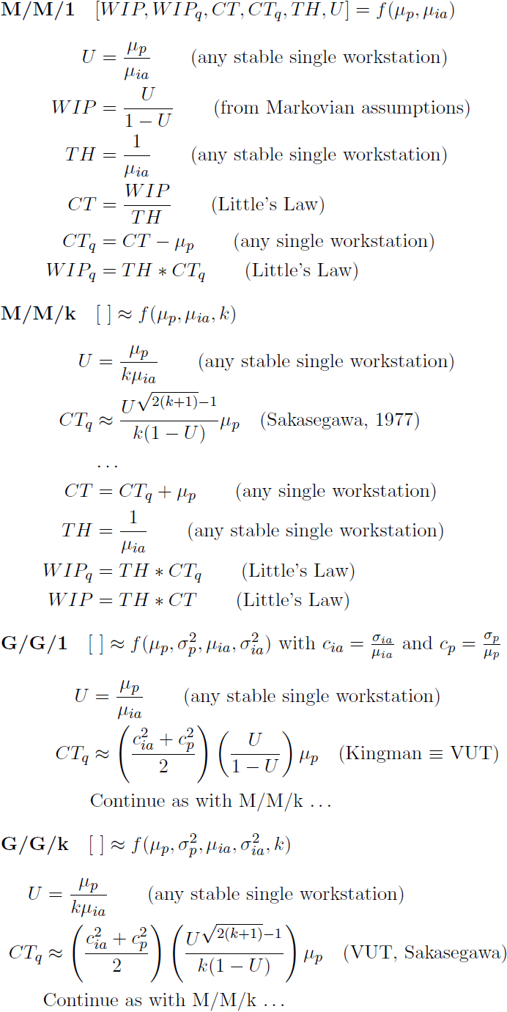
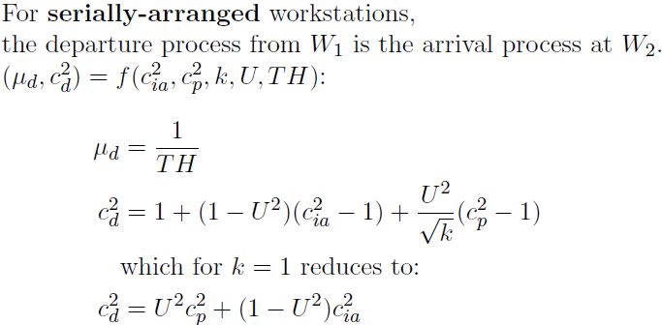
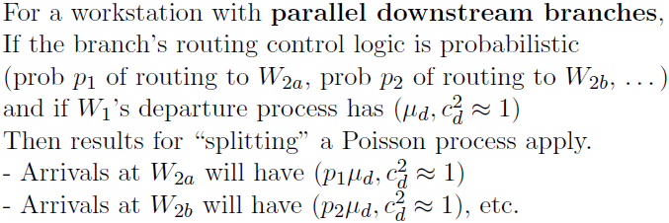
1
Queueing Theory for Single Workstations
(Source: Hopp & Spearman, Factory Physics, ed. 2)
(Copyright © 2016, Georgia Institute of Technology)
2
k
W₁
W₂
W_{2a}
W₁
W_{2b}
Notes:
Lower Resolution (which for some reason, prints better?)
(1) LaTeX -> PDF
(2) Screen captures from Acrobat Reader at zoom=157% on a 96dpi monitor
(3) Crop images in mspaint, save as PNG, and import here
(4) Make it look pretty

Slide 2
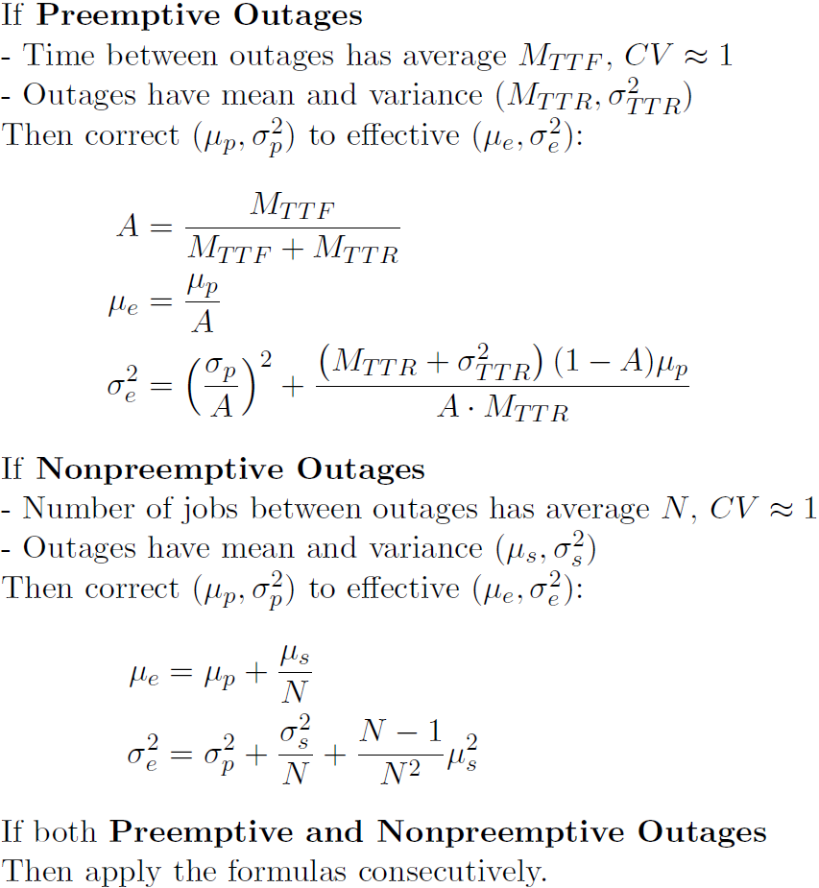
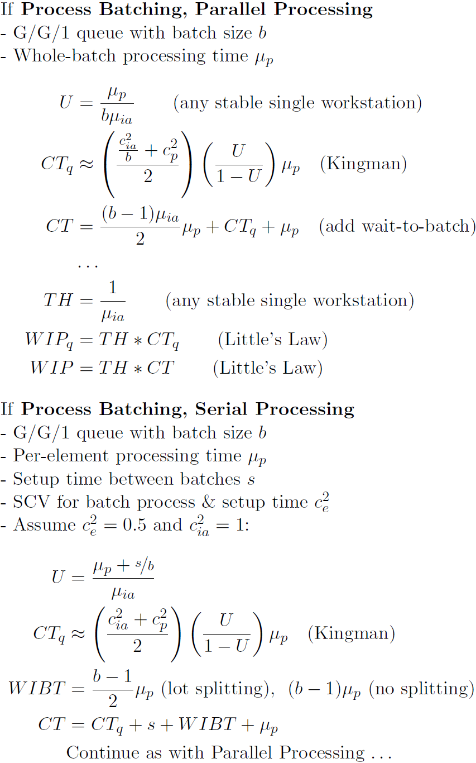
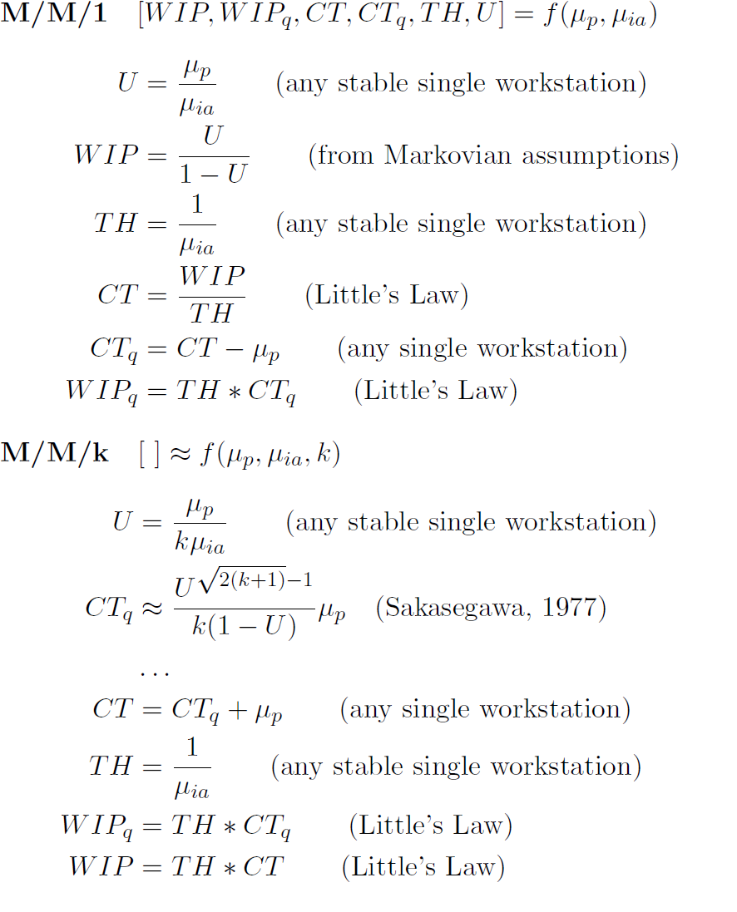
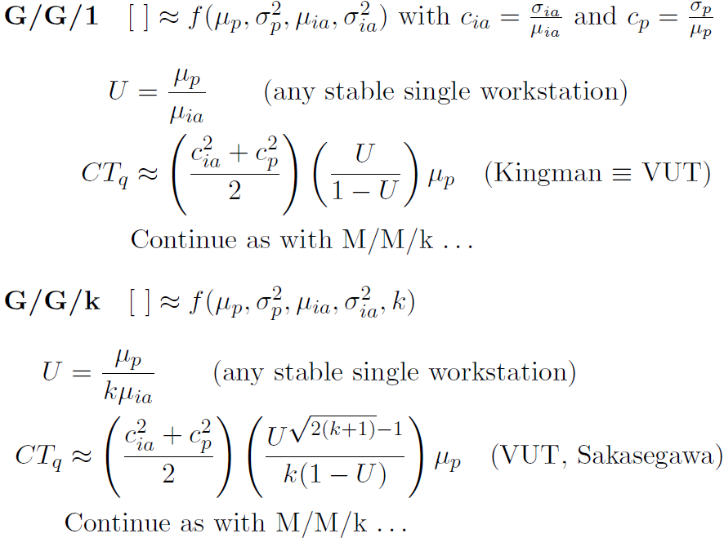
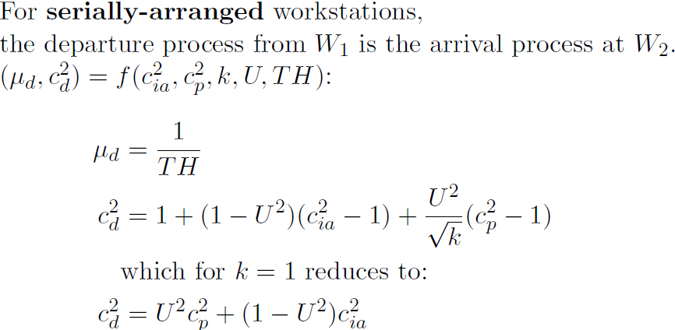
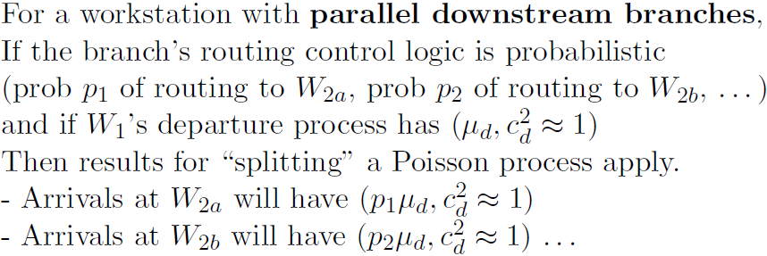
1
Queueing Theory for Single Workstations
(Source: Hopp & Spearman, Factory Physics, ed. 2)
(Copyright © 2016, Georgia Institute of Technology)
2
k
W₁
W₂
W_{2a}
W₁
W_{2b}
Notes:
Higher Resolution (which for some reason, prints worse?)
(1) LaTeX -> PDF
(2) Screen captures from Acrobat Reader at zoom=200% on a 96dpi monitor (the cost of 157% versus 200%: the leftmost image is not contiguous)
(3) Crop images in mspaint, save as PNG, and import here
(4) Make it look pretty

