Slide 1
IETF Hackathon: DOTS Interop
IETF 104
23-24 March, 2019
Prague

Slide 2
Hackathon Plan
DOTS: DDoS Open Threat Signaling
standardization of signaling for DDoS protection
Important drafts
draft-ietf-dots-signal-channel-30 (latest)
draft-ietf-dots-data-channel-27 (latest)
draft-nishizuka-dots-signal-control-filtering-05 <- NEW!!
Interoperability test and run-through of usecase scenarios

Slide 3
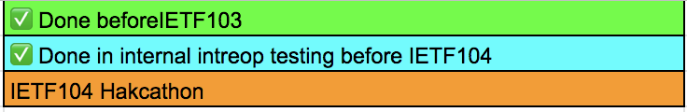
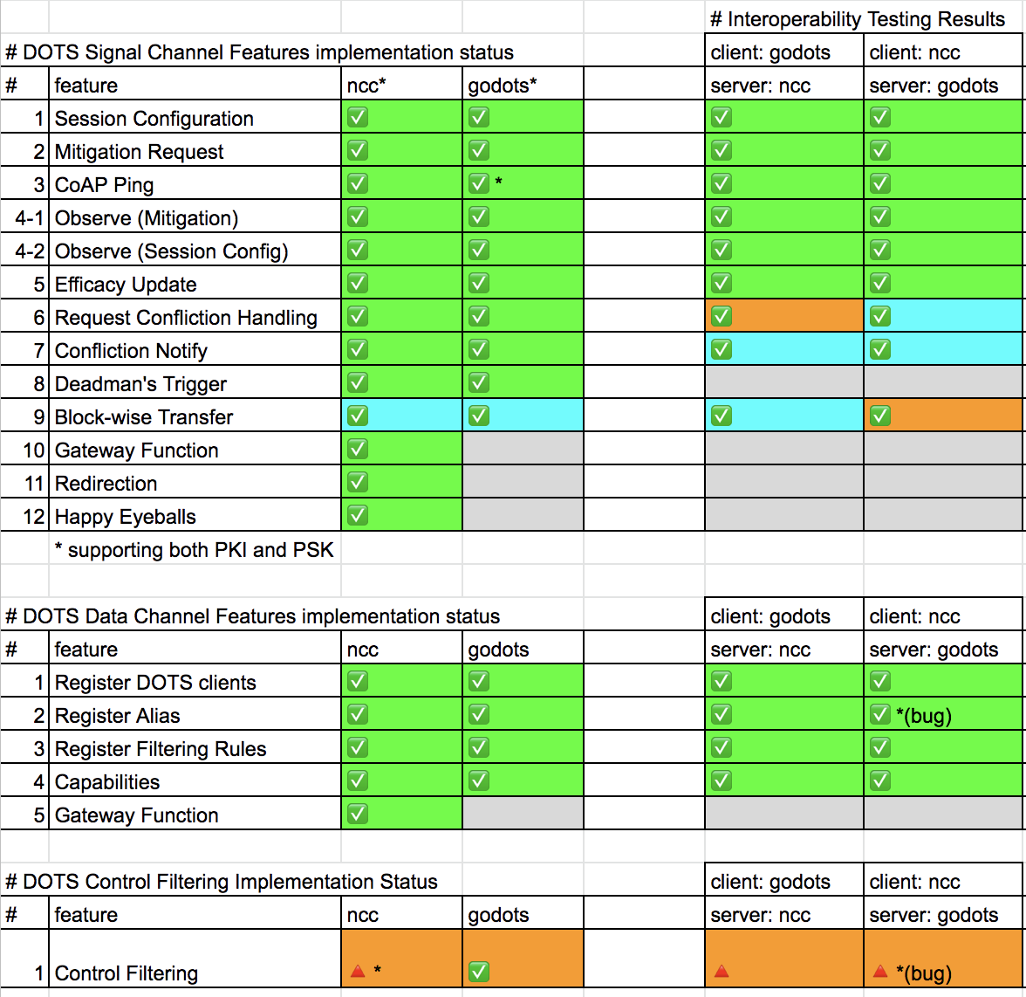
What got done
We are on the last corner for the first publication of DOTS spec!
~90% test coverage
open source code
https://github.com/nttdots/go-dots
Tested a new feature of filtering control over signal-channel even in attack time

Slide 4
The Initial Problem
Attack Time
ACLs (c1)
myacl, activation-type=immediate
DOTS Data Channel
Deativate(myacl)
Client Domain
C1
S
Mitigations (c1)
mid, attack-mitigation-in-progress
The use of the data channel during attack time is not an option
The Signal channel does not allow to control ACLs

Slide 5
The Solution
Attack Time
ACLs (c1)
myacl, activation-type=deactivate
DOTS Signal Channel
Deativate(myacl)
Client Domain
C1
S
Mitigations (c1)
mid, attack-successfully-mitigated
Allow for the Signal Channel to get control on filters:
augment /ietf-signal:dots-signal/ietf-signal:message-type
/ietf-signal:mitigation-scope/ietf-signal:scope:
+--rw acl-list* [acl-name] {control-filtering}?
+--rw acl-name
| -> /ietf-data:dots-data/dots-client/acls/acl/name
+--rw activation-type? activation-type

Slide 6
What we learned
DOTS protocol enables mitigation requests and ACL control even under the hostile network situation.
Issues found in IETF103 hackathon were addressed
2 new usecases are tested (successfully)
Implementation considerations will be reported to WG
DOTS
DOTS
CoAP
RESTCONF
TLS
DTLS
TLS
TCP
UDP
TCP
IP
IP
Signal Channel Layers
Data Channel Layers

Slide 7

Wrap Up
Team members: Kaname Nishizuka (NTTCom)
Yasuaki Morita (Lepidum)
Jon Shallow (Self)
Liang 'Frank' Xia (Huawei)
First timers @ IETF/Hackathon:
4 new members!! contributed to OSS project
https://github.com/nttdots/go-dots

