Slide 1
IETF Hackathon: RIOT-6TiSCH
IETF 104
23-24 March, 2019
Prague
Notes:
<number>

Slide 2
Tighten integration of OpenWSN 6TiSCH stack into RIOT on useful hardware
RFCs 7554, 8180, 8480
Restart work from earlier sprints
Run OpenWSN stack on OpenMote B (15.4g)
Improve integration at Layer 4, RIOT Sock I/F
<number>

Slide 3

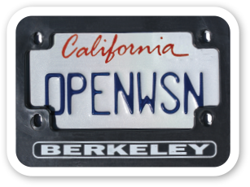
Application
gcoap
sock API
UDP
EUI64
UART
Timer
LED & Debugpins
802.15.4
netdev API

Slide 4
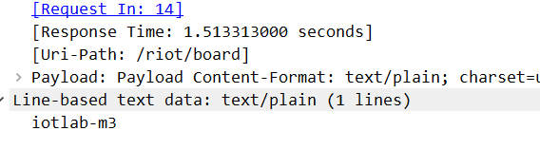
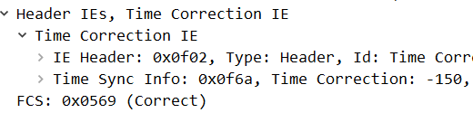
CoAP on 6TiSCH

Slide 5
Top Down Results
Works well with clean Sock API to Layer 4
Rebase
Resolve compiler issues
Prioritize future work
Run on FIT IoT-LAB motes – it still works
<number>

Slide 6
Bottom Up Results
MAC layer for time sync depends on driver
Start from abstract interface
Mesh data sheets with timer, radio APIs
Devil in details
Need more work
<number>

Slide 7
Wrap Up
Team members
Peter Kietzmann
Michel Rottleuthner
José Alamos
Ken Bannister
First timers @ IETF/Hackathon:
Jose, Ken
PRs
Bottom https://github.com/RIOT-OS/RIOT/pull/8570
Top
https://github.com/RIOT-OS/RIOT/pull/10579
<number>

