Slide 1
IETF Hackathon: LPWAN OpenSCHC
IETF 104
23-24 March, 2019
Prague

Slide 2
Hackathon Plan
Improve open source implementation of SCHC
https://github/openschc
What is SCHC (Static Context Header Compression)?
compressing headers and fragmenting packets for LPWANs (Low Power Wide Area Networks)
standardized at the LPWAN Working Group of IETF
draft-ietf-lpwan-ipv6-static-context-hc submitted to IESG

Slide 3
What got done
Made OpenSCHC easier to use
Cleaned up code repo, added README, new Wiki
Adjusted code to run with micropython, not just Python3
Added/changed unit tests to support Pytest
Added Sphinx documentation
Added test coverage
Implemented more compression functionalities
Added connector to exchange messages over LoRaWAN with pycom device

Slide 4
What got done
Made OpenSCHC easier to use
Cleaned up code repo, added README, new Wiki
Adjusted code to run with micropython, not just Python3
Added/changed unit tests to support Pytest
Added Sphinx documentation
Improved functionalities
Augmented test coverage
Implemented more compression functionalities
Added connector to exchange messages over LoRaWAN with pycom device

Slide 5
What we learned
Some parts of spec not understood by implementors
We will add examples in Appendix section
Implementing a full system requires describing the compression rule, the fragmentation parameters, etc. New draft started about data model for these
draft-toutain-lpwan-schc-yang-data-model
Work at this hackathon provides food for new draft

Slide 6
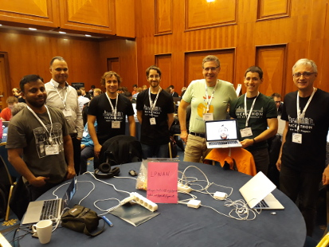
Wrap Up
9 team members
Cédric Adjih
Sergio Aguilar*⁺
Jose Ignacio Alamos*
Sandoche Balakrichenan
Dominique Barthel
Antoine Bernard*
Ivaylo Petrov
Shoichi Sakane⁺
Laurent Toutain
* First timer @ IETF/Hackathon
+ Remote
<Other links, contacts or notes>
https://github.com/openschc

