Slide 1

IETF Hackathon: SSH
IETF 104
23-24 March, 2019
Prague
Notes:
<number>

Slide 2
Hackathon Pre-Planning
VMs Setup – Source and Destination with Wireshark on both ends.
Latest Installation of Requirements such as Ruby, Node etc..
Travis compatibility.
Simple network design between VMS using Virtual Box.
RC4 debrief in the team working remotely from Mauritius
<number>

Slide 3
IETF Hackathon in Action
Understanding of the RFC:
https://tools.ietf.org/html/draft-ietf-curdle-rc4-die-die-die-15
Post handshake during Key Exchange.
NET-SSH (PR 671) and Node (PR 126).
NET-SSH incorporation in VMware and several Ruby Intersystems.
SSH Streams in Node application
<number>

Slide 4
Post-Analysis
Deployment of SSH still shipping with RC4.
Still long way to go to eradicate RC4.
Support from OpenSource developers is needed to move forward.
Thanks to Eric Rescorla for needful at IESG.
Thanks for collaboration of Camara in this draft.
<number>

Slide 5
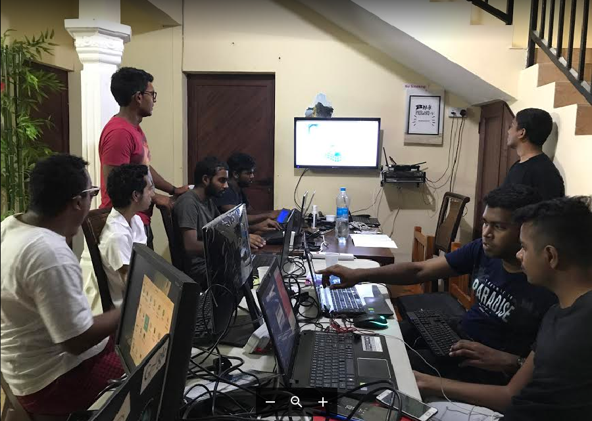

Wrap Up
Team members:
Nitin Jaykishan Mutkawoa
Jagveer Loky
<number>

