Slide 1
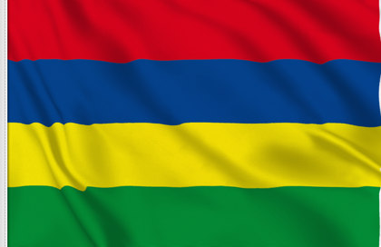
IETF Hackathon: TLS 1.3
IETF 104
23-24 March, 2019
Prague
Notes:
<number>

Slide 2
Hackathon Plan
Post Handshake Authentication & TLS 1.3 in API
RFC 8446 (TLS 1.3)
Working remotely from Mauritius
1

Slide 3
What got done
TLS 1.3 in PHP7 (Reviewed and close to being merged)
PHA in wget (feedback incoming, doubts about PHA)
PHA in nagios (no feedback yet)
TLS 1.3 in Kubernetes controller plugin (Patch in progress)
Nmap (in progress)
TLS-SHARP (in progress)
Twisted (in progress)
1

Slide 4
What we learned
PHA might need to be refined and implemented better.
Better API integration for OpenSSL (?)
1

Slide 5

Wrap Up
Team members:
Muzaffar Auhammud
Codarren Velvindron
Rahul Golam
Diresh Soomirtee
Loganaden Velvindron
Kishan Takoordyal
See you at the next IETF in Canada.
1

